Slide 1
Design and manufacture of mirrors, and active optics
Buddy Martin
Steward Observatory Mirror Lab
<number>

Slide 2
Outline
What makes a good mirror?
Modern mirror concepts
thin solid mirrors
segmented mirrors
lightweight mirrors
Honeycomb mirrors
design
casting
Optical manufacture
requirements
aside on active optics and model fitting
fabrication
machining
polishing
measurement
interferometry
null correctors
GMT measurements
<number>

Slide 3

What makes a good mirror?
Fundamental requirement is to deliver a good wavefront to focal plane in almost all conditions.
Hold its shape to a fraction of a wavelength on large scales
Be smooth to a small fraction of a wavelength on small scales
Contribute little to local seeing (temperature gradients in air)
Stiffness against wind: bending stiffness
E = Young’s modulus, t = thickness
Stiffness against gravity: bending stiffness
This puts a premium on low mass.
Short thermal time constant
c = specific heat, k = thermal conductivity
Mirror must equilibrate with air quickly to reduce thermo-elastic deflections and mirror seeing.
cross-section of an 8.4 m honeycomb mirror for the Giant Magellan Telescope
<number>

Slide 4
Optical telescopes
Hale Telescope at Palomar used first large lightweighted mirror.
Most powerful telescope for 45 years because of difficulty making a larger mirror that would not distort due to its weight and thermal inertia.
<number>
Notes:
<number>

Slide 5
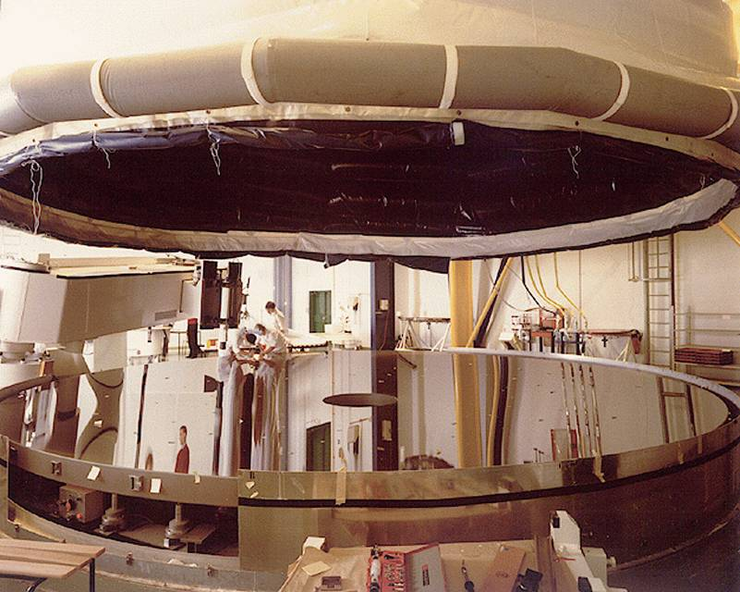
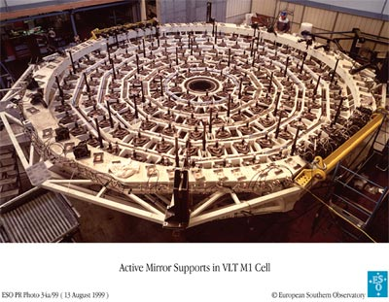
New mirror concepts after 1980: 1. Thin, solid mirrors
3 solutions emerged ~1980:
Thin, solid mirrors whose shape is controlled by active optics
Active optics concept by Ray Wilson and colleagues in Europe
Concept:
Replace stiffness by active control of shape
Reduces mass and thermal inertia (somewhat) with 175 mm thick mirror
Technology:
Zerodur glass ceramic and ULE glass, both with near zero thermal expansion
Precise active mirror supports
Wavefront sensors similar to those used for adaptive optics
ESO VLT (4 x 8.2 m), 2 Gemini telescopes, Subaru telescope
<number>

Slide 6
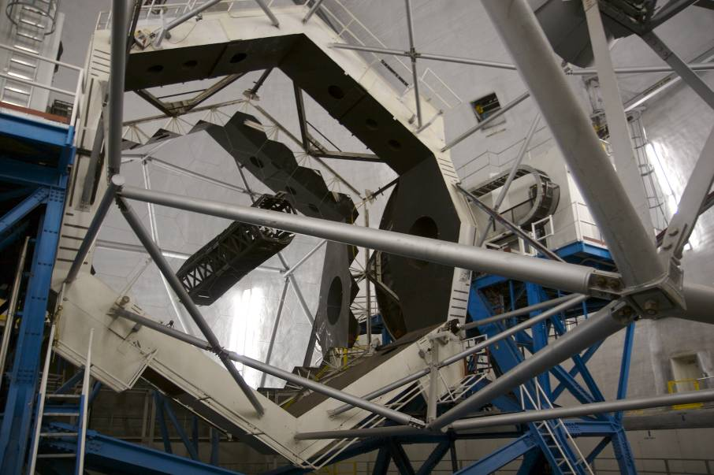
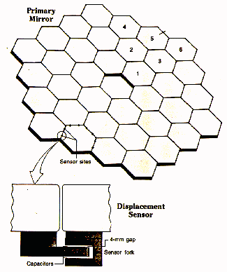
2. Segmented mirrors
Developed by Jerry Nelson and colleagues at UC
Concept:
Achieve continuous optical surface by active control of position of small segments.
Reduces mass and thermal inertia even more than thin solid mirror (75 mm vs 175 mm)
Technology
Precise segment positioning actuators (~10 nm resolution)
Precise segment-segment displacement sensors
Occasional wavefront measurement of segment phasing
Used for Keck, Hobby-Eberly, Grantecan, SALT
To be used for TMT (30 m), ESO ELT (39 m)
<number>

Slide 7
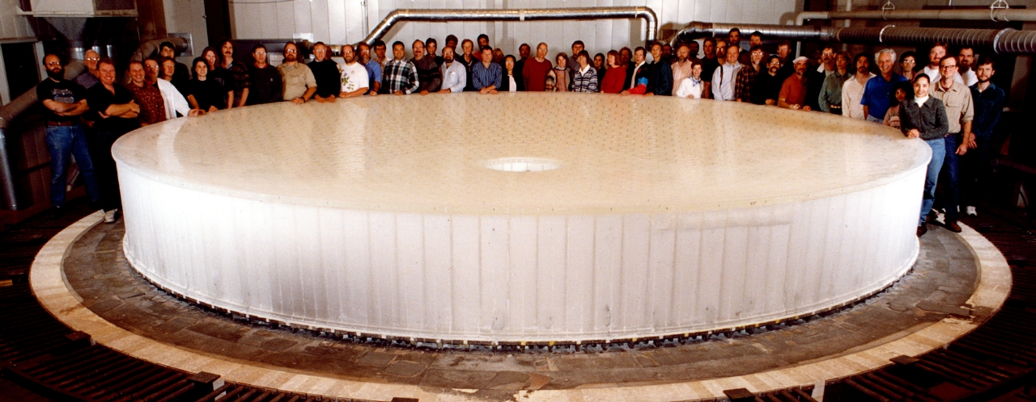
3. Honeycomb mirrors
Developed by Roger Angel and colleagues at UA
Concept:
Extend Palomar technology to 8 m with more extreme lightweighting
Maintain stiffness of traditional mirrors, reducing dependence on active control
Achieve very short thermal time constant with thin glass sections, active ventilation
Technology
One-piece spin-casting of honeycomb structure with 80% lightweighting
Polishing and measuring very fast mirrors (short focal length, f/1 - f/1.25)
Used for MMT, 2 Magellan telescopes, LBT
To be used for LSST, GMT 25 m
<number>

Slide 8
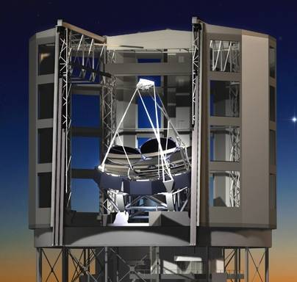
Giant Magellan Telescope
25 m optical telescope being built in Chile
Primary mirror has 7 segments, each a honeycomb mirror 8.4 m in diameter.
6 outer segments are off-axis sections of parent paraboloid.
Secondary mirror is segmented to match primary, with 1.1 m segments.
Fine alignment, adaptive correction, and phasing are done with small, agile secondary segments.
<number>

Slide 9
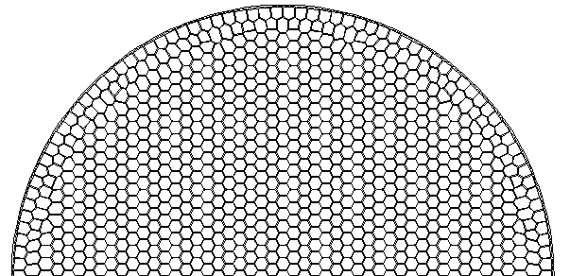
Structure of a GMT mirror segment
Honeycomb structure puts most of mass at top and bottom, where they provide the most stiffness.
Borosilicate glass has lowest thermal expansion (α = 3 ppm/K) among materials that can be cast into complex form.
Facesheet thickness = 28 mm makes thermal time constant < 1 hr.
Hex cavity size = 192 mm limits gravity sag of unsupported facesheet to 7 nm.
Rib thickness = 12 mm contributes little mass while maintaining safety.
Overall thickness 700 mm gives excellent stiffness against wind.
<number>
Notes:
<number>

Slide 10
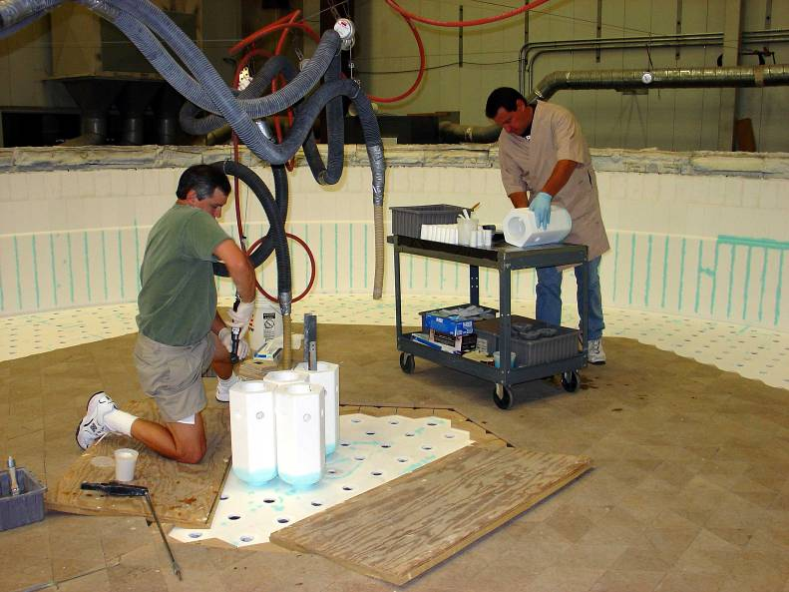
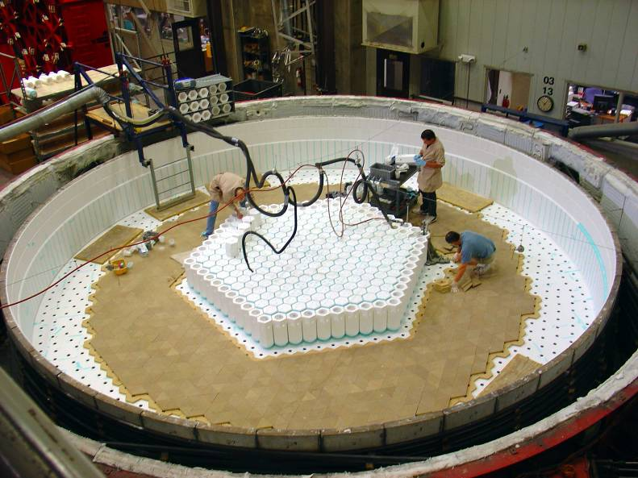
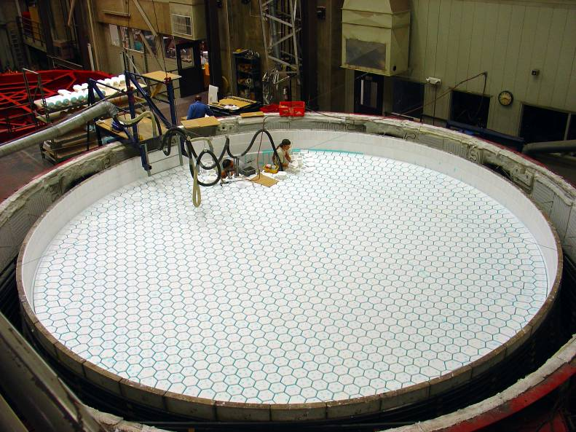
Casting process for GMT mirror: mold assembly
Tops of boxes follow shape of mirror surface; no two are identical.
Machine and install 1681 ceramic fiber boxes in silicon carbide tub.
<number>
Notes:
<number>

Slide 11
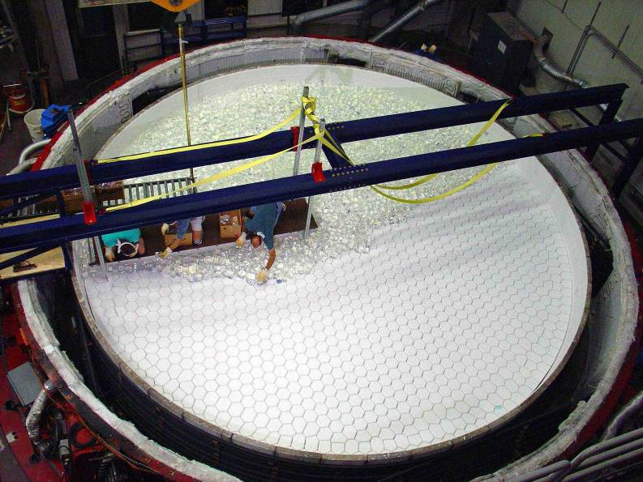
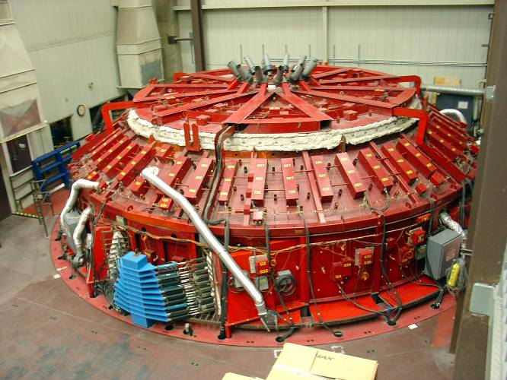
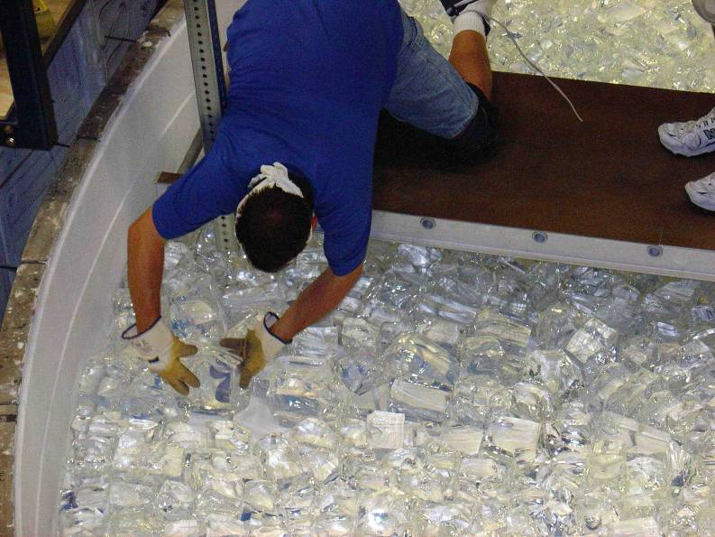
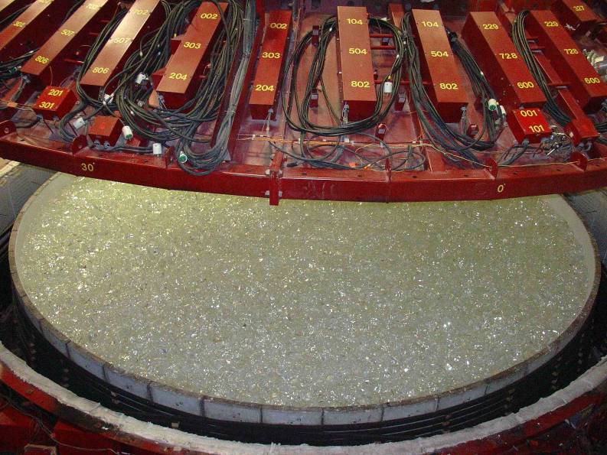
Loading of glass
Inspect, weigh, and load 18 tons of Ohara E6 borosilicate glass in 2-5 kg blocks.
Spin-casting gives parabolic shape to ~1 mm accuracy. Eliminates need to grind out ~20 tons of solid glass for an LBT mirror.
<number>
Notes:
<number>

Slide 12
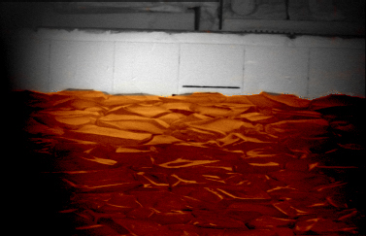
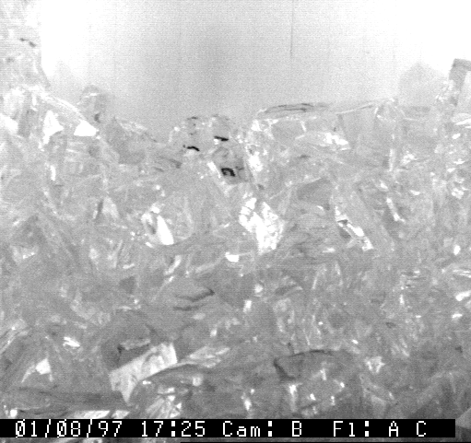
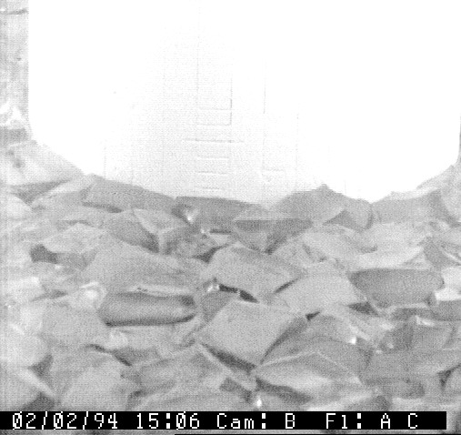
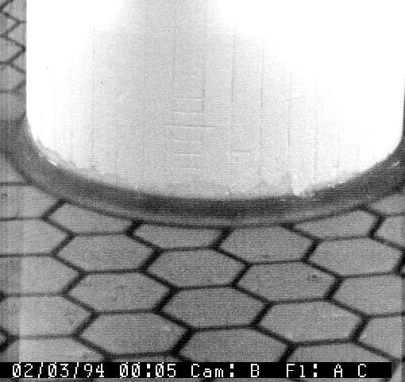
Glass melting
UV cameras mounted in the furnace lid monitor the casting.
Heat to 1160˚C, spin at 4.9 rpm, hold 4 hours to allow glass to fill mold. Cool rapidly to 900˚C then slowly for 3 months, 2.4 K/day through annealing.
<number>
Notes:
<number>

Slide 13
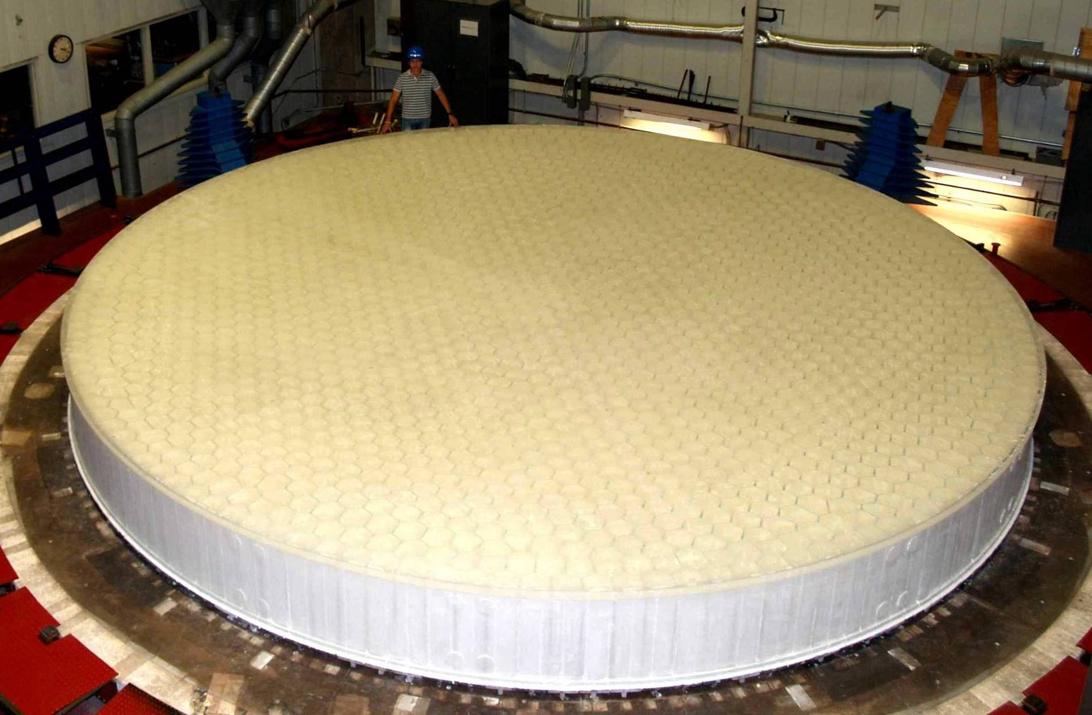
First GMT mirror blank
<number>
Notes:
<number>

Slide 14
Accuracy requirements
“Seeing” is degradation of images due to index variations and turbulence in atmosphere.
Typically 0.5 - 1.0 arcsecond at an excellent site, exceptionally 0.3 arcsecond.
Telescope optics must be more accurate than best wavefront the atmosphere will deliver, at all spatial scales.
Without adaptive optics, telescope optics must not significantly degrade images delivered by the atmosphere.
With AO, most of DM stroke should be reserved to correct the atmosphere, not the telescope optics.
Atmosphere induces large WF errors on large spatial scales, small errors on small scales.
Spectrum of WF errors is described by structure function = mean square difference in WF between points in pupil, as a function of their separation x.
x
<number>

Slide 15
Specification for a telescope mirror
Structure function due to atmosphere:
Image FWHM:
r0 = coherence length, or Fried parameter
Start with 0.11 arcsecond seeing.
Eliminate tilt across full pupil: tighten on large scales.
Add allowance for 2% scattering loss due to 16 nm rms WFE on small scales.
<number>

Slide 16
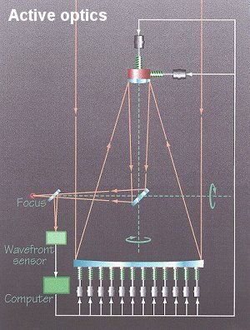
Impact of active optics on requirements
Active optics is active control of alignment (primary and secondary) and shape of primary, based on WF measurements in telescope.
Necessary because no 8 m mirror is rigid
Built into all modern telescopes
Active optics is slow (> 1 minute) and corrects only large-scale errors.
Implication for manufacturing:
No need to completely eliminate all low-order shape errors, because they will be controlled with active optics at telescope.
Manufacturing requirement is to control large-scale shape within easy range of active-optics correction in telescope.
When mirror surface error is measured in lab, simulate active-optics correction of low-order components.
Compute actuator forces and optimized shape.
Tells how much you can easily correct.
<number>

Slide 17
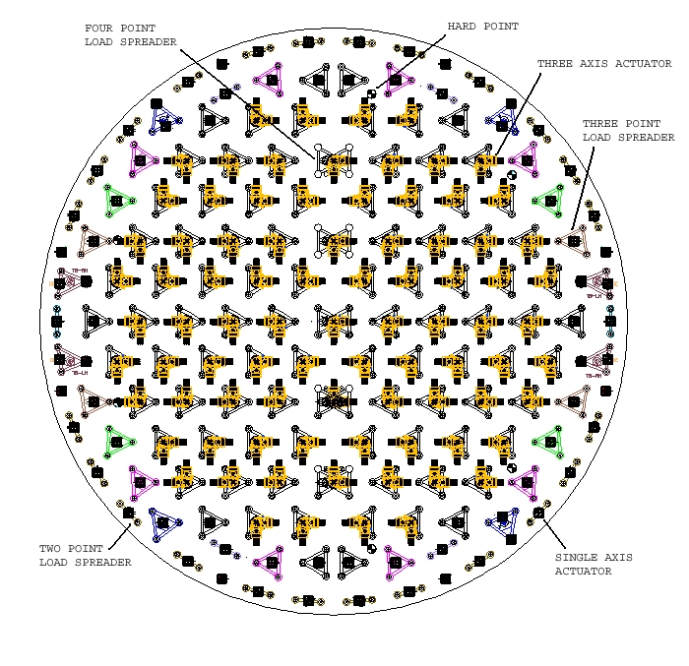
GMT mirror support layout
160 active support actuators
<number>

Slide 18
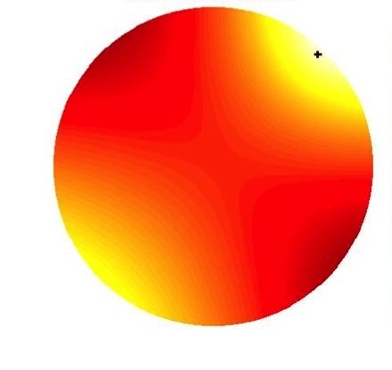
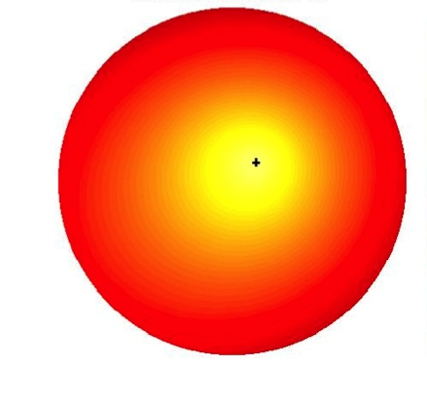
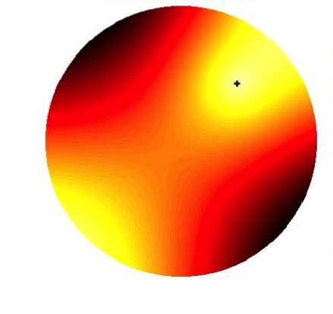
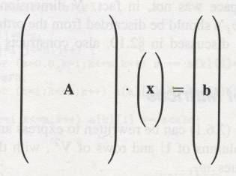
Active optics as a model-fitting problem
Problem is to calculate the support forces that will best correct the measured wavefront error.
Calculate or measure the effect on the mirror shape of a unit force on each actuator.
→ 160 influence functions
Find linear combination of influence functions that would match current shape error.
Data are measured surface displacements zi. Model is sum of influence functions. Model parameters (to be determined) are forces fj.
= f1
+ f2
… + f160
measured shape error z
160
influence functions
Influence functions are not localized, because of compensation for net force and moment.
Each 2-D shape becomes a ~300 x 1 column vector.
A is interaction matrix, with units of nm/N. Each column of A is one influence function.
~300
f
z
<number>

Slide 19
Optical fabrication (what happens after the casting)
Machine (generate) surface to accuracy ~10 μm rms.
Measure with mechanical profiler or laser tracker.
Lap with loose abrasives to ~1 μm accuracy.
Measure with laser tracker or IR interferometer.
Polish and figure to required accuracy.
Measure with visible-wavelength interferometer.
Redundant measurements of anything you might get wrong.
<number>

Slide 20
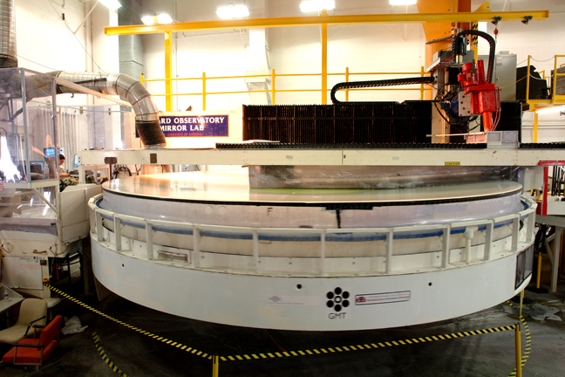
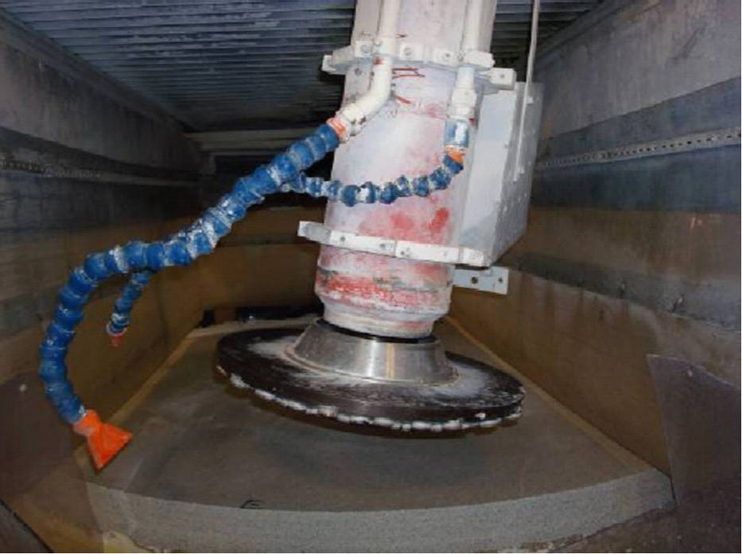
Generating (machining)
Spinning tool has diamond particles embedded in a metal or resin substrate.
Shape of surface is determined mostly by motion of tool.
Surface accuracy is limited by accuracy of machine.
Grinding leaves microscopic roughness ~ ¼ particle size, and sub-surface damage (micro-fractures) to depth of ~1 particle size.
Particle size is typically 200-400 μm.
<number>

Slide 21
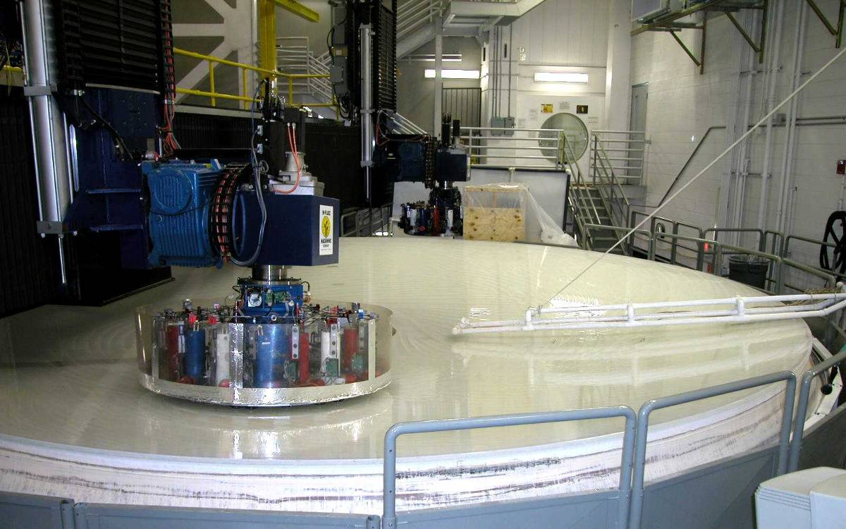
Loose-abrasive grinding and polishing
Loose-abrasive grinding and polishing are lapping operations, and provide much better control of surface shape.
Disk (lap) rests on mirror surface with defined force, not defined position, normal to surface.
Removal rate depends on relative speed, pressure, and abrasive material.
Typical sequence is loose-abrasive with 50, 25, 12 μm particles, then polish with 1-3 μm metal oxide particles.
Loose-abrasive grinding uses a hard lap surface and loose (not bound) abrasive particles.
It works by mechanical abrasion, i. e. by breaking away microscopic pieces of glass.
Polishing uses both mechanical and chemical removal of material, leaves a specular (shiny, transparent) surface with no sub-surface damage.
Removal rate ~ 1 nm per meter of relative motion, gives very good resolution of removal.
<number>
Notes:
<number>

Slide 22
Figuring and smoothing
Lapping operations remove surface errors by figuring and smoothing.
Figuring is directed removal, generally based on Preston’s (1927) relation Δz = k p v Δt .
Vary dwell time, pressure, and/or speed as a function of position on mirror.
Requires a map of surface error.
Calculate removal vs position using an integral over time, incorporating motion of lap across surface.
Smoothing is removal of glass from high spots simply because lap exerts more pressure there.
Does not require knowledge of where the highs are.
Depends on stiffness of tool: bending stiffness and compressibility.
Most effective for small-scale shape errors.
<number>
Notes:
<number>

Slide 23
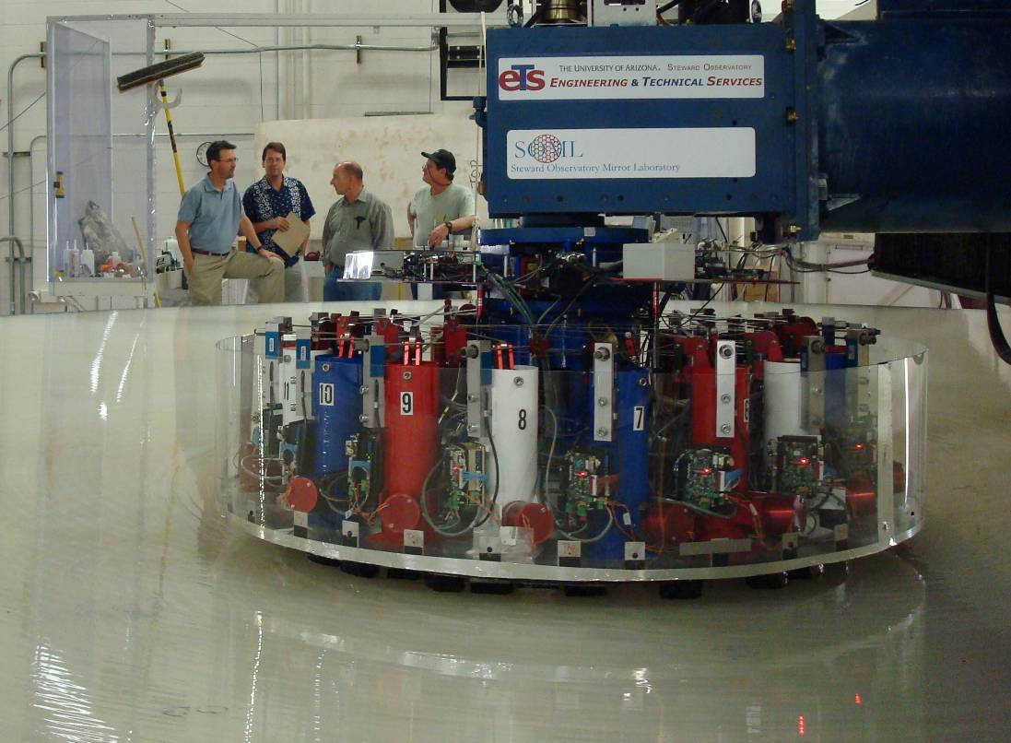
Polishing aspheres
Smoothing with a stiff lap makes excellent spherical surfaces with relatively little effort.
The lap and the mirror come to a common surface with equal curvature everywhere: a sphere.
Departure from a spherical surface makes it difficult to achieve smoothing, and complicates figuring.
Difficult to make lap have right shape everywhere on mirror.
Options include:
small lap so misfit is limited to a few microns
flexible lap so it will sag to match surface
methods of localized removal that do not use a lap
ion beam figuring
magneto-rheological finishing
All of these sacrifice or compromise smoothing.
Options that preserve smoothing:
stressed-mirror polishing (Nelson and co.)
stressed-lap polishing (Angel and co.)
rigid-conformal lap (Kim and Burge)
<number>
Notes:
<number>

Slide 24
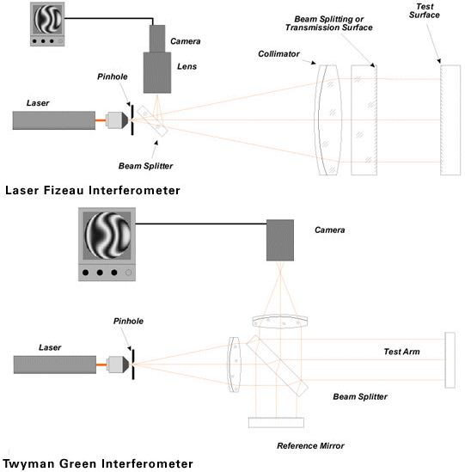
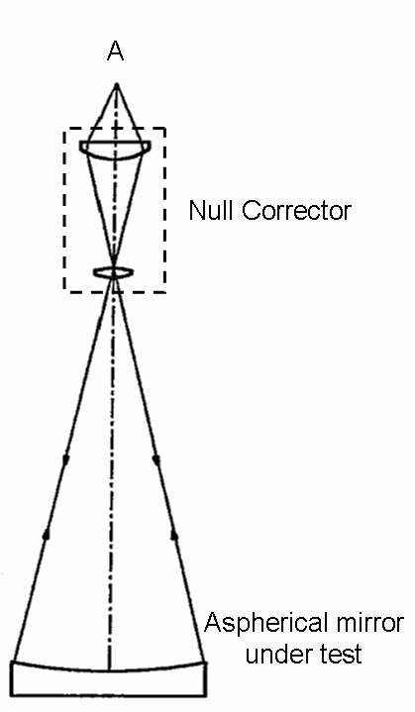
Measurement
Interferometer and null corrector form a template wavefront with same shape as ideal mirror.
Mirror is figured until it matches that wavefront, producing a null interference fringe.
<number>

Slide 25
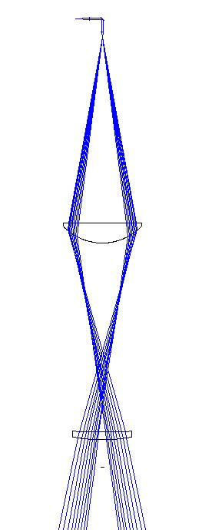
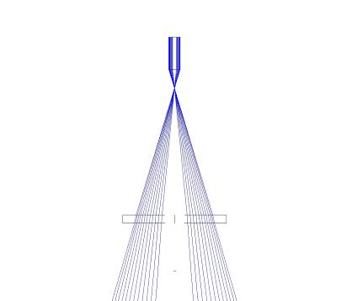
Measuring aspheres: null correctors and validation holograms for LSST
interferometer
interferometer
695 mm
relay lens, 292 mm diam
196 mm
diffractive null corrector
706 mm
74 mm
validation hologram
field lens,
222 mm diam
Test of tertiary mirror uses single-element diffractive null corrector, and similar validation hologram.
validation hologram
102 mm
Validation holograms provide independent validation of accuracy of test wavefront.
Test of primary mirror uses 2-element refractive null corrector. To validate its accuracy, a computer-generated hologram (CGH) designed to mimic a perfect mirror can be inserted below null corrector.
<number>

Slide 26
Optical tests for LBT and GMT
LBT (8.4 m f/1.1)
1.4 mm aspheric departure
GMT segment
14 mm aspheric departure
roof
Test optics
Axisymmetric
Test optics at ~20 m
Light beam from optical test is only 200 mm diameter near the test optics. Allows direct measurement of test wavefront with hologram.
No axisymmetry
Light path defined by GMT is much larger: 3.5 m diameter at top of test tower. Direct measurement of test wavefront is impossible.
Use independent tests of the mirror instead.
20 m
<number>
Notes:
<number>

Slide 27
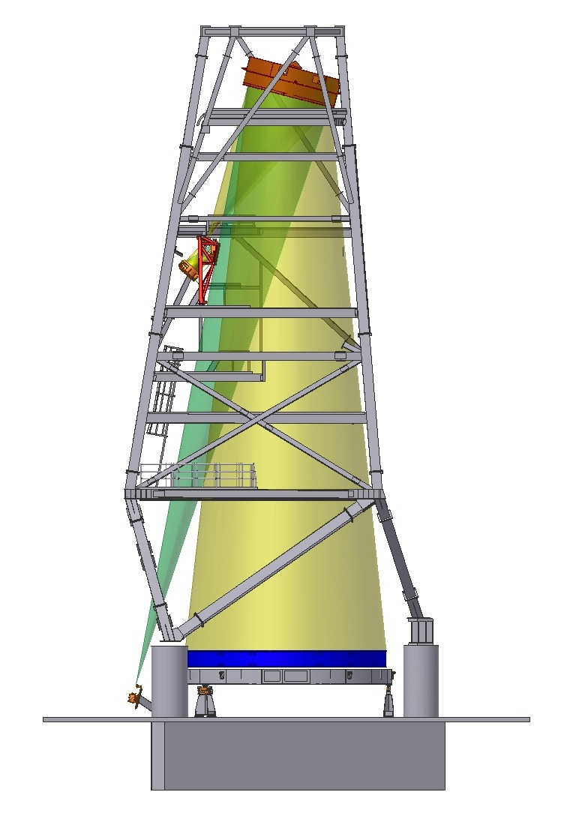
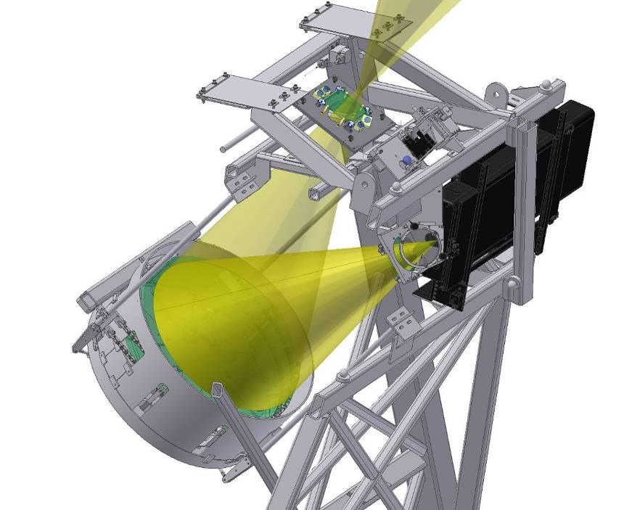
GMT optical test
3.75 m fold sphere
reference CGH
vibration-insensitive interferometer
0.76 m fold sphere
computer-generated hologram
interferometer for in situ test of fold sphere
Reference CGH validates wavefront from first 2 elements of null corrector, and is used to align large fold sphere and GMT segment to that WF.
GMT segment
<number>

Slide 28
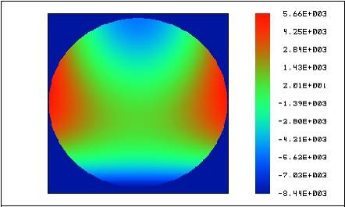
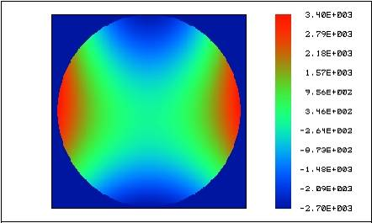
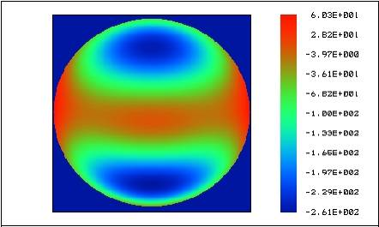
Shaping of test wavefront by null corrector
Follow wavefront from segment back to interferometer:
14 mm p-v at GMT surface
6.1 mm p-v at intermediate focus between fold spheres
320 μm p-v between 76 cm sphere and CGH
difference from sphere (μm)
<number>
Notes:
<number>

Slide 29
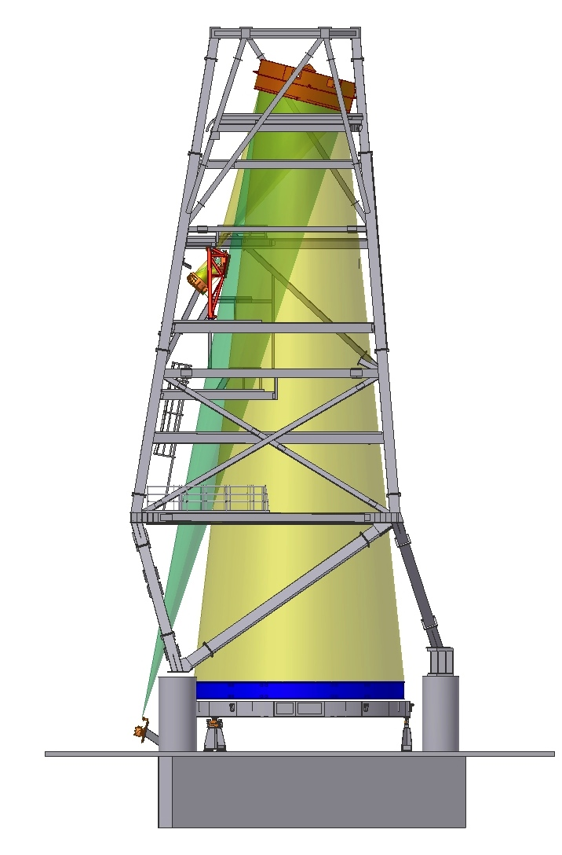
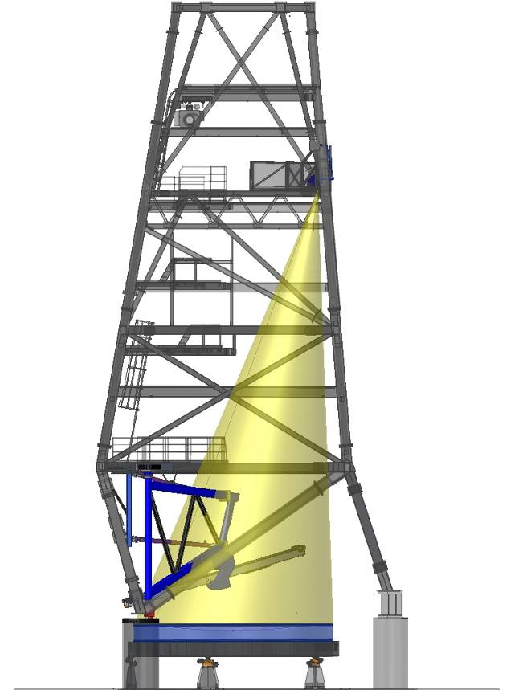
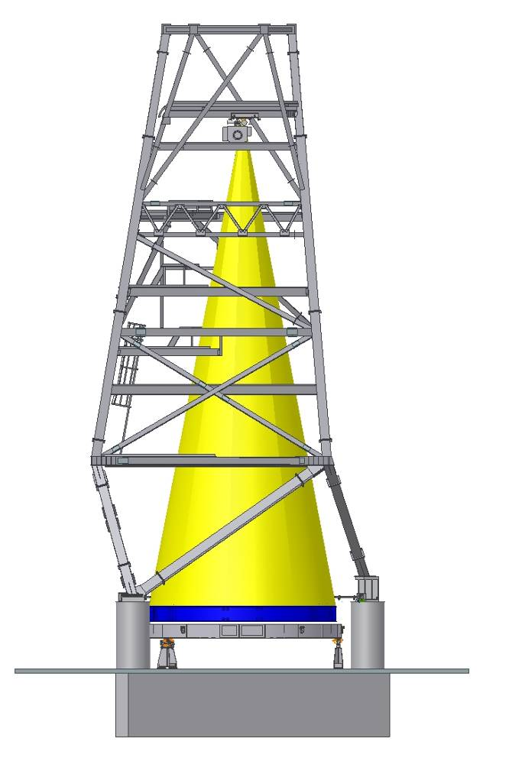
4 independent measurements
Principal optical test
Full-aperture, interferometric test
Also provides SCOTS slope test.
Scanning pentaprism test
Measures low-order aberrations
via slopes. Uses natural telescope focus (no null corrector).
Laser Tracker Plus
Scans surface with laser tracker.
Works on ground or polished surface.
<number>
Notes:
<number>

Slide 30
More on active optics and model fitting
Calculate or measure the effect on the mirror shape of a unit force on each actuator.
→ 160 influence functions
Measure current shape error.
Find linear combination of influence functions that would match current shape error.
Data are measured surface displacements zi. Model is sum of influence functions. Model parameters (to be determined) are forces fj.
= f1
+ f2
… + f160
measured shape error z
160
influence functions
Influence functions are not localized because of compensation for net force and moment.
Each 2-D shape becomes a ~300 x 1 column vector.
A is interaction matrix, with units of nm/N. Each column of A is one influence function.
~300
f
z
<number>

Slide 31
Solving Af = z
See Numerical Recipes for insightful (but not easy) description of options.
Generally have more displacements than forces (more data than unknown model parameters).
No exact solution: want the approximate solution that minimizes sum of squares of residual errors.
Find it any of a number of ways, e. g. Matlab “\” operator, if you know there are no redundant equations.
2 or more influence functions that are very similar counts as redundancy.
If there are, solution will blow up because similar influence functions will be combined with large forces so as to nearly cancel.
In our case there is redundancy because forces are not independent. They satisfy
sum of forces = weight of mirror
net moment about x = 0
net moment about y = 0
Could fix that by removing 3 influence functions.
But generally you also want to limit the forces: remove patterns of forces that contribute little to reducing residual error but use lots of force.
Take care of both issues, and be much better aware of what’s going on physically, by solving with singular-value decomposition….
<number>

Slide 32
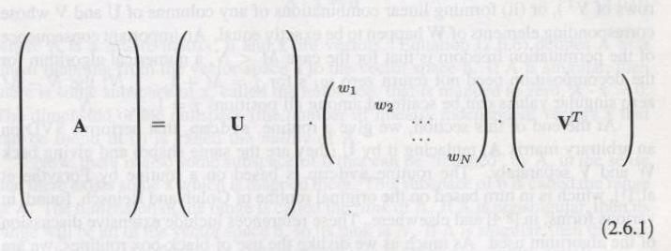
Singular-value decomposition
From Recipes:
Interpret these factors in physical terms:
U has same dimensions as A apart from normalization. Columns of U are displacement vectors that form an orthonormal basis for all displacements that can be achieved with your 160 actuators.
Each column is called a bending mode.
V is 160 x 160. Columns of V are force sets that form an orthonormal basis and match up with columns of U: column j of V produces column j of U.
W is a 160 x 160 diagonal matrix whose elements wj give magnitudes of displacement.
If f = cj Vj then z = cj wj Uj
Think of wj as the flexibility of bending mode j; it contains all the scaling information.
SVD is unique apart from re-ordering of columns of U and V, and corresponding wj.
Standard order has wj decreasing from most flexible to stiffest.
<number>

Slide 33
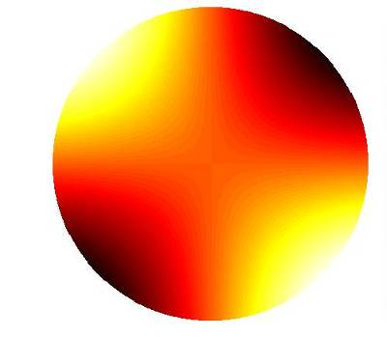
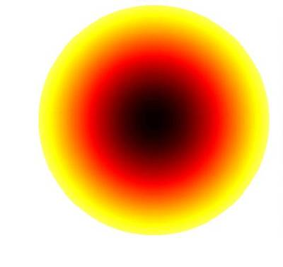
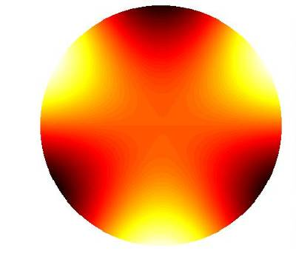
Resolve measured shape error into bending modes
= f1
+ f2
… + f160
measured shape error z
influence functions
= b1
+ … + b3
+ b4
+ …
bending modes
(What does mode 2 look like?)
<number>

Slide 34
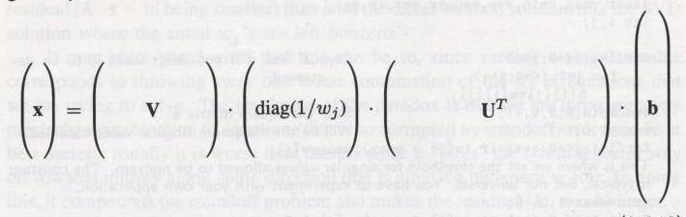
Solution by SVD
f
z
From right to left:
Take scalar product of measured surface error and each bending mode:
Resulting vector tells how much of each bending mode there is (mode coefs bj from prev slide).
Multiply each mode coefficient by stiffness 1/wj.
Resulting vector tells how much of each force mode.
Convert from force modes to actuator forces.
If there is redundancy, some wj = 0.
Corresponding columns of V are the force vectors that cause no displacement: the nullspace of A.
Can add an infinite amount without changing mirror shape.
Eliminate them by setting those (1/wj) to zero.
Do same for any wj small enough to give unreasonable forces.
Go further: Eliminate all the modes that don’t affect the shape enough to justify their large forces.
<number>

Slide 35
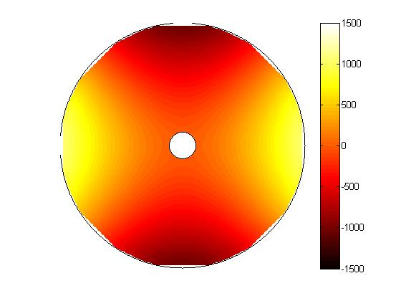
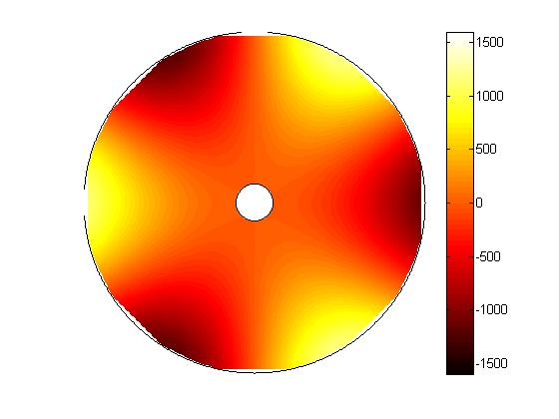
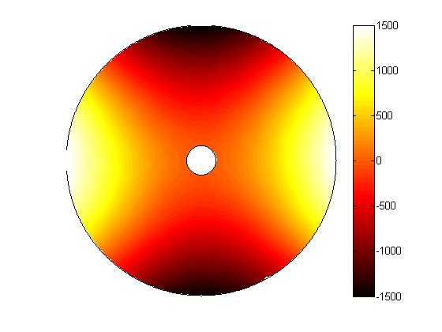
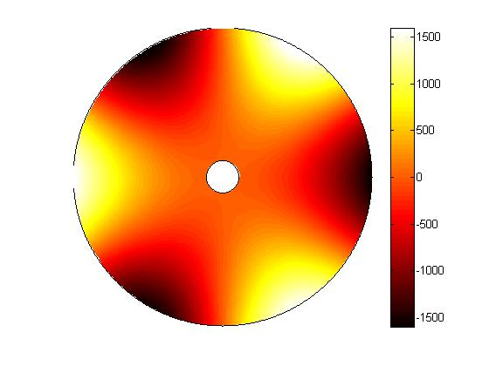
Measured bending modes for LBT primary mirror
calculated by finite-element analysis
measured
in lab
mode 1
5 N rms force
mode 3
30 N rms force
<number>

Slide 36




Measured bending modes for LBT primary mirror
calculated
measured
mode 5
60 N rms force
mode 6
85 N rms force
<number>

Slide 37
Comments on model fitting
You can solve any model fitting problem in the same way.
Measure or calculate the influence of each parameter on the data.
Think of it as an influence function, or a sensitivity, or a derivative.
E. g. fitting functions to data
Influence functions are your functions evaluated at the data points.
Solution is the coefficients of the functions.
Trivial with, e. g., Matlab “\” operator.
Be aware of redundancies in model.
Use SVD if there are any.
For SVD, units can matter.
SVD minimizes the “length” of the solution vector.
If model parameters are of different kinds (e. g., primary mirror support forces and secondary mirror displacements), scale them so a unit change in each is equally “painful”.
Avoid huge range of numbers by normalizing data.
Think of the problem in physical terms, not just as a system of equations.
<number>

Slide 38

Pitch and polishing surfaces
Traditional polishing surface is pitch, used by Newton to polish first telescope mirrors.
Extremely viscous fluid, like tar. Behaves like a solid for short periods, like a viscous fluid on longer timescales.
Serves 2 roles:
Abrasive particles embed in pitch surface and are dragged across mirror surface.
Flows to match the shape of the mirror when pressed against mirror.
Lap surface must match mirror surface to ~1 micron in order to achieve smoothing, and to maintain uniform pressure for figuring.
Synthetic polishing pads are often used on top of pitch.
<number>
Notes:
<number>

