Slide 1
Optical system engineering for space & ground telescopes January 21, 2014
Lecture 1
Dr. James Breckinridge
Adjunct Professor
College of Optical Sciences
jbreckin@optics.arizona.edu

Slide 2
Who am I?
PhD in Optical Science, College of Optical Sciences, U of A
3 years Lick Observatory
12 years at Kitt Peak National Observatory
33 years at NASA/JPL building instruments and developing optics technology
Developed space telescopes and instruments for astrophysics, earth and planetary remote sensing
Optics technology and Flight Optical Systems for remote sensing: WF/PC2, Galileo and Cassini Imaging spectrometers
NSF: Advanced Technology & Instruments Program Manager
NASA: Chief technologist of the NASA Exoplanet Program
Teach the Optical Engineering class at CALTECH (’82-current)
Just finished a book: Basic Optics for the Astronomical Sciences

Slide 3
To help me: please raise you hands if you have had a class in:
Introductory physics with optics
Full semester or year class in general optics
Physics: electricity & magnetism (E&M)
Course in optical design
Course in physical optics

Slide 4
Four Lectures
Introduction to optical system engineering
Science measurement objectives => requirements => specifications =>
Hardware/software = >test & calibration => science
Hubble space telescope: what went wrong & how did we fix it

Slide 5
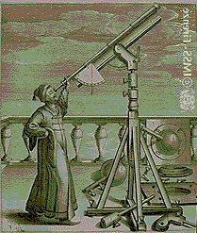
Tuesday, January 21, 2014
The scientific method [Renaissance Europe]
What can we measure?
Analysis tools
Optical system engineering
How space optics differ from ground-based optics
Projects move through time in three dimensions (cost, schedule, performance)

Slide 6
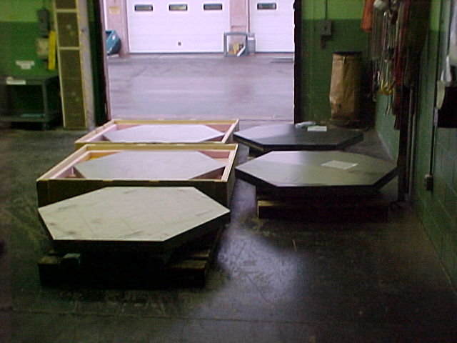
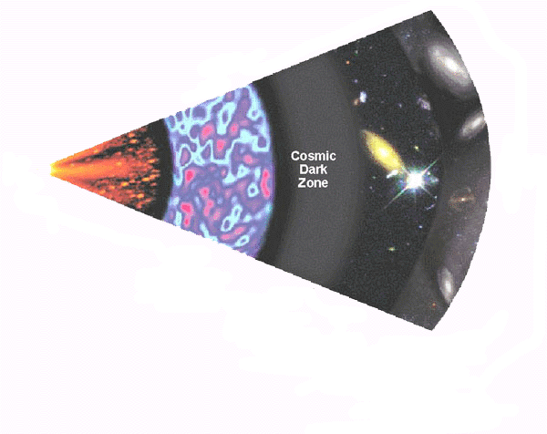
Thursday, January 23, 2014
The NASA process
Technology
Mission development
Flight hardware approval & build
Overview of large ground based telescopes
Requirements development
Science measurements, technology risk map science into realized engineering
Telescope system architectures
Filled, segmented, sparse, interferometers

Slide 7
Tuesday January 28, 2014
How to build space telescopes and instruments?
The work breakdown structure (WBS)
Deliverables & milestones
Technology development
Mission specific
Science measurement enabling
Your design of space telescopes –In addition to optics
Radiation, electrostatics, thermal, launch vibration, pointing & control, scattered light (coronagraphs)
Science in the noise
The DECADE report

Slide 8
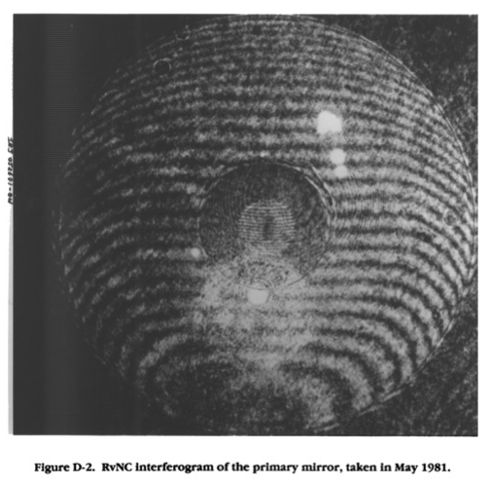
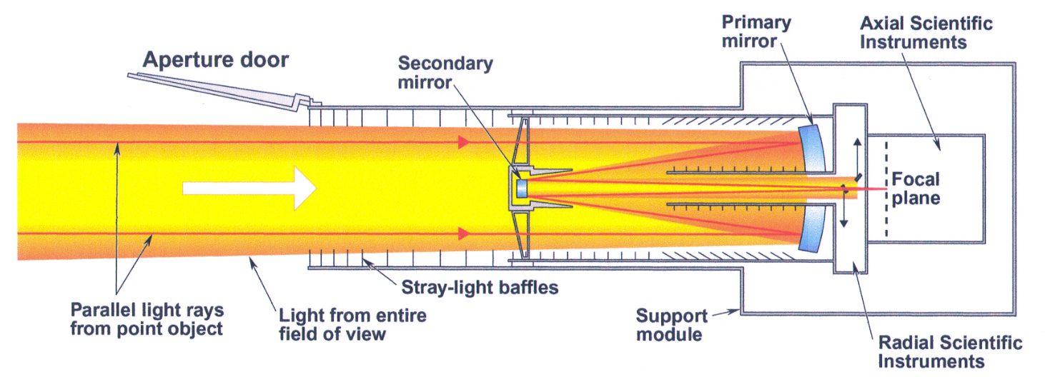
Case study of flight optical systems
Thursday January 30, 2014
Hubble space telescope 1990-today (24 years)
Telescope and instrument system overview
Fabrication of the optics
Search for the optical prescription
Implementing the fix

Slide 9
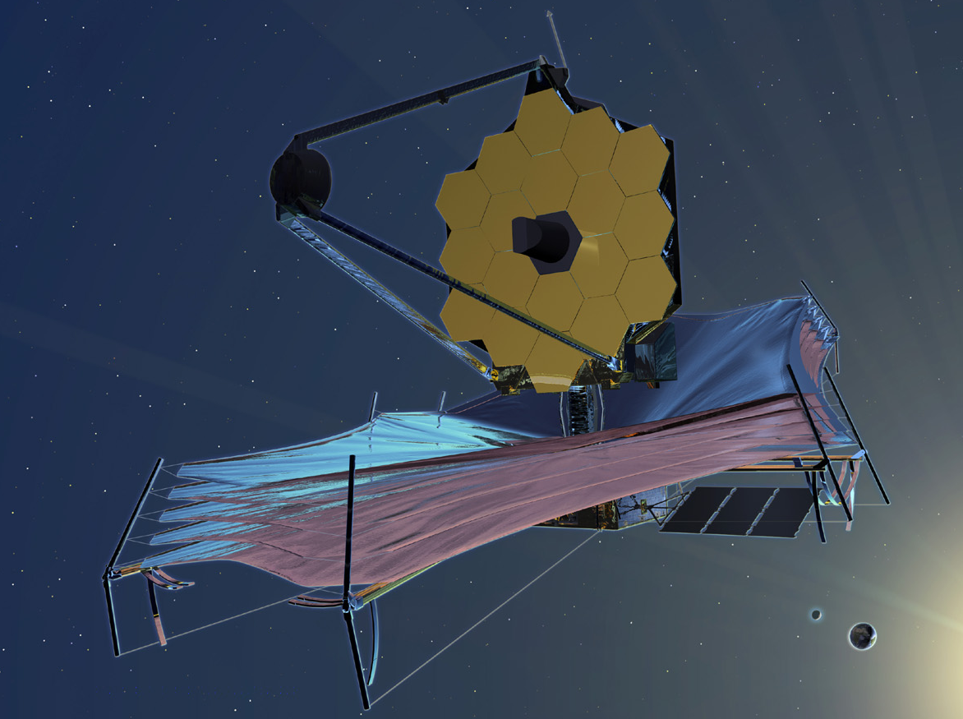
Today
The scientific method
What is a space optical system?
Why build a new telescope/instrument
Optics for astronomy

Slide 10
The scientific method
Develop theory
to
explain the
measurements
Apply the theory
to
predict new
observations
Observe
Measure
Change observation
conditions
OR
Build new telescopes
& instruments
Notes:
Astronomers use the scientific method to uncover the wonders of the universe. The scientific method is shown here. Beginning in the upper left we Observe & Measure = > Develop theory => Apply that theory to predict new observations => and build new telescopes to make new measurements.

Slide 11
The scientific method
Develop theory
to
explain the
measurements
Apply the theory
to
predict new
observations
Observe
Measure
Change observation
conditions
OR
Build new telescopes
& instruments
This class
Notes:
This class is about designing and building new telescopes and instruments to make new science measurements

Slide 12
The scientific method “engineering meets science”
Design. build,
test, calibrate
new instrument
Measure a
physical
phenomenon
Develop new
Observational
Methodology
Telescope
Instrument
Image analysis
tools
OK
Develop physics
based model
Can we use the
current system?
Observational
methodology
Precision
Cost
Apply the model
to forecast new
measurements
No
Technology Development TRL 1=5
Notes:
Often times we need new technology in order to develop new instruments and telescopes.

Slide 13
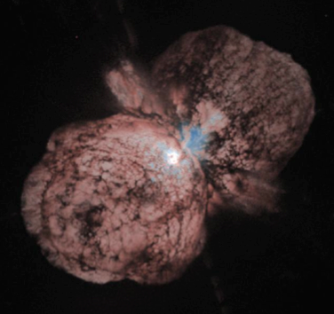
Space Telescope Optical System: The astronomer must understand these aspects
Space
Ground

Slide 14
Applications for space optics
Earth remote sensing
Watershed management
Land management & urban planning
Weather models & CO₂ “global warming”
Planetary science
Geology (Mars, Venus, satellites/asteroids)
Atmospheric science (Mars, Venus, Four giant planets)
Astrophysics
Cosmology
Stars and stellar systems
ExoPlanets: radial velocity spectrometers & precision radiometers & coronagraphs
Heliospheric science

Slide 15
Lexicon
Optical science
Study of the generation, propagation, imaging, measurement and analysis of electromagnetic radiation from ~200 nm to ~50 micron wavelength
Optical engineering
Understand requirements, identify system approach, design telescopes & instruments, specify, test components integrate, align, test and calibrate an optical system to a fixed cost.
Optics Technology
Technology development to enable new scientific or engineering measurements
Devices (detectors, A/O, wavefront sensors, optical metrology)

Slide 16
Where is the science? What can we measure?
Intensity as a function of
A single point
An image
Wavelength
Time
Polarization
The total number of variables is:
where n is the number of spectral channels
This information needs to fit onto a 2d spatial + time detector => the instrument!

Slide 17
A new telescope/instrument system is designed and built to
Provide new scientific data
Open a new temporal frequency window
Kepler (occultation science)
Open a new spatial frequency window
Interferometry
wide FOV
Open a new spectral window
Collect more photons
Measure more accurately (characterize after discovery)
Peer deeper into the cosmos
Reduce cost

Slide 18
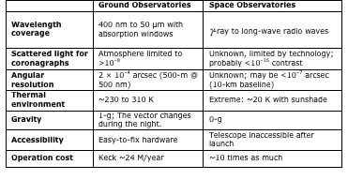
Optics for space vs. ground

Slide 19
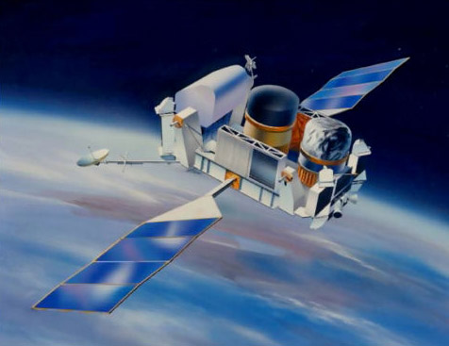
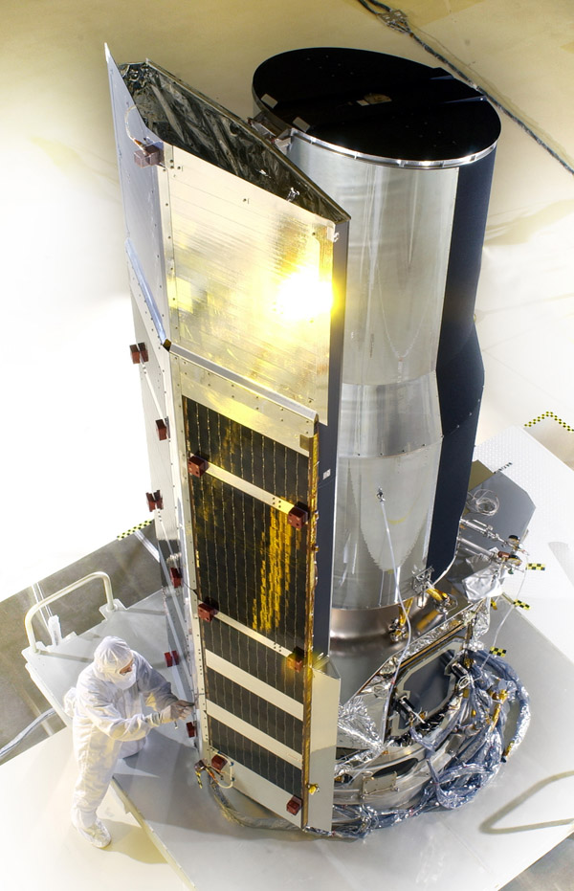
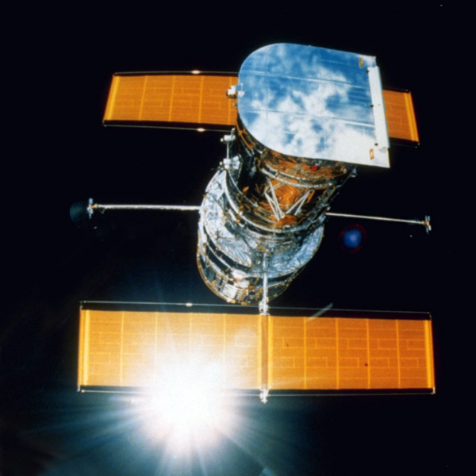
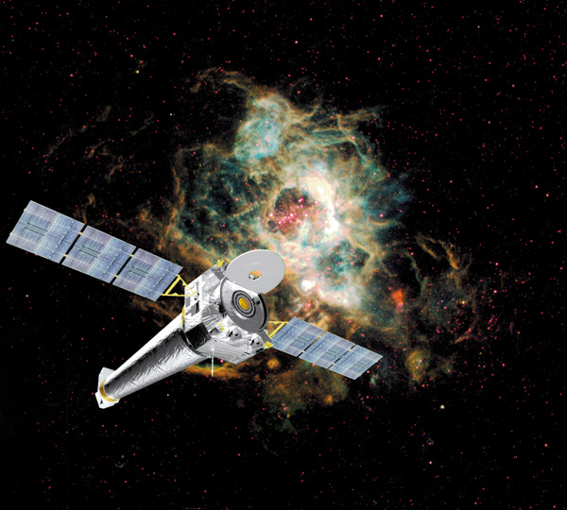
The 4 Great Observatories
Compton: Gamma Ray
Hubble: vis
Spitzer: Far IR
Chandra: X-ray
Compton
Spitzer
NASA
Hubble
NASA - MSFC
Chandra
NASA

Slide 20
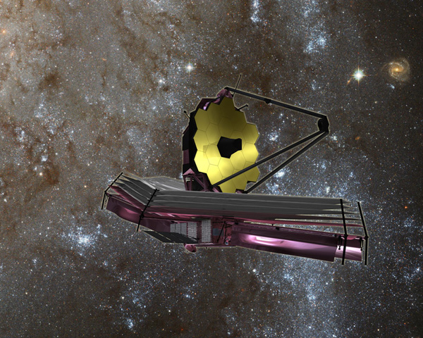
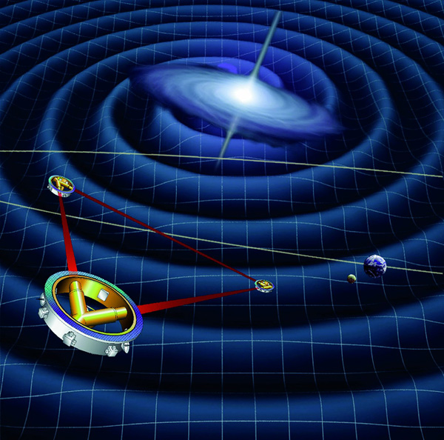
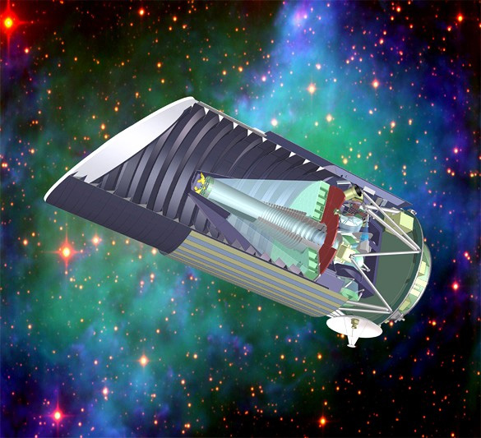
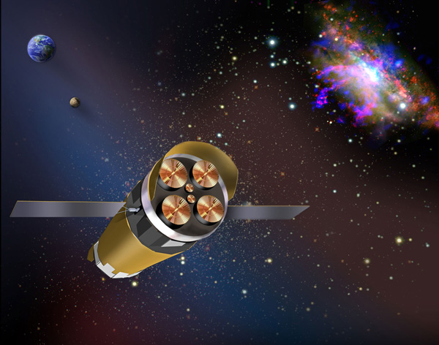
New NASA Missions
James Webb Space Telescope
WFIRST-2.4
Dark energy, exoplanets, missing mass
Constellation X
LISA – Gravity Wave Experiment
JWST
NASA
Constellation X
NASA
ESA
LISA
NASA, LBNL
JDEM

Slide 21
Tools for telescope optics, engineering and technology
Geometrical ray trace (Light pencil - normal to a geometric wave)
Image location, size, orientation and brightness
Scalar diffraction (Light is a wave)
Image quality – diffraction spectrometers [stellar composition, RV, etc. ]
Vector diffraction (Light is a vector wave)
Image quality – polarimetry [interstellar medium, high energy processes]
Radiometry (Power transfer - Watts)
Image intensity and background noise [luminosity, Cephied variables]
Statistical theory (Light is represented by random fluctuations)
Detection process, image quality, threshold detection
Quantum theory (Light is quantized, optical/UV detectors)
Detection process, Image intensity, image quality and physical properties of the source/intervening matter.
Solid-state physics (detectors)
Coupling EM radiation into lattice structures, readout electronics

Slide 22
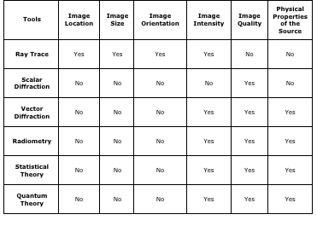
Tools used to model optical systems

Slide 23
How do we build a large, complicated system?
Understand the job
Develop functional requirements
Measure polarization with an rms error of ??? as a function of wavelength on stars to V = 5
Define and develop new technology
Invent low noise spectro-polarimeter
Develop engineering requirements
Telescope aperture 3.6 meter, Cassegrain, ….
Divide the problem into manageable parts
Consistent with talents and skills available
Consistent with available facilities & equipment

Slide 24
System development process
Science
“Determine the scope of global warming”
Science measurement objectives
“Measure the annual abundance of CO₂ to an accuracy of 0.1%”
Functional requirements (constraints on the instrument & system) {derived}
“the needed signal to noise is 60:1, global measurements, season…”
Develop a System architecture {create}
“Telescope with spectrometer, low earth orbit, down link capacity……. ”
Develop a point design {create}
“Grating or Fourier transform spectrometer, spectral resolution, ..??”
Model source, telescope/instrument and data processing to demonstrate the science measurement objectives have been met.
Is new technology needed?

Slide 25
System development process
Science
“Find terrestrial sized exoplanets”
Science measurement objectives
“Measure radial velocity to 10 cm/second”
Functional requirements (constraints on the instrument & system)
“the needed signal to noise is 10:1; measure same object at intervals over 5 year period . . . . ”
Create a System architecture
“Telescope with spectrometer, ground or space? . . . . .”
Develop a point design
“Grating or Fourier transform spectrometer, spectral resolution, ..??”
Model source, telescope/instrument and data processing to demonstrate the science measurement objectives met
Is new technology needed?

Slide 26
System development process
Science
“Find terrestrial sized exoplanets that might support life”
Science measurement objectives
“Measure radial velocity to 10 cm/second & record spectra”
Functional requirements (constraints on the instrument & system)
“the needed signal to noise is 10:1; measure same object at intervals over 5 year period with spectral resolution ??? . . . . ”
Create a System architecture
“Large aperture telescope with spectrometer, ground or space? . . . . .”
Develop a point design
“Grating or Fourier transform spectrometer, spectral resolution, ..??”
Model source, telescope/instrument and data processing to demonstrate the science measurement objectives met
Is new technology needed?

Slide 27
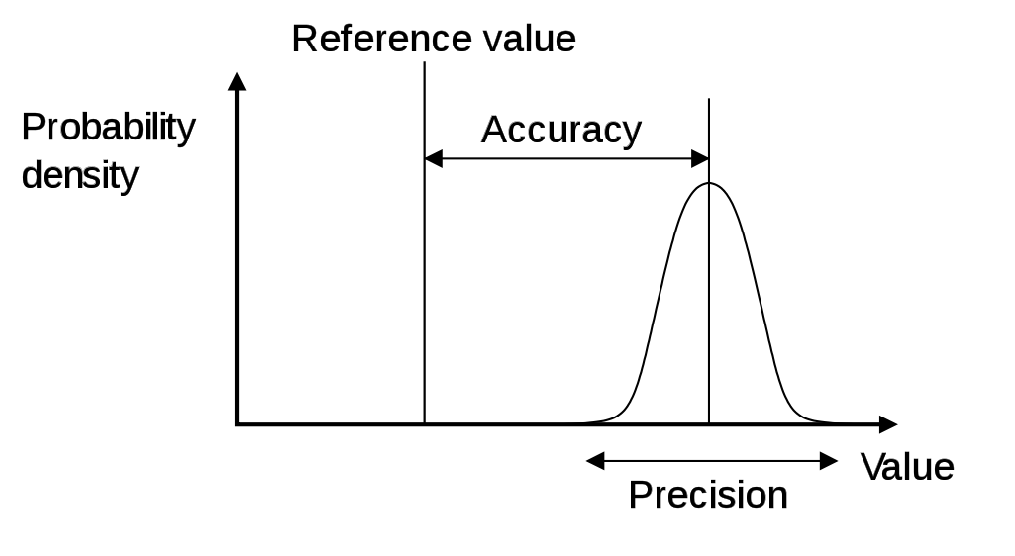
Example of a science measurement requirement
Mission studies
Science measurement requirement
Measure the wavelength position of a line in the spectrum of a 26th magnitude star with 10% accuracy at the 95% confidence level
If photons are Poission
distributed:
use the detector
QE to define the
telescope

Slide 28
Large telescope projects
If built by only one person (lone researcher) could take 5,000 years!
This is not practical!
So “hire 500 people for 10 years!”
Big job in
Communication of requirements
Time phasing of schedule
Defending cost

Slide 29
Definitions “speak the language”
Program
Typically 4 to 10 people
Several projects exist within a program
Perhaps 2 to 6 projects
Typically 50 to 2000 tasks for each project
Several tasks exist within a project
Requires 1 to 10 technical people

Slide 30
Definitions
Spacecraft
Hosts a telescope system – a payload
Telescope system (payload)
Hosts several optical/IR instrument subsystems
Optical/IR Instrument
Contains: mirrors, lenses, structure (optical bench), filters, focal planes, preamplifier, baffles, control computer and other sub-subsystems.
We also use “work breakdown structure” (WBS) level 1, level 2, level 3, ……..

Slide 31
Projects move through time in 3 dimensions
Cost
As time passes is the cost consistent with the budget, schedule & performance?
Schedule
Are tasks and hardware delivered on schedule?
How to avoid “standing around” waiting
“marching army”- salaries paid but no work!
Performance
Requirements being met?
Negotiate performance to keep cost and/or schedule obligation (promise)

Slide 32
How do we build a large, complicated system?
Create a work-breakdown structure (WBS)
Assign personnel to jobs in the WBS you know they can do
Prepare proposal and work plan with schedule and cost
Be funded
Re-plan the job to meet funding constraints
Accept the requirements and start work
Design, specify, build, assemble, align, test, calibrate

Slide 33
How do we build a large, complicated space or ground optical system?
Tasks and Projects progress through time in three dimensions
t₂
t₁
Cost
Cost
Performance
Performance
Schedule
Schedule
Time

Slide 34
Optical system engineering integrates:
Optical design: first order layout, aberrations
Physical optics: materials, coatings, scalar & vector diffraction, image formation and unwanted radiation control & mitigation.
Solid-state physics & electronics: conversion of photons to electrons, detectors, packaging, low-noise amplifiers and electronics
Radiative transfer: transfer of power from object space, through the telescope/instrument system and onto the detector at the plane detector.
Mechanical and mechanisms engineering: optical metrology
Wavefront sensing & control: sense and correct wavefront aberrations in telescope systems – wavefront PSF.
Structures and dynamics: Active and passive damping.
Thermal engineering: coatings, heaters, mechanical coolers & cryogens
Spacecraft engineering – orbital mechanics
End-to-end optical system characterization, verification, validation & calibration & modeling
The successful observational astronomer understands
how all these affect the quality of his data.

Slide 35
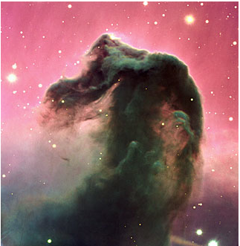
Space Telescope Optical System: The astronomer must understand these aspects
Space
Ground

Slide 36
The optical scientist is responsible for
The quality of the wavefront across the field of view at the focal plane
The efficient conversion of image photons to an electronic signal
Minimum unwanted radiation
Scattered light & emission
Extraction of signal from noise
Image processing

Slide 37
Telescope aperture architectures
Larger - monolith
diameter increases angular resolution
area increases radiation collected
Filled
Segmented
Sparse
Interferometry
Spatial interferometry

Slide 38
Filled, segmented, sparse and interferometer apertures
What kind of aperture are you going to build?
A<8 m
8>B>30 m
D>50m
A
B
C
D

Slide 39
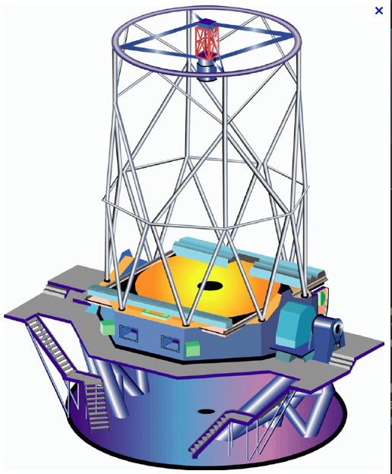
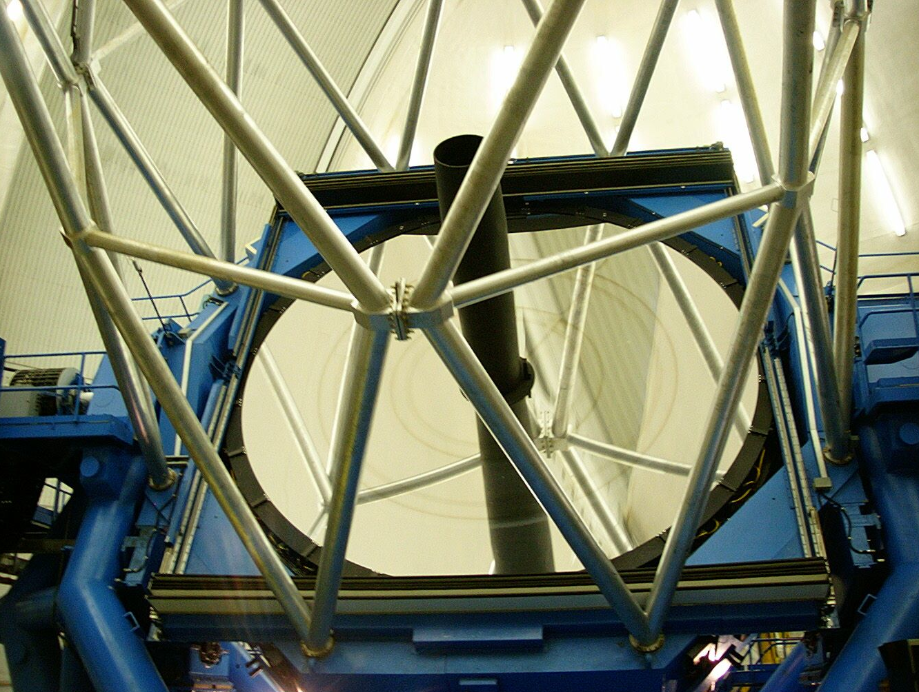
Monolithic mirrors
Gemini (N & S)
8 meter mirror
Alt-Az Mounted
Instruments at the Nysmith focus
ESO Very Large Telescope (VLT)

Slide 40
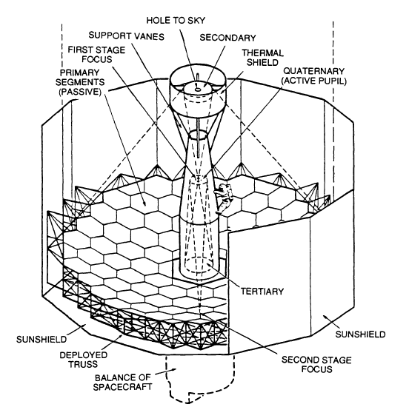

Slide 41
Tuesday, January 21, 2014
The scientific method [Renaissance Europe]
What can we measure?
Analysis tools
Optical system engineering
How space optics differ from ground-based optics
Projects move through time in three dimensions (cost, schedule, performance)

Slide 42
Four Lectures
Introduction to optical system engineering
Science measurement objectives => requirements => specifications =>
Hardware/software = >test & calibration => science
Hubble space telescope: what went wrong & how did we fix it

