Slide 1
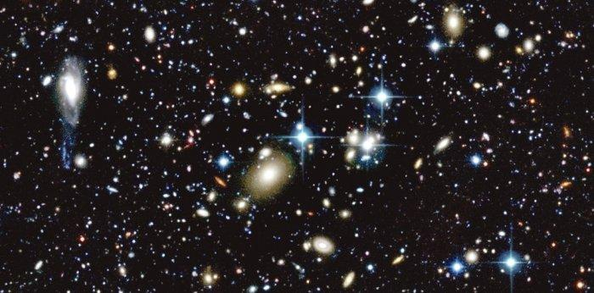
Supernova Survey
Feb 26 2013
Alexander Rodack
Soha Namnabat
Xiaoyin Zhu

Slide 2
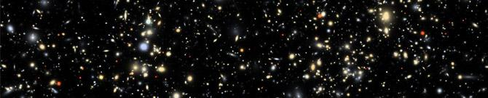
Questions
How do stars die ?
Watching and counting supernovae in galaxies
Measure supernovae rate & compare with number of existing stars
Try to monitor a large number of Galaxies, with high sensitivity

Slide 3
What’s Supernova? Why important? Type? Characteristics? How to detect?
A supernova is a stellar explosion that is more energetic than a nova. Supernovae are extremely luminous and cause a burst of radiation that often briefly outshines an entire galaxy, before fading from view over several weeks or months. During this short interval a supernova can radiate as much energy as the Sun is expected to emit over its entire lifespan
With ~10¹¹ stars per galaxy, and most stars living several billion years, the death rate of stars in a large galaxy is on the order of 1/year. Some of these stars will produce supernovae (the most massive ones). The supernova rate in galaxies provides a measurable link between number of stars and their lifetimes.
The estimated rate of supernova production in a galaxy the size of the Milky Way is about one every 50 years.

Slide 4
Main Types of Supernovae
Type Ia
  Occur when a binary system in which a white dwarf is orbiting “close” to a less dense companion star, and accretes matter from the companion star. Once the white dwarf has accreted enough mass to reach the Chandrasekhar limit (1.38 solar masses), it becomes thermonuclearly unstable, and collapses in a large explosion, destroying the white dwarf.
  These supernovae are very useful to the field of astronomy because they all peak to nearly identical absolute brightness because the white dwarfs are roughly the same mass when the explode regardless of their position in the universe.
Type II
  Occur when stars between 8 and 40 times the mass of the Sun die. Throughout the lifetime of a massive star, it goes through cycles of fusing different elements (main fusion fuels in order: H, He, C, Ne, O, and Si) until it builds an iron core (when Si fuses into Ni, the Ni decays into iron). The star cannot generate enough core heat to fuse iron, so once the core reaches the Chandrasekhar limit, gravity collapses the the star. This collapse generates immense heat in the core, creating neutrons and neutrinos, meaning neutron degeneracy pressure can stabilize the core. With the core now stable, the outer layers of the star (which are collapsing at nearly 25% the speed of light) “bounce” off the core, and create a shock wave that blows the star apart.
  This is distinguishable from a Type Ia Supernova because it contains hydrogen in its spectrum.

Slide 5
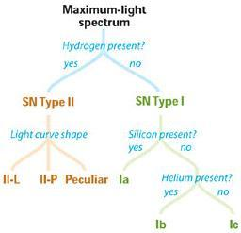
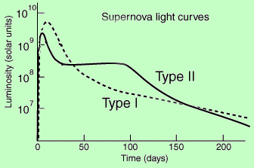
Supernova Light Curves and Spectra
This image shows the difference between Type I and Type II Supernovae light curves. This difference is needed in order to distinguish which one has been observed.
This flow chart notes the major differences in observable atoms in the spectra of different types of supernovae.

Slide 6
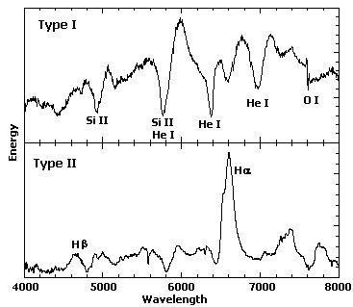
Spectra
Seen here are generic images of spectra from supernova explosions. As mentioned, the Type I has strong Si lines and no H lines, and Type II has strong H lines.

Slide 7
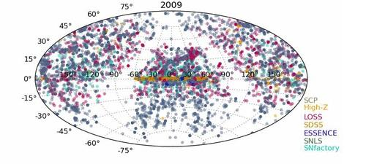
This is a compilation of Supernova discoveries since 1885
http://upload.wikimedia.org/wikipedia/commons/5/53/Sn_discoveries.gif

Slide 8
Existing Telescopes used to search for Supernovae
SDSS: Sloan Digital Sky Survey
KAIT: Katzman Automatic Imaging Telescope at the Lick Observatory (LOSS)
MHO: Madawaska Highlands Observatory
BOSS-Backyard Observatory
Puckett Observatory
The CfA Supernova Group (High-z Supernova Search)
Hubble Space Telescope (Supernova Cosmology Project)
ESSENCE: Equation of State: SupErNovae trace Cosmic Expansion "
The CBA Belgium Automated Supernova-Search Program
SNLS: Supernova Legacy Survey
SN factory: The Nearby Supernova Factory

Slide 9
BOSS-Backyard Observatory (over hundreds since 2008)
an amateur collaboration worked together as a group since mid 2008 to search, discover, record, and report new supernovae in the southern sky.
http://www.bosssupernova.com/
Puckett Observatory (270 Supernova since 1994)
a private facility, owned and operated by amateur astronomer Tim Puckett, located in the state of Georgia, United States. It is dedicated to the discovery of supernovae, and the study of comets.
http://www.cometwatch.com/
The CfA Supernova Group
conduct supernova-related research at the Harvard-Smithsonian Center for Astrophysics (CfA)
http://www.cfa.harvard.edu/supernova/index.html
SN factory: By over 600 by September 20, 2008
http://snfactory.lbl.gov/
SNLS: (over 1000 between 2003-2008)
The Canada-France-Hawaii Telescope Legacy Survey Supernova Program (SNLS) primary goal is to measure the equation of state of Dark Energy
http://cfht.hawaii.edu/SNLS/

Slide 10
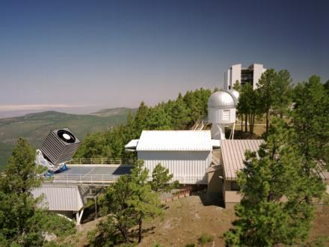
The Sloan Digital Sky Survey
The SDSS Supernova Survey was a 3-year
extension of the original SDSS that operated
from July 2005 to July 2008. The primary
scientific motivation was to detect and
measure light curves for several hundred
supernovae through repeat scans of the
SDSS Southern equatorial stripe 82 (about 2.5° wide by ~120° long).
Over the course of three 3-month campaigns (Sept-Nov. 2005-7), SDSS-II SN discovered and measured multi-band light curves for ~500 spectroscopically confirmed Type Ia supernovae in the redshift range z=0.05-0.4.
http://www.sdss.org/supernova/aboutsupernova.html

Slide 11
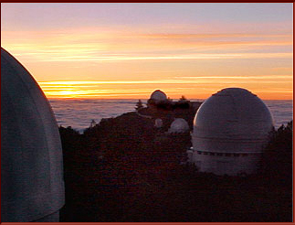
KAIT: Katzman Automatic Imaging Telescope
Katzman Automatic Imaging Telescope (KAIT), located at Lick Observatory atop Mount Hamilton, California, is an entirely robotic telescope dedicated to the search for supernovae and the monitoring of celestial objects. It is a 76 cm diameter reflecting telescope equipped with a CCD camera and automatic guider.
Mirror Diameter: 76 cm
Focal Ratio: 8.2
Lim. Mag r' (30s): 19.5
FOV deg²: 0.013
CCD Camera Pixel size: 24.0 microns
Pixel scale: 0.8 arc-seconds per pixel
http://astro.berkeley.edu/bait/public_html/kaitinfo/index.html

Slide 12
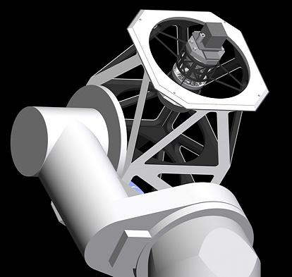
Madawaska Highlands Observatory
FOV: 5 deg²
Limiting magnitude z’ = 22 (s/n=3)
111.5 mega-pixel monolithic digital camera
0.76 arcseconds per pixel prime focus
- f/2.5 - 9um pixel
Exposure = 37sec. (including 16 second download)
8 hour survey = 3,767degrees²
Galaxies per degrees² = 15,000 ( z’)
Potential total galaxies = 15,000 gal/deg² X 3,767 deg²= ~56,000,000
http://madawaskahighlandsobservatory.com/supernovae-search.html

Slide 13
Our Program Plan-Improve What has been Done
Survey large area of the sky, with the ability to see galaxies that are farther away than previous surveys looked at
Identify galaxy types using spectrograph
Identify supernovae and their type using spectrograph

Slide 14
Accomplishing the Plan
Identify or create a telescope that could outperform the MHO program
  This includes seeing larger apparent magnitudes, getting better images, seeing more of the sky in less time, and achieving a better Signal to Noise Ratio
Design or use a Spectrograph with a high enough spectral resolution to identify faint galaxy types, as well as supernova types
Have large amounts of Data Storage available
Have software to process the data by comparing previously taken spectra to new spectra

Slide 15
Overview of How the Plan Would Work
Survey the sky to get visual images of all the visible galaxies up to an apparent magnitude of 25, and take spectra of each.
Run spectra data through software to compare them to previously identified trends in galaxy spectra to determine if each galaxy is elliptical, spiral, or irregular.
Repeat the survey every 2-3 days and use software to compare the previously stored data to the newest data to look for differences
When a difference is located, revisit that area once per day for 1-2 weeks to track the data, confirm that it is a supernova, and identify the type of supernova.

Slide 16
Constraints and Trade-offs for Telescopes
Ground vs. Space
Optical vs. IR (Optical easy and cheap)
small D and big FOV vs. Large D and small FOV
# of galaxies
exposure time vs. sensitivity
telescope time

Slide 17

Possible Choices for Telescopes
Each of these telescopes that has been designed is a candidate for use looking for/at supernovae and will soon be installed
  James Webb Space Telescope (JWST)
  Large Synoptic Survey Telescope (LSST)
  New Design
Separate telescope for step 4 to preserve survey time of LSST
  Because LSST will provide the coordinates of the detected supernova, any telescope could be pointed at it once a day to track data

Slide 18
Why the LSST?
The LSST has a sky coverage of 18000 square degrees, and a FOV of 9.6 square degrees
The LSST is designed to survey the Southern Sky every 3 days
The LSST has the capability of viewing a dim supernova 10.3 billion light years away
The site in Cerro Pachon will give minimal environmental impact on the results
The site being in Chile means that the data collected from this project will not overlap with that found by MHO, so the entire sky can be viewed for data

Slide 19
Why the LSST continued
According to the LSST website, a spiral galaxy of apparent magnitude 25 can be seen with a SNR of 2.98 after a 30 second exposure (which is a 2.2 magnitude improvement over MHO, with far less time needed for exposure)
Compared to JWST, if something goes wrong with the system, it can be fixed much more cheaply and easily
Runs from 330nm to 1070nm, meaning we can observe in both optical and near-IR
Using LSST will negate the cost and time of developing a completely new telescope
LSST is a great compromise between FOV and Diameter because it has an 8.4m diameter with a FOV of 3.5 degrees

Slide 20
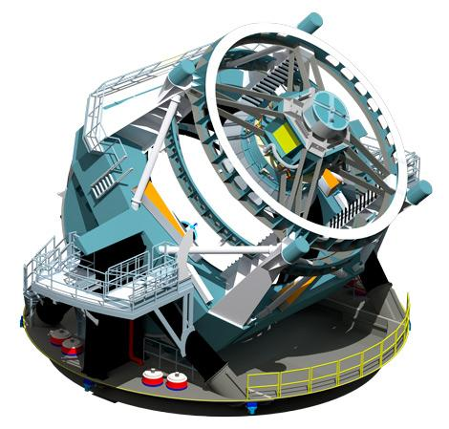
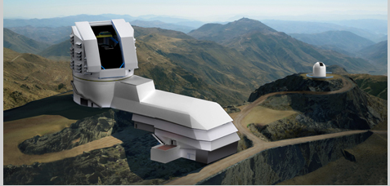
The LSST
The picture above (and on all slide tops) is a simulated image of the galaxies LSST will be able to view
These are pictures of what the LSST and its observatory will look like when completed in approximately 2020

Slide 21
LSST Supernova Calculations
Number of galaxies visible:
18,000 square degrees in 3 days, viewing 55,000 galaxies per square degree means 9.9*10^8 galaxies viewable
Possible Supernovae Detected:
As a baseline, we took the number of galaxies MHO can see and divided it by the number of supernova it is predicted to see, and got a factor of 2200.
We increased this to 2300 to compensate for LSST’s better specifications
9.9*10^8 / 2300 = 430,500 supernova

Slide 22
Comparison of LSST to the Best Performing/Planned Supernova Survey Telescopes
 | KAIT | MHO | LSST
Aperture (m) | 0.7 | 1.0 | 6.68
Lim. Mag r' (30s) | 19.5 | 22.8 | ~26
FOV deg² | 0.013 | 4.94 | 9.6
Discoveries/year | 66 | >25000 | ~430,500 +

Slide 23
Spectrograph
Resolving Power needed on the order of 1000
This gives a Δv on the order of 300,000 m/s
This would be more than accurate enough to track the redshift of galaxies compared to one-another without greatly increasing exposure time needed
LSST does not have a spectrograph, so this section of the mission must be separate
Find a spectrograph in the Southern Hemisphere meeting this resolution

Slide 24
Taking Spectra
Because we are looking at so many faint galaxies, taking the spectra of each is not practical/possible
We will need to compare supernova to galaxy type for a given percentage of the total galaxies we see

Slide 25
FEROS at La Silla Observatory
Has a spectral resolution of up to 48000 (higher than we require)
Is capable of seeing 17 magnitude objects with and SNR of ~5
Is located in the southern hemisphere
This will allow us to catalog some of the galaxies LSST can see, allowing us to do some categorizing of supernova to galaxy type

Slide 26
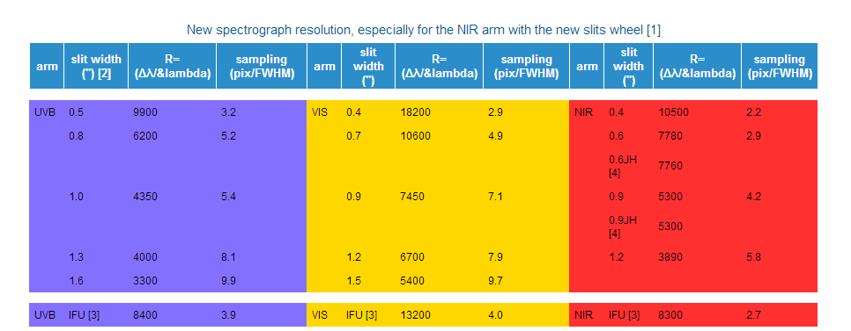
VLT’s XSHOOTER
Spectrograph Specifications

Slide 27
VLT XSHOOTER Continued
Full wavelength coverage, with spectral resolution within our requirement
Limiting magnitude of ~20
6000 20 magnitude galaxies per deg^2 * 18000 deg^2 = 1.08*10^8 galaxies => 10.9% of LSST survey can be cataloged
This will allow us to catalog further galaxies than FEROS, which makes this a better choice for our mission

Slide 28
Spectra Continued
Use of either or both of these spectrographs would add to the cost of the mission, but would save the money of designing and building new equipment.

Slide 29
Other Sources of Information
http://tonnyvanmunster.ipage.com/supernovae/supernova_search_program.htm
http://www.skyandtelescope.com/resources/proamcollab/3307271.html?page=1&c=y
http://www.lsst.org/lsst/
http://www-kpno.kpno.noao.edu/Info/Caches/Catalogs/RC3/rc3_catalog.html

Slide 30
