Slide 1
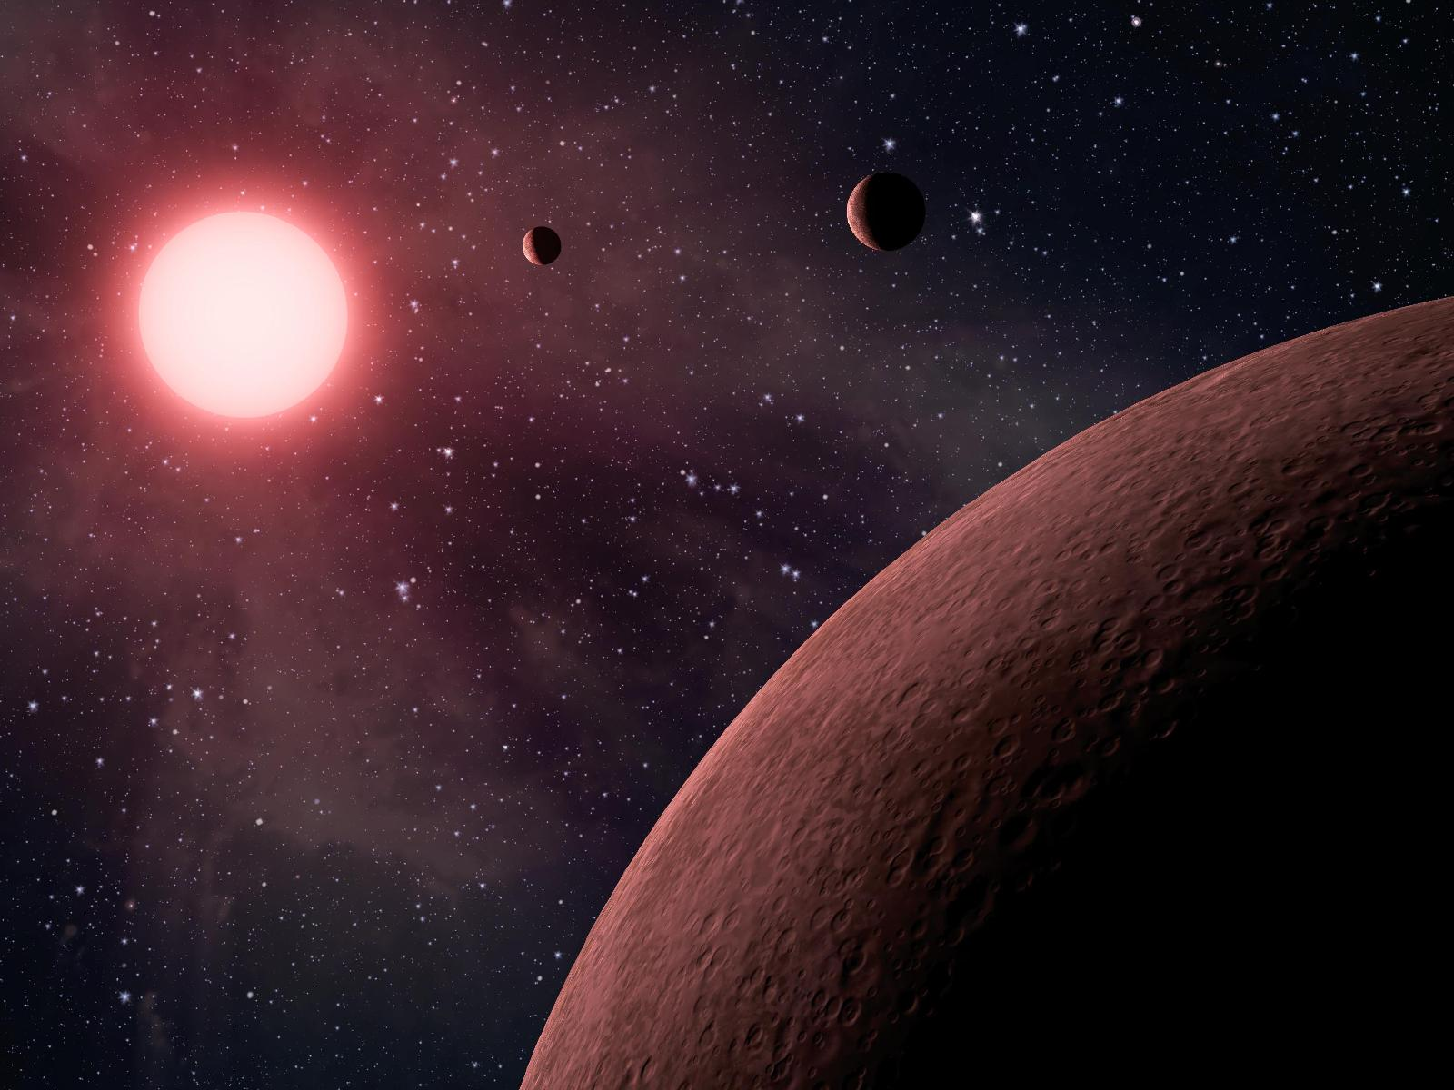
Expanded Ground-Based Kepler Array: Phase 1
Danielle Doughty
Alex Felli
Craig McNabb
Kelsey Miller
Iain Pearson
Steph Sallum
Nick Thelin

Slide 2
Mission Objective
Multi-phase approach
Phase I: Detection
Phase II: Imaging
Detection of Earth-size planet transits
Full sky coverage
Ground based array
Future direct imaging of planet candidates

Slide 3
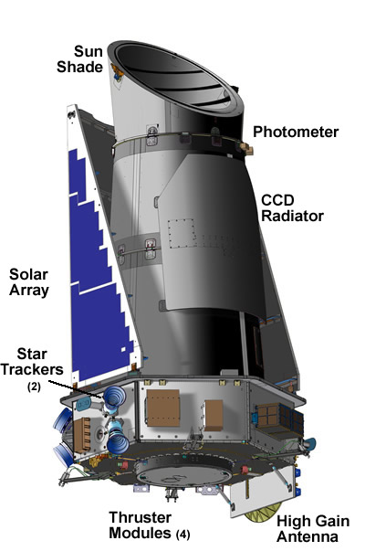
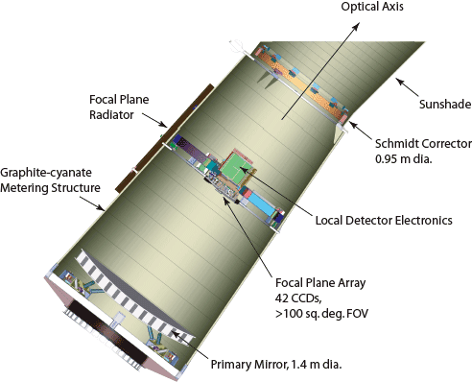
Current Transit Mission Comparison: Kepler
Space based telescope
Aperture: 0.95 m
FOV²: 105 deg²
Dimmest mag: 12
Exposure time: 6.5 sec
Cadence: 1 min, 30 min, 5 hrs
Can detect Earth-like transit:
Around G2V star
@ 4sigma
6.5 hr total integration time
http://kepler.nasa.gov/Mission/QuickGuide/MissionDesign/PhotometerAndSpacecraft/

Slide 4
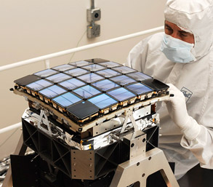
Current Transit Mission Comparison: Kepler
CCD
Array of 42 CCDs
Each 50x25 mm
Each with 2200x1024 pixels
Read out ever 6 seconds
Defocused to 10 arcsec
Data downlink: 1/month
Planet candidates to date: 2740
Eclipsing binaries (false positives): 2165
Confirmed planets: 114
http://kepler.nasa.gov/Mission/QuickGuide/MissionDesign/PhotometerAndSpacecraft/

Slide 5
Design Process: Science Goals
Phase 1:
Full sky coverage
Target stellar magnitude: 12
Sensitivity: 10PPM
Phase 2:
Direct imaging of exoplanet candidates

Slide 6
Design Process: Science Goals
Sensitivity Calculations:
Calculate by exposure time the highest magnitude at which 10 PPM sensitivity is achievable
Define sensitivity as the change (in PPM) corresponding to 3σ
Assume noise sources are Poisson & sky only
F* = F0_{λ} × 2.515^{-m} × λ in photons m⁻² s⁻¹
S* = F* × (πD²) × Δt in photons
Same formulae for F_{sky} and S_{sky} assuming background of 21 mag arcsec⁻²
N = √(S* + S_{sky})

Slide 7
Design Process: Science Goals
Target Star Magnitude vs. Exposure Time
8.4 m
4 m
We chose an 8.4 m aperture with a 10 minute exposure time.

Slide 8
Design Process: Science Goals
With 50% detector efficiency
With a perfect detector

Slide 9
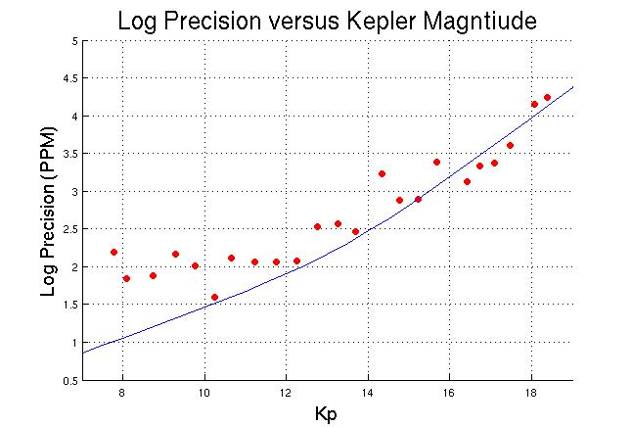
Design Process: Science Goals

Slide 10
Design Process: Science Goals
Phase 1:
Transit period > 3hrs
Orbital period < 2 months

Slide 11
Design Process: Ground vs Space
Ground
Pros
Easy to update
Lasts for many years
No need to worry about other orbiting debris hitting structure
No need for self contained energy source or communications gear
Cheaper!!!
Keck (10m diameter $100M in 1992)
Cons
Looking through atmosphere
Reduction in resolution
Reduction in usable wavelengths
Can only operate at night
The Earth ROTATES!
Notes:
danielle

Slide 12
Design Process: Ground vs Space
Space
Pros
Do not have to deal with atmosphere
Better resolution
Able to use full spectrum
Cons
Will only run for a few years
Technology is out of date by launch date
Downlinking data is expensive
Cannot be updated after launch due to expenses and accessibility
Testing of any new technology
Expensive!!!
Kepler $550M first 3 years
Building from Ball Aerospace ($236M)
$18M each following year (till 2016)

Slide 13
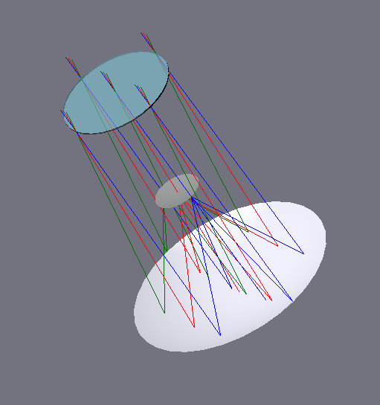
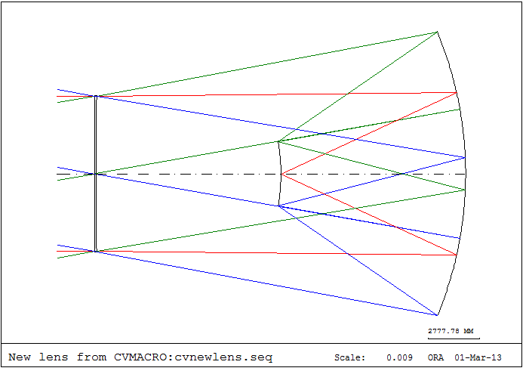
Design Process: Telescope Specs
Mirror design
Schmidt Telescope Design
Reduce Coma
F/1.19
10° FOV
8.4m Diamater
-20m Radius Of Curvature

Slide 14
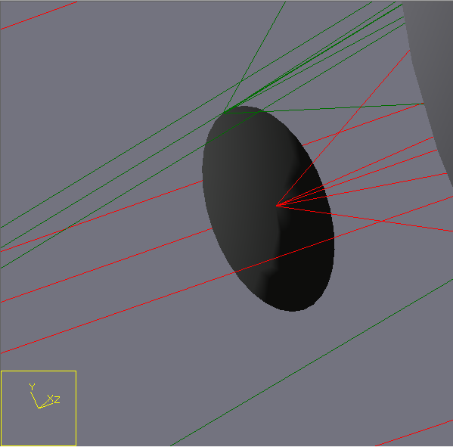
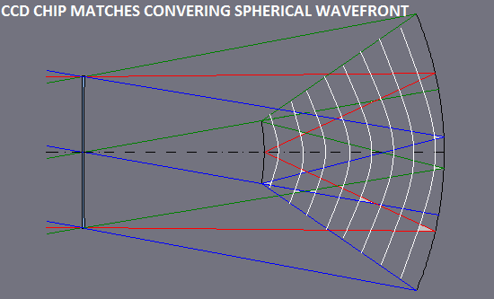
Design Process: Telescope Specs
Minimizing Aberrations
Spherical Wave fronts With Radius of Curvature of -10 meters
Induces Spherical Aberration
Eliminated by curving CCD Array

Slide 15
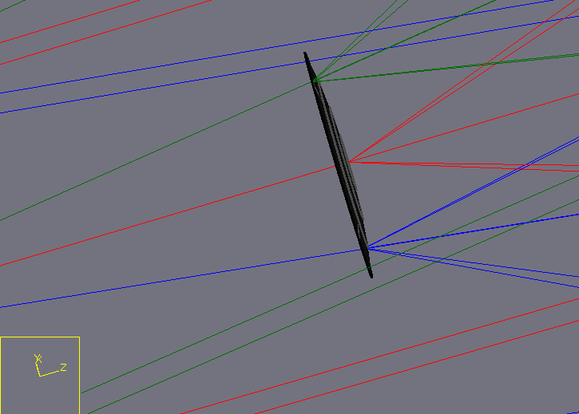
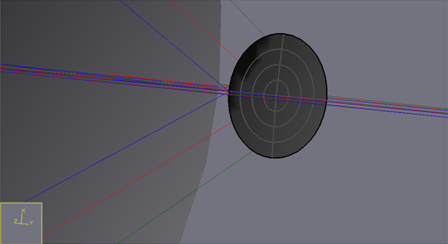
Design Process: Telescope Specs
CCD Design
1.7m Diameter
373.2 MegaPixel Array
-10m Radius of Curvature
Related to Focal Length of Telescope

Slide 16
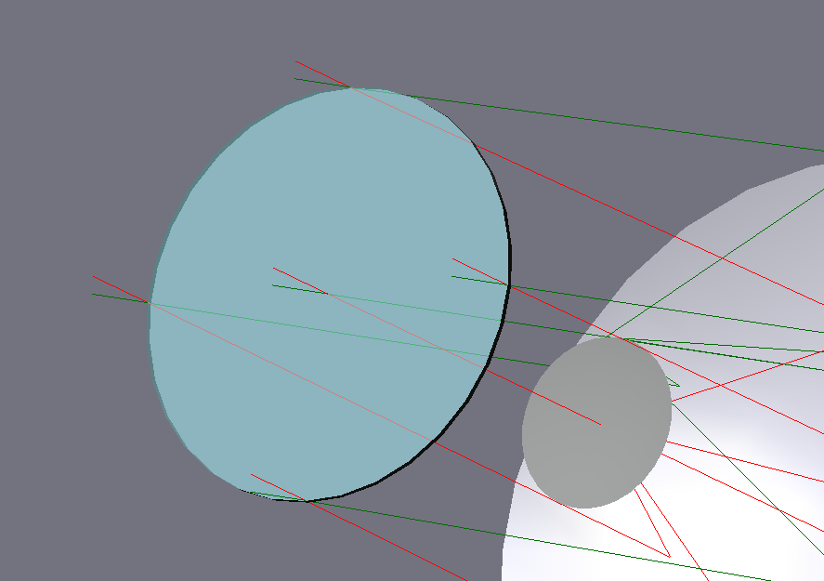
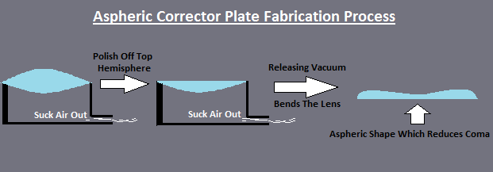
Minimizing Aberrations - Coma
Coma Present Due To Off Axis Rays
Eliminated by placing a stop at the Radius Of Curvature Of The Mirror
Further Reduce Aberrations By Aspheric Corrector Plate
Design Process: Telescope Specs

Slide 17
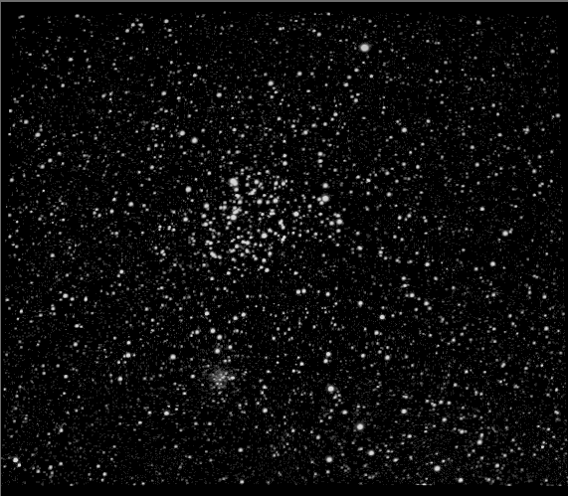
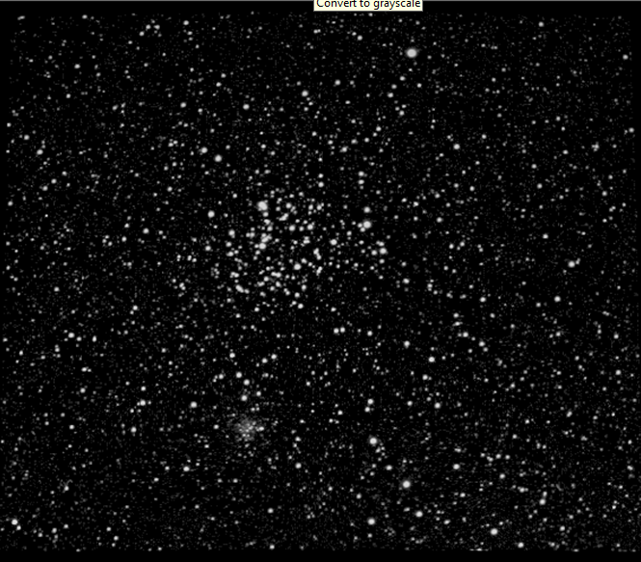
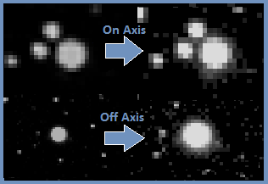
Telescope Specs: How Well Does It Perform?
On Axis Spot Size of 5um
Off Axis Spot Size of 1.2mm
Only 0.5 Waves of Spherical Aberration
M=7000x
Object Entering Telescope
Conjugate Image Formed On CCD Array

Slide 18
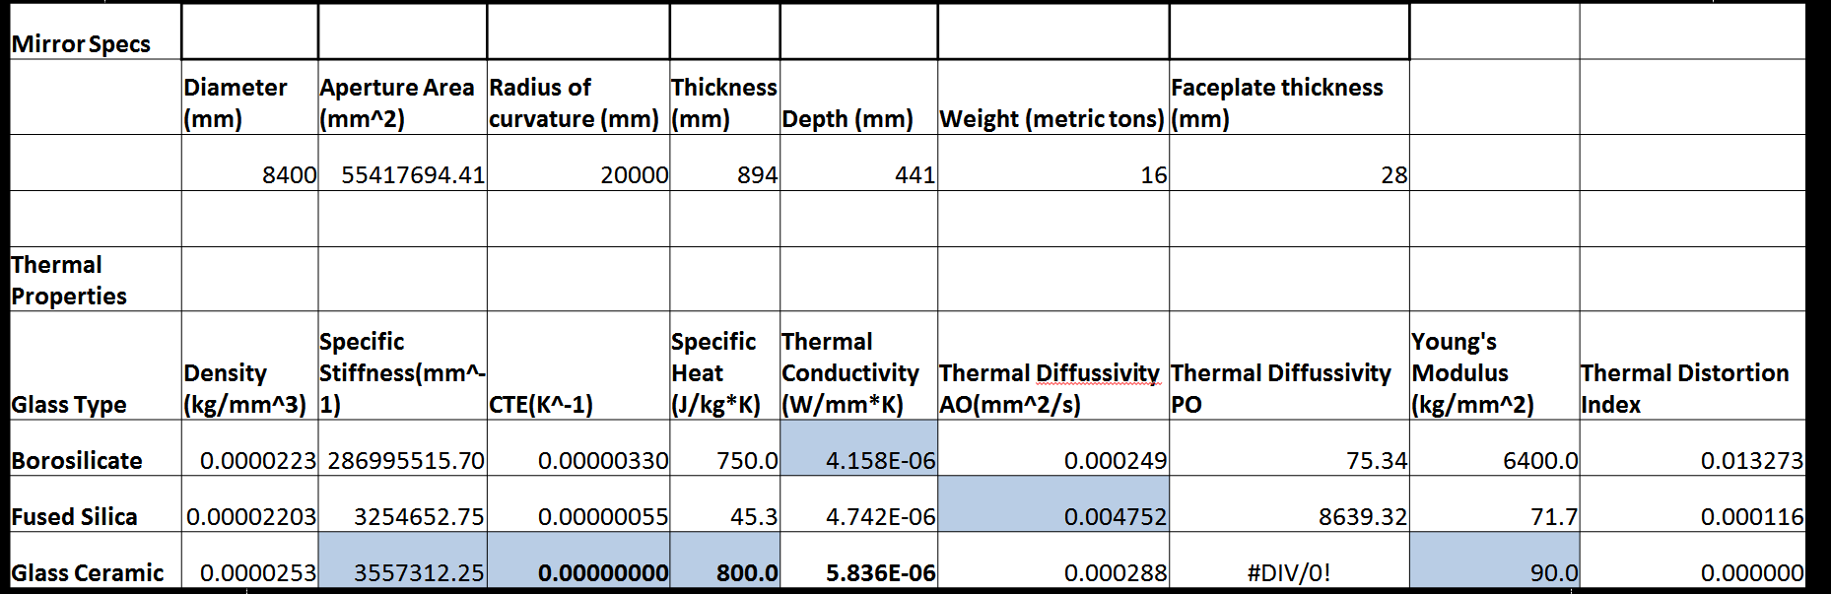
Design Process: Thermal Properites

Slide 19
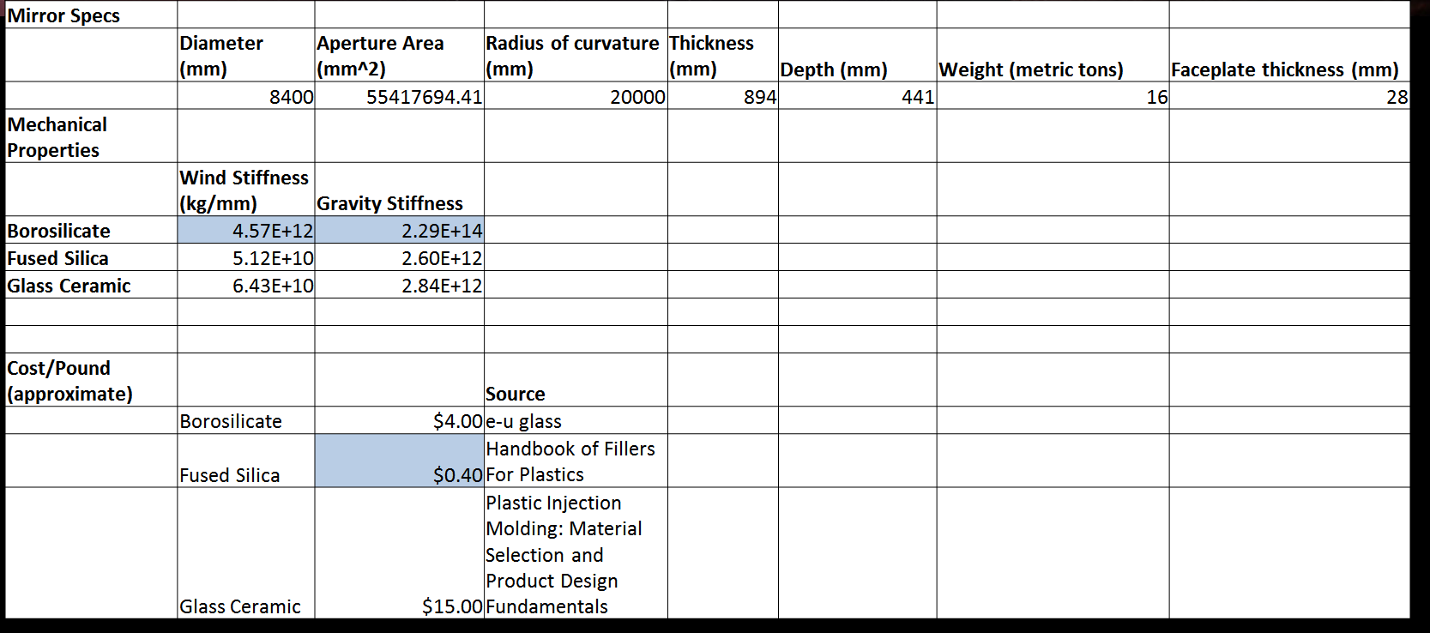
Design Process: Mechanical Properites

Slide 20
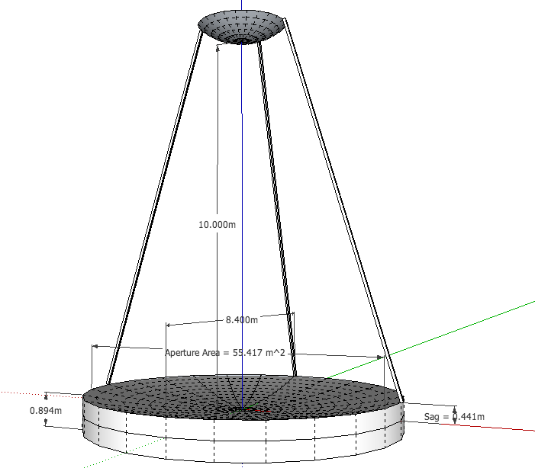
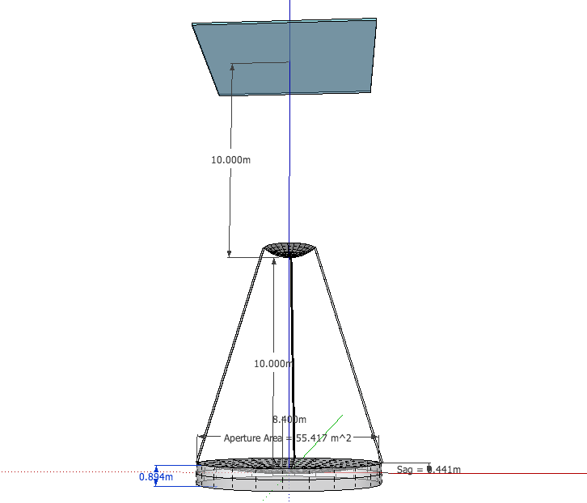
Design Process: Telescope Specs

Slide 21
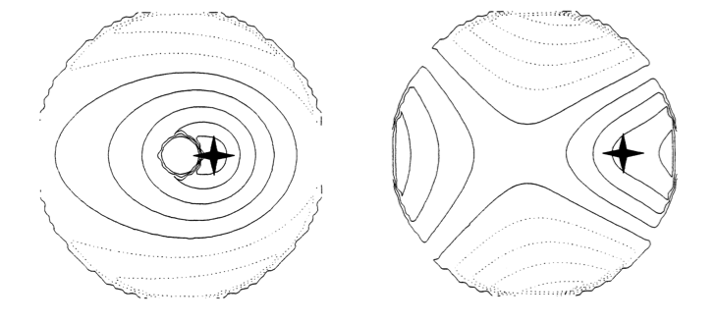
Design Process: Active Optics
Actively shapes a telescope's mirrors to prevent deformation due to external influences such as wind, temperature, mechanical stress.
Effects of Shape change for one individual actuator exerting 1N of force on a 6.5m honeycomb mirror. The surface contours are shown at 5nm.

Slide 22
Design Process: Active Optics Design
Three zones of supports to control active optics.
Enables Tip, tilt, and piston.
Hydraulic system.
Actuators connected to mirror by puck bonding at honeycomb intersections.
Each actuator has a three point load spreader.
262 Pucks bonded.

Slide 23
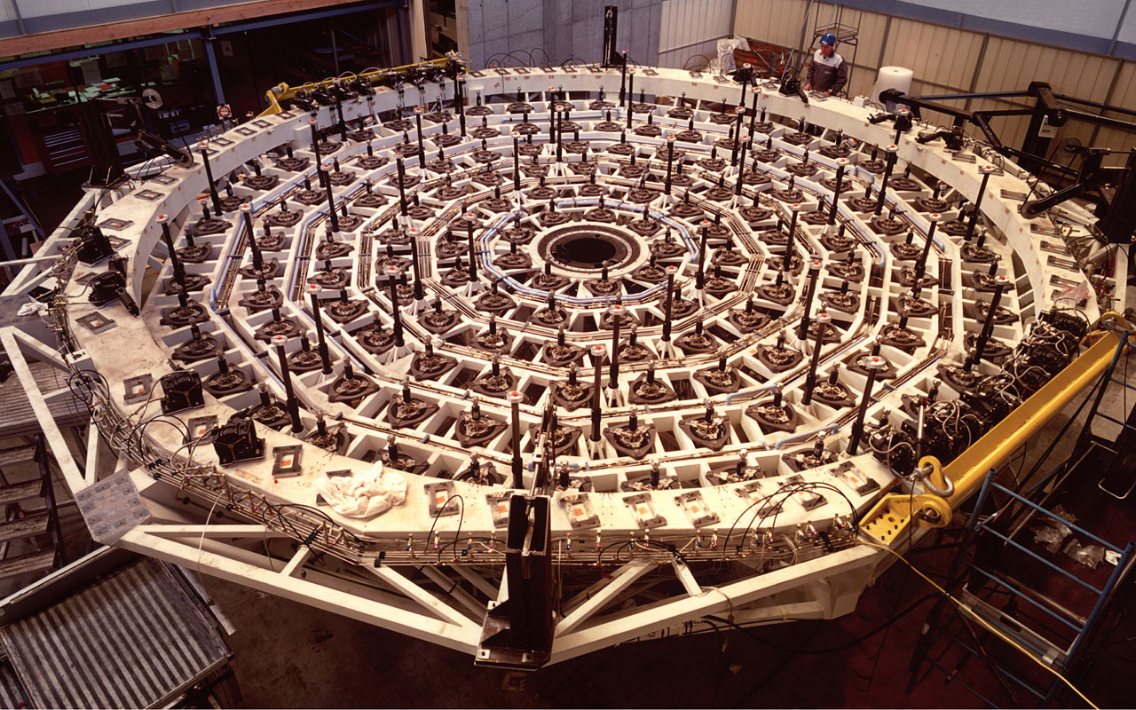
Design Process: Active Optics Design
Three zones of supports to control active optics.
Enables Tip, tilt, and piston.
Hydraulic system.
Actuators connected to mirror by puck bonding at honeycomb intersections.
Each actuator has a three point load spreader.
VLT Primary Support

Slide 24
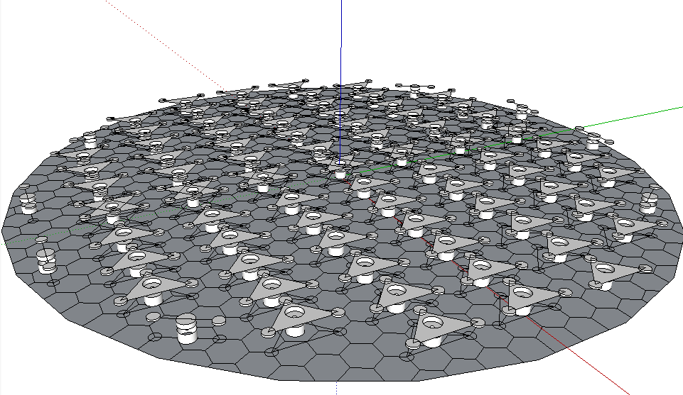
Design Process: Telescope Specs

Slide 25
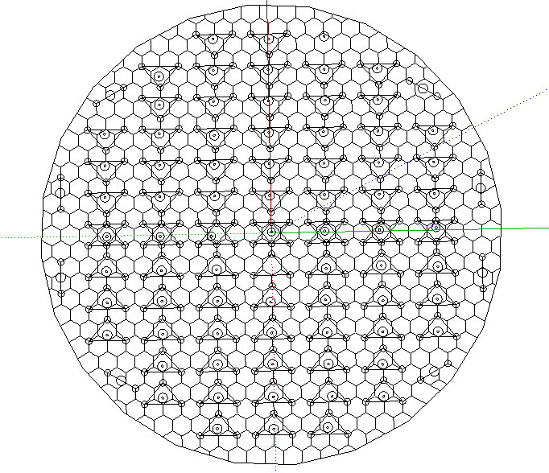
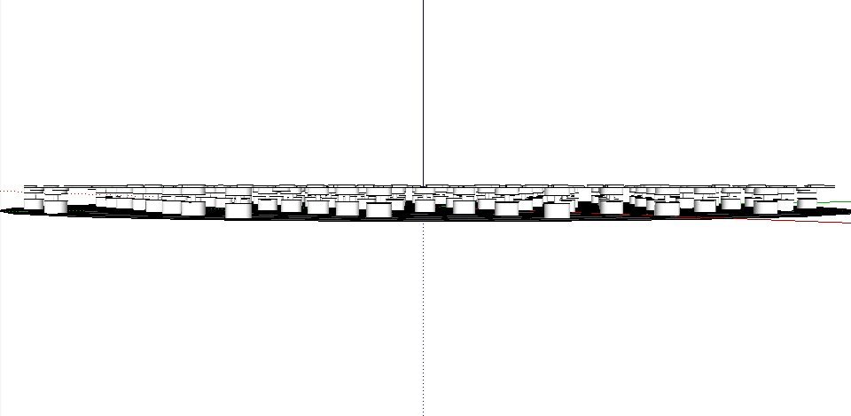
Design Process: Telescope Specs

Slide 26
Design Process: Main Idea
Divide the sky into subregions
Continually scan over a particular subregion, switching between telescopes as the Earth rotates
After a given amount of time, move to a new subregion
We can look at 2 subregions at a time (Northern and Southern hemisphere)

Slide 27
Design Process: Number of Telescopes
Let θ be the minimum angle above the horizon we can observe
We need to be able to see the same portion of sky for all 24 of the day
Absolute minimum number of telescopes:

Slide 28
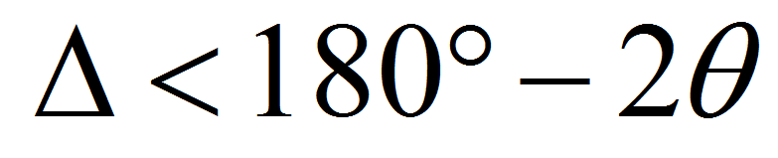
Design Process: Number of Telescopes
Put N telescopes in each hemisphere
Required longitude separation Δ between telescope locations:

Slide 29
Design Process: How much of the sky will we be able to see?
Let β₁^{n}, β₂^{n}, …, β_{N}^{n} be the magnitudes of the latitudes of the N telescopes in the Northern hemisphere
Assume all β < 90°-θ
Let β_{min}^{n} = min{β₁^{n}, β₂^{n}, …, β_{N}^{n}}
Then define β^{s}’s and β_{min}^{s} in the same way for the Southern hemisphere

Slide 30
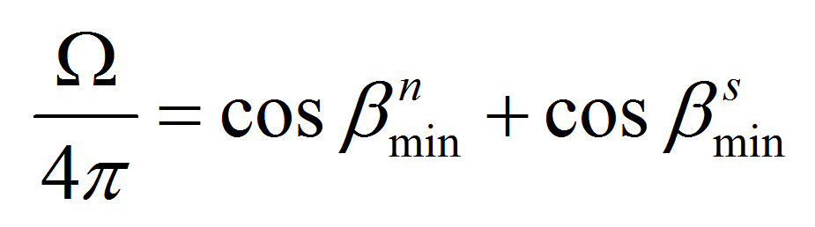
Design Process: How much of the sky will we be able to see?
If β_{min}^{n}, β_{min}^{s} > θ, then we will be able to see the full sky (4π sr)
If β_{min}^{n}, β_{min}^{s} < θ, then the fraction of sky we will see is

Slide 31
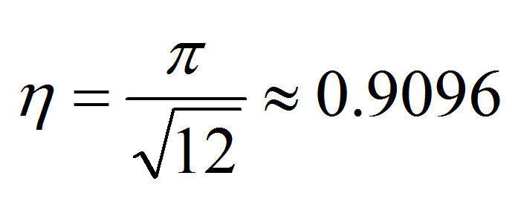
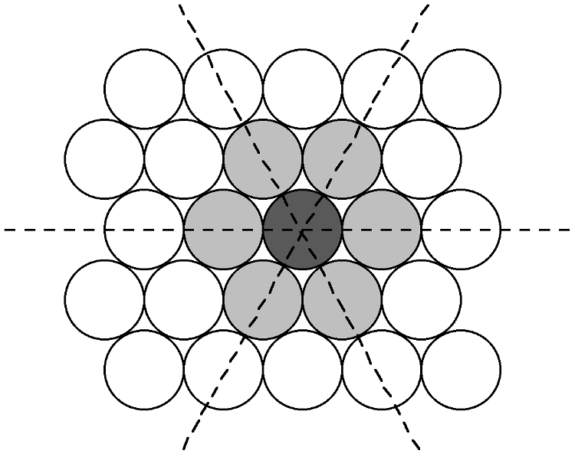
Design Process: How much of the sky will we be able to see?
Since our FOV is circular, we will look at circular patches of sky
If we don’t overlap, then highest packing density is hexagonal
So we will cover 90.9% of the sky

Slide 32
Design Process: How much of the sky will we be able to see?
T_{exp} = exposure time
T_{transit} = time duration of fastest transit we want to observe
P = largest orbital period of planets we want to detect
N_{s} = number of data samples required during the duration of the fastest transit
N_{transits} = number of transits required to say there’s a planet

Slide 33
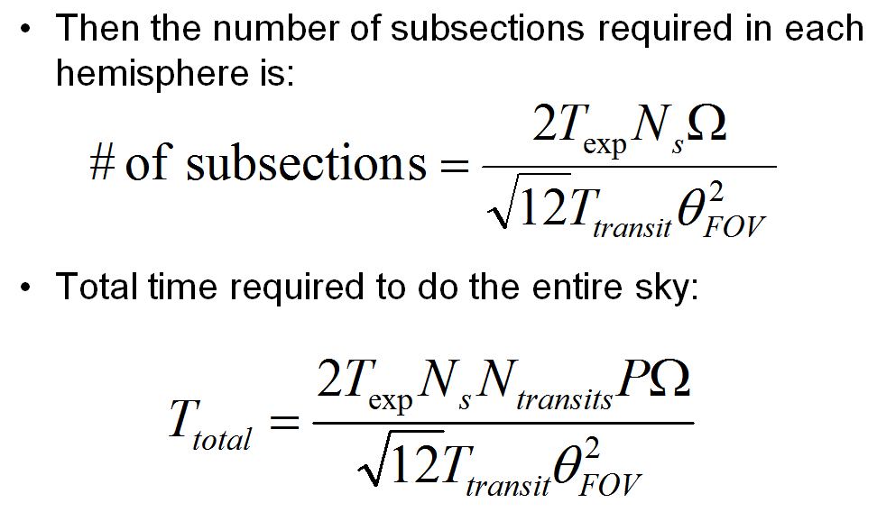
Design Process: Main Idea

Slide 34
Design Process: Some assumptions
Telescopes can observe as low as 20 degrees above the horizon
Each portion of the sky will be visible for at least 6 months
3 transit detections are required to say there’s a planet there
Transit duration is about 3 hours
We need 3 data points over the duration of a transit

Slide 35
Design Process: The result
To view the entire sky, we need 3 telescopes in each hemisphere, with longitudes separated by less than 140°, and latitude magnitudes greater than 20°
21 subregions in each hemisphere
Scan over 6 FOVs in each subregion
Total project duration will be 11 years

Slide 36
Design Process: We should then be able to find 90% of planets with:
Host star magnitude 12 or lower
Orbit aligned between host star and Earth
Orbital period less than 2 months
Transit time of at least 3 hours

Slide 37
Design Process: Telescope Locations (Northern Hemisphere)
Maui, Hawaii
20.42N, 156.15W, 3058m
La Palma, Canary Islands, Spain
28.46N, 17.53W, 2400m
Lijiang, China
26.52N, 100.14E, 3250m

Slide 38
Design Process: Telescope Locations (Southern Hemisphere)
Cerro Pachon, Chile
30.20S, 70.59W, 2737m
Coonabarabran, Australia
31.17S, 149.04E, 1165m
Sutherland, South Africa
32.23S, 20.49E, 1759m

Slide 39
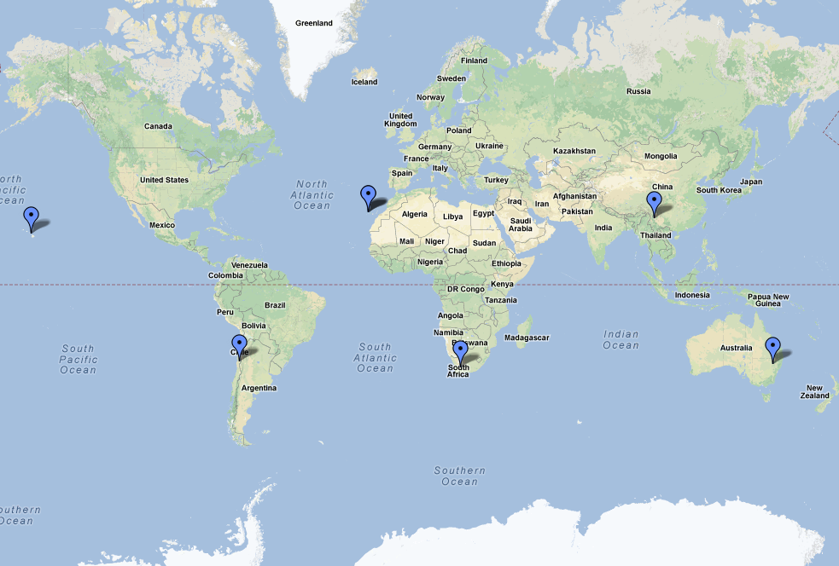
Design Process: Map

Slide 40
Data Processing: Storage
Each raw image taken will produce an image size that corresponds to approximately 373.2MP
Assuming an image is taken every 10 minutes and eight hours of night, we will produce approximately 18GB of data per night per site
Each month we will have 540GB per site per month
Each image is scanned for known stars, this allows the image to be calibrated photometrically and astronomically.

Slide 41
Data Processing: Structures
Three Data Structures
Infrastructure Layer
Consists of computing, storage, and networking hardware and software
Middleware Layer
Handles processing, data access, user interface, and system operations services
Applications Layer
Comprised of data pipelines and science data archives

Slide 42
Data Processing: Data Flow
← Behind the Cloud|| User facing services →
Data Valet Workflows
Astronomers
(Data Consumers)
Data Creators
Load Workflow
Load DB
WarmSlice DB 1
Data Consumer
Queries & Workflows
CSV
Files
Cold Slice DB 1
Image Processing Pipeline (IPP)
Merge Workflow
Flip Workflow
Hot Slice DB 2
MainDB
Distributed View
MyDB
CSV
Files
Load Workflow
Load DB
CASJobs
Query Service
Telescope
Merge Workflow
Cold Slice DB 2
MainDB Distributed View
Flip Workflow
WarmSlice DB 2
Hot Slice DB 1
Validation Exception
Notification
MyDB
Admin & Load-Merge Machines
Slice Fault Recover Workflow
Data flows in one direction→, except for error recovery
Production Machines

Slide 43
Data Processing: Transit Detection
Light curve generation
Harder than Kepler due to sky background
Compare target star to mean of all other stars in the field
Minimizes chance of having a variable/transiting comparison star contaminating target light curve

Slide 44
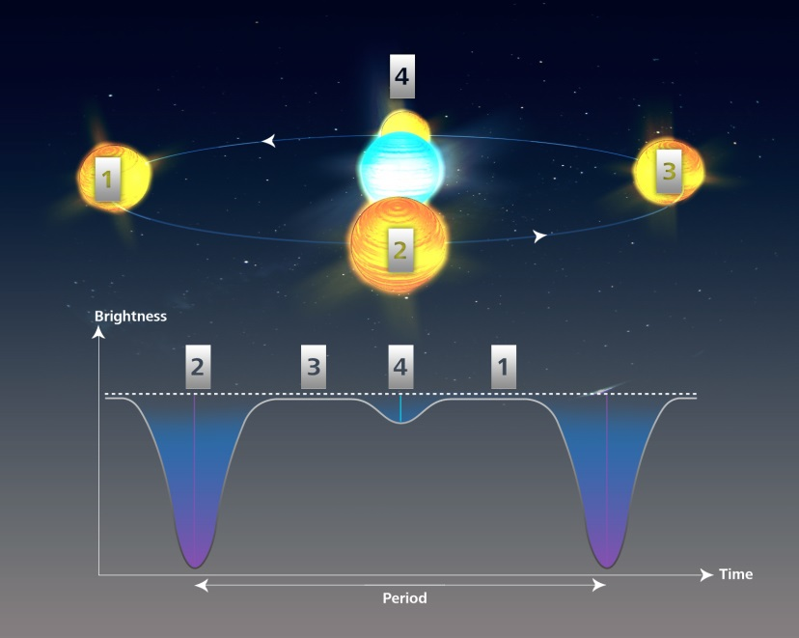
Data Processing: False Positives
False positives
Undiluted eclipsing binaries (strong radial velocity variations not compatible with planetary scenarios) with a low mass stellar companion
Diluted eclipsing binaries (‘blends’) whose eclipse depth is diluted with the target flux (by another star in the system) and can therefore mimic a planetary transit
For Kepler an overall FPP of less than 10% for 90% of the candidates with a median value close to 5%.
Notes:
KELSEY

Slide 45
Data Processing: False Positives
Confirmation methods
Radial Velocity
Can be done with other, smaller ground based telescopes (has been done by SOPHIE spectrograph mounted on the 1.93-m telescope at the Observatoire de Haute-Provence for Kepler candidates)
Has been done by performing weighted cross-correlation with a numerical G2 mask
Transit time variation technique
exclude outliers and transit times with unusually large uncertainties
reject any transit times for which the measurement uncertainty exceeds twice the median of the transit time uncertainties
Notes:
KELSEY: Radial velocity measurements: obtained by performing weighted cross-correlation with a numerical G2 mask
Transit time variation:linear ephemeris (L2) calculated after cleaning the transit times to exclude outliers and transit times with unusually large uncertainties. Speciﬁcally, we reject any transit times with an absolute deviation from the linear2 Ford et al.
ephemeris exceeding four times the median absolute deviation of transit times from the ﬁrst linear ephemeris (L1). We also reject any transit times for which the measurement uncertainty exceeds twice the median of the published transit time uncertainties. We record the median timing uncertainty for the remaining NT T transit times
(σT T). Then, we calculated an updated the best-ﬁt linear ephemeris (L2) using the cleaned transit times. We report the epoch (Elin) and period (Plin) of the updated linear ephemeris (L2) in the electronic table.
We consider a small p-value as indicating that a transit timing data set is worthy of further investigation

Slide 46
Expanded Ground-Based Kepler Array vs Kepler
EGBKA
6 telescope array
Ground based
Visible wavelengths
Sensitivity (PPM): 10
Dimmest visible mag: 12
Exposure time: 600 sec
Cadence: 60 min
f/#: 1.19
Primary D: 8.4 m
Corrector plate D: 8.4 m
F: 10 meter
CCD : 1.7m
FOV²: 95 deg²
90.69% full sky coverage
Phase 1 duration: ~ 11 yrs
Kepler
Single aperture
Space based
Visible wavelengths
Sensitivity (PPM): 441 (SC) 80.5 (LC) 25.4 (hr C)
Dimmest visible mag: 12 (catalogued)
Exposure time: 6.5 sec
Cadence: 1 min, 30 min, 5 hrs
f/#: 1
Primary D: 1.4 meter
Corrector plate D: 0.95 m
F: 1.4 meter
CCD : 0.78m²
FOV²: 105 deg²
0.25% full sky coverage
Mission duration: >7.5 years
Notes:
KELSEY

Slide 47
Revisions After This Slide
Notes:
KELSEY

Slide 48
EGBKA Re-Design
Telescope & CCD design
Schmidt design
Segmented mirror
Segmented corrector plate 30 ft above primary
f/1.19
Diameter: 4 meters
λ/D: 0.025 arcsec
Focal length: 4.76 meters
Plate scale: 43.33 arcsec/mm
FOV: 10 degrees
Pixel size: 0.16 micron
CCD size: 0.83 meters
2.5*10¹³ pixels
Layout
6 telescope array
3 locations around the equator
2 telescopes per location
Notes:
KELSEY

Slide 49
EGBKA Re-Design
Observations
Only galactic plane (30deg x 180deg)
8.3% full sky
Pro – high star density
Con – potentially giving up closer star systems
Exposure time: 3 min
Notes:
KELSEY

Slide 50
Revised Sensitivity Calculations
Calculate by exposure time the highest magnitude at which 10 PPM & 100 PPM sensitivity are achievable
Define sensitivity as the change (in PPM) corresponding to 3σ
Assume noise sources are Poisson, sky, and scintillation
F* = F0_{λ} × 2.515^{-m} × λ in photons m⁻² s⁻¹
S* = F* × (πD²) × Δt in photons
Same formulae for F_{sky} and S_{sky} assuming background of 21 mag arcsec⁻²
σ_{scin} = 0.003 D^{-2/3} T^{-1/2} (Kornilov et al. 2012)
N = √(S* + S_{sky}+σ_{scin}²)
Notes:
KELSEY

Slide 51
10 PPM
Notes:
KELSEY

Slide 52
100 PPM
Notes:
KELSEY

Slide 53
4 Meter Aperture 3 Minute Exposure Time
Assumes 50% detector efficiency.
Notes:
KELSEY

Slide 54
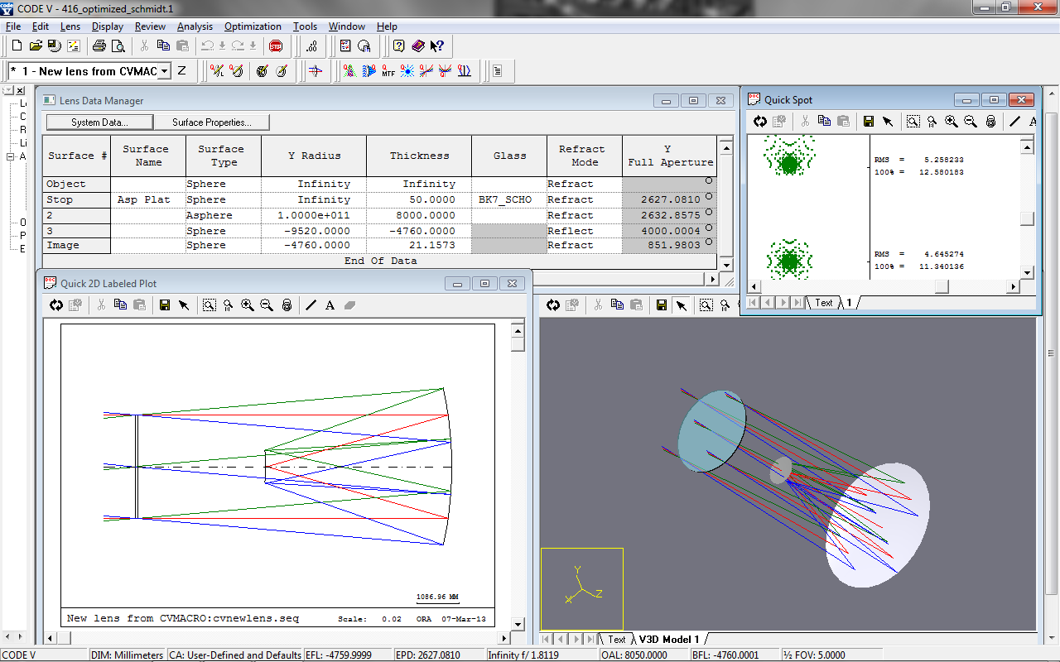
Possible New Telescope Design
Corrector plate now has a smaller diameter than mirror
Mirror Diameter = 4 meters
Corrector Plate Diameter = 2.63 meters
This gives the CCD have a diameter of 851mm
Much more realistic!

