Slide 1
Spaceborne High Accuracy Radial Velocity Planet Searcher SHARPS
Nick Ballering
Vernon Dunlap
Russell Knox
Emily Kopp
Patrick Llull

Slide 2
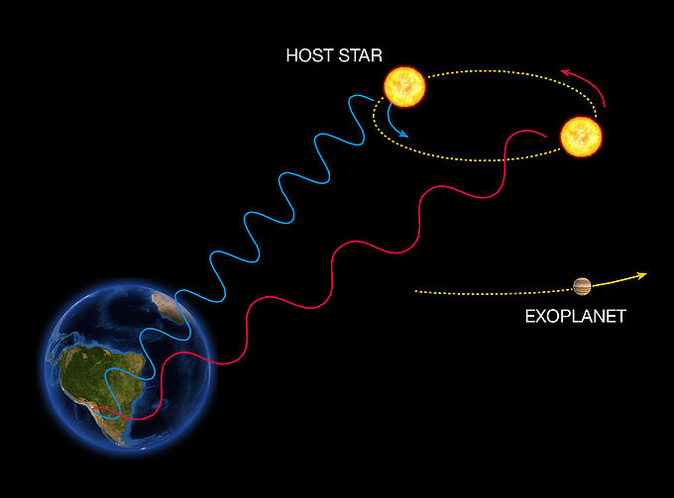
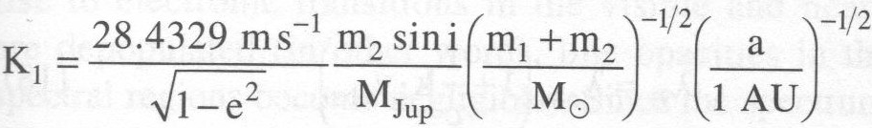
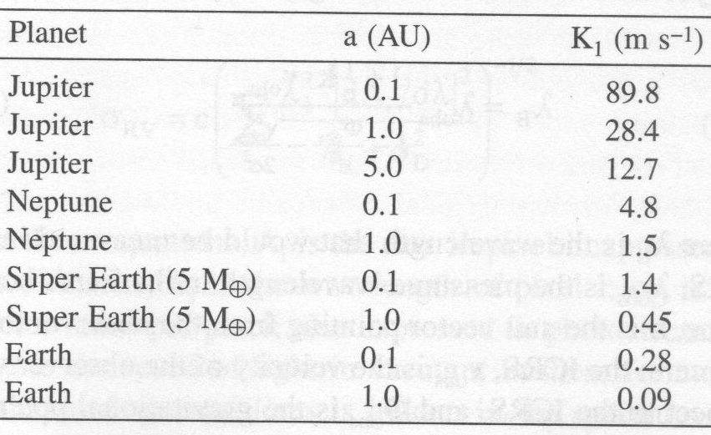
RV Method
Measure Msin(i)
Science Goals:
Detect planets at 0.05 – 0.09 m/s
Follow up Kepler transit detections (faint stars)
(solar mass star)

Slide 3
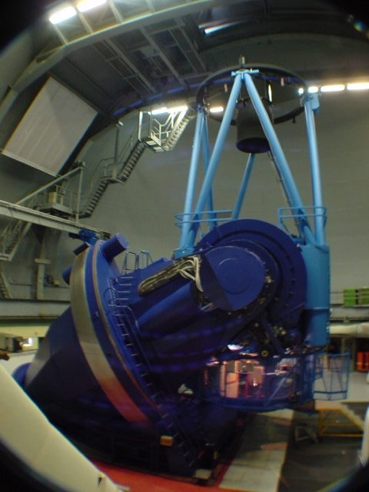
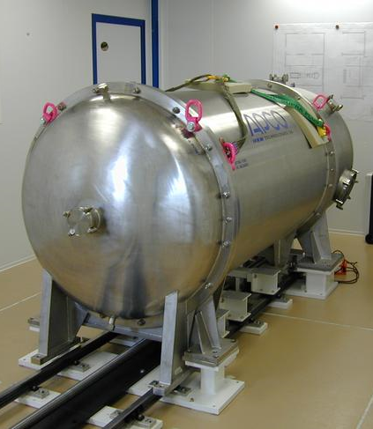
High Accuracy Radial Velocity Planet Searcher
3.6 meter ESO Observatory
Echelle Spectrograph Chamber

Slide 4
RADIAL VELOCITY, δv, PRECISION
δv: change in spectral line position, Doppler shift.
M: number of spectral lines measured (HARPS~ 129).
R: Spectral resolution (HARPS 120,000)
SNR: (HARPS 110/pixel, 220 for 4 pixel resolution)
www.physics.umt.edu/~nate/astr362/Lab6

Slide 5
High Precision Spectroscopy
Opportunities for improvement
Gratings
Access to UV (more lines?)
Temperature control
Spectral Resolution
SNR
Better Calibration source (e.g. laser comb)
HARPS Design
0.5 - 1 m/s δv
Instrument in a vacuum controlled to 0.01 K
378nm-691nm spectral band

Slide 6
SPECTRAL RESOLUTION
G. Rieke, UofA
α: Blaze angle of Echelle grating (HARPS 75^{ο})
D_{p}: Diameter of primary mirror (HARPS 3.6m)
D_{c}: Diameter of collimated beam (HARPS 208mm)
Δθ: Width of slit on sky, radians (HARPS ~ 1’’-sec)

Slide 7
Astrophysical Line Broadening
Measured line width = astrophysical line width convolved with instrumental line width (minimize both!)
Sources of broadening: stellar rotation, pulsations, granulation, and saturated lines
Choose good sources: old stars, quiescent stars (Maunder state), F stars or smaller (but small stars spin down more slowly)
Well-modeled broadening mechanisms (always improving!)
Bin data over period of stellar oscillations to average out
Does not impose fundamental Δv floor (i.e. new tech will allow ESPRESSO get to 10 cm/s and CODEX to 1 cm/s)

Slide 8
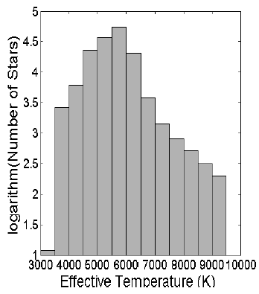
Target Selection
O-A stars: no good spectral lines
FGK stars: best Fe lines
Smallest M stars: overlapping lines (bad)
Smaller stars: larger RV signal because are less massive
Smaller stars: intrinsically fainter, worse SNR
Smaller stars spin down more slowly (bad)
Smaller stars: more common
Larger stars: more likely to host planets
Conclusion: G, K, and early M stars best
Kepler targets mostly G stars!
Kepler Targets

Slide 9
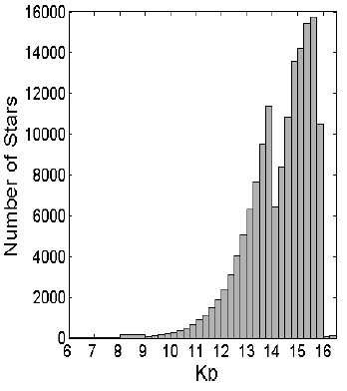
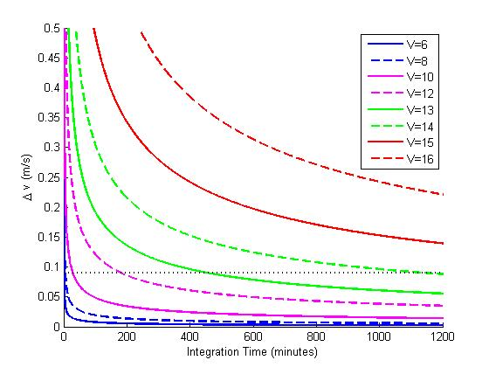
SHARPS Performance
Kepler target apparent magnitudes
K_{b} ~ V

Slide 10
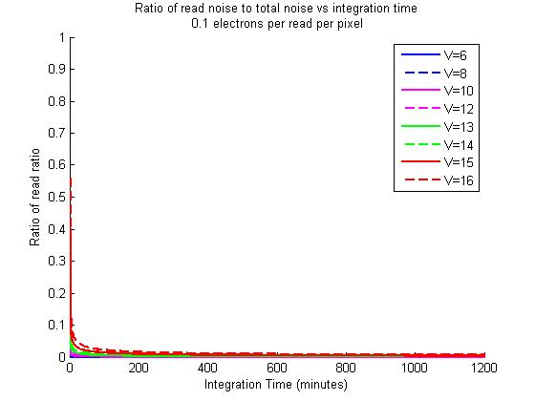
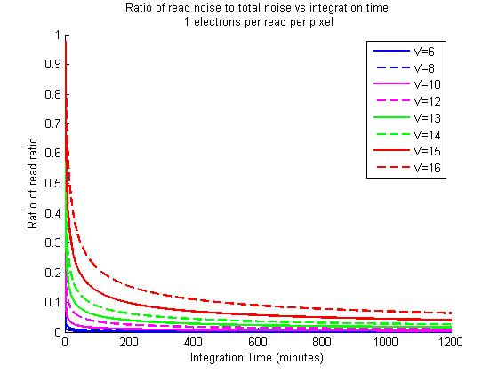
Read Noise
Read noise becomes important for Standard CCDs at around 14-16 mag, with integration times less than 1 hr
With EMCCD read noise effectively irrelevant

Slide 11
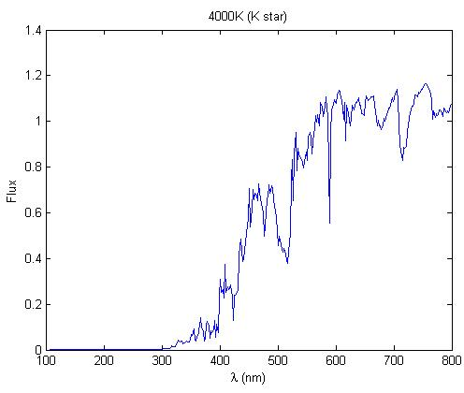
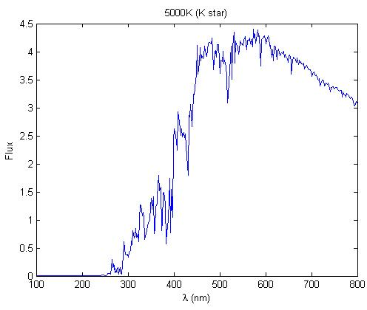
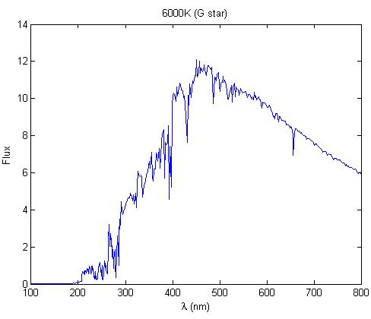
Alternative Design: UV Spectroscopy
Pros
Can’t access from ground
Density of lines increases at shorter wavelengths
Smaller λ/D diffraction limit
Cons
Engineering difficulties: special coatings, fewest possible optical surfaces (curved grating, etc.)
For best stars, flux drops off towards UV (hot stars no good)

Slide 12
Plate Scale
In order to sample the spectrum completely we want 4 pixels per FWHM.
Or pixel size is limited by what can be manufactured pix ~ 15 μm
FWHM (in meters) = λ/D * 1/P.S.
1/P.S = 1/focal length (assuming P.S is rad/m and focal length is 1/m)
This gives a final focal length of 254 m.

Slide 13
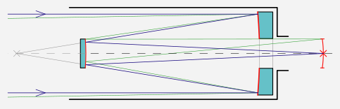
Optical Design
Effective Focal Length = 254 m
f/# = 72.6
Primary Mirror
D = 3.50, F = -40.0 m
7.59 m
Secondary Mirror
F = 28.0 m

Slide 14
Optical Design for SHARPS
Spectrograph
Single-object spectroscopy
No need for slit mask
Double fiber
One gathers signal from the object, the other spectral standard and sky background
Fabry-Perot considered but not used – good spectral resolution but poor efficiency; only practical for monochromatic light
Frequency comb to distinguish individual frequencies from a polychromatic source
Characterizes a signal in terms of its envelope and carrier frequency – can modulate a piezoelectric mirror to determine phase properties of an envelope and its carrier frequencies
Ritchey-Chretien space telescope
Minimizes spherical aberration and field curvature with hyperboloid mirror design
Diffraction-limited spectroscopy
Earth-trailing orbit: no planetary interference when taking RV measurements
Vacuum pressure – ideal for spectroscopy

Slide 15
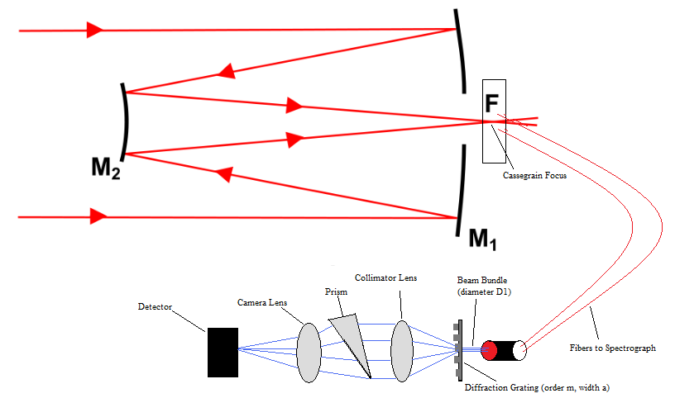

Telescope/ Spectrograph Design
Ritchey-Chretien Telescope
Narrow telescope FOV (5” - reduces aberrations)
Array located at Cassegrain Focus to relay spectra to spectrometer via fibers
-Telescope integrated with the spectrograph
-Resolving power of grating:
-Maximize resolution based on these parameters
-5” FOV, 3.5m primary diameter, focal length 254m(F/72.6 system); slow system minimizes aberrations

Slide 16
SHARPS vs. HARPS
SHARPS
HARPS
Space allows high-precision RV measurements
Follow-up of Kepler’s exoplanet discoveries
Improvements on the order of 20x-50x the resolving power of HARPS
Pressure and temperature stabililty – maintenance not crucial, don’t need a large vacuum/pressure chamber attached to the telescope
Ground-based
Cheaper, though sacrificing much resolving power (R = 115,000)
Cannot measure UV spectra
Pressure must be constantly monitored and kept stable

