Slide 1
SWIMS
A New NIR MOS Spectrograph for
TAO 6.5m Telescope
K. Motohara, M. Konishi, K. Tateuchi, N. Mitani, T. Aoki, K. Asano, M. Doi, T. Handa, K. Kawara, K. Kohno, S. Koshida, T. Minezaki,
T. Miyata, T. Nakamura, S. Sako, T. Soyano, M. Tanaka, T. Tanabe, K. Tarusawa, and Y. Yoshii

Slide 2
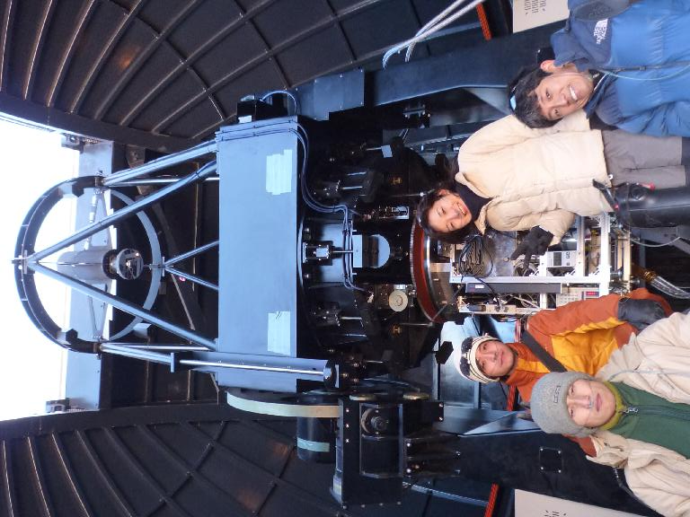
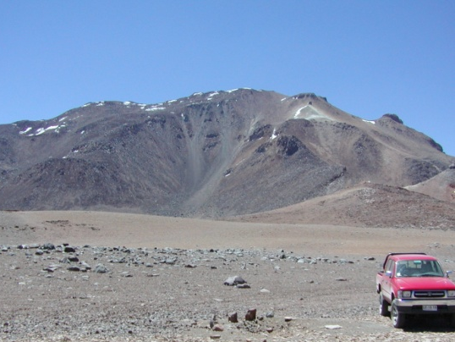
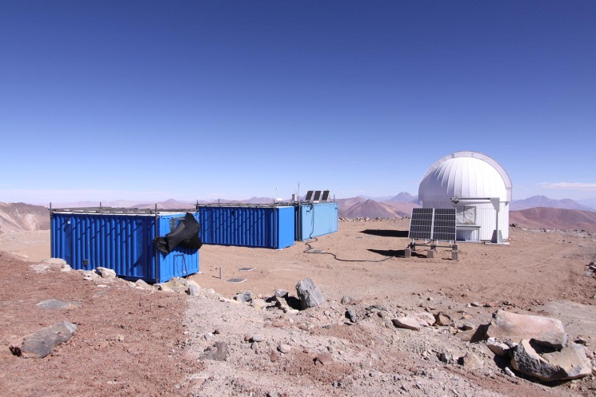
TAO
The University of Tokyo Atacama Observatory Project
Construct an infrared-optimized 6.5m telescope at the world’s highest site of 5650m(18000ft) altitude, Co. Chajnantor at Atacama desert, Chile
Current status:
  Installed a 1m telescope (called miniTAO), and started observations in the near- to mid infrared

Slide 3
Advantage of Co. Chajnantor
Photometric nights > 60%, / usable >80% (Miyata+08)
Median Seeing 0.7” @ V-band (KM+08)
High Transmittance by low pressure (<0.5atm) + dry climate <= PWV 0.5mm (25%tile) (1mm@MKO)
Atmospheric
Transmittance
Excellent observational condition in
both NIR(1-2.5mm) and MIR (5-40mm)

Slide 4
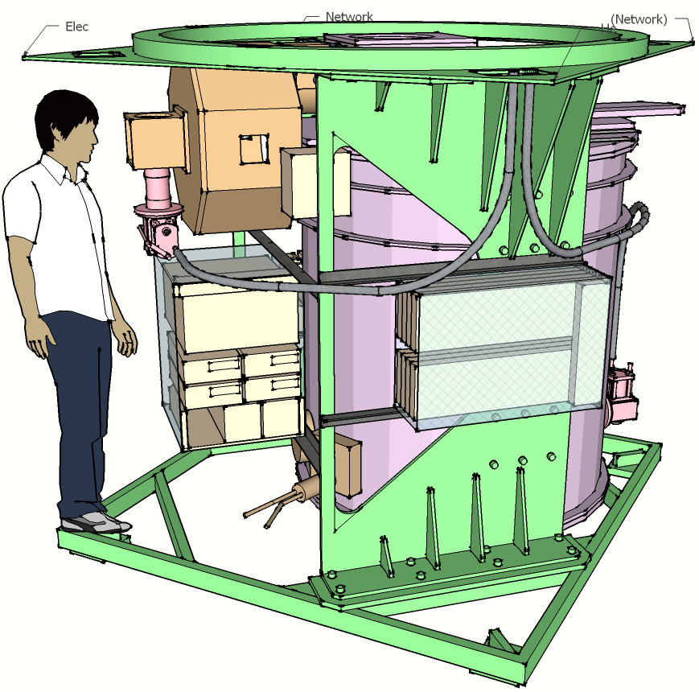
SWIMS
Simultaneous-color Wide-field Imager and
Multi-object Spectrograph
2.0m
NIR Spectrograph for TAO 6.5m
  Wide-Field (9.6’ φ FoV on TAO)
  MOS Spectrograph
  2-band simultaneous Imaging/Spectroscopy
  : 0.9-1.4 and 1.4-2.5μm
  R~1000 (4pix/0.52”slit)
Funded as a part of “Economy Stimulus Budget ”, 2009-2010

Slide 5
Science with SWIMS
Galaxy Redshift Surevey
High transmittance at TAO site
: Ideal for the redshift survey in the infrared
Full 0.9-2.5μm spectra can be obtained simultaneously
: precise continuum / line ratio measurement possible
Simultaneous Hi-z Narrow-band Imaging (e.g. Hα/OIII, Hβ/OII)

Slide 6
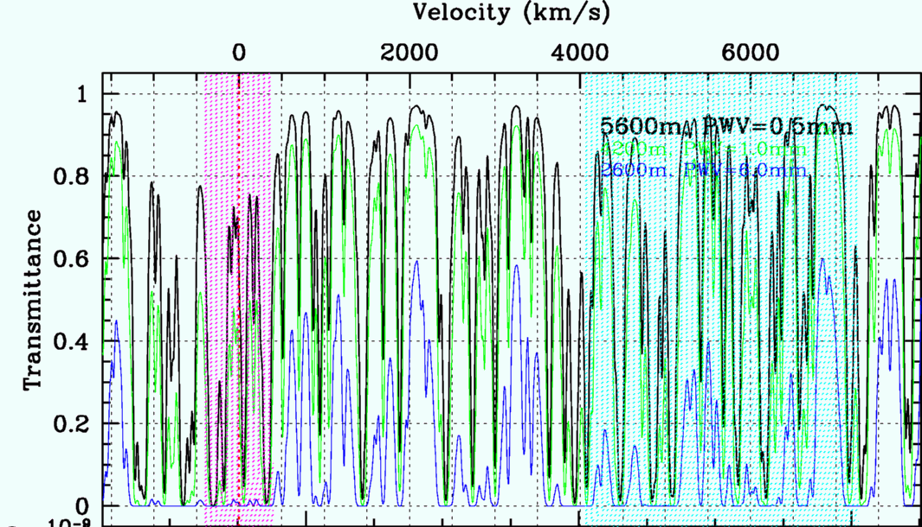
Science with SWIMS
New Window for Paα
Hydrogen Paα line (1.8751mm) available
  Strongest Hydrogen Line in NIR
  Good probe in dusty environment

Slide 7
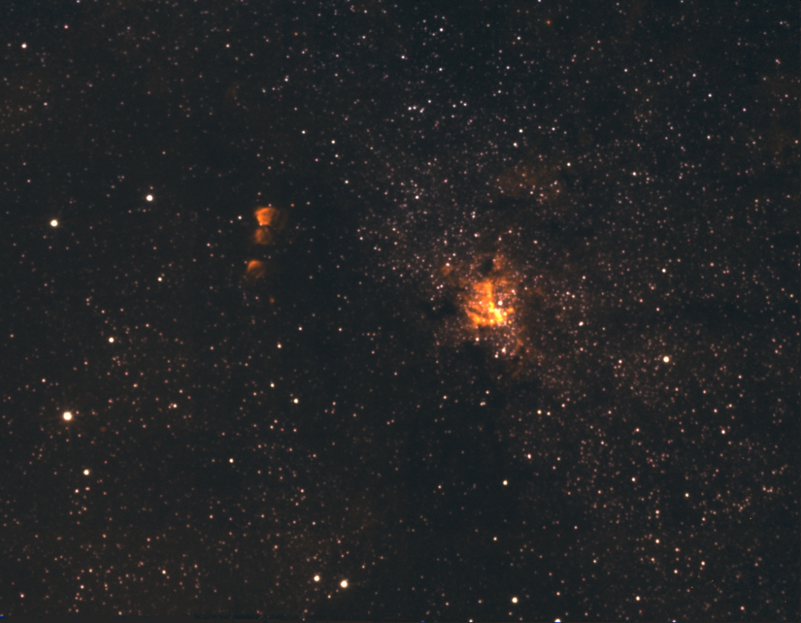
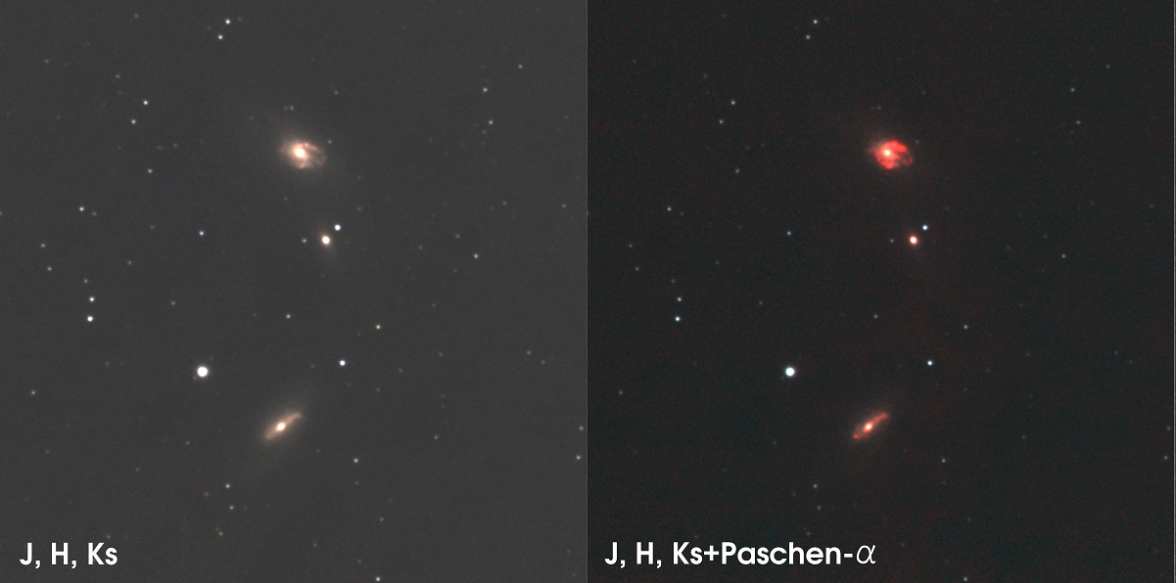
Paα Imaging with ANIR at Co. Chajnantor
Starburst Galaxies IC4686/4687
Galactic Center (Sgr A*)

Slide 8
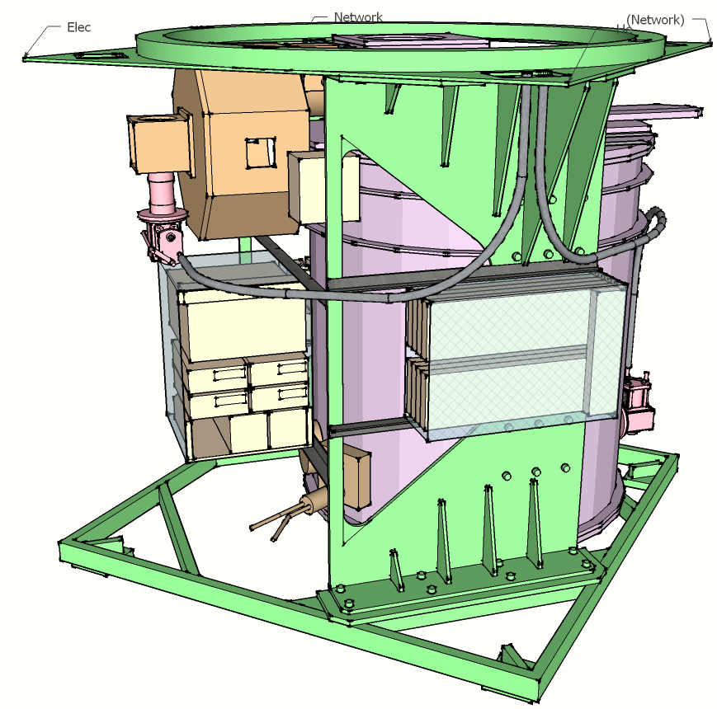
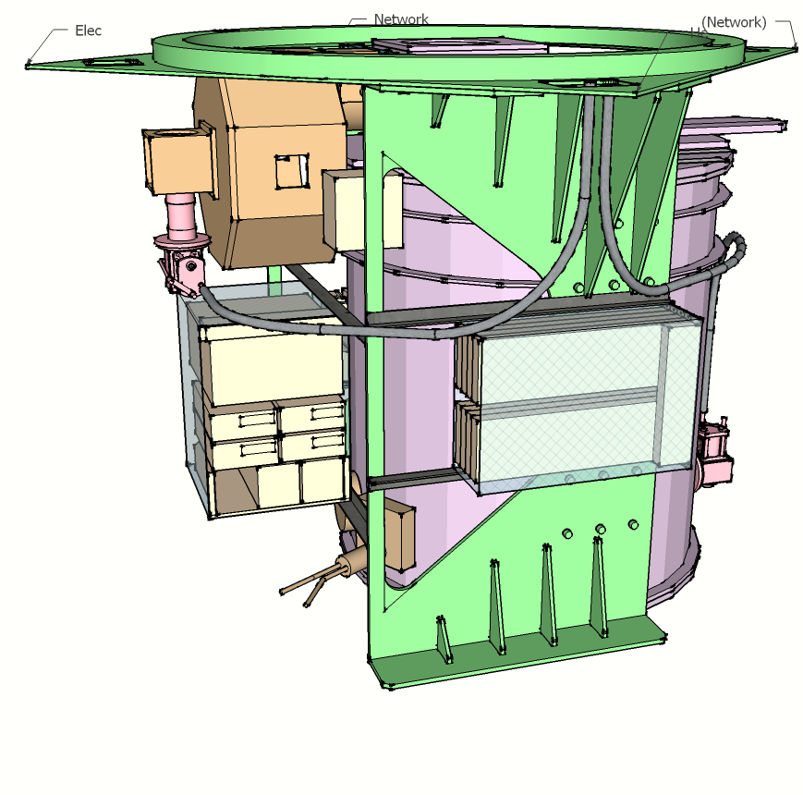
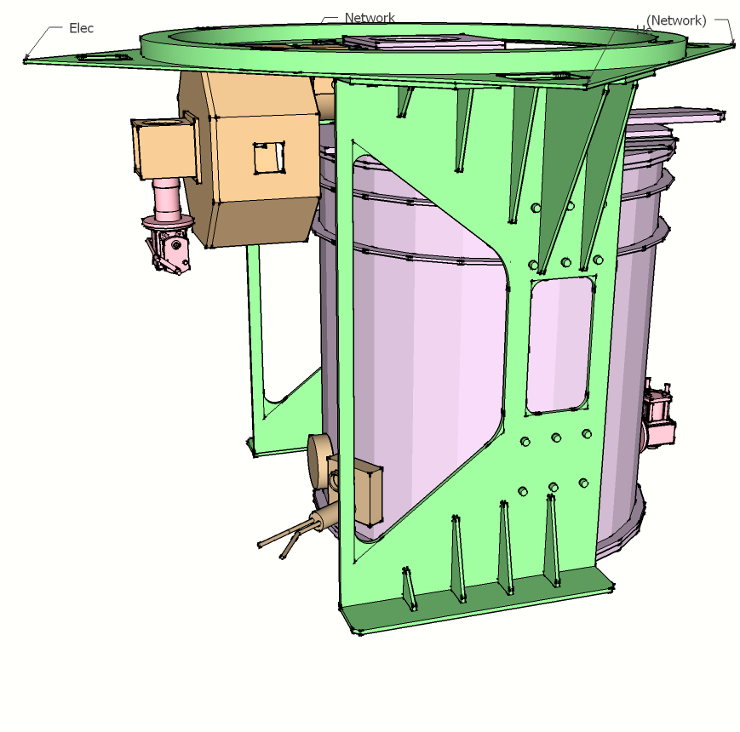
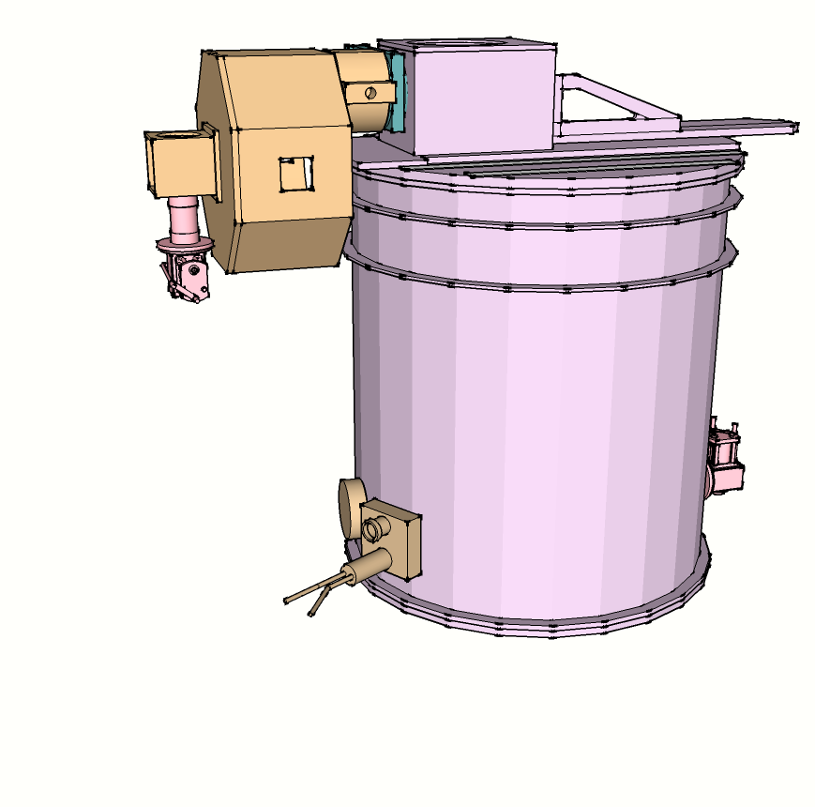
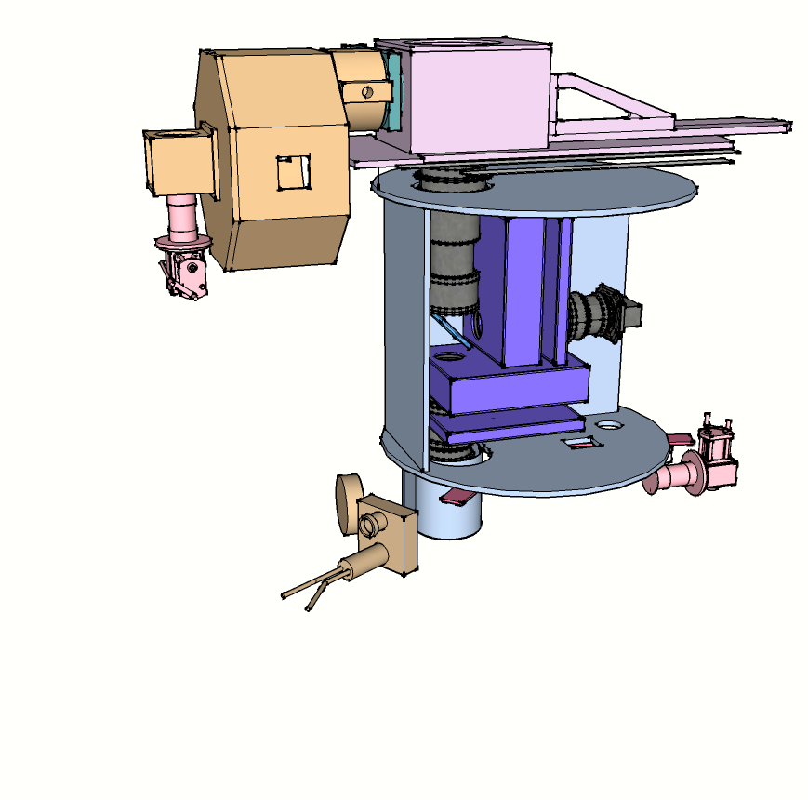
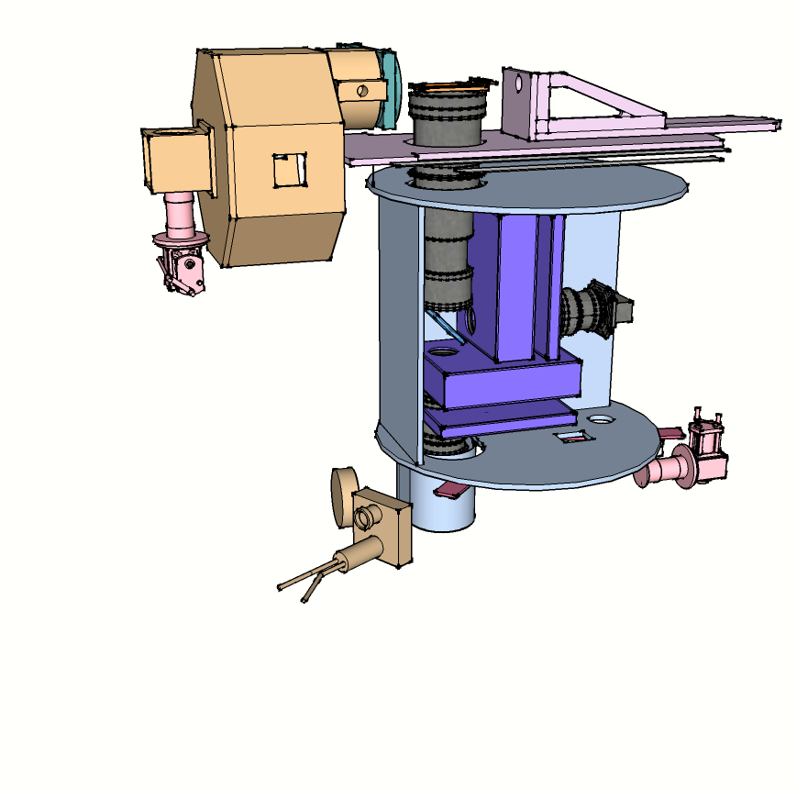
SWIMS Dewar Layout
MOS Exchanger Unit
MOS
Slit Plate
Optics
Unit
Main Dewar
Configuration on the Cassegrain Focus of
Subaru Telescope

Slide 9
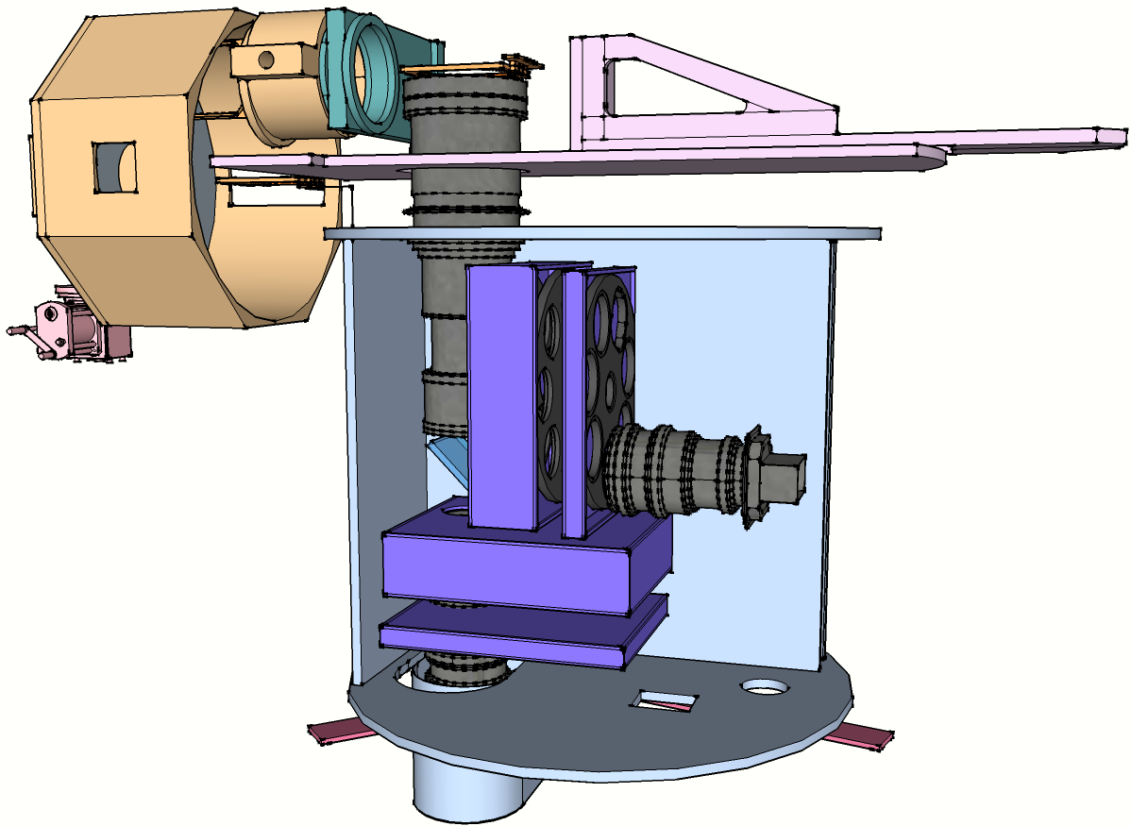
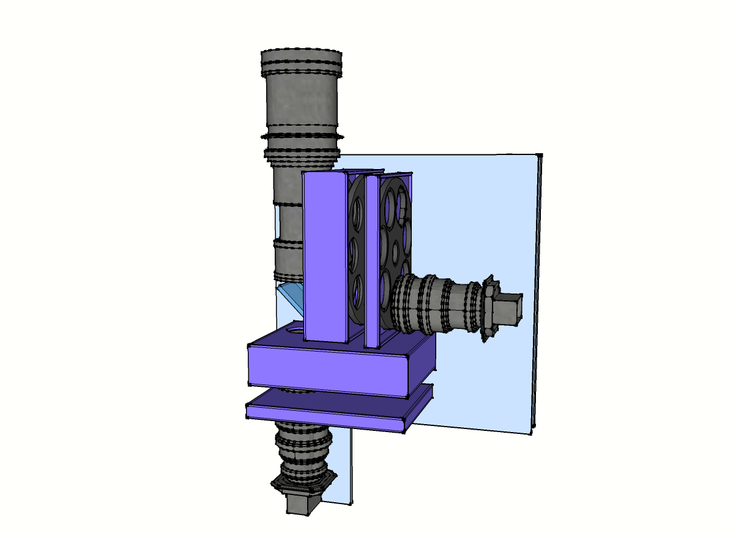
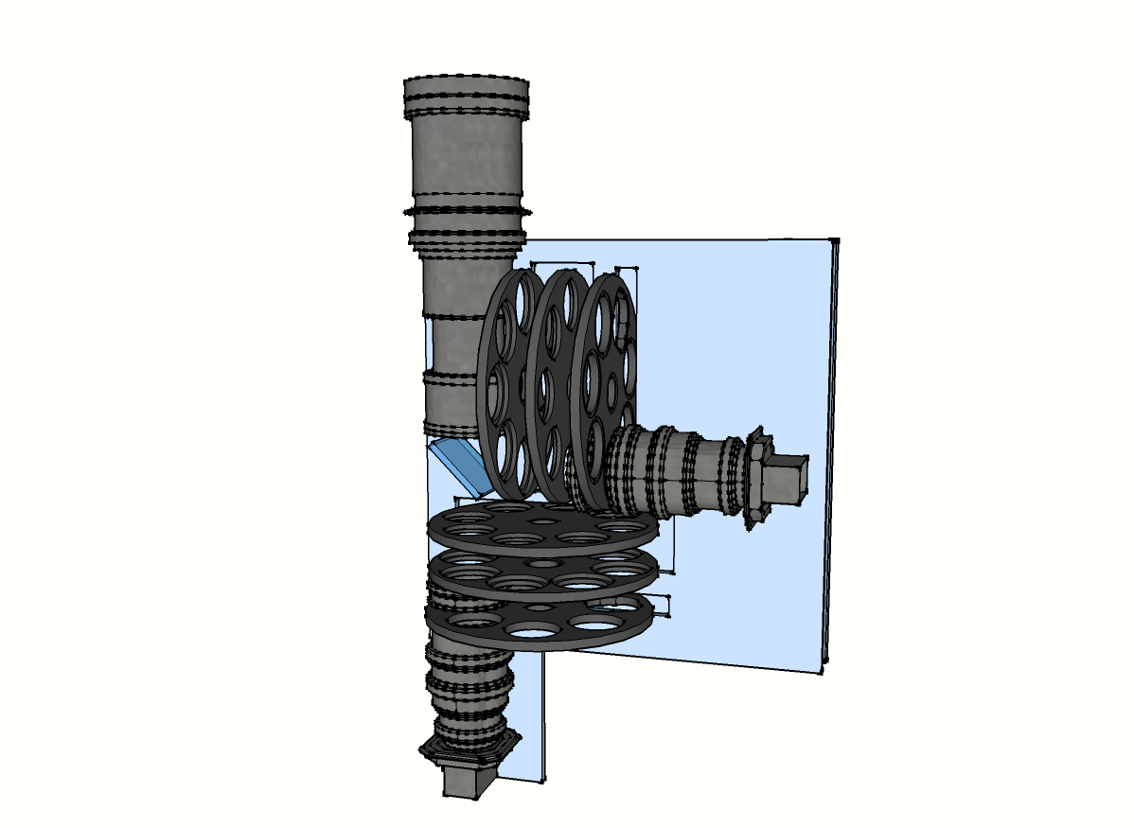
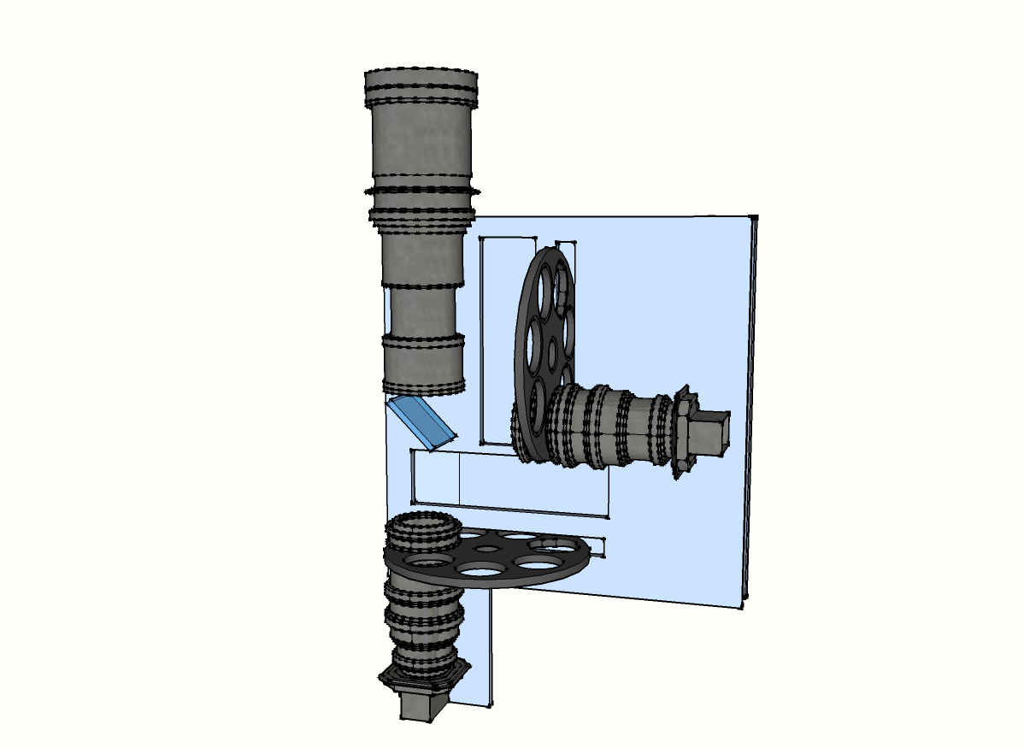
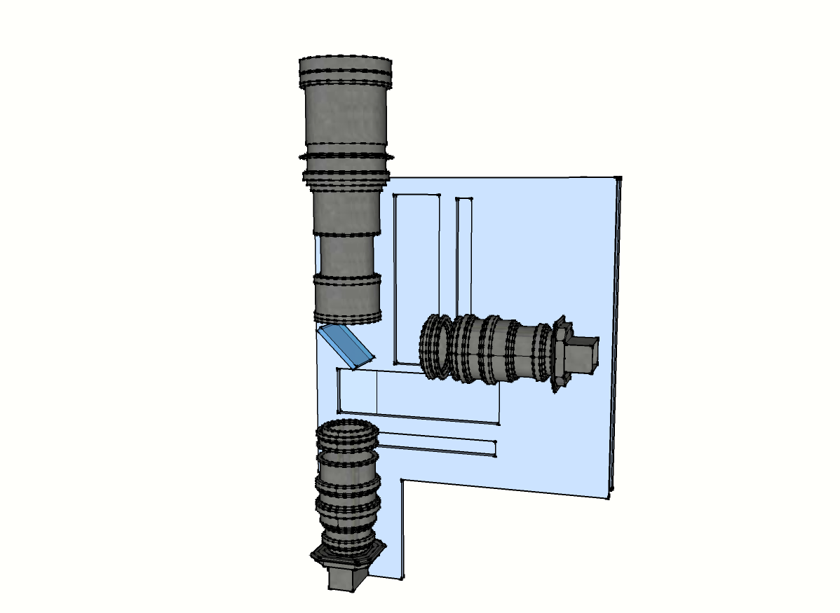
SWIMS Optics
(Design/Fabrication : Optcraft)
230mmφ
Split collimated beam using a Dichroic Mirror(DM) at 1.4mm
Final F-ratio=4.8 : 0.13”/pix
Independent filter wheels for NBFs to avoid wavelength offset
Each focal plane is covered by 2 H2RGs
NBFs are placed in
Converging light
Dichroic Mirror
Filter Wheels
For NBFs
Filter Wheels
For BBFs &
DIspersers
1600mm
Blue Channel
(λ = 0.9-1.4 μm)
6.6 x 3.3’
φ 7.2’
Red Channel
(λ = 1.4-2.5 μm)
→
Future

Slide 10
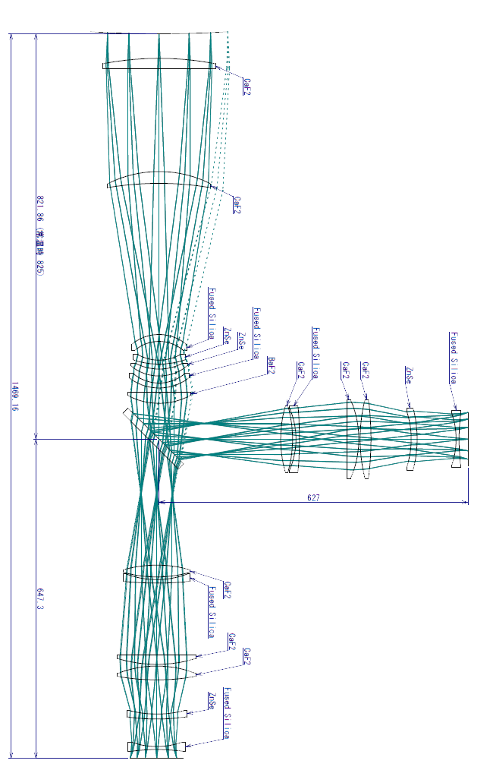
SWIMS on Subaru/Cassegrain
TAO 6.5m not available before 2016
First science with Subaru
Collimator design optimized for Subaru
(Re-optimized to TAO by changing the collimator unit)
FoV of 6.6’ x 3.3’ (MOIRCS : 7’x4’)
0.10”/pix

Slide 11
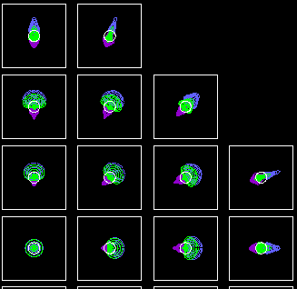
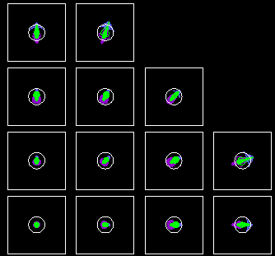
Performance of Optics
(Subaru Design)
Blue Channel
Red Channel

Slide 12
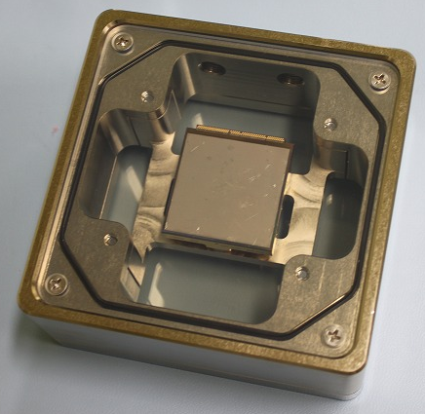
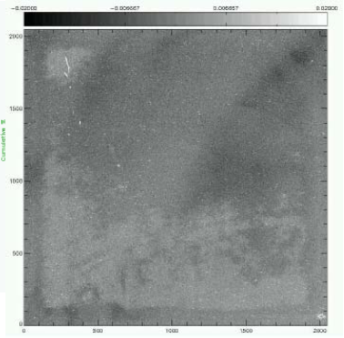
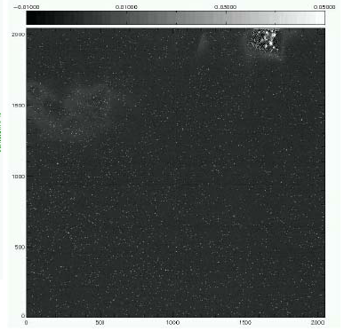
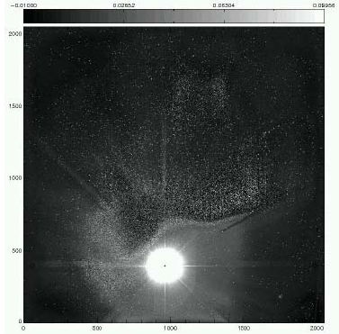
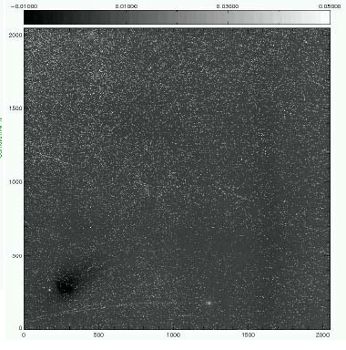
Focal Plane Arrays
8 HAWAII2 RGs / 2.5μm cutoff
=> Currently only 4 procured/delivered
SIDECAR ASICs for readout
Covers central 6.6’x3.3’ FoV@Subaru
0.1”/pix sampling
Dark Current < 0.005e-/s
#191
#196
#206
#208

Slide 13
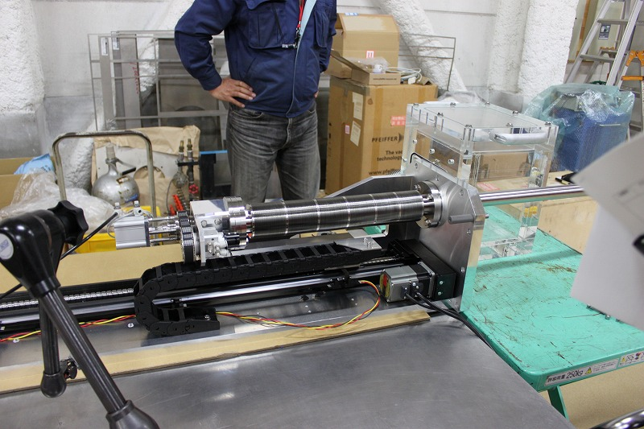
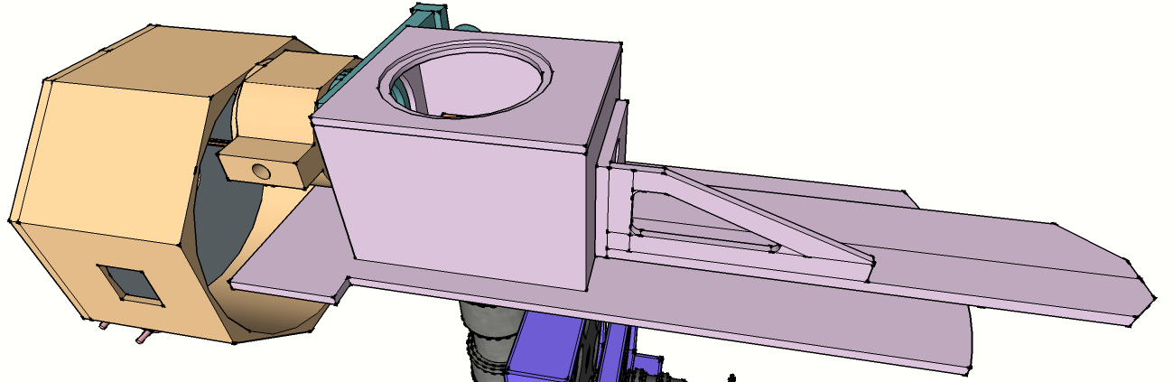
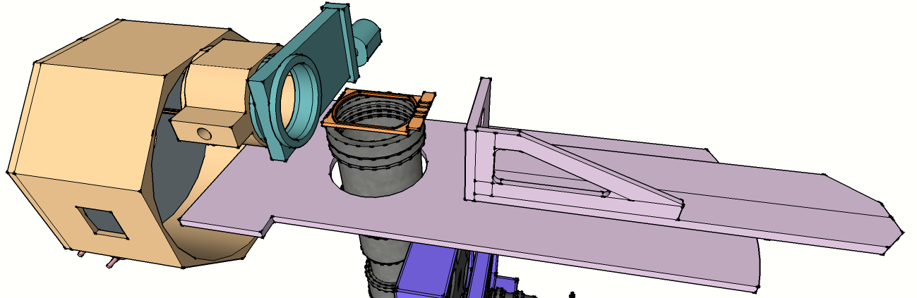
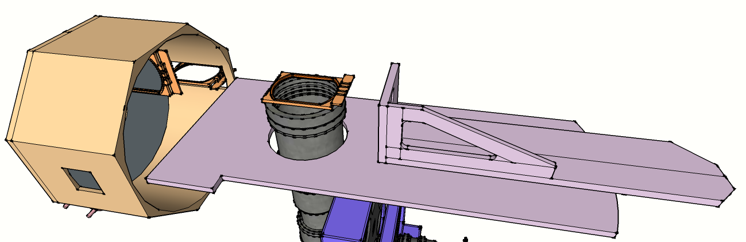
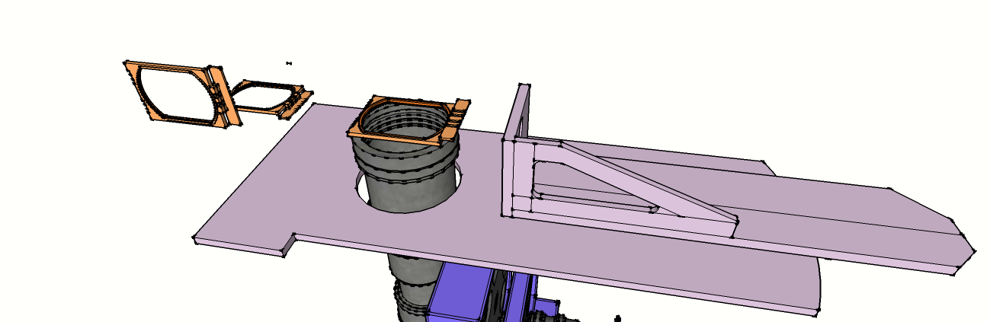
MOS Slit Plate Exchanger
(Design/Fabrication : Sentencia)
Based on the design of MOIRCS
  Turret-type mask stocker
  Robotic mask exchanger
Gate Valve
MOS Slit Masks
Mask Catcher Unit (Robo-hand)
Not Shown here
Collimator Unit
~2.3m

Slide 14
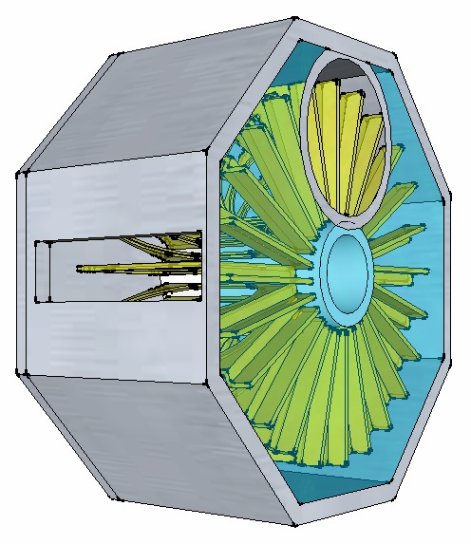
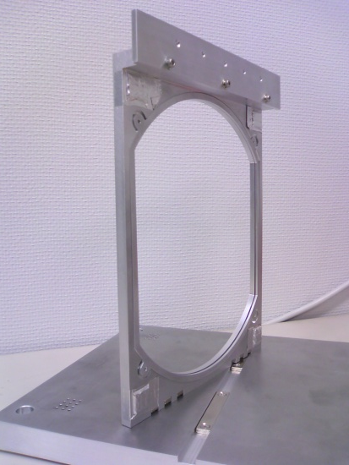
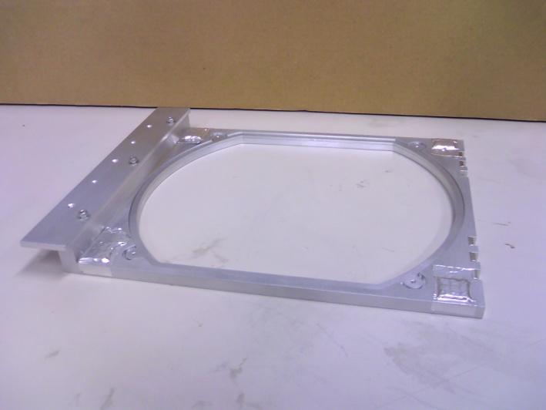
MOS Slit Unit / Holder
Maximum # of mask slit : 20
New design with high reliability
  Magnet – latch (Both at the focus and the stock)
  Operative even at the TAO Nasmyth focus
  Curved mask to adjust focal plane curvature
Neodyium Magnets
210mm
250mm
Prototype Mask Holder

Slide 15
Schedule
2010/Nov : Array #1, #2 delivery
2011/Jan : Closing design phase
2011/Jan : Array #3, #4 delivery
2011/Jan : Dichroic mirror delivery
2011/Mar : Completion of a new laboratory building
2011/Mar: Delivery of the dewar, MOS, optics componetns
2011/Q2-2012/Q2 : Assembly, adjustment, etc…
2012/Q3 or later : Transport to Subaru, setup
2013/Q1 : First Light at Subaru ?

Slide 17
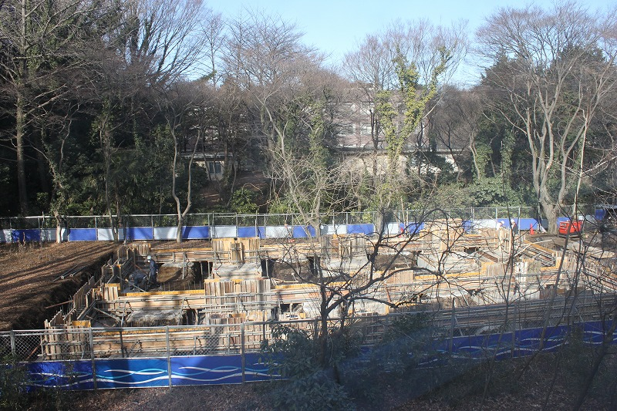
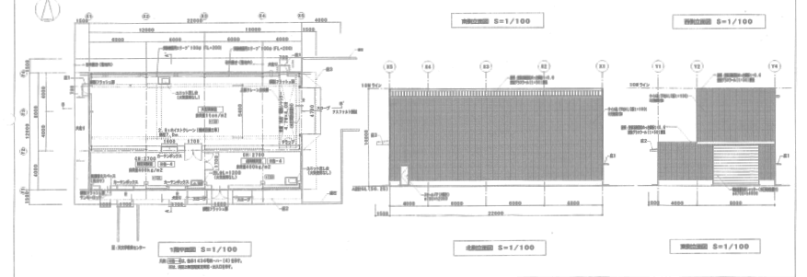
New Building at Mitaka
Wii be completed in mid-March

Slide 18
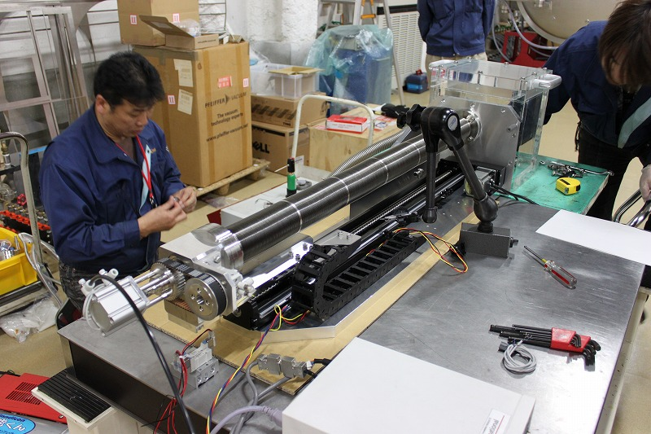
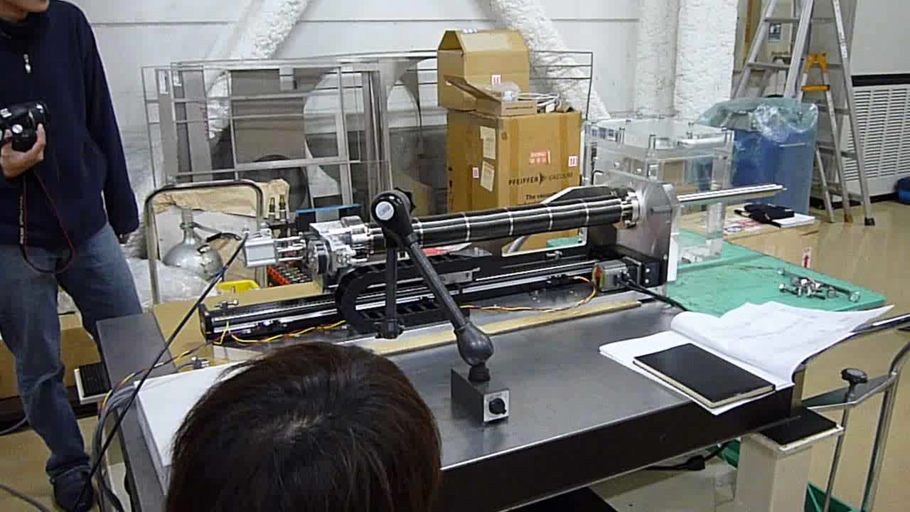
Mask Catcher Unit

Slide 19
Atmospheric Transmittance
5600m
PWV=0.5mm
4200m
PWV=1.0mm
2600m
PWV=6.0mm

Slide 20
Dichroic Mirror

