Slide 1
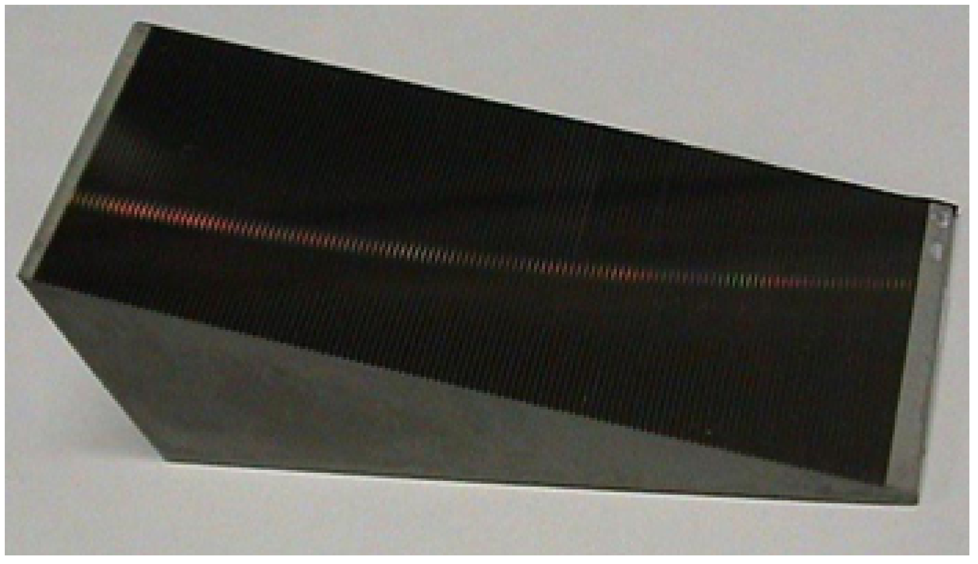
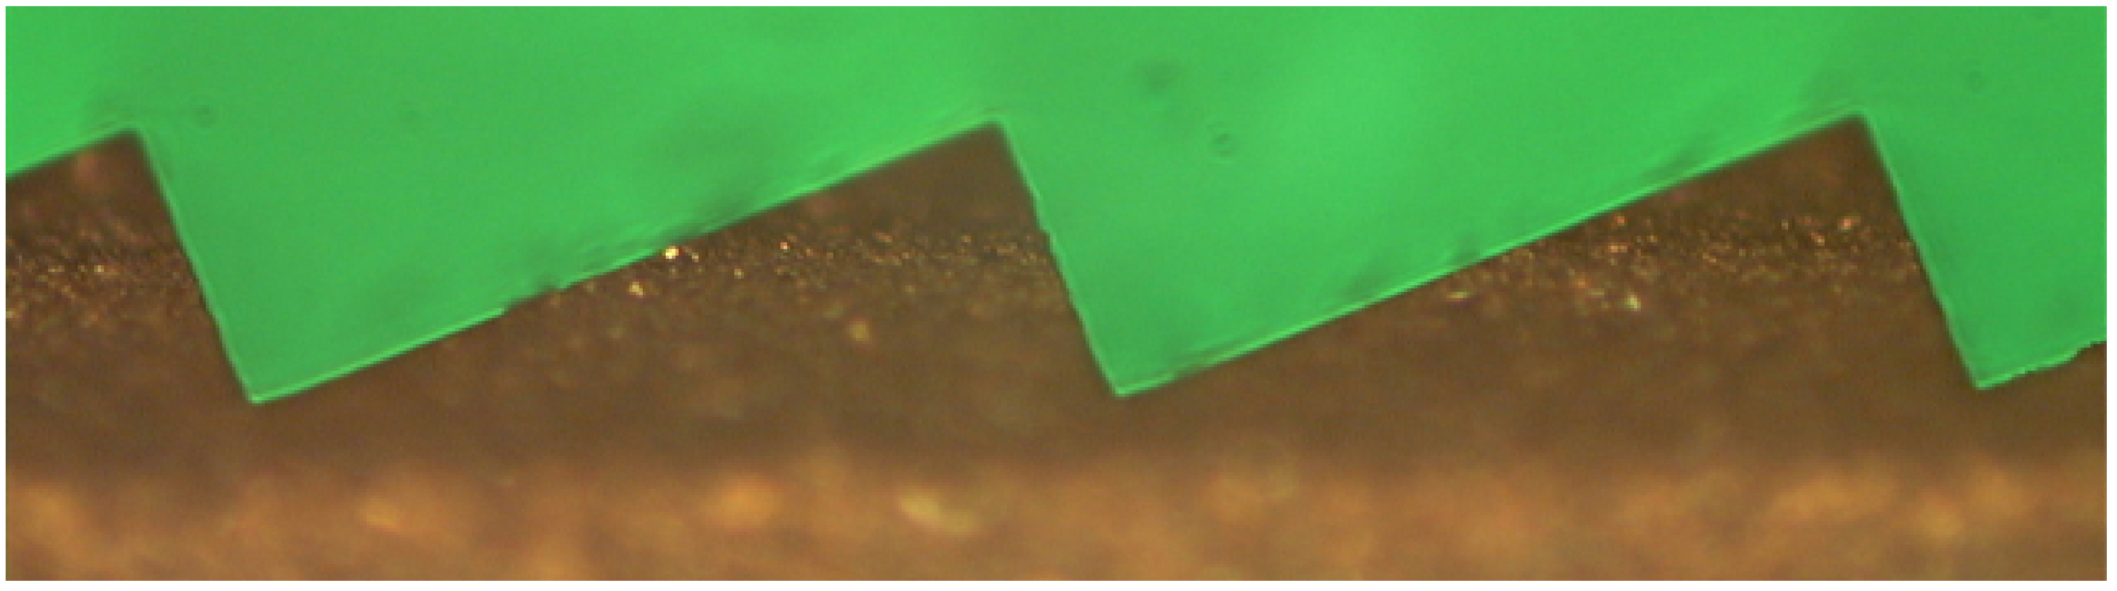
Development of the mid-IR Echelle high-dispersion spectrograph employing the germanium immersion grating
Yasuhiro Hirahara*ª, Tsuyoshi Hiraoª, Yoshio Tatamitaniª, Tomohisa Yonezuª, Noboru Ebizuka^{b}, Kentarou Kawaguchi^{c}, Hitoshi Tokoroª, Tomomichi N. Okaª
ªDepartment of Earth and Planetary Sciences, Graduate School of Environmental Studies,
Nagoya University, Nagoya 464-8602, Japan
^{b}Department of Electrical Engineering and Computer Science, Graduate School of Engineering, Nagoya University, Nagoya 464-8603, Japan
^{c}Department of Chemistry, Okayama University, Okayama 700-8530, Japan
Notes:
We have developed a germanium immersion grating mid-infrared cryogenic spectrograph (GIGMICS) designed for the Nasmyth focus stage of NAOJ Subaru 8.2 m telescope, which operates at N-band (8-13 μm) in wavelength with the R ~ 50,000. A single crystal germanium immersion echelle grating (30 ﾗ 30 ﾗ 72 mm) for collimated beam size of φ28 mm was fabricated by utilizing ultra precision micro-grinding method coupled with the ELID (ELectrolytic In-process Dressing) technique (Ohmori, H. 1992)¹. All optical components are arranged on the 800 mm diameter cold optical base plate (~30 K) of the cryostat. By the Si:As IBC (Impurity Band Conductor) focal plane array (FPA) detector (412 ﾗ 512 pixels, unit pixel size 30 μm) operated at 5 K simultaneously acquires ~13 % wavelength coverage for N-band. The instrument has been assembled and is now tested for the application to the gas-phase IR high-resolution spectroscopy.

Slide 2
Interstellar Molecules
Detected in IR
Only(≒Nonpolar)
○Simple Hydrides, inorganic species：
H₂, HF, HCl, H₂O, NH₃, C₂, O₂, CH₄, CO, CO₂, N₂O, H₂S, CS, SO₂, OCS, SiH₄, SiO, SiS, NaCl, KCl, AlCl, AlF, PN, HCP
○molecules in cyclic (AROMATIC) form：
c-C₃H, c-C₃H₂, c-(CH₂)₂O, c-C₃H₂O(cycloprpenone), C₆H₆ (benzene), c- SiC₂, c- SiC_{3,}
○”Cyanopollynes, polyacetylenes and related “LINEAR Carbon chains”：
C₃, C₅, C₃O, C₃S, C₃O, C₃S, H₂C₃, H₂C₄, H₂C₆, C₂H₂, HC₄H(diacetylene）, HC₆H(triacetylene), C₂H₄, C₄Si, HCN, HNC, HC₃N, HNCCC, HCCNC, HC₅N, HC₇N, HC₉N, HC₁₁N, CH₃CN, CH₃NC, CH₃CH₂CN, CH₃C₃N, CH₃C₅N, CH₃CCH, CH₃C₄H, CH₃C₆H, C₂H₅CN, C₂H₃CN, C₂H₅CN
○Ions：
H₃⁺, CH+(OPT), CO⁺, SO⁺, CF⁺, HCO⁺, HOC⁺, HN₂⁺, HCS⁺, H₃O⁺, H₂COH⁺, HOCO⁺, HCNH⁺, HC₃NH⁺, C₄H⁻, C₆H⁻, C₈H⁻, C₃N⁻, C₅N⁻
○Radicals：
CH, CH₂, CH₃, OH, NH, NH₂, SH, HNO, SO, NS, NO, SiC, SiN, NaCN, MgCN, MgNC, AlNC, SiCN, SiNC, NH₂CH, HCO, CCH, C₃H, C₄H, C₅H, C₆H, C₇H, C₈H, CN, C₃N, C₅N, H₂CN, HCCN, HC₄N, CH₂CN, CCO, CCS, CP, PO
○Aldehydes, Alchoholes, Ethers, Ketons, Amides and related species(“Pre-Biotic” molecules)：H₂CO, H₂CS, CH₃CHO, HNCO, HNCS, NH₂CHO, HC₂CHO, CH₂OHCHO, CH₃OH, C₂H₅OH, CH₂CHOH, CH₃SH, (CH₃)₂O, (CH₃)₂CO, HCOOH, HCOOCH₃, CH₃COOH, H₂CCO, CH₂CCHCN, CH₂NH, CH₃NH₂, NH₂CN, CH₃CONH₂
C_{60,} C₇₀
(Spitzer)
, H₂O⁺, H₃O⁺, OH⁺, SH⁺, H₂Cl⁺(Herschel)
Few IR “line survey” in IR, “No” laboratory IR data
Orion KL, 4-25 μm, IRTF (3.0 m) & IRSHELL (Evans et al. 1991)
IRC+10216, 8-13 μmKitt Peak Mayall telescope (3.8 m) & FTS (Keady & Ridgway 1993, Boyle et al. 1994)

Slide 3
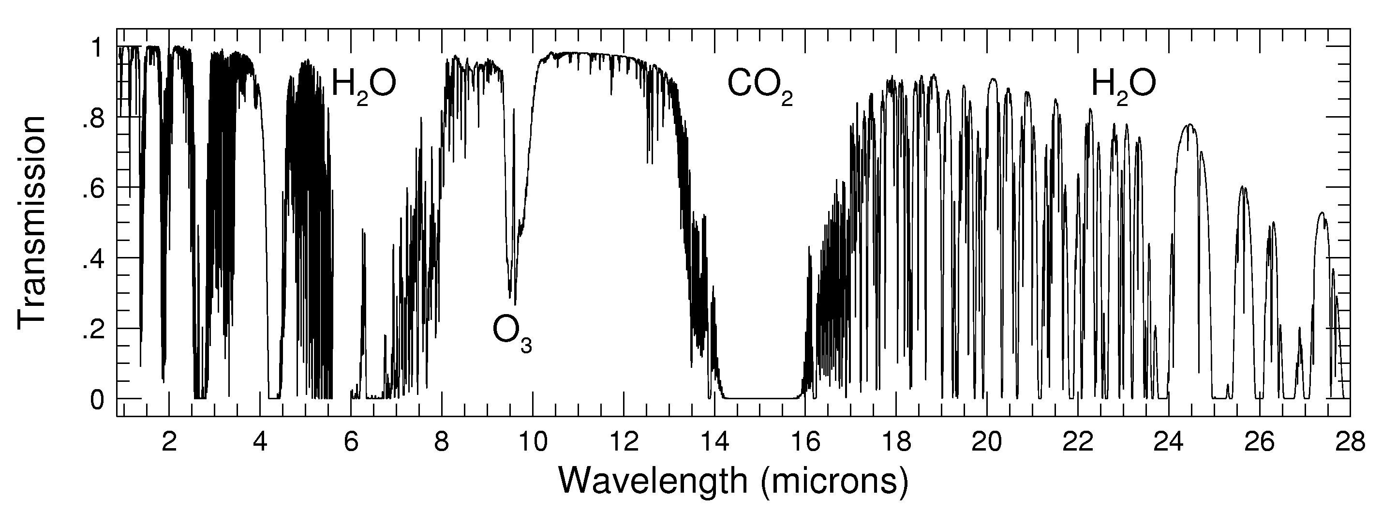
Science in N-Band
Atmospheric Opacity
N-Band 7.5 ~ 13.5 μm
“All molecules have Vibrational transition”
CH₄, C₂H₆ , …, Carbon Chain, “PAH”s
(SiO)_{x} ….
Chemistry Related to Star Formation
“Fingerprint” region for Complex Organic molecules: ν=2π√(k/μ), k: force constant
Notes:
How important 10 micron region is!
Fingerprint region.
Higher resolution, more informative.

Slide 4
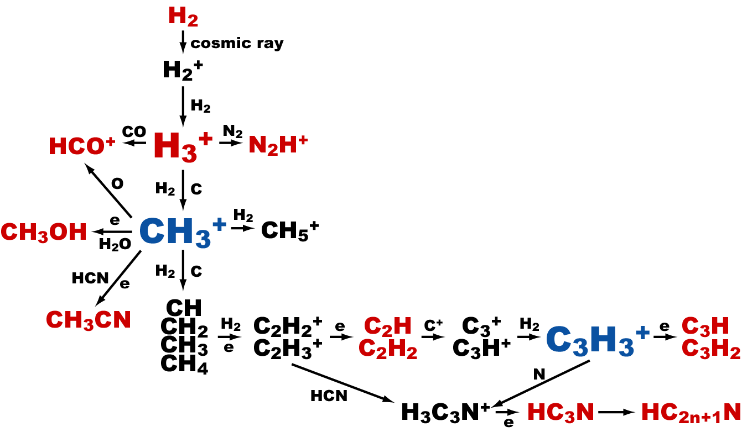
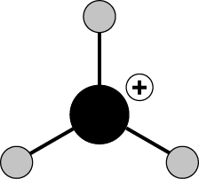
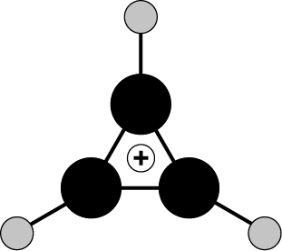
Ion molecule reaction network for Carbon
Key ions:
H₃⁺, CH₃⁺
C₃H₃⁺: “Smallest Aromatic ion”: n(π e⁻)=2

Slide 5
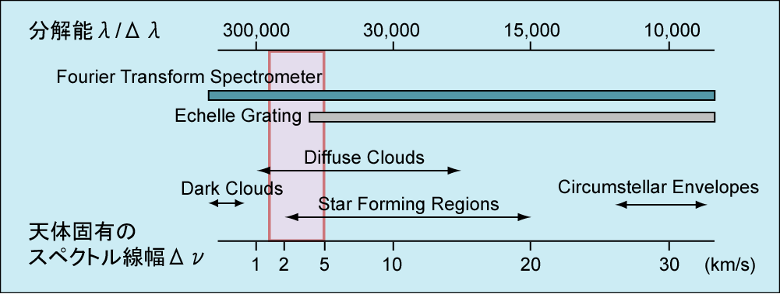
Required Spectral Resolution
“Rotationally resolved” vibration spectrum is useful for
○definite identification of a “new” molecule
○accurate derivation of abundances and excitation
○the understanding the “chemistry”=formation pathways
R=10,000-200,000

Slide 6
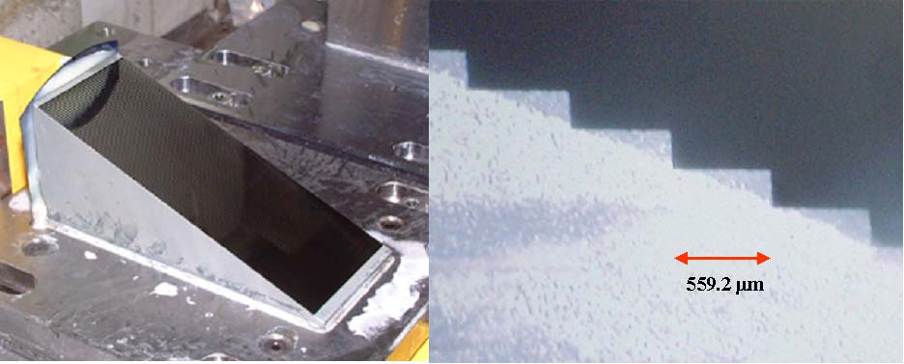
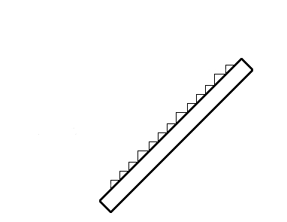
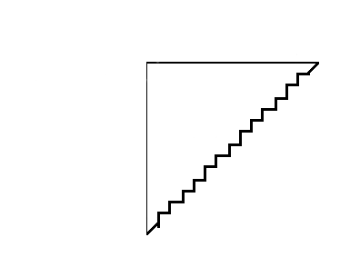
Germanium Immersion Grating
Resolving Power, R = λ/Δλ = ΔL/λ = 2L/λ
Resolving Power, R = λ/Δλ = ΔL/λ = 2nL/λ (n ~ 4 for Ge)
→ Compact Cryogenic Optics
L
L
L
n
n
ΔL=2L
ΔL=2nL
Conventional Grating
Immersion Grating
Grooves on the Ge Surface : Fabricated by RIKEN’s ELID (ELectrolytic In process Dressing) Micro-machining Method (Ebizuka et al., 2003)
30 mm
N = 130 grooves
Surface Roughness:
~3 nm
R~51,000 @ 10μm
For 25mm beam diameter
30 mm
β= 68.75º
m=0.6 mm
72 mm
Notes:
The key device for our new spectrometer is the Ge immersion grating, which is directly grooved onto the surface of wedge shape of single crystal Ge which is transparent but highly refractive material. In comparison with the conventional grating, the effective path-difference delta f increases by factor of the reflactive index n, so that the size of the grating becomes compact. making fine and precisely periodical grooves on the hard and fragile Ge surface is overcome by the great effort of Dr, Ebizuka and Prof. Ohmori’s group, by adopting their unique machining technique ELID - Electrolytic In-process dressing micro machining method. As Size dimension is shown here, this precious devices is used for our cryogenically cooled echelle grating with very high diffraction order.

Slide 7
Optical design of GIGMICS
Slit width 0.612 arcsec (0.488 mm) at R = 50,000, F/12.5
Echelle grating Ge immersion grating
Groove interval : 0.6 mm
Blaze angle : 68.75 deg.
Order : 344-560
Cross Disperser Short wavelength (7.5-10 μm)
Groove constant : 100 grooves/mm Blaze angle : 26.7 deg. Long wavelength (10-13.5 μm)
Groove constant : 61.97 grooves/mm Blaze angle : 18.1 deg.
･ Collimator Al spherical mirror Focal length : 500 mm (F/20)
･ Camera Ge and ZnSe lenses Focal length : 192.5 mm (F/7.7)
･ Detectors 512 x 412 Si:As IBC (Spectrograph) 5K cooled
256 x 256 InSb (Slit viewer) 30K cooled
(Cryostat x 2, for 5K, 30K for optics, 70K for Radiation shield)
･Cryogenic actuators 4 (Filter Slit, Cross disperser, Focus)
Notes:
I will breafly show you the optical layout, which is a basic lithorow type . 2 detector are mounted on the disk of 80cm diameter, one for imagingm and the other for taking echelle format. The slit, immersion grating. Repetively turn down

Slide 8
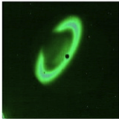
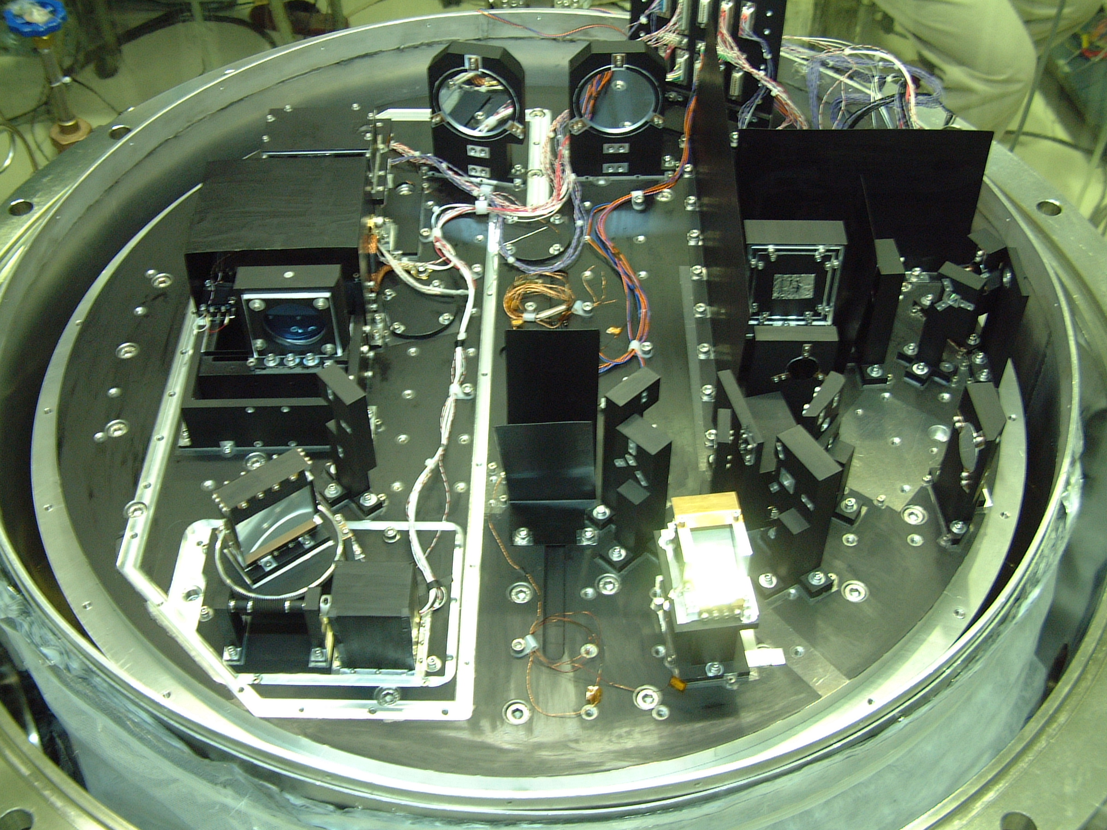
Optical layout of GIGMICS
＊Before mounting filter and slit turrets
K-band image of Saturn
Collimators (F/20, φ80)
Si:As
512*412 pixel, 6 K
InSb (Slit Viewer)
256*256 pixel
SP-optics
Fore-optics
Camera Lens (F/7.7)
Mitaka 1.5mφ, F/12.5
(Subaru simulator)
Cross Disperser
Slit Mirror (0.488 mm)
Cryostat: φ800, 30 K
Immersion Grating
Notes:
This picture shows the optical setup of GIGMICS, consisting of fore-optics and spectrograph optics, described in detail.
1.1 Fore-optics
Light entering the cryostat at f nunmber/12.5 through the window is collimated by the first spherical mirror (SM₁). Through the cold Lyot stop and the BaF₂ blocker (F₁).
The second spherical mirror (SM₂) reimages the telescope’s focal plane at f/20 onto the slit mirror,
to reflect a 8arcsec beam on an 8m telescope field of view into the slit viewer shown here,
used to guide on an astronomical object at the slit. here is illustrated the result of K-band image of saturn.
In this region, filter and lens turret is mounted, although not shown in this picture. Moreover, this slit mirror module has now been replaced with slit turret. Note that the slit size is appropriate for the point source diffraction limit for the telescope for10 micron.
==MOTION==
1.2 Spectrograph optics
The Light passing through the slit enters into the Littrow-mount echelle spectrograph.
The light reflects off the flat fold mirror through the long pass filter, which cuts on at sevenpoint five 7.5 μm,
and then expands at f/20 to the spherical mirror here (SM₃).
The mirror collimates the light, creating a 25 mm diameter beam on the Germanium immersion grating (IG).
The dispersed light returns to SM₃,
and then go to the second spherical collimating mirror (SM₄),
which reflects it to the cross-disperser (CD) mounted on the
cryogenic rotational stage driven by the worm gear mechanism.
The cross dispersed light is reflected to the spectrograph detector here,
through the Ge - ZnSe achromatic doublet lens (L₃+L₄).
The lenses is mounted on the flex stage shown here for focus adjustment.
The focal reducer changes the beam to f/7.7,
to satisfy the Nyquist sampling condition on the detector for the diffraction pattern.
==END==
It is used in very high order, ranging from 332 at 13.5 μm to 597 at 7.5 μm.
The groove facets are tilted 0.69ｰ relative to the incident aperture of the immersion grating to eliminate the ghosts caused by reflection from the incident aperture.
The camera lens images the focal plane at 1.15 : 1 demagnification onto D₁.
The ZnSe collimating lens (L₂) between the Lyot stop and the second collimating mirror allows the slit viewer to be used for Lyot stop viewer.
The Lyot stop viewer is useful for alignment with the telescope optics. A set of the collimating lens (L₂)
and the second collimating mirror (SM₂) forms images of the Lyot stop and the pupil onto the slit with a scale increase of 1 to 1.06.
The camera lens of the slit viewer transfers these images,
( It is composed of the ZnSe camera lens, the long pass filter, which cuts on at 2.75 μm, and the detector, 256 ﾗ 256, 30 μm/pixel InSb FPA detector (D₁). The collimating lens is mounted on the lens turret (LT), so as to remove from the optical pass during spectroscopic observations.)

Slide 9
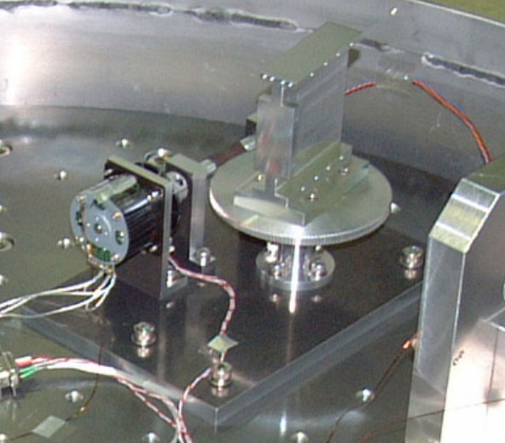
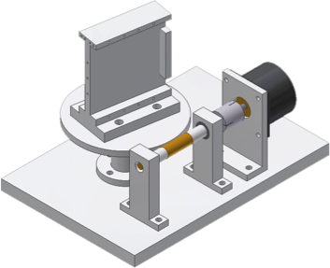
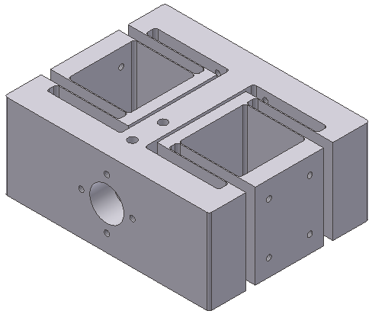
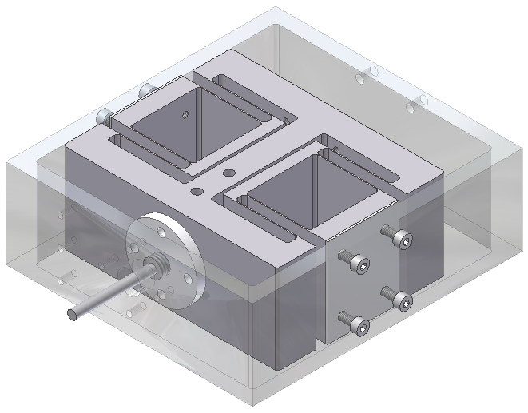
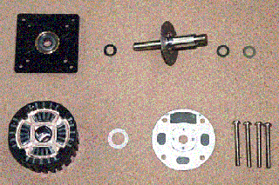
Motions(1): Focus adjuster & Crossdisperser stage
Commercial stepper motors (Escap P 430-258-005), bearings of which are replaced with MoS2 sputtering bearings of NTN Corp.
(Z-Lab, Nagoya Univ.)
Cross Disperser
Focal lens mount stage:+/- 1.0 mm, Resol. 0.01 mm
Flexture stage with parallel spring
Bending of YH75 (t=0.5 mm)
Spur gear

Slide 10
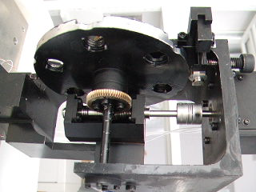
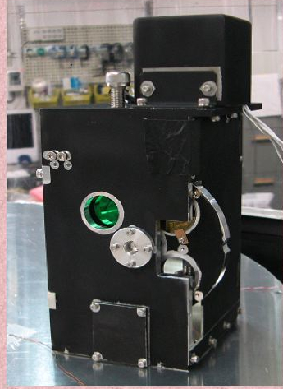
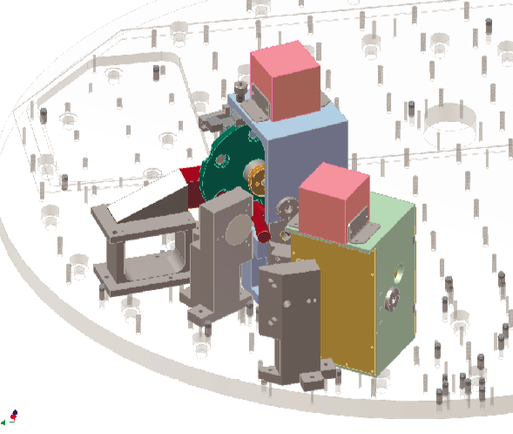
Motions(2): Filter Turret & Slit Turret

Slide 11
Echelle Spectral Formats

Slide 12
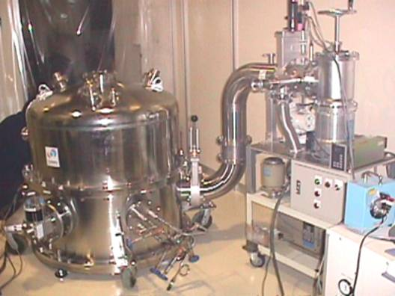
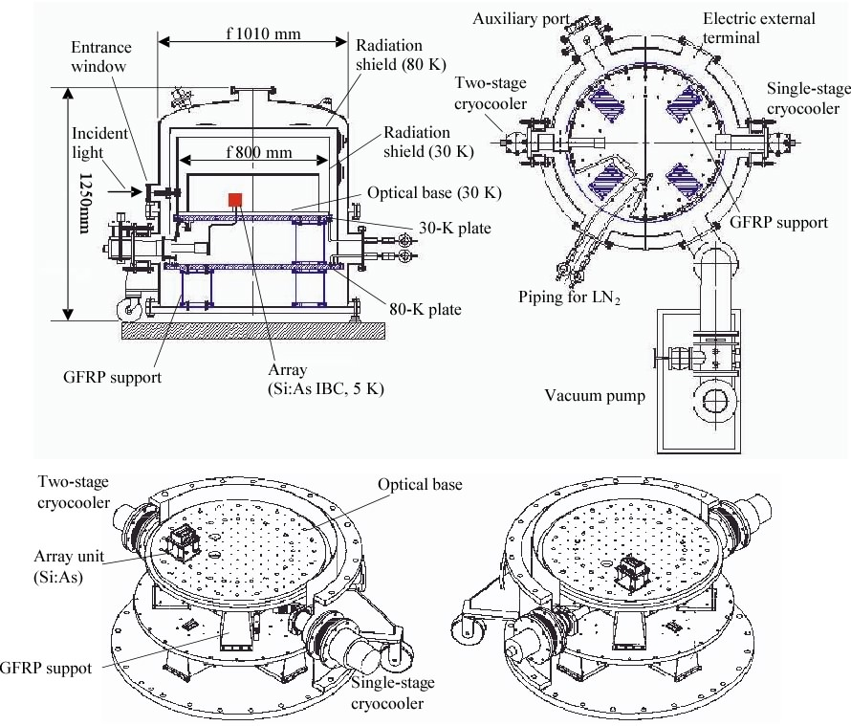
Cryostat
2 Cryocoolers
Outer radiation shield: ~70K
Inner radiation shield,
Optics on 800mmφStage,
& Slit viewer(InSb FPA detector)
: 3０K
Si:As BIB FPA detectpr: 5~7K
Notes:
GIGMICS has a 30 K cooled inner optical chamber surrounded by an outer chamber that is cooled down to 80 K, all contained in a large vacuum jacket (Fig. 4). The vacuum jacket weighting about 1,000 kg consists of a cylinder-shaped base section onto which a large O-ring sealed covers are bolted. The base section and the cover are made of stainless steel (SUS 304). The external dimensions of the vacuum jacket are 1010 mm diameter ﾗ 1250 mm height. The G10 fiberglass supports are used to separate the outer chamber from the vacuum jacket wall and the inner optical chamber from the outer chamber. The outer chamber is wrapped with twentyfold layered aluminized Mylar sheets to reduce the radiation from the inner wall of the vacuum jacket.
GIGMICS is equipped with two closed cooling systems. A two-stage cryocooler (RDK-408D: Sumitomo Heavy Industry Ltd.) cools the optical chamber and a Si:As IBC FPA detector down to 30 K and 4 K, respectively. The first stage has a rated cooling of 37 W at 40 K, and the second stage has a rated cooling of 1.0 W at 4.2 K. A single-stage cryocooler (TZ-65: Daikin Co.) with a capacity of 60 W at 80 K cools the outer chamber down to 80 K. At the beginning of cooling, the cooling speed is boosted by pouring LN2 into pipes attached to base plates of both chambers.
In order to minimize the deviation of optical axis caused by the difference of thermal contraction, the optical base plate and most of optical components were fabricated from the A6061 aluminum alloy.

Slide 13
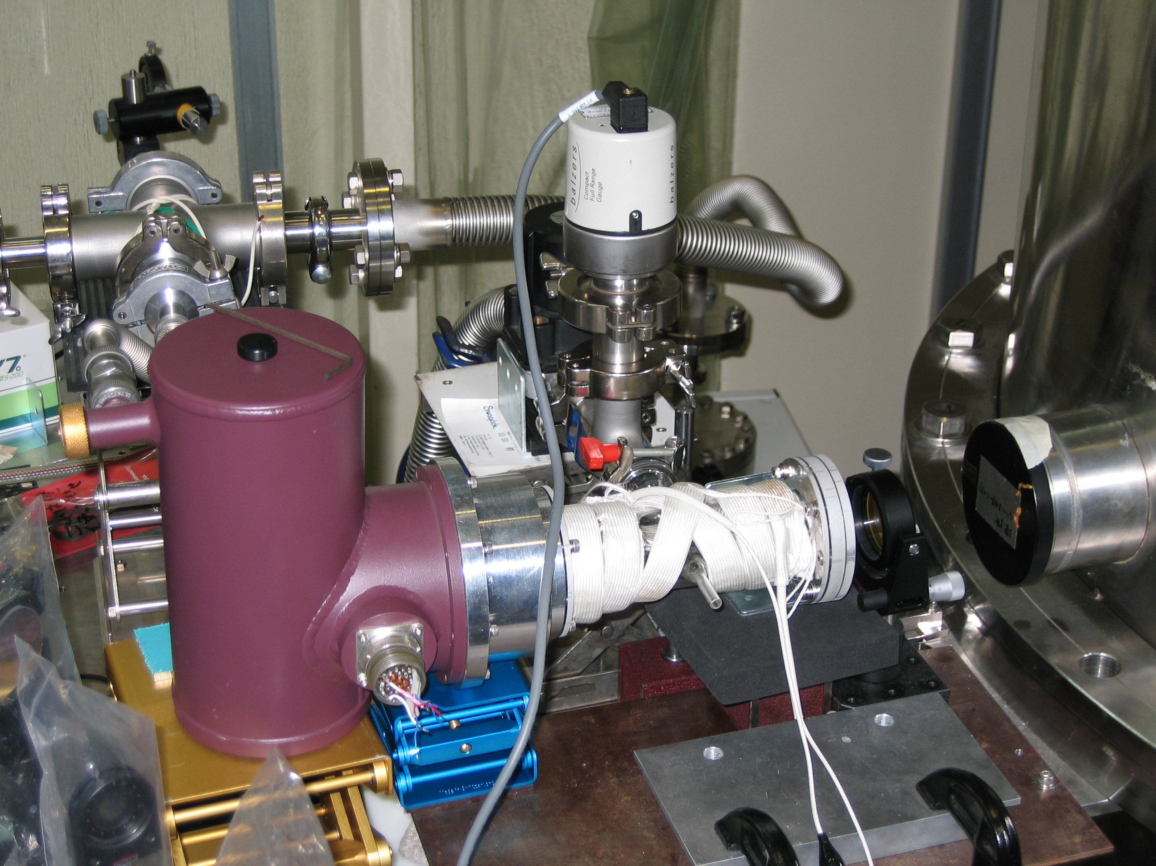
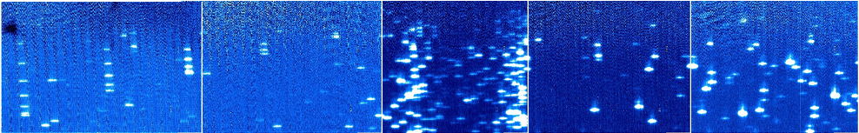
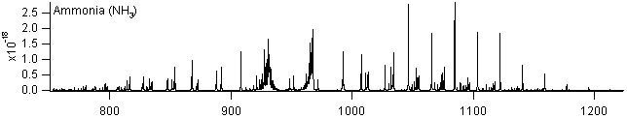
Echellegram of NH₃ in Emission at 370 K
By Rotating Cross Disperser(s), Observable Spectral Region between 7.5 μm and 13.5 μm Can Be Selected.
820 cm⁻¹ (12.2 μm)
1,100 cm⁻¹ (9.1 μm)
Liq. N₂ Cryostat (110 K) Background Reducer
ν₂ (inversion)

Slide 14
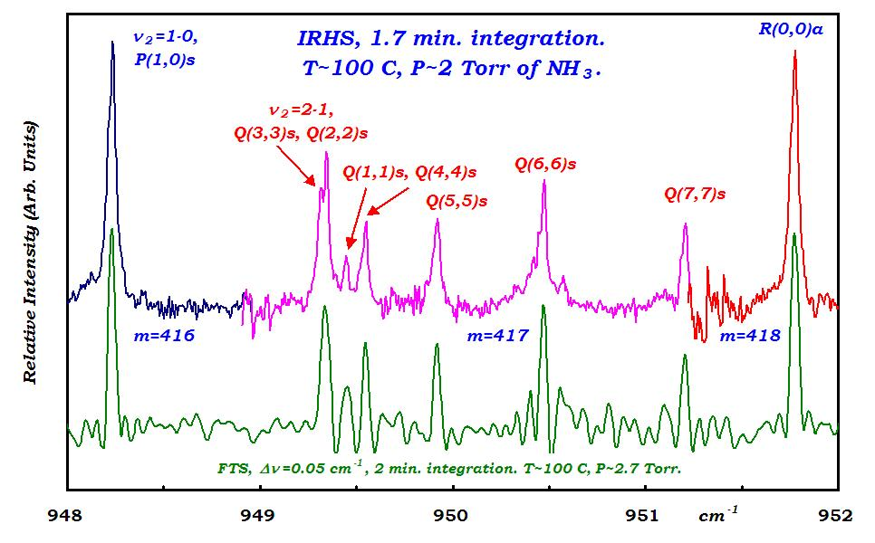
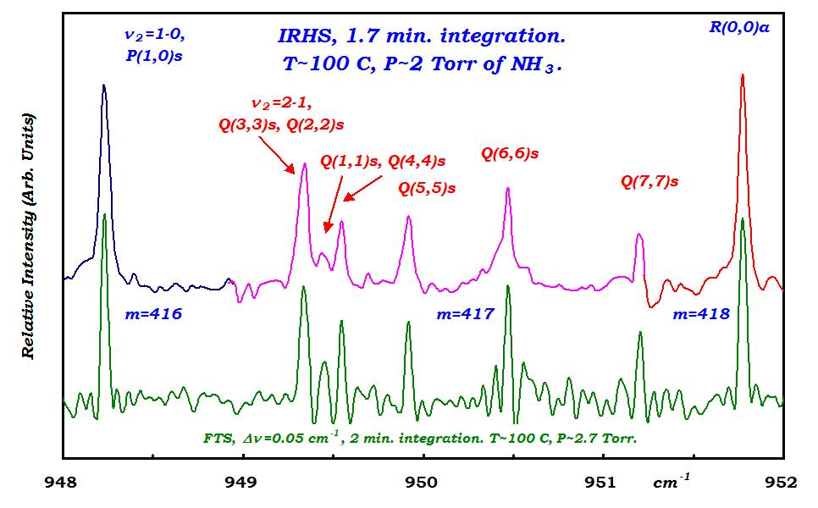
Comparing Echellegram with FT Spectra
º
FWHM = 0.03~0.05 cm⁻¹
R~30,000

Slide 15
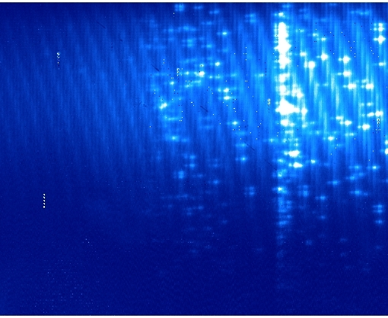
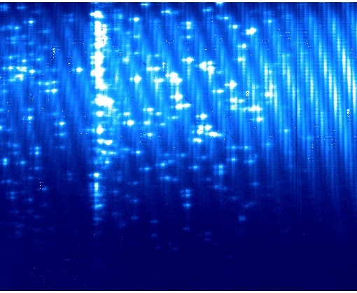
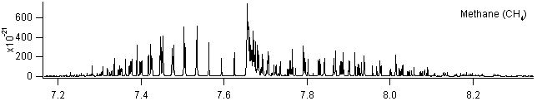
Laboratory GIGMICS spectrum (II): methane
1390 cm⁻¹(7.2μm)
1220 cm⁻¹(8.2μm)
θ=32º （Cross Disperser Angle) 31º

Slide 16
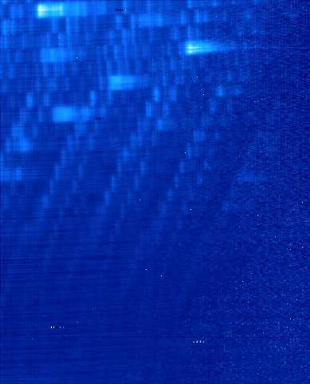
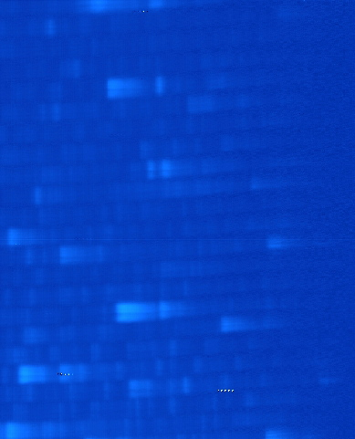
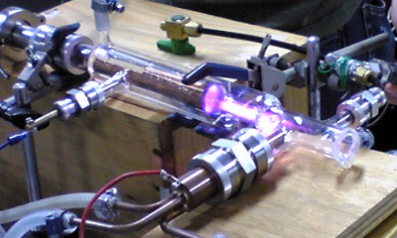
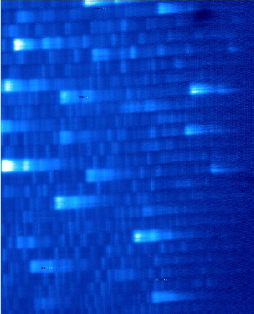
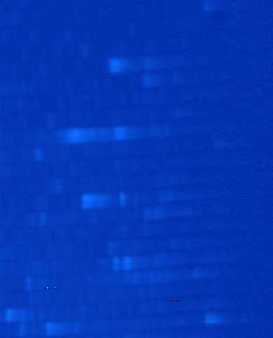
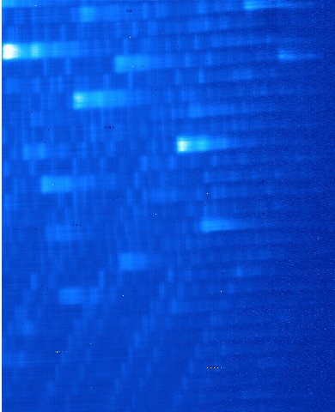
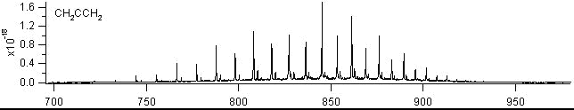
Laboratory GIGMICS spectrum (III): allene
700 cm⁻¹(14.3μm)
950 cm⁻¹(10.5μm)
θ= 188° 193°
H₂C=C=CH₂
(3)アレン

Slide 17
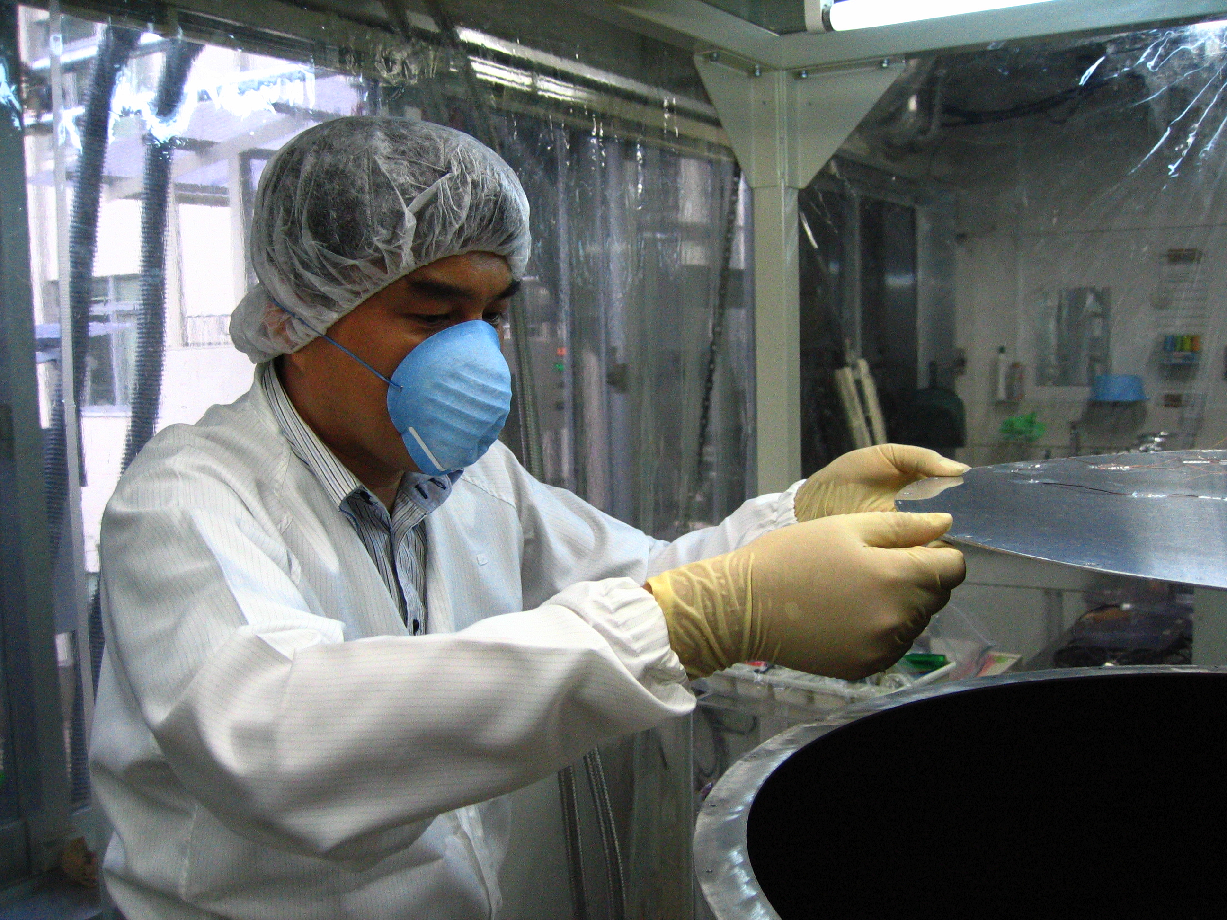

GIGMICS now at KANATA 1.5-m telescope, Higashi-Hiroshima Observatory, Since Dec. 2010 for the first light
Targets:
Vib.-rot. Transitions of Methane, Ethane, Ammonia, N₂O, O₃, SO₂, H₂O, CO₂, SO₂, H₂S, NOx, Halogen Oxides, etc.,
in the Planets, Stellar Atmosphere, bright SFRs, CSE of late type stars, and the upper atmosphere of the Earth
End：

Slide 18
Supl: Sensitivity
N_{photon}(Dark) = 150 photons·pixel⁻¹·s⁻¹ : Good!
Observed Ratio of “Signal-to-Noise Ratio (SNR)”
(SNR)_{Ech}/(SNR)_{FT} = 100
Ratio of Theoretical SNR
for Single-Channel System (Detector Noise Dominant),
(SNR)_{G}/(SNR)_{FT} = [N]^{-1/2} ~ 0.002
for Multi-Channel Grating Spectrometer (Echellegram)
(SNR)_{Ech} /(SNR)_{FT} = [N]^{-1/2} · N_{eff} = 100 (N_{eff} ~ 50,000)
If Modulation Noise Dominant
[(SNR)_{Ech} /(SNR)_{FT}] = [N]^{+1/2} · N_{eff} ~ 2 ×10⁷
N = 512 ×412 = 210,944 (Number of Spectral Elements).

Slide 19

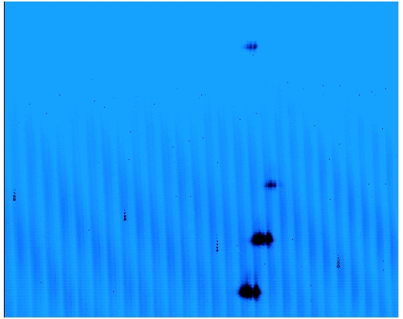
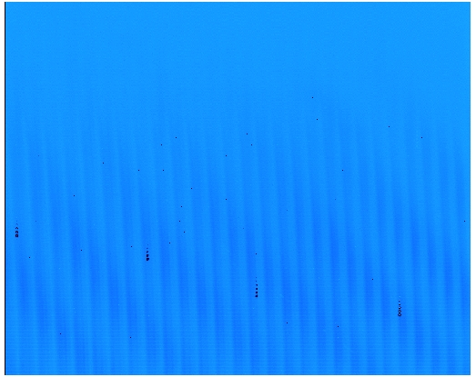
Echellegram of CO₂ Laser with Thermal Radiation
mλ = nd[sin(β) + sin(γ)]
m
0
11.03 μm (907 cm⁻¹)
10.59 μm m=415
N_{photon}
λ
0.67 μm (58 cm⁻¹)
10.55 μm m=416
~10 % of Bandwidth in One Integration
10.57 μm m=415
10.59 μm m=414
m = 400
405
410
415
420
425
10.36 μm (965 cm⁻¹)
0.000 sec
0.667 sec
Dispersion : δλ ~ 8 ⋅10⁻⁵ μm·pixel⁻¹ (~0.007 cm⁻¹·pixel⁻¹) @ 10.6 μm

Slide 20
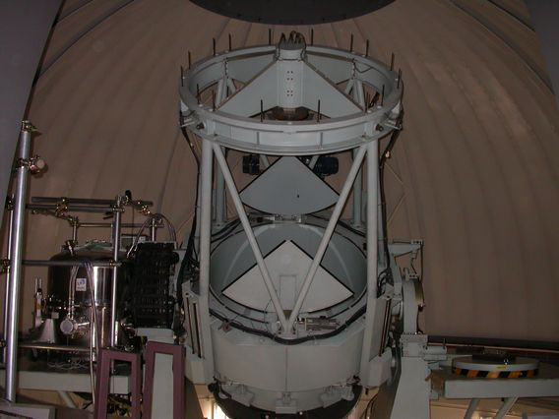
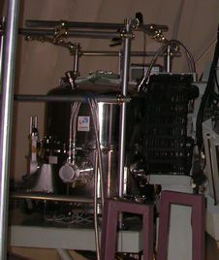
First-Light Observation with Slit Viewer
Mitaka 1.5m Telescope, March – May 2005
Diameter：1.5 m
F：12.2
Field of View：15 arcsec (88.7 μm/arcsec)
Diameter：1.5 m
F：12.2
Field of View：15 arcsec (88.7 μm/arcsec)
Mitaka 1.5mφ, F/12.5
(Subaru simulator)
Slit Viewer Performance : ~50% of Estimated
- Limiting Magnitude : 7.1 mag. at K-band (2.2 mm)
(1.0 sec exp. time, S/N = 10, seeing = 1”.0, N_{readout} = 620e⁻)

Slide 21
Signal Detectability of IRHS
N_{photon}(Dark) = 150 photons·pixel⁻¹·s⁻¹
N_{photon}(Background Radiation) :
T_{room} = 290 K : 1,500 photons·pixel⁻¹·s⁻¹
T_{eff} = 210 K : 250 photons·pixel⁻¹·s⁻¹
cf. Full-well Capacity (Si:As, 5 K)
~ 200,000 photons·pixel⁻¹ (t = 500 sec for T_{eff} = 210 K)
Detectable If N_{photon}(Signal) > [N_{photon}(BR)]^{1/2}
= 16 photons·pixel⁻¹·s⁻¹ (T_{eff} = 210 K)
Cryogenic Cooling Allows Us to Extend Integration Time & Enhance Signal-to-Noise Ratio.

