Slide 1

東京大学が進める光赤外線分野の 基礎開発研究
Basic developments on optical-infrared astronomy
driven by the University of Tokyo
東京大学 天文学教育研究センター
Institute of Astronomy, the University of Tokyo
酒向 重行 (SAKO, Shigeyuki)
2011/1/18 すばる将来装置計画ワークショップ 国立天文台

Slide 2
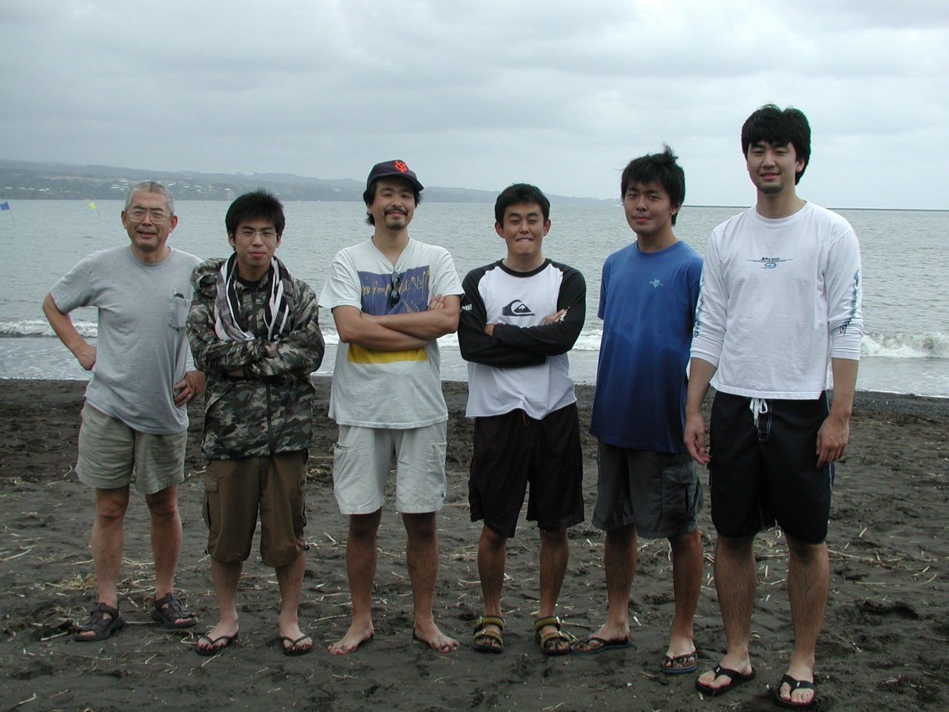
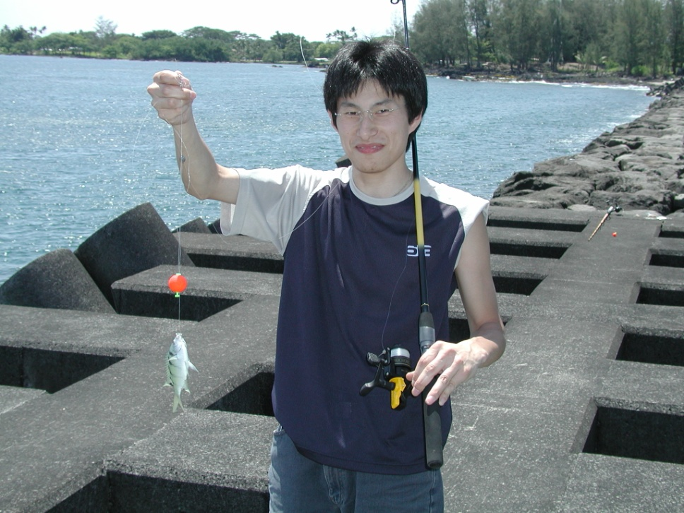
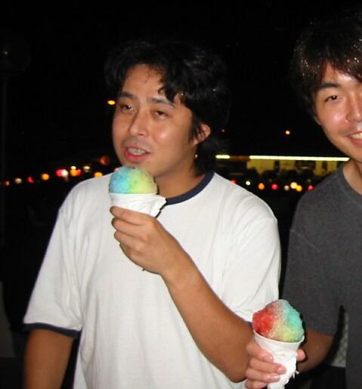
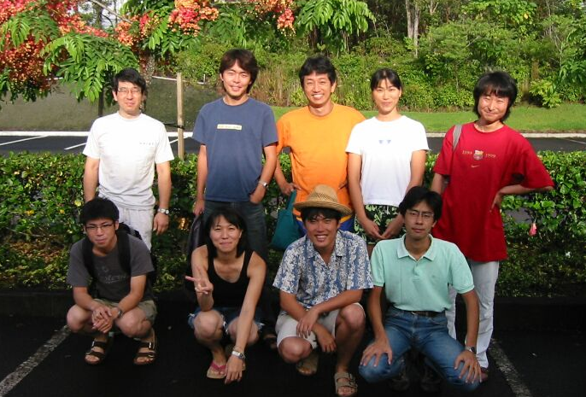

Slide 3
Framework of developments in U-Tokyo
Observatory in Atacama, Chile
Oversea base
Observatory in Kiso, Japan
Domestic base
TAO
KISO
Staff: 0
TS : 3
PD : 2
ST : 0
miniTAO
Staff: 0
TS : 0
PD : 0
ST : 0
1.0-m telescope
6.5-m telescope (future plan)
1.0-m telescope
Headquarter in Tokyo
Staff: 14†
TS : 1
PD : 3†
ST :25(16)
Mitaka(IoA)
Hongo
Developments of instruments and basic technologies are mainly proceeding at Mitaka and Kiso.
Staff: 9†
TS : 0
PD : 1†
ST:15(9)
† Including persons on other research fields

Slide 4
Instruments developed by U-Tokyo
Development phase
for TAO 6.5-m and Subaru 8.2-m | SWIMS | NIR camera and spec. with MOS
 | MIMIZUKU | MIR camera and spec.
for Kiso Schmitt 1.0-m | KWFC | Wide field CCD imager
for KyotoSangyo-U 1.3-m | WINERED | NIR high resolution spec.
Observation phase
on miniTAO 1.0-m | ANIR | NIR camera
 | MAX38 | MIR camera
on Kiso Schmitt 1.0-m | 2kCCD | Wide field CCD imager
on Hokkaido-U 1.6-m | NICE | NIR mid resolution spec.
on Hiroshima-U 1.5-m | DMC | 15-bands CCD camera
List of instruments whose PI is in U-Tokyo

Slide 5
New technologies from the instrument projects
SWIMS
→ Micro shutter
MIMIZUKU
→ Metal mesh filter
→ Moth-eye optics
→ Cold Tip-Tilt
MAX38
KWFC
→ CCD controller
→ Filter changer with Robotic arm
WINERED
→ Immersion grating

Slide 6
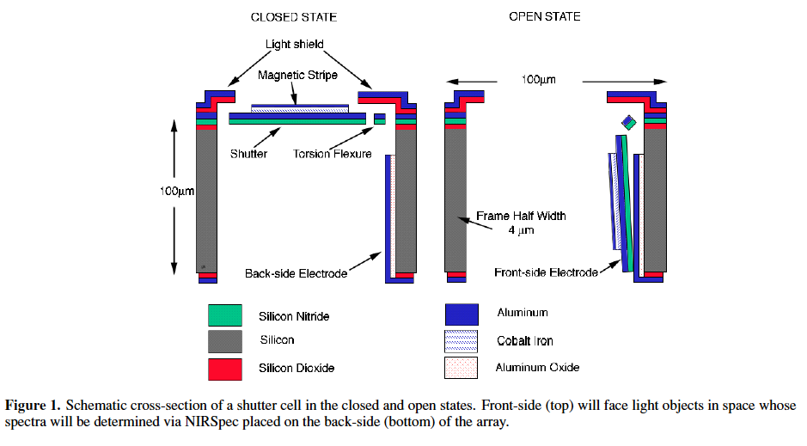
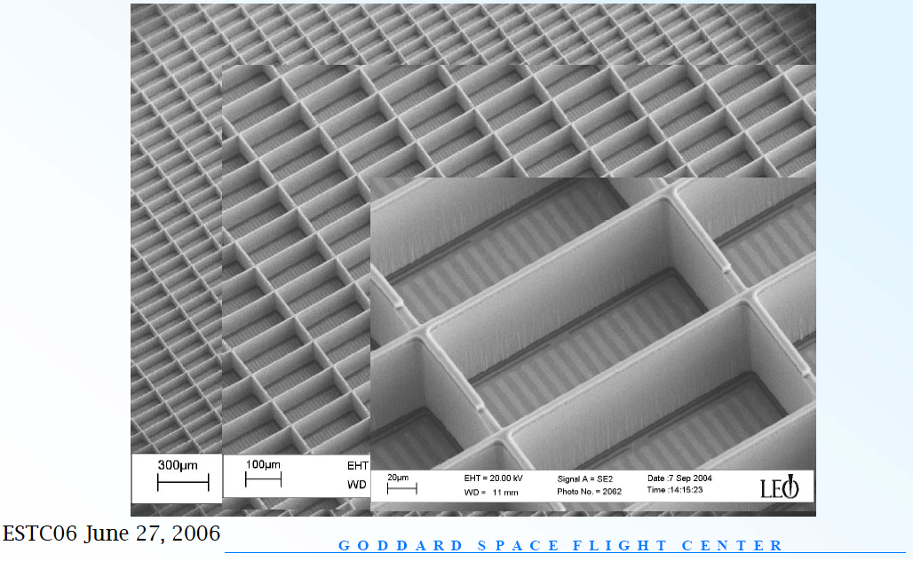
Electrostatic drive type Micro shutter array
Motohara et al.
Micro shutter array
Array of small shutters (0.1 to 1 mm size)
Can open a shutter at an arbitrary position
Use as a MOS slit → Simplify a MOS system
Array for JWST (Goddard) is closest to practical use
→ scanning with magnets
→ complex system
In this study, Electrostatic drive type has been developed.
Moseley+06
King+05

Slide 7
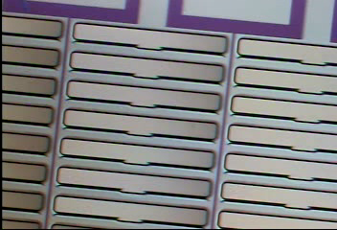
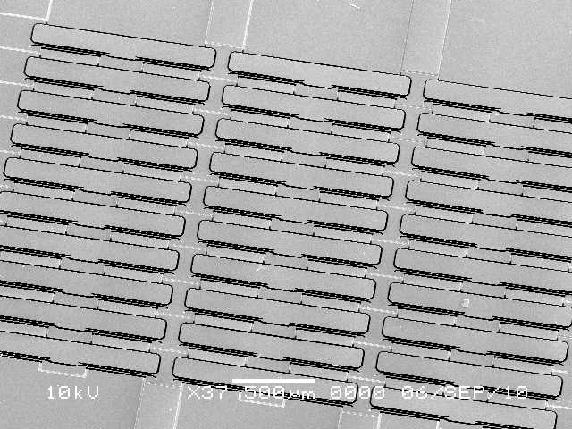
Electrostatic drive type Micro shutter array
IoA, U-Tokyo + Institute of Industrial Science, U-Tokyo + NAOJ
Since 2004
With electrostatic force (>100V is necessary), not magnetic force
Simple addressing method
Succeeded in opening and closing shutters.
Next steps
Structure to prevent light leak
Stable behavior
Larger format
1mm x 0.1mm

Slide 8
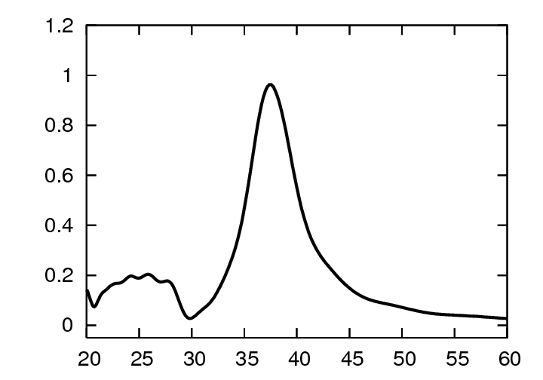
Metal mesh filter
Miyata & Sako et al.
No good optical filters in 25 - 40 μm
No transparent material in 25 – 40 μm
× Multi-layer interference method
In this study, MIR filters without transparent material have been developed.
Metal mesh filter
Thin metal film with hole array
Band-pass profile (R~10)
Peak transmittance of ~100%
Surface Plasmon-Polariton (SPP) effect
t ~ λ/10
λ
g
a
Transmittance
Wavelength (μm)

Slide 9
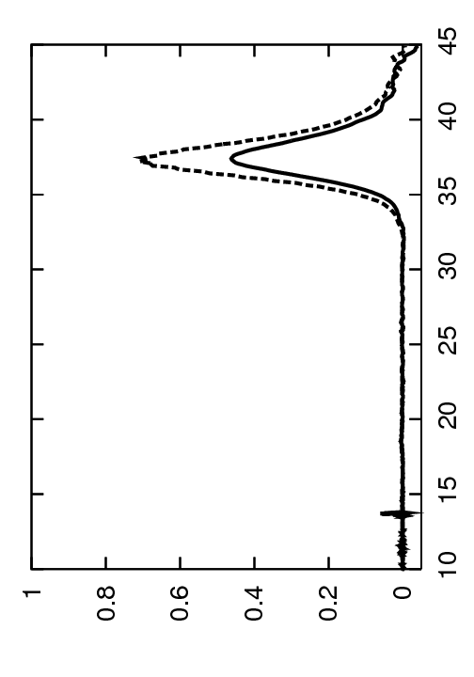
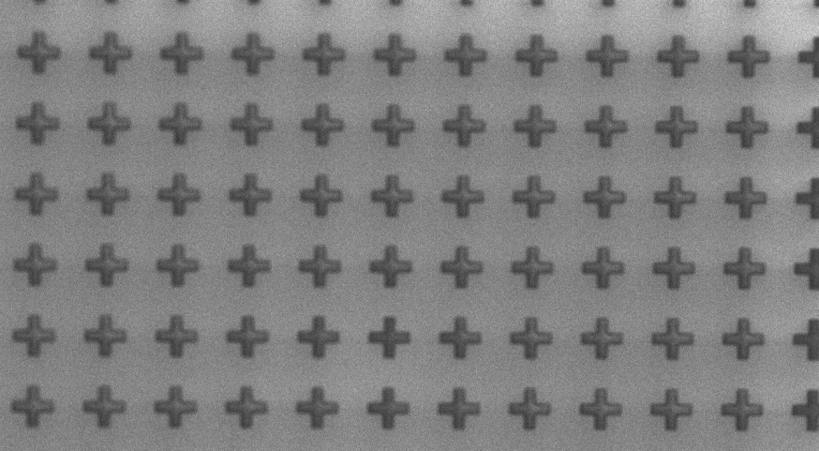
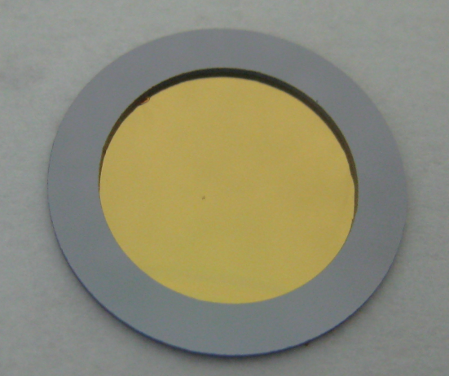
Metal mesh filter
IoA, U-Tokyo + NTT-Advanced Technology + JAXA & NAOJ
Since 2006.
FDTD simulation & Photolithography fabrication
Succeeded in obtaining a peak trans. of > 90% and R~10
Blocking ratio of < 0.01% by stacking 4 filters
used in miniTAO/MAX38.
Next steps → Increase in Strength, Larger aperture
stacking 4 filters
SEM image
measurements
300K
4K
Transmittance
Transmittance
R ~ 17
↓ < 0.01%
φ10mm
29.5 μm pitch cross pattern
Wavelength (μm)

Slide 10
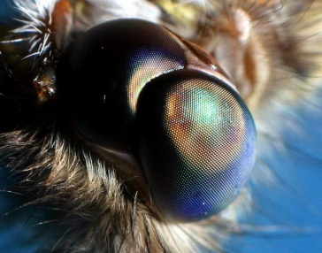
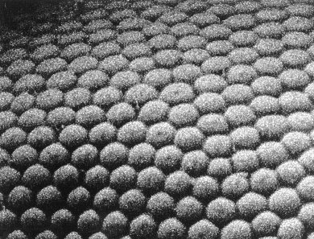
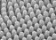
Silicon Moth-eye
Sako & Miyata et al.
No good optical substrate in 25 - 40 μm
Silicon is one of the few potential candidates
Problem
・ High refractive index (n~ 3.4)
→ High reflection loss (30% on one surface)
・ AR-coating is not available
(the same reason of filters)
In this study, AR surfaces without multilayer interference have been developed.
Moth eye anti-reflection structure
Sub-wavelength scale structure
Broadband Anti-reflection effect
Single material
Compound eye of Moth
20μm
1μm
Pillar structures with a pitch of 0.5 – 1μm on the surface of one eye

Slide 11
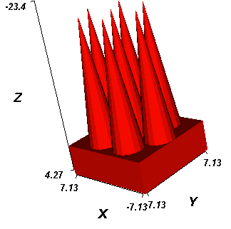
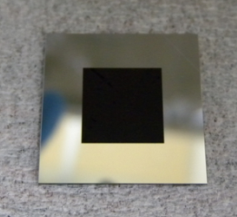
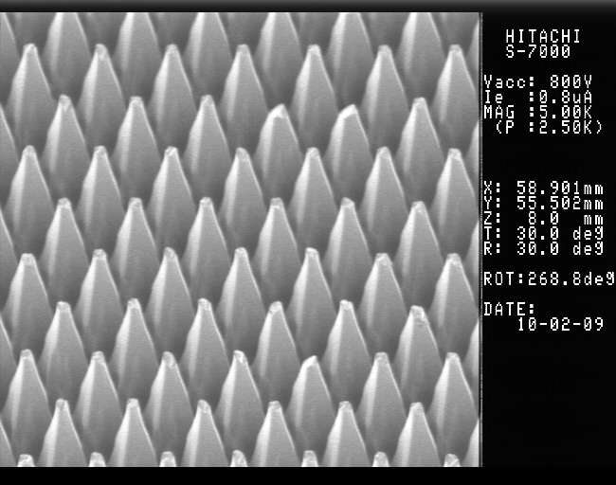
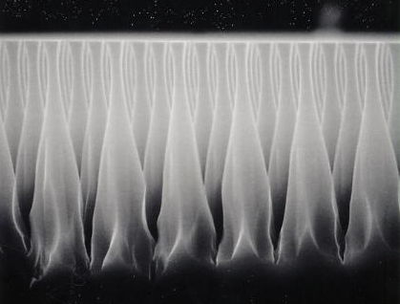
Silicon Moth-eye
IoA, U-Tokyo + NTT-Advanced Technology + JAXA & KAKENHI
Since 2009
RCWA simulation & Photolithography and RIE fabrication
Succeeded in obtaining a trans. of 98% in 25 - 40μm on one surface.
Next step
Both side, Moth-eye on Lens, Grism, and window, and for NIR.
Design for MIR
Fabricated Silicon Moth-eye
Results (measurement)
Transmittance
1
100%
0.9
95%
0.8
- circular cone
- 60°adjacent
- pitch 5μm
- length 20μm
Overview
10 x 10mm
Visible image
0.7
0.6
SEM images
10 20 30 40 50 60 70
Wavelength (μm)

Slide 12
Cold Tip-Tilt Mirror
Nakamura et al.
Cryogenic opt-mechatronics is a key technology in TMT and SPICA era
Expand the capability of infrared instruments
High stability and low power are needed
In this study, cryogenic tip-tilt (chopper) mirror for MIR observations has been developed.
Cold tip-tilt (chopper) system
→ No need tip-tilt motion of 2ndary mirror
→ Enables tip-tilt observations in space
(to remove fast vibration generated by refrigerators)
Tip-tilt
2ndary
Cold
Tip-tilt
mirror
Cryogenic dewar
MIR observation with chopping techniques
Typical chopping Freq. is
1 – 10Hz

Slide 13
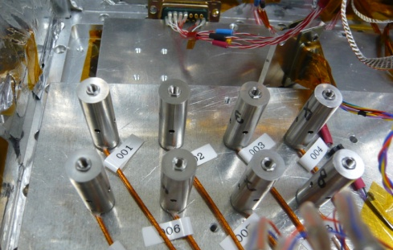
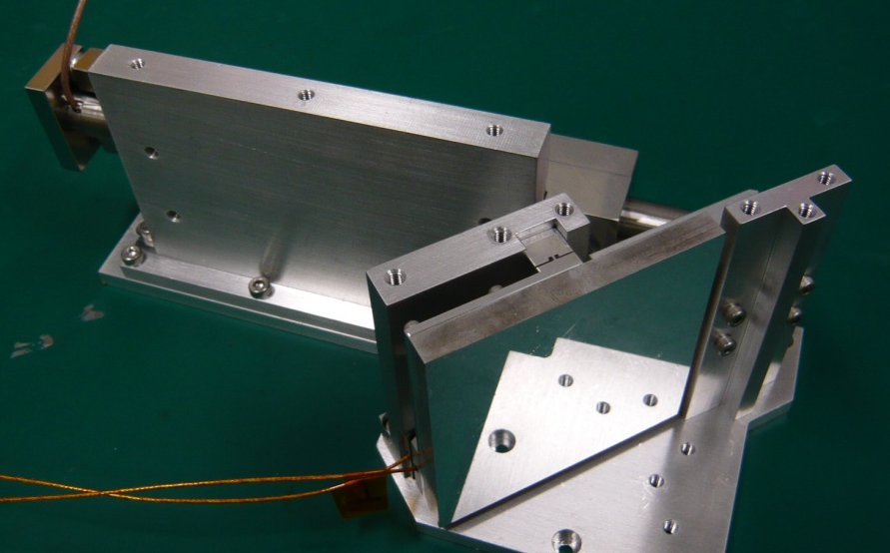
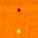
Cold Tip-Tilt Mirror
IoA, U-Tokyo + Fuji ceramics + JAXA & KAKENHI
Since 2005.
Cryogenic piezo actuators were developed .
Stroke is extended by a factor of 2.7 at 7K
Succeeded in driving the chopper with
max 5 Hz and 15“ amplitude, and < 100mW at < 20K.
Used in miniTAO/MAX38
Next step → 2-axis type, larger amplitude, faster feedback
Driving test of new piezos
Overview of Cold Tip-Tilt system
Observation image
B-beam
A-beam

Slide 14
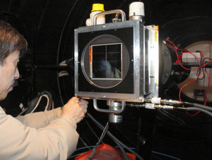
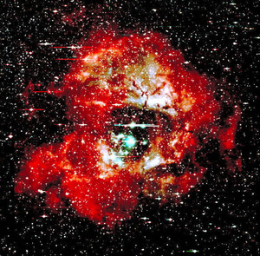
New CCD controller
Sako et al.
No suitable controller for 1 – 8 CCDs system
Almost projects driven by University need small-mid sized system, not larger like HSC.
In this study, new CCD controller for small-med sized system (KAC: Kiso array controller) has been developed.
Kiso wide field camera (KWFC)
Next generation open-use instrument on Kiso 1m telescope
Wide F.O.V. (2deg x 2deg)
8CCDs of 2k x 4k pixels
4 SITe and 4MIT CCDs from NAOJ
Opened in Apr. 2012
KWFC camera
First light image
2deg x 2deg 2010/12

Slide 15
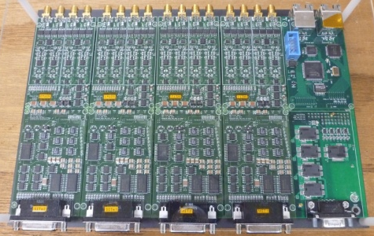
New CCD controller
IoA, U-Tokyo + Several Universities and Institute in Japan (Hokkaido-U, Kyoto-U, AoyamaGakuin-U, and JAXA) + NAOJ
Since 2009
Succeeded in taking astronomical images with Kiso/KWFC
Welcome participation of this project
Development plan
Redesign the analog circuit for Hamamatsu CCDs (2011/1-8)
Installed into
→ Spectrometer developed by
Hokkaido-U and Kobe-U
→ Kyoto 3D instrument for Subaru
→ Test systems for Infrared and
X-ray satellites
KAC analog boards for 8 CCDs

Slide 16
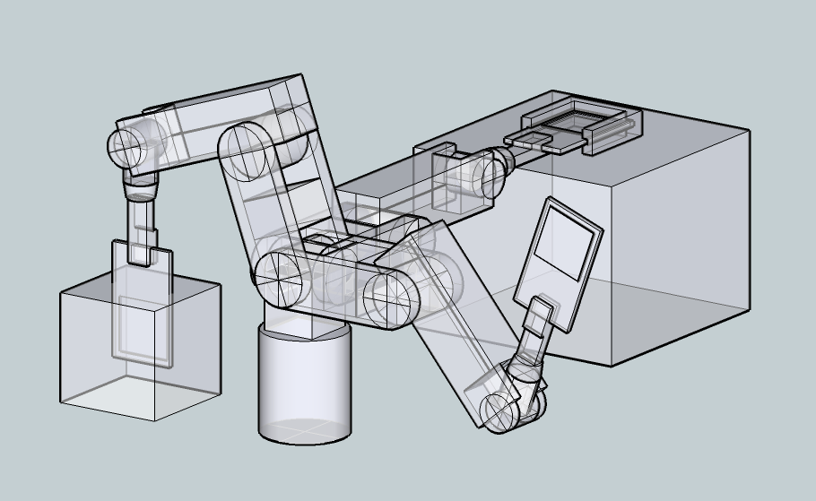
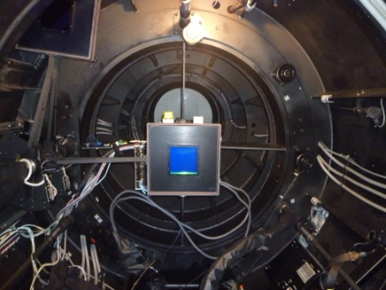
Filter exchanger with Robotic arm
Holder
(focal plane)
IoA, U-Tokyo + Mitsubishi electronics system & service + Sumitomo foundation
Since 2010
Filter exchanger is set at the prime focus of KISO Schmitt telescope
Uses an industrial robotic arm
Stores 16 filters (158 x 158 x 15mm) in the magazine box
Realizes a compact and lightweight system
Put an unique ideas to practical use
KWFC camera
Filter Magazines
The arm and the magazines are placed on a framework of the telescope. The arm is evacuated outside of a beam in observations.
Filter exchanger
to be put here
KWFC
Inside the Schmidt telescope
from the primary side

Slide 17
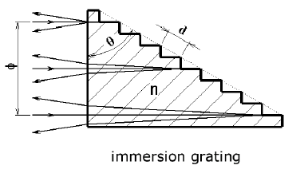
Immersion grating for NIR
Immersion grating
A sort of reflection type grating
Diffraction side is filled with ‘n’
Resolution and Physical size of spectrometer
High resolution spectroscopy with Large telescope
a size of optics ∝ resolution
→ large and heavy instrument → high cost
Immersion grating with large ‘n’ can downsize the optics
→ In this study, immersion gratings for NIR have been developed.
Ikeda and Kobayashi et al.
θ
φ ∝ R・D/n
φ : beam size
D : diameter of prime mirror
R : spectral resolution
n

Slide 18
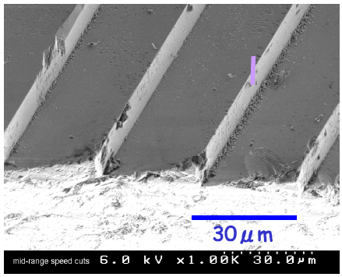
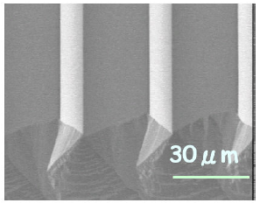
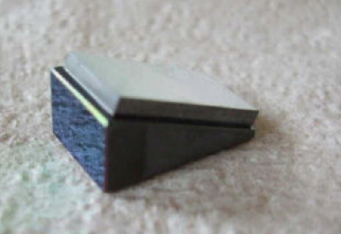
Immersion grating for NIR
IoA, U-Tokyo + Photocoding + KyotoSangyo-U + NTT-Advanced Technology +Lawrence Livermore National Laboratory + JAXA & NAOJ
Since 2005
Two types of substrate : ZnSe (broad band), Silicon (high n)
Fabrication processes of grooves
ZnSe → nano precision fly-cutting technique (LLNL)
Silicon → anisotropic etching + photolithography (NTT-AT)
Succeeded in making high quality grooves with both methods
Next steps: improve diffraction efficiency and assemble the elements
Silicon grating
Au
Optical
contact
Silicon prism
Grooves on ZnSe
Grooves on Silicon
Silicon immersion grating

Slide 19
Basic developments expand community and build a strong foundation
Company
Company
Company
University
Company
Company
U-tokyo
University
Company
IoA
Lab A
Hongo
Lab B
Institute
Company
Company
University
NAOJ
JAXA

Slide 20

Universities are highly-responsive
While energy sources are present,
the responses are continued.
Continuous and widespread supports
to the basic developments are important.
Company
Company
Company
University
Company
Company
U-tokyo
University
Company
IoA
Lab A
Hongo
Lab B
Institute
Company
Company
University
NAOJ
JAXA

Slide 21
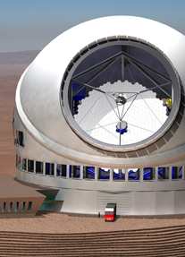
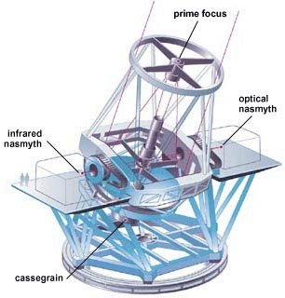
Summary
U-Tokyo has developed several new basic technologies in promoting mid-small sized instrument projects.
The basic developments have expanded the community on Japanese astronomy.
Continuous and widespread supports to the basic development are important to build a strong foundation toward TMT era.
While energy sources are present, responses between Universities are continued.
Company
Company
Company
University
Company
Company
U-tokyo
University
Company
IoA
Lab A
Institute
Company
Hongo
Lab B
University
Company
NAOJ
JAXA

