Slide 1
Understanding Metallicity at High Redshift Universe
KenTaro Motohara
(IoA, Univsersity of Tokyo)

Slide 2
Gas Phase Metallicity
Gas Phase Metallicity (Oxygen Abundance) is crucial to understand galaxy formation/evolution, as it traces the previous star formation history.
When resolved into sub-galactic scale, it also provides information of
Mass assembly/Merger
Inflow/Outflow

Slide 3
Metallicity in the Local Galaxies
Metallicity in close pairs are systematically lower than in field spirals (Kewley+06)
Metallicity gradient in close pairs shows shallower gradients than those in isolated spirals (Kewley+10)
⇒ merger supplies low-metallicity gas at outer galaxies into the central region ?
Kewley et al. ApJ 721, L48 (2010)

Slide 4
Metallicity in Merger Simulation
Merger simulations show that metallicity at a center of a galaxy is lowered during the encounter
Due to Gas inflow
1st pericenter
2nd pericenter
Rupke et al. ApJL 710, L156 (2010)
Montuori et al. A&A 518, A56 (2010)

Slide 5
Inverse Metallicity Gradient at z~1?
SINFONI/KMOS Observations (Queyrel+12, Stott+14)
Metallicity from N2 Index ([NII]6584/Hα6563)
Inner parts of Galaxies Show Lower Metallicity
Evidence of Interaction or Cold Stream
Stott et al., MNRAS in press (2014)

Slide 6
However… We need to Understand Physical Status of HII Regions
Hi-z HII Regions Occupy Different Regions on BPT Diagram
Yabe et al., PASJ 64, 60 (2012)
Steidel et al., arXiv:1405.5473

Slide 7
Higher Ne? Larger U? Harder EUV?
N2 Index is affected, then
Larger EUV or Ne
smaller U
Overestimate Metallicity.
Kewley et al., ApJ 774, 100 (2013)

Slide 8
Evolution of BPT Diagram
z=0
Can be Explained By a Evolution Model,
Where at z~2.5
10 times denser electron density
2 times higher Ionization Parameter
z=0.8
z=1.5
z=2.5
Kewley et al., ApJ 774, L10 (2013)

Slide 9
Ionization Field at LAE/LBG
Z=2-3 LAE/LBG shows 10 times higer [OIII]/[OII]
Can be Explained By 10 times Higher Ionization Parameter
Nakajima & Ouchi, MNRAS 442, 900 (2014)

Slide 10
What’s NeXT?
We need to understand physical status in HII regions at Hi-z Universe
Density
Ionization ParameteR
MetallicitY
Their Distribution within a galaxy

Slide 11
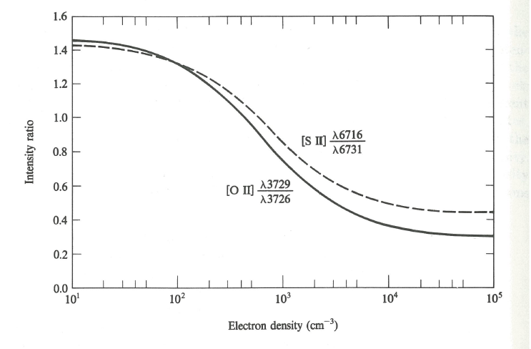

Electron Density Measurement
[OII]3729/3726
[SII]6731/6716
Depends on $\sqrt{T_{e}}$ : Higher temperature results in lower density

Slide 12
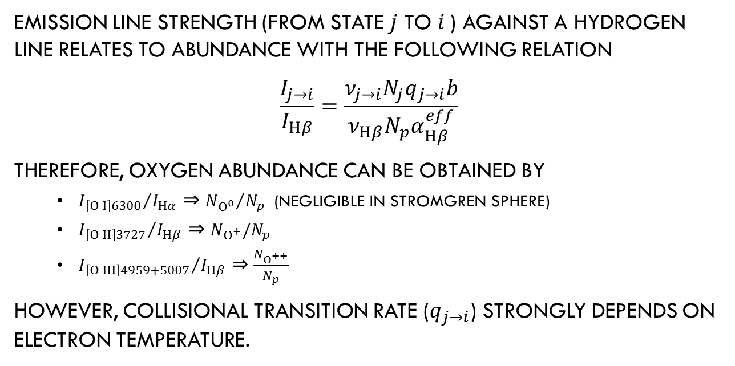
Metallicity Measurement (Direct Method)
Emission Line strength (from state $j$ to $i$) against a Hydrogen Line relates to abundance with the following relation
$$\frac{I_{j→i}}{I_{Hβ}}=\frac{ν_{j→i}N_{j}q_{j→i}b}{ν_{Hβ}N_{p}α_{Hβ}^{eff}}$$
Therefore, Oxygen Abundance can be Obtained by
${I_{\left[O I\right]6300}}/{I_{Hα}}$ ⇒ ${N_{O^{0}}}/{N_{p}}$ (Negligible in Stromgren Sphere)
${I_{\left[O II\right]3727}}/{I_{Hβ}}$ ⇒ $N_{O^{+}}/N_{p}$
${I_{\left[O III\right]4959+5007}}/{I_{Hβ}}$ ⇒ $\frac{N_{O^{++}}}{N_{p}}$
However, Collisional transition rate ($q_{j→i}$) strongly depends on electron temperature.

Slide 13
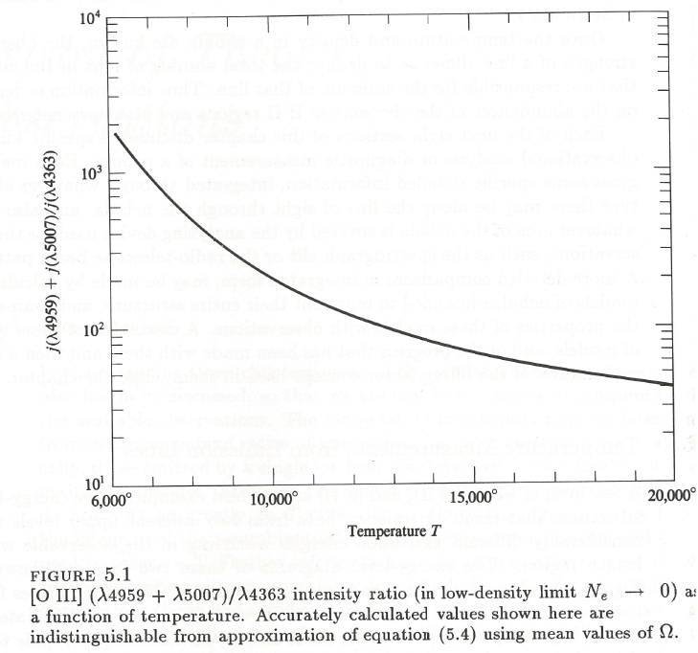
Electron Temperature Measurement
For Direct Measurement, [OIII]4363 or [NII]5755 is necessary
However, They are extremely weak…
Stacking May gives us Some Insight, especially when metallicity is low (and temperature is high)

Slide 14
Metallicity Measurement (Empirical)
N2 Index : [NII]6584/Hα6563
O3N2 Index : ([OIII]5007/Hβ4861)/([NII]6584/Hα6563)
R23 Index : ([OII]3727+[OIII]4959,5007)/Hβ4861

Slide 15
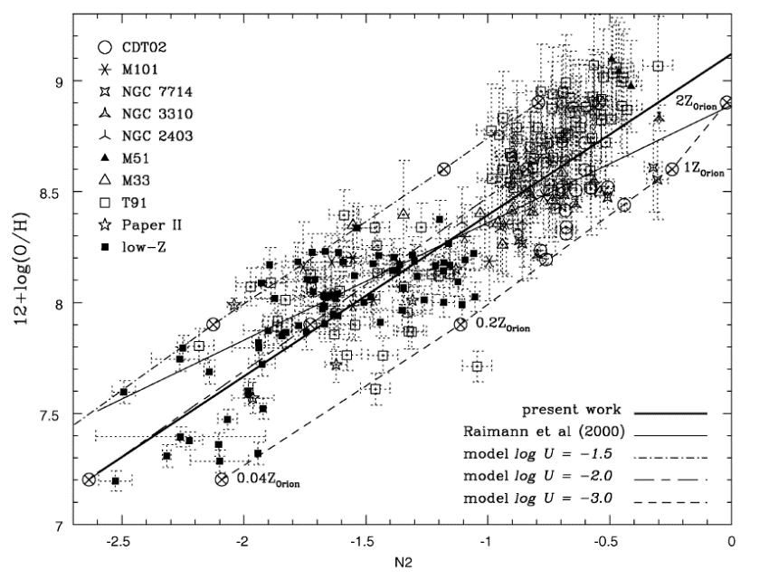
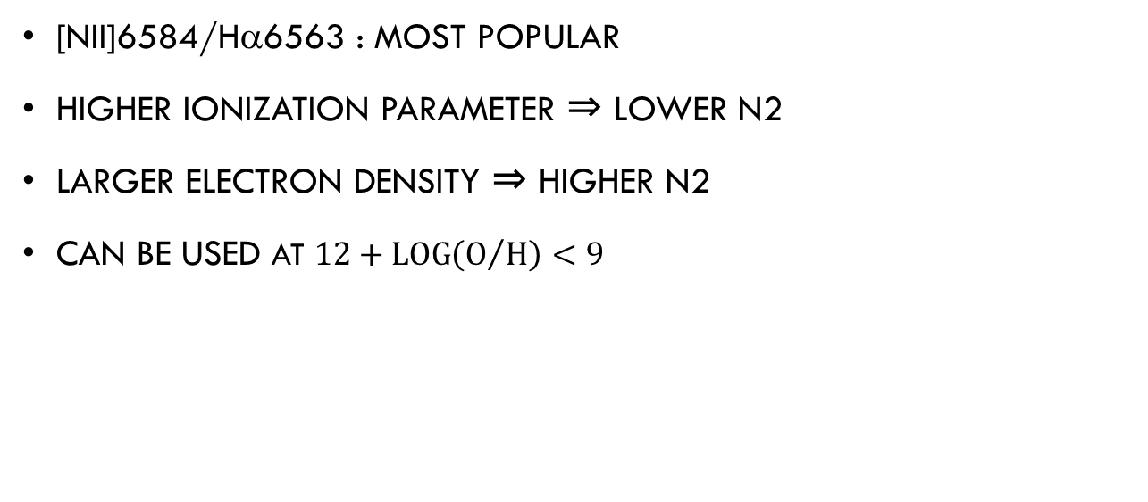
N2 Index
[NII]6584/Hα6563 : most Popular
Higher Ionization Parameter ⇒ lower N2
Larger Electron Density ⇒ Higher N2
Can be used at $12+\log\left(O/H\right)<9$
Denicolo, Terlevich, Terlevich, MNRAS 330, 69 (2002)

Slide 16
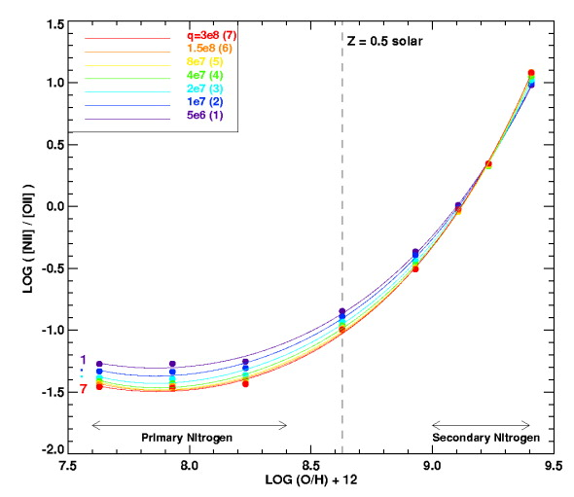
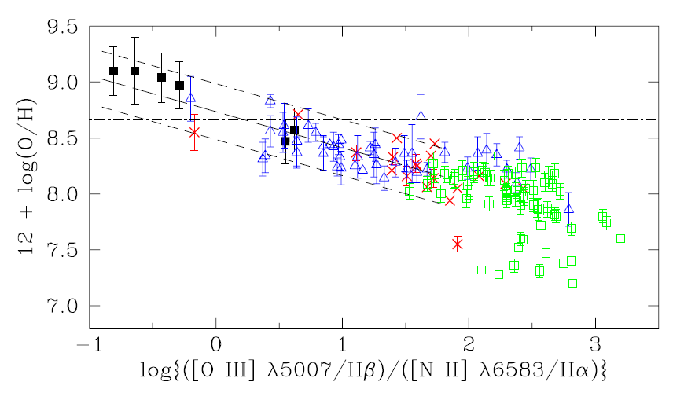
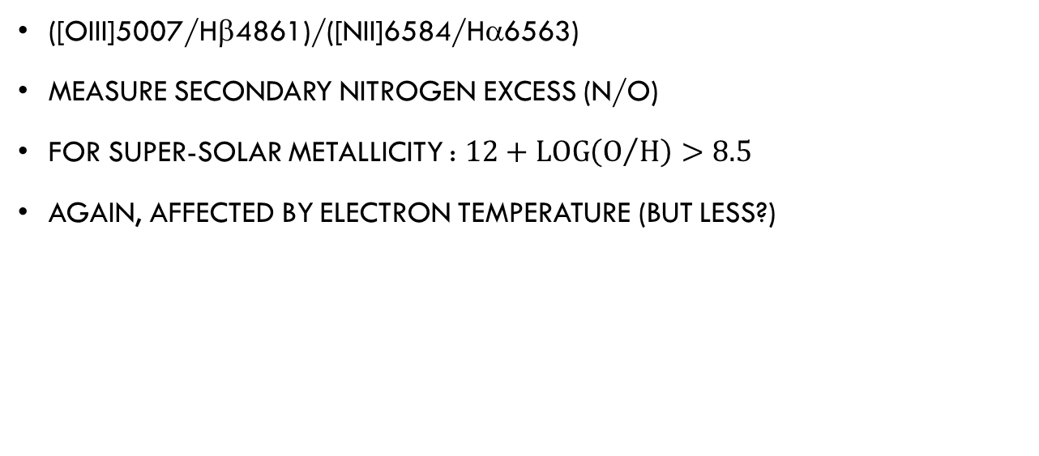
O3N2 Method
([OIII]5007/Hβ4861)/([NII]6584/Hα6563)
Measure secondary Nitrogen Excess (N/O)
For Super-solar Metallicity : $12+\log\left(O/H\right)>8.5$
Again, Affected By Electron Temperature (but less?)
Kewley & Dopita, ApJS 142, 35 (2002)
Pettini & Pagel, MNRAS 348, L59

Slide 17
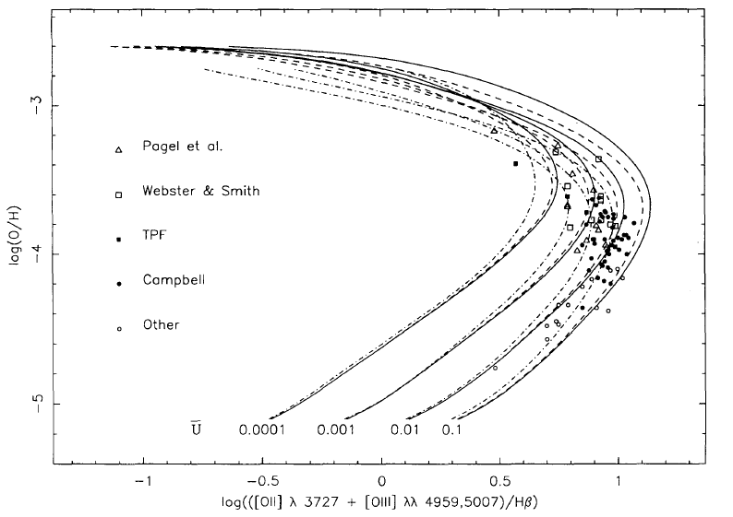
R23 Method
([OII]3727+[OIII]4959,5007)/Hβ4861
Bimodal Distribution
Can be separated in combination with O3N2 index
Affected By Ionization Parameter
Need Correction for dust extinction
McGaugh, ApJ 380, 140 (1991)

Slide 18
Ionization Parameter
[OIII]5007/[OII]3727 will be a good indicator
Need correction for Dust Extinction
Nakajima & Ouchi, MNRAS 442, 900 (2014)

Slide 19
Metallicity Measurement (Empirical)
N2 Index : [NII]6584/Hα6563
O3N2 Index : ([OIII]5007/Hβ4861)/([NII]6584/Hα6563)
R23 Index : ([OII]3727+[OIII]4959,5007)/Hβ4861
All the Indices may require correction for different environment
Observations of all the emission lines are necessary to solve the problem

Slide 20
IFU Survey of z=1-2 Galaxies
Various Galaxies at z=1~2
Samples maybe supplied by Existing surveys(SXDS, GOODS-N, SDF) and NEWLY planned SWIMS-18 Survey (on TAO/Subaru)
Cover whole major optical emission lines
[SII]6731/6716
Hα6563+[NII]6584
[OIII]5007
Hβ4861
([OIII]4363) : possibly by stacking?
[OII]3729/3726
Spectral Resolution should be enough to resove [OII] : R>3000

Slide 21
SensitiVity of ULTRA-Subaru
Max 1.8arcsec FoV/Starbug ⇒ 12kpc diameter
0.2arcsec sampling ⇒ 1.4kpc 7kpc diameter split into 19 fiberS
Replacement of Detectors and grisms may provide better sensitivity by ~1.5mag
Still, Sensitivity is a big problem : Need to be brighter by ~2mag than normal spectroscopic targets ⇒ possible targets will be those with K_{AB}<21

Slide 22
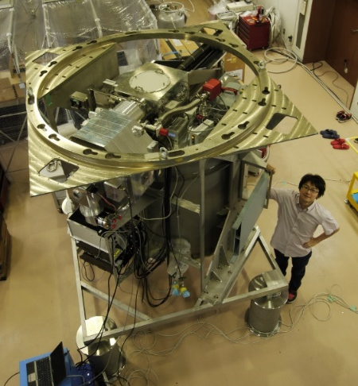
SWIMS
S W I M S
Simultaneous-color Wide-field Infrared Multi-object Spectrograph
1st generation instrument for TAO 6.5m
FoV of 9.6’Φ on TAO
2-band simultaneous imaging at 0.9～1.4 / 1.4～2.4micron
Capable of R=1000 spectroscopy from 0.9 to 2.5 micron in a single shot
Capable of MOS spectroscopy for max 40 objects
Will be carried into Subaru as a PI instrument in FY2015

Slide 23
SWIMS-18
Wide Field Survey using 18 filters
9 MBFs, 6 NBFs, 3 BBFs
1sq.degree FoV
MBF survey
Accurate Photo-z at z=1-3
1.2e7 MPC3 Volume
NBF Survey
Dual line emitter survey (Ha/[OIII], etc)
7.5e5 MPC3 Volume

Slide 24
Answers to Questions
(Q1) What is the optimum spatial sampling (or diameter in arcsec of each fiber in the bundle) and FOV of the bundle?
Larger FoV per bundle is preferable 0.2arcsec (~1.4kpc) is enough
(Q2) What is the optimum and minimum number of the fiber bundles (or multiplicity) in the 13'.6 diameter FOV?
Number density of K_{AB}<21 mag z=1-2 galaxies is ~0.2/arcmin^2, Therefore, the optimum numbers is ~30.
However, they can be covered with multiple shots, so the minimum number can be that of the baseline specification (16 with 1.8arcsec fov).
(Q3) What is the critical wavelength range in near-infrared covered by the Starbug system (0.9-2.0micron)?
Full range of 0.9-2micron is necessary To sample all the important optical emission lines from [OII]3727 to [SII]6731 at redshift upto ~2.

Slide 25
(Q4) What is the optimum spectral resolution?
R=3000 is preferred to resolve velocity field of the galaxy as well as to resolve [OII]3726/3729.
However, wide wavelength coverage is another important feature for effective observation. It will be nice if ZJ or HK spectrum can be taken with a single shot.
(Q5) What is the sensitivity requirement for the phase-I instrument?
K_{AB}~22.5 per fiber
(Q6) Please describe a brief observation plan for your science case with the fiber bundle multi-object IFU.
- Number of objects / Survey area : TBD
- Fields : SWIMS-18 Field, SXDS, GOODS-N ….
- Number of nights to complete your survey : TBD, 1 Pointing/NIGHT?
- Uniqueness

Slide 26
(Q7) How could the proposed science cases be competitive or complementary to the science with 30m class telescopes (e.g. TMT) or space telescopes (e.g. JWST) in 2020s?
the proposed observations can be carried out ONLY for the brightest objects by 8m class telescopes, with coarse (>1kpc) sampling. TMT will probe galaxies with L* or fainter luminosity, with higher spatial resolution.
(Q8) Please describe the requirements for Phase-II instrument (Starbugs + dedicated spectrograph) to develop your science case.
Fiber bundle configurations : 0.2”/fiber, FoV of each bundle larger than 1.8arcsec, # of bundles ~30
Wavelength coverage : 0.7 to 2.0 micron
Spectral resolution : R=3000
Sensitivity : K_{AB}=22.5mag/fiber (when binned down to R~500)
(Q9) What is the unique point of the fiber bundle multi-object IFU with Starbugs compared to the imager or multi-object slit spectrograph?
High efficiency survey speed with Multi-object IFU capability.

