Slide 1
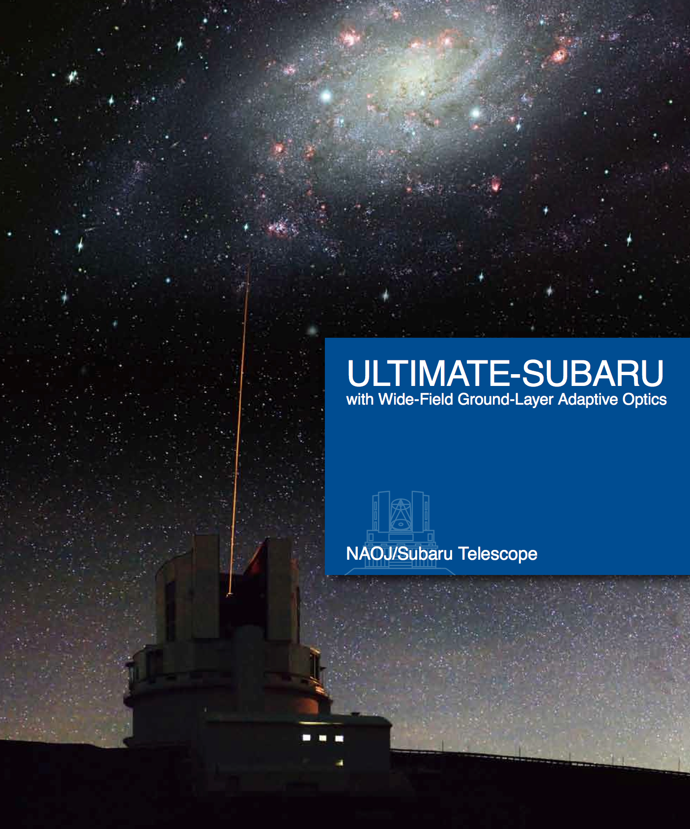
Ultra-wide-field Laser Tomographic Imager and MOS with AO for Transcendent Exploration by SUBARU telescope.
PI: N. Arimito
PM: Y. Hayano
PS: T. Kodama

Slide 2
Project overview
Why we need ULTIMATE-SUBARU?
GLAO System overview
Seeing at Mauna Kea (next talk by Oya-san)
GLAO simulation (next talk by Oya-san)
Project organization
Schedule and budget
Technical studies
Adaptive secondary mirror study
Telescope modification study
Wide field imager

Slide 3
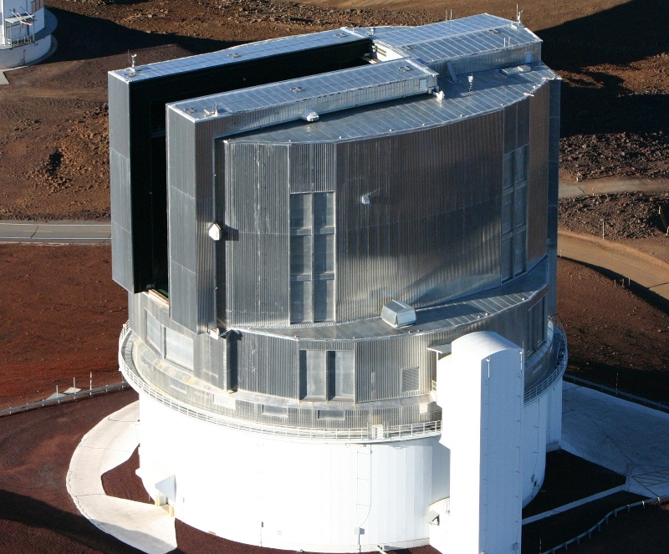
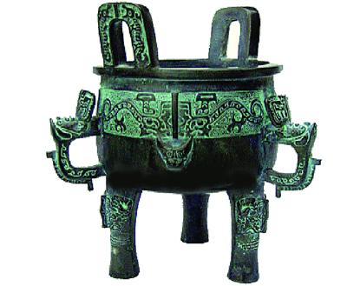
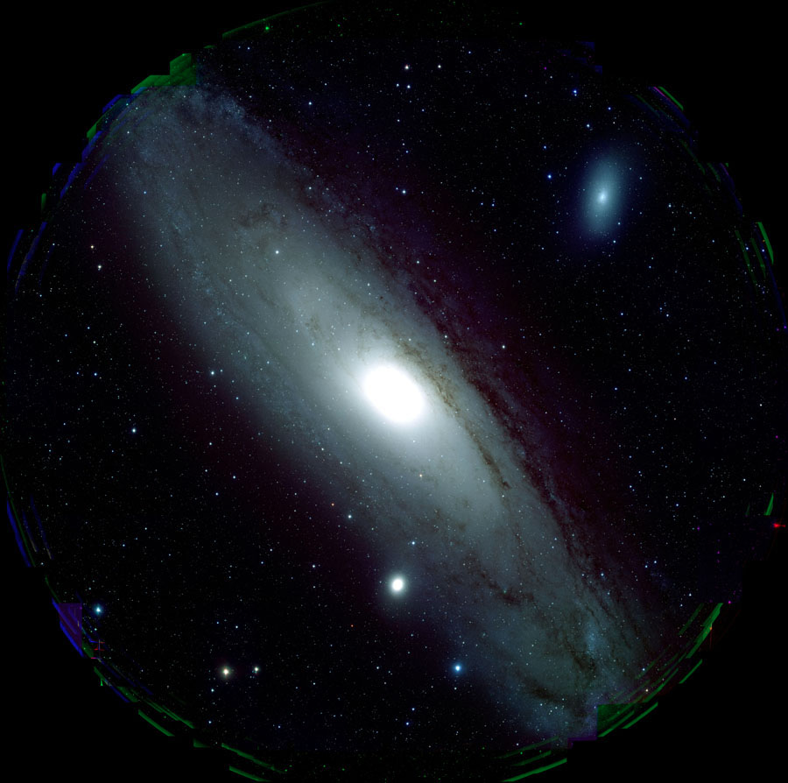
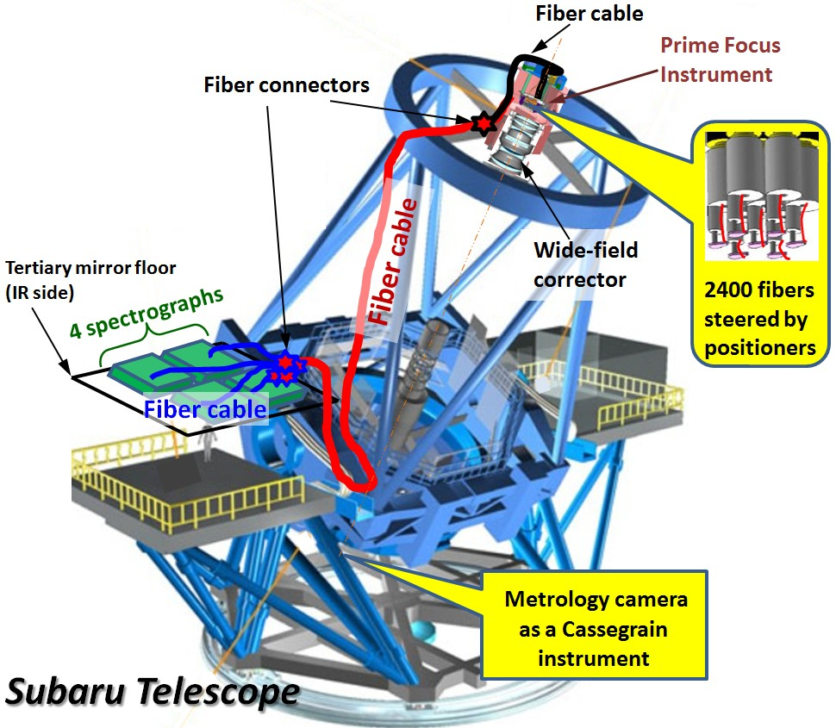
Key instruments at Subaru Telescope 鼎（tripod pot）
HSC first light
HSC
(vis)
PFS
(vis)
GLAO
NIR instrument

Slide 4
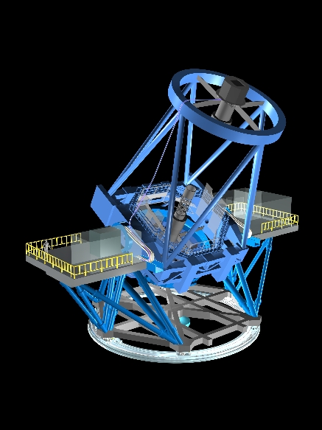
System Overview
Ground Layer AO with Adaptive Secondary Mirror (4 LGSs)
Wide-field Near-IR Instrument (Imager + MOS or M-IFU)
→ Seeing Improvement (FWHM 0.4”→0.2”) over FOV ~15’
Higher Sensitivity Equivalent to 2x Telescope Aperture^{*1}
6 Times Wider Field of View^{*2}
Targeted to Start Commissioning in 2020
4 laser guide star
Adaptive
Scondary
Mirror
Wavefront
Sensor
NIR instrument
*1 For point sources.
*2 Relative to MOIRCS (seeing limited NIR instrument)

Slide 5

GLAO
Guide stars
Atmospheric
turbulence
Turbulence at
ground layer
Feedback correction
to deformable
secondary mirror
Estimation of
ground-layer turbulence
Wavefront
sensors

Slide 6
System Overview
Ground Layer AO with Adaptive Secondary Mirror (4 LGSs)
Wide-field Near-IR Instrument (Imager + MOS or M-IFU)
→ Seeing improvement (FWHM 0.4”→0.2”) over FOV ~15’
Higher sensitivity equivalent to 2x telescope aperture^{*1}
6 times wider FOV^{*2}
~200 times wider FOV compared with AO188/LGS+IRCS
Targeted to Start Commissioning in 2020
4 laser guide star
Adaptive
Scondary
Mirror
Wavefront
Sensor
*1 For point sources.
*2 Relative to MOIRCS (seeing limited NIR instrument)
NIR instrument

Slide 7
GLAO - Specifications under Consideration
Guide stars | 4 LGSs + 3 NGSs
DM | Secondary mirror | ~1000 actuators, modification of VLT ASM.
High-order WFS | > 8x8 SH | visible, EM-CCD(TBD)
Tip-tilt-focus WFS | 2x2 SH or quad | visible
Laser | 20 W CW | TOPTICA (589nm) (option: Rayleigh)
LGS constellation | 15’ in diameter
Laser Launch | ~25cm dia. (TBD) | side launch

Slide 8
NIR Instrument - Specifications under Consideration
Wavelength | 0.8-2.5μm
Plate Scale | 0.06-0.1”/pix
FoV | approx.13‘x13’ | Wider with Split FoVs?
Filters | Broad+Narrow | R?, I,z,J,H,K, NB
MOS | Multi Slit Mask | Alternatively Multi-IFU
λ Dispersion | 2000(TBD) | Under Investigation

Slide 9
Main Science Targets
“Anatomy” of galaxies at z=1 – 3
What are the key parameters to drive the galaxy evolution?
What determines morphologies of the galaxies?
Large-Scale Near-IR Surveys (Imaging and spectroscopy) of about 5000 galaxies
Discovery of the Most Distant Galaxies at z>7.5
Understand of the Cosmic Reionization
NBF imaging survey (〜180 arcmin²), 100 galaxies.
→ Target sample for TMT.

Slide 10
ULTIMATE-SUBARU organization
PI
N. Arimito
Subaru Director
Project management
Y. Hayano、O. Lai
Science team
T. Kodama、I. Iwata.
ngAO working group menbers
International collaborators
Adaptive Optics
2nd DM (Adoptica, MELCO, NAOJ)
WFS (NAOJ, others）
LGS (TOPTICA, NAOJ, others)
RTC (NAOJ, others）
Telescope Mod. (MELCO, NAOJ)
Test and Integration（NAOJ, etc）
Opto-mechanics (NAOJ, coll.）
Electronics(NAOJ, coll.）
Control (NAOJ, coll.）
Software(NAOJ, coll.）
Staff 3/Postdoc 3/Tech 2/coll.
Wide-field NIR inst.
Opto-mechanics (NAOJ, coll.）
Electronics(NAOJ, coll.）
Cryogenic system(NAOJ, coll.）
Detector, Camera(NAOJ, coll.）
Control(NAOJ, coll.）
Data analysis(NAOJ, coll.）
Staff 3/Postdoc 3/Tech 2/Coll.

Slide 11
Schedule
2012
13
14
15
16
17
18
19
2020
Review
Review
Concept Design
Review
Prelim Design
Detail Design
Fabrication
Telescope Modification
FL
Integration and Test
Science Operation
AO188/LGS
HSC
PFS
TMT

Slide 12
Cost estimation, budget
Items | Cost | Budget
ASM system | 6 M | Grant-in-aid Scientific Research, etc.
Laser system | 0.5 – 4 M | Grant-in-aid Scientific Research, etc. (if Rayleight LGSs, cost is 1/10)
Wavefront sensor unit | 1 M | Grant-in-aid Scientific Research (International collaboration)
Realtime controller | 0.5 M | Grant-in-aid Scientific Research, etc. (International collaboration)
Telescope modification | 5 – 8 M | NAOJ budget
NIR instrument | 0 – 10 M | Existing instrument at first. (MOIRCS or MOIRCS upgrade etc.)
Manpower | 2 M | NAOJ budget and Grant-in-aid Scientific Research
Contingency | 5 M
Total | 20 – 36.5 M
Grant-in-Aid for Scientific Research on Innovative Areas, 2015-2019
Grant-in-Aid for Specially Promoted Research, 2016-2020
Grant-in-Aid for Scientific Research (Category S), 2020-2024

Slide 13
Technical studies

Slide 14
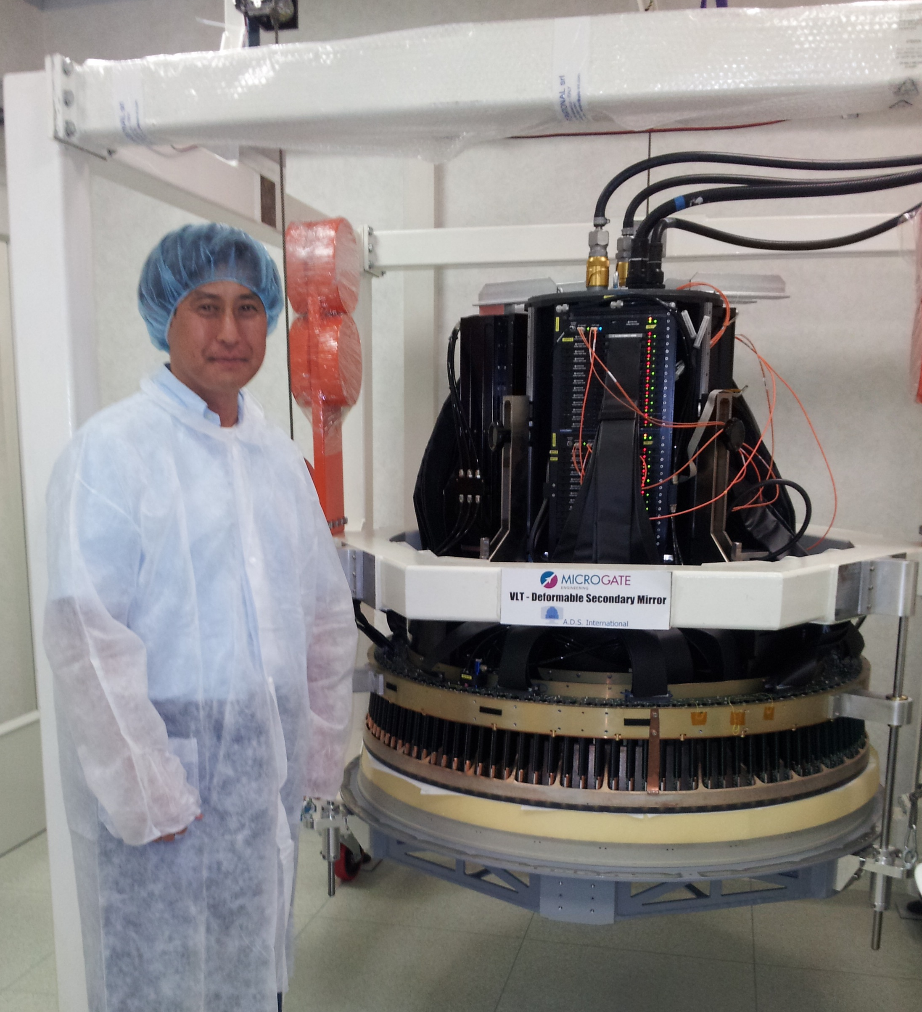
Adaptive Secondary mirror for VLT
Interface cables
(Power, Network, coolant)
Control electronics
Hexapods will be located around control electronics.
Actuator plate
Actuators
Reference plate
Thin shell mirror
Thin shell supporting foam

Slide 15
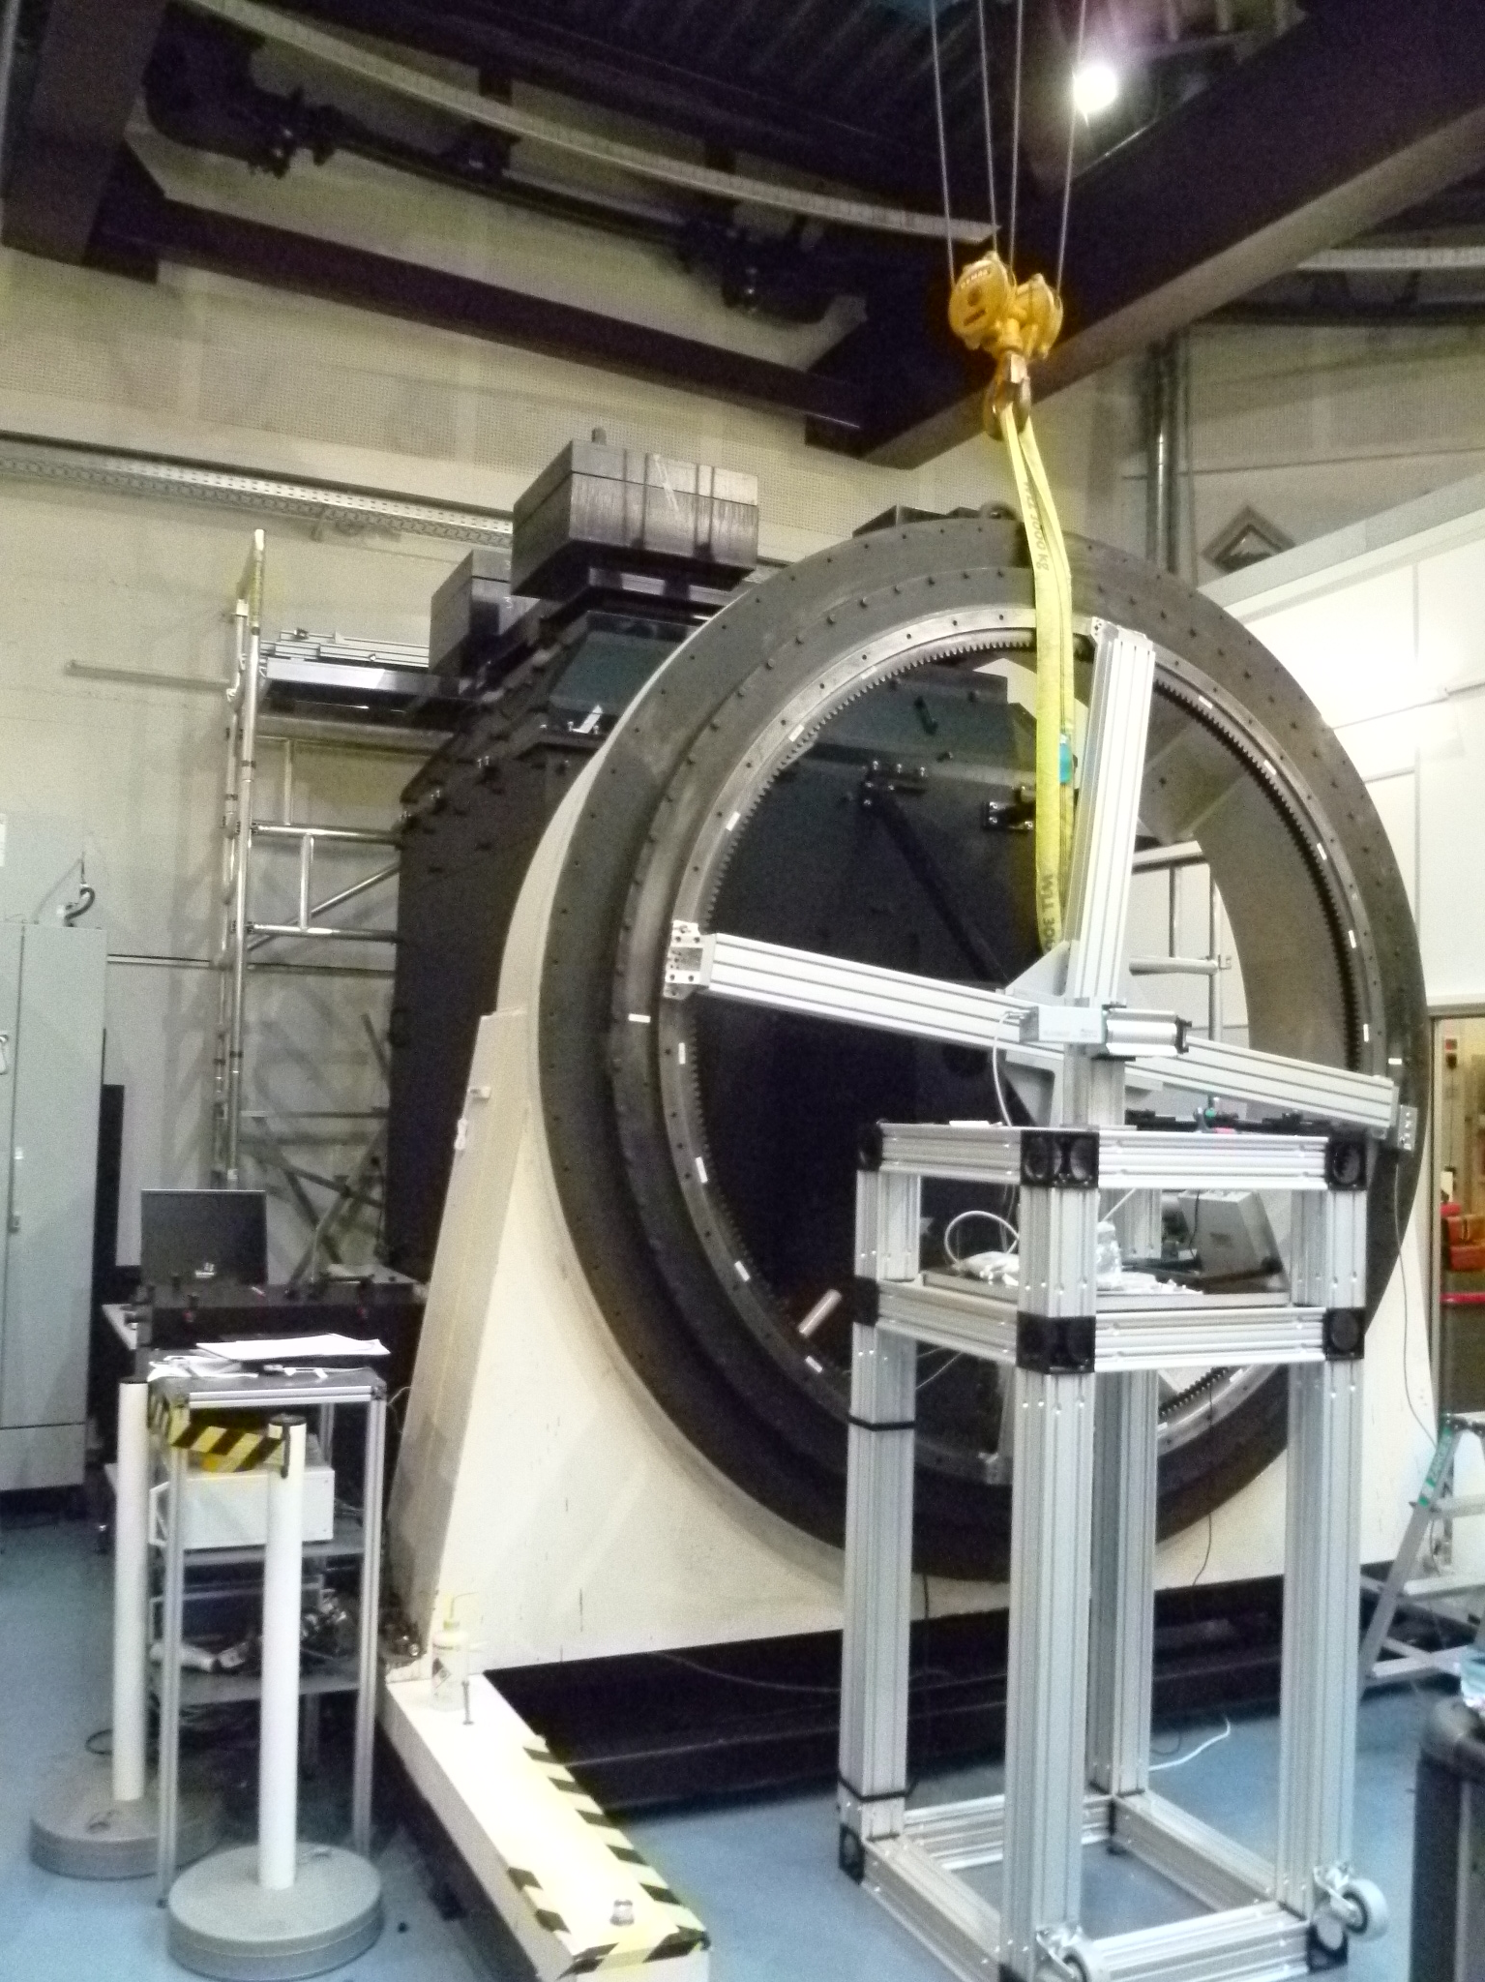
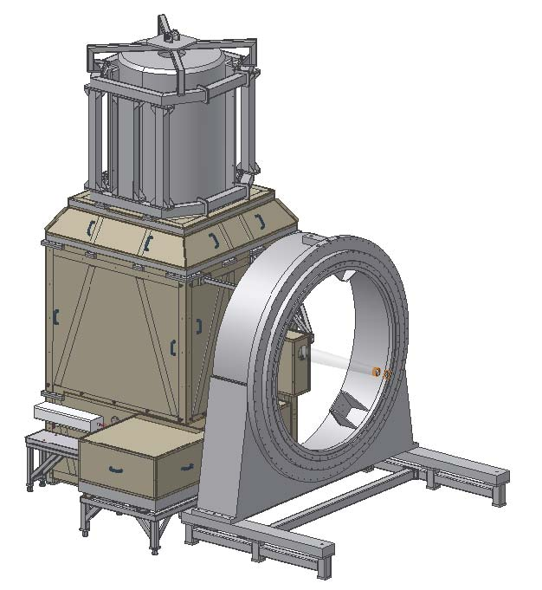
ASM test unit at ESO (ASSIST) (2012/11/13)

Slide 16
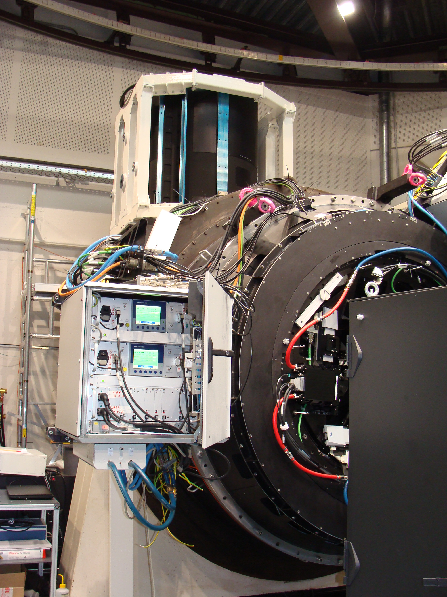
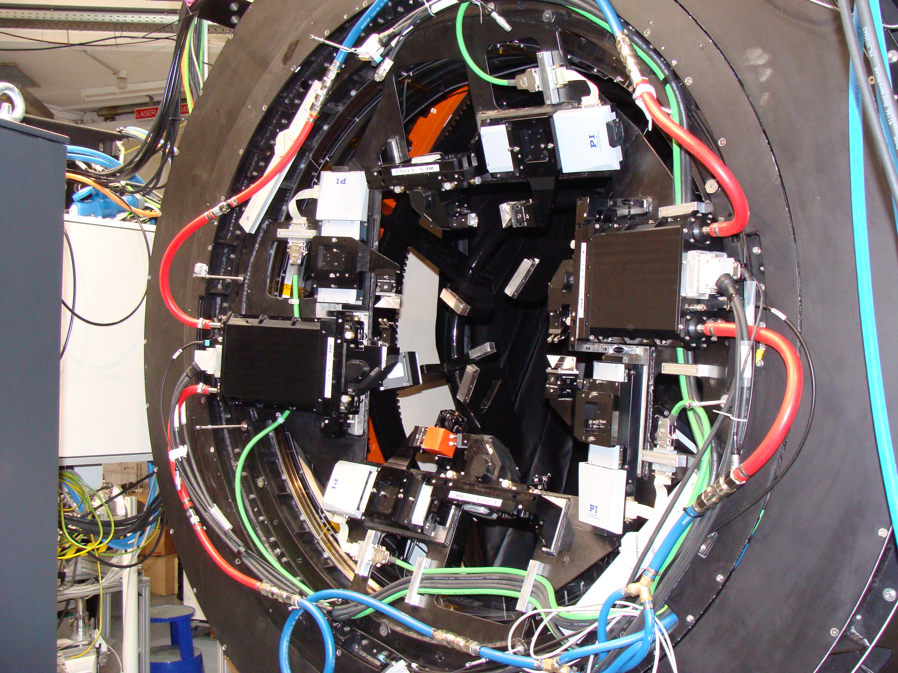
ASM test at ESO with GRALL (2013/3/27)

Slide 17
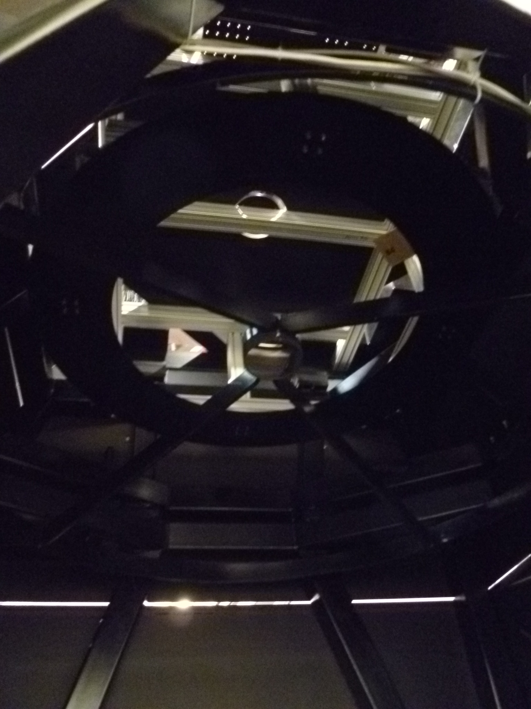
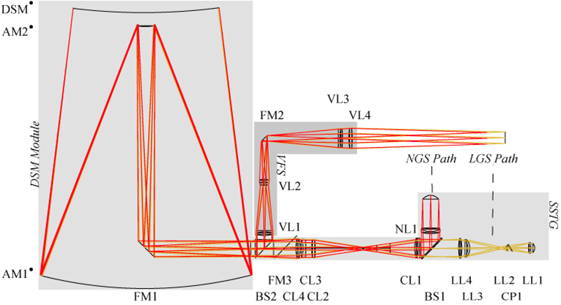
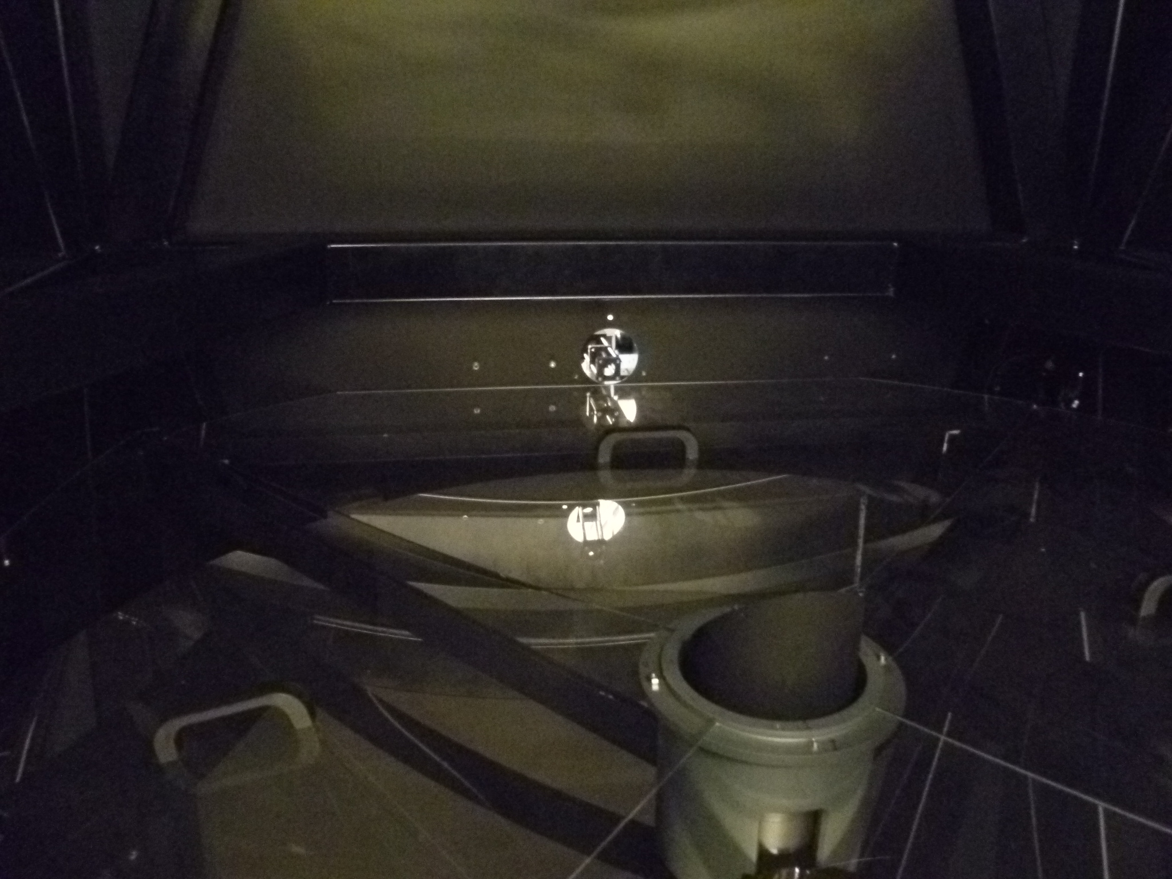

Slide 18
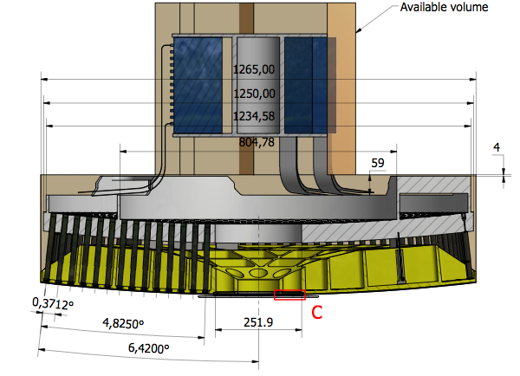
Subaru ASM model

Slide 19
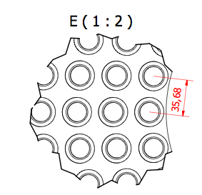
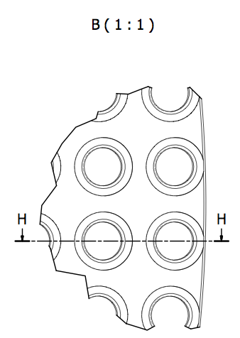
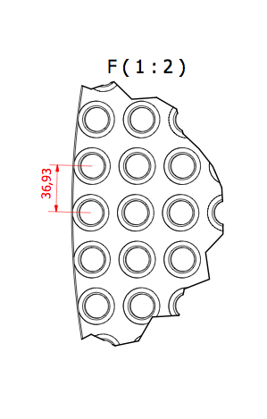
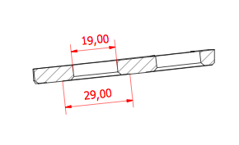
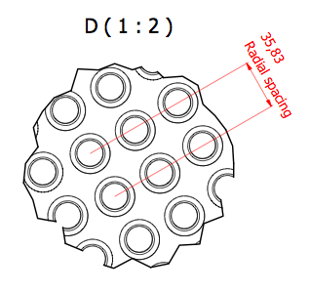


Slide 20
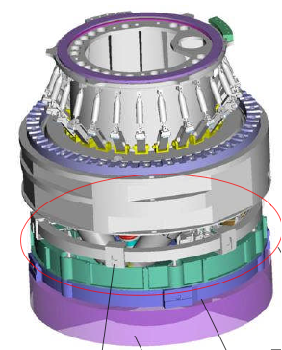
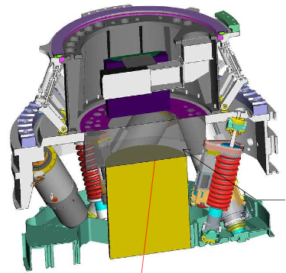

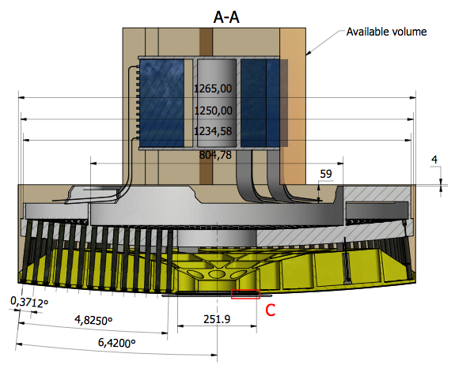


Interface to existing IR M2

Slide 21
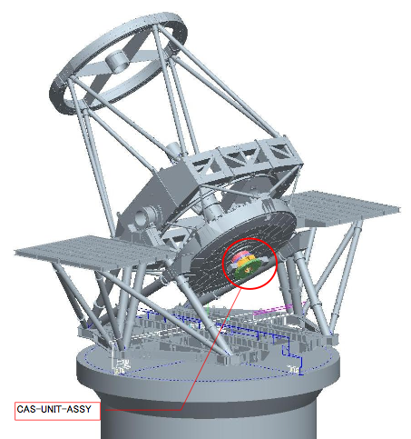
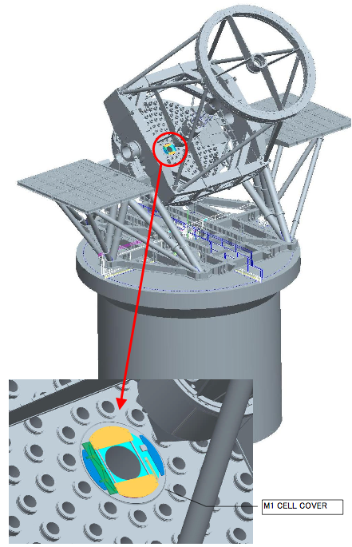
Vignetting by telescope structures
M3 Unit
Cassegrain Unit
M1 cell
cover

Slide 22
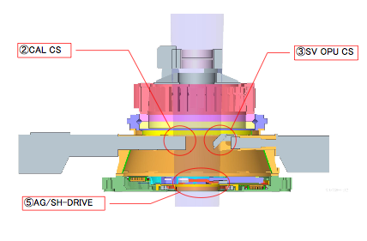
Cassegrain Unit
φ16 arcmin
① ADC
Remove
Remove
Remove
Modify

Slide 23
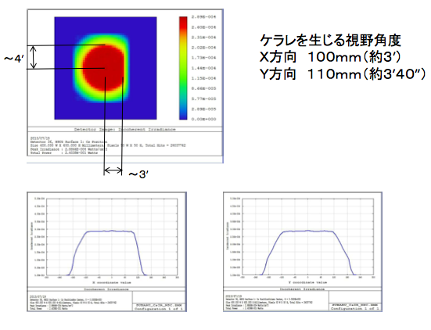
FOV at Cassegrain (current)

Slide 24
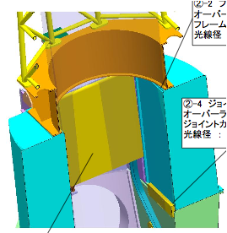
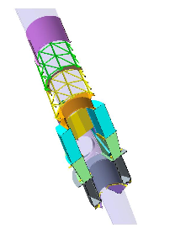
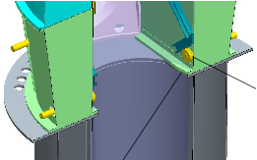
M3 unit
φ16 arcmin

Slide 25
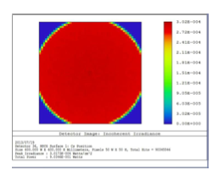
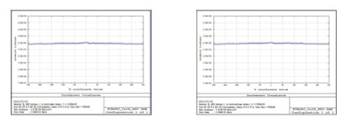
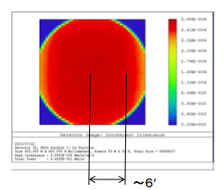
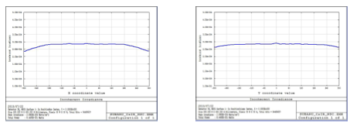
Expandable FoV at Cassegrain
Only M1, M2
With M3 unit
~ 8’

Slide 26
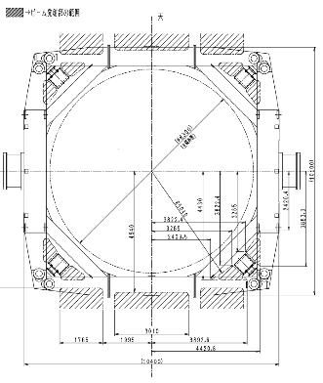
Location of LLT and laser head
Candidate location
Rear
Cable tray area (Use during M1 coating)
Walk way
Balance weight
Winch for mirror cover
IR
OPT
No longer exist
Cable wrap and duct at elevation axis (IR)
Cable wrap and duct at elevation axis (OPT)
Terminal box (lower center section)
Balance weight
Front

Slide 27
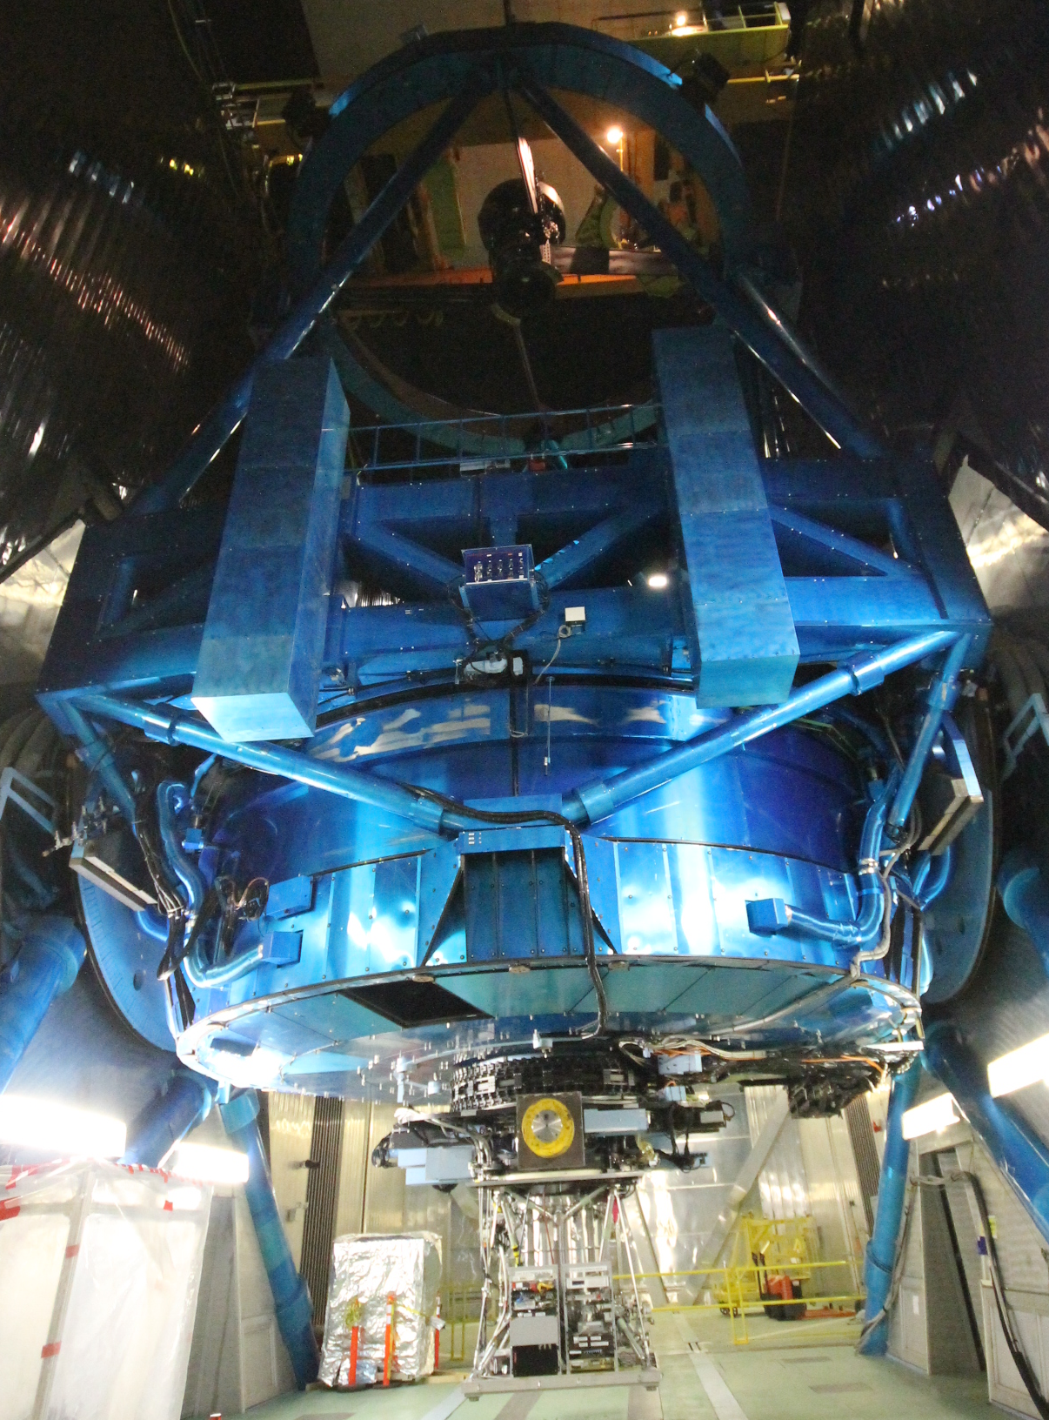
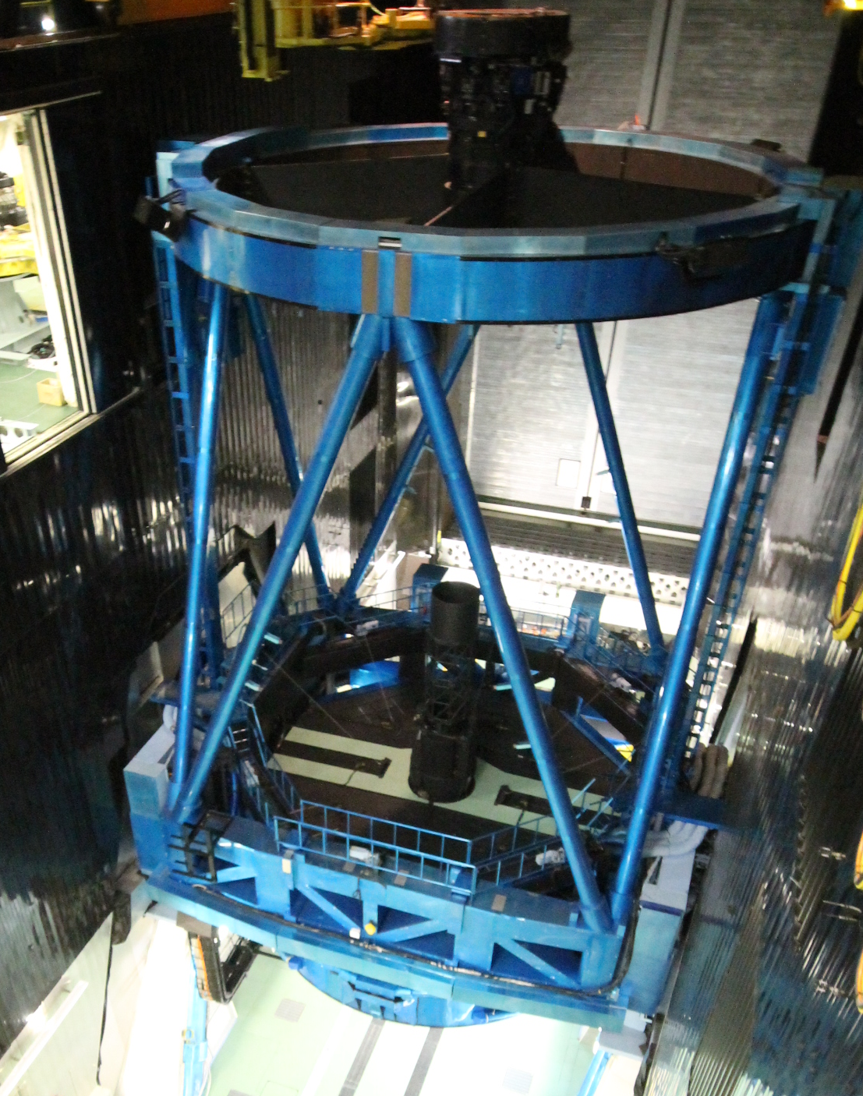
Candidate location for LLT

Slide 28
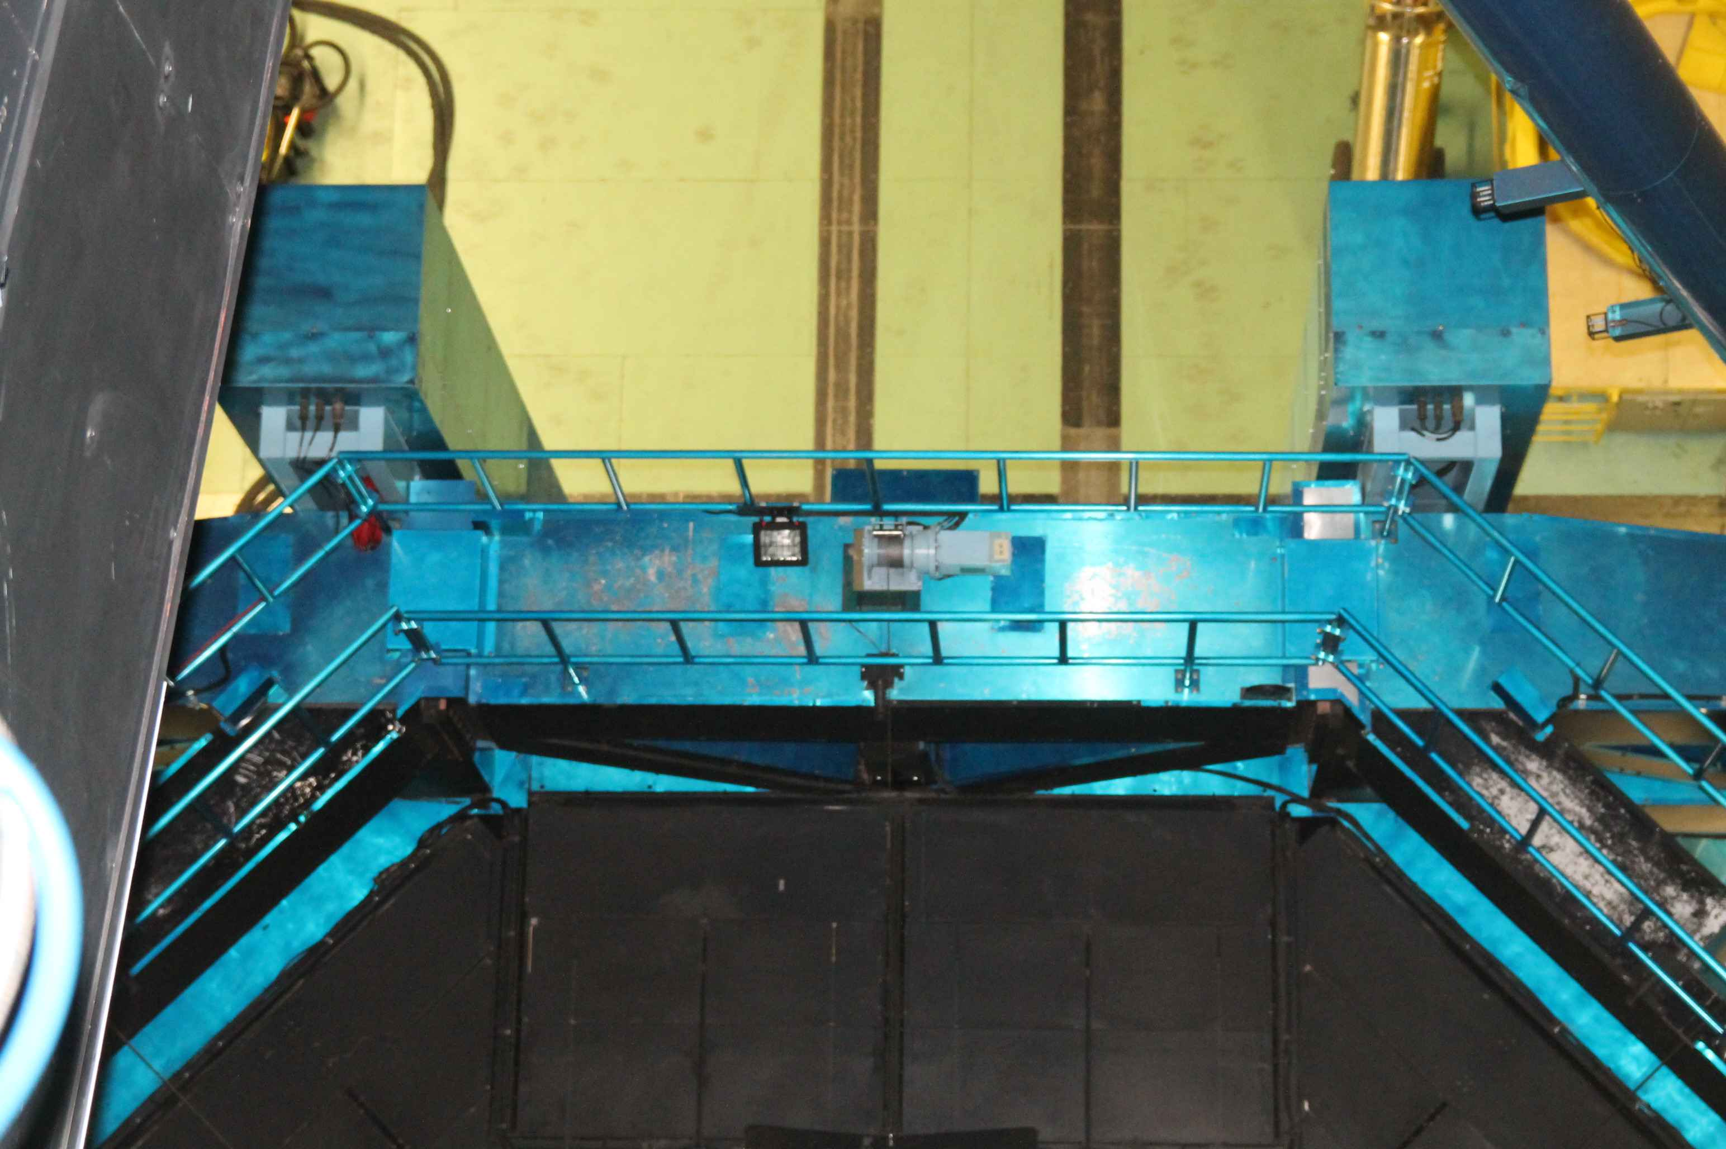
Front side
Laser head and
LLT location

Slide 29
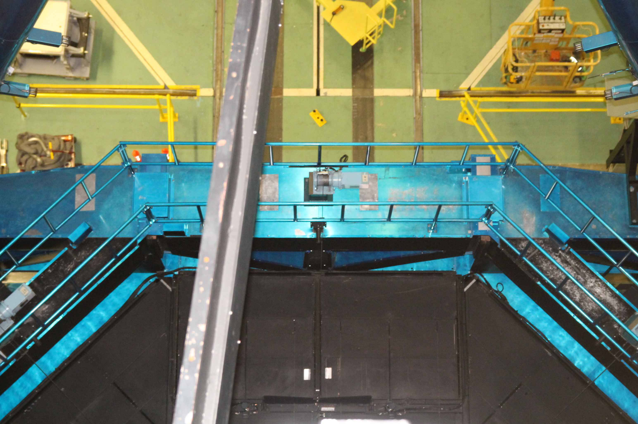
Rear side
Laser head and
LLT location

Slide 30
Feasibility study for NIR instrument
Optical design
w/wo field splitting
Change telescope optical parameters or not.
Optical components (CaF₂) < 400mm
Goal FWHM <0.15” over FoV and 0.8-2.5μm

Slide 31
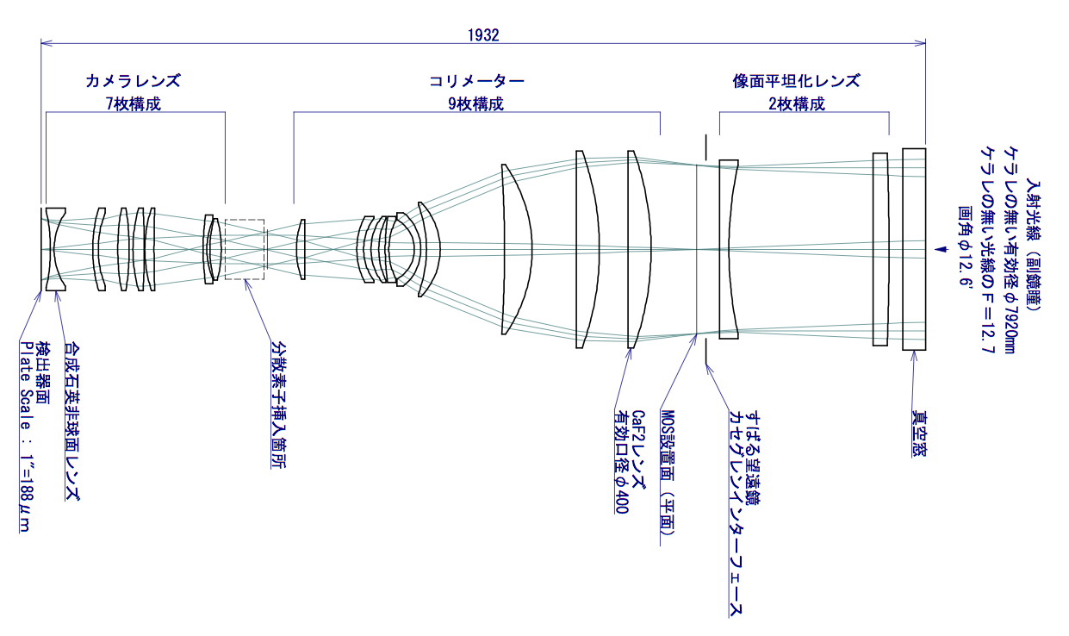

Wide-Field NIR Imager+Multi-Object Spectrograph (A case without FoV splitting)
Example of Optical Design
focusing lenses
collimating lenses
field flattener
input window
FoV 12.6’

Slide 32
Next step
Conceptual design review
International Collaboration
AAO、NRC, etc.
Adaptive secondary mirror
Interface to IR M2 unit.
Further design study with ADS, Microgate.
Fiber laser (TOPTICA/MPBC) upgrade
Budget application
Grant-in-Aid for Scientific Research on Innovative Areas, 2015-2019.

