Slide 1
GLAO instrument specifications and sensitivities
Yosuke Minowa

Slide 2
Simulated instruments as of 2013
Wide Field NIR imaging
  Broad-band (BB) imaging
  Narrow-band (NB) imaging
Multi-Object Slit (MOS) spectroscopy
  Emission line
  Continuum
KMOS type Multi-IFU spectroscopy
  Emission line

Slide 3
New Instrument Plan
Multi-object fiber IFU spectrograph
  Fiber-bundle IFU system
  Utilize “Starbugs” developed by AAO
  Each bundle consists of 37, 19, 61 fibers within φ~1.4, 1.0, 1.8 arcsec FOV.arcminute² FOV.
  Each fiber has 0.2 arcsec diameter.

Slide 4
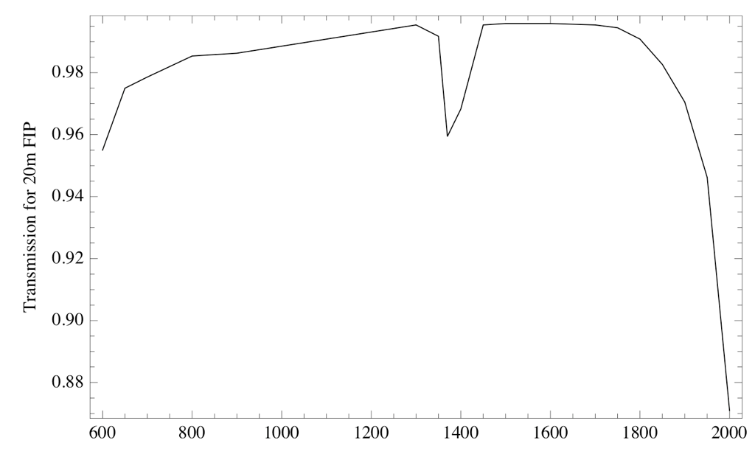
Fibre throughput model fibre only, no coupling losses or FRD
Wavelength (nm)

Slide 5
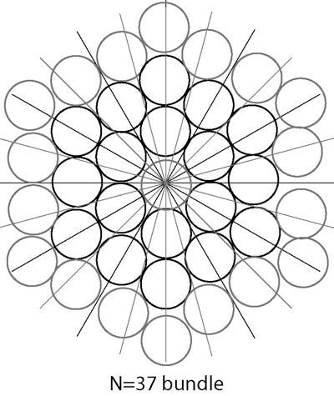
Fibre Bundle Configuration (1)
Number of fibres | 37 (7 fibres on an axis)
Spatial sampling | 0.2 arcsec / fibre
Bundle sky diameter | 1.4 arcsec (point to pint)
Number of detector pixels per fiber | 4
Number of pixels per bundle | 148
Number of bundles per 2k detector | 13 (1924 pixels; plus sky fibers?)
Object Multiplicity (MOIRCS) | 26
Sky Fibres/detector | 30 sky fibres with 1 fibre gap

Slide 6
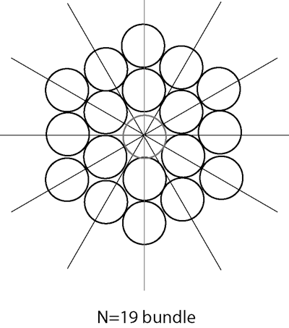
Fibre Bundle Configuration (2)
Number of fibres | 19 (5 fibres on an axis)
Spatial sampling | 0.2 arcsec / fibre
Bundle sky diameter | 1.0 arcsec (point to pint)
Number of detector pixels per fiber | 4
Number of pixels per bundle | 76
Number of bundles per 2k detector | 26 (1976 pixels; plus sky fibers?)
Object Multiplicity (MOIRCS) | 52 (feasible??)
Sky fibres /detector | 17 sky fibres with a 1 fibre gap

Slide 7
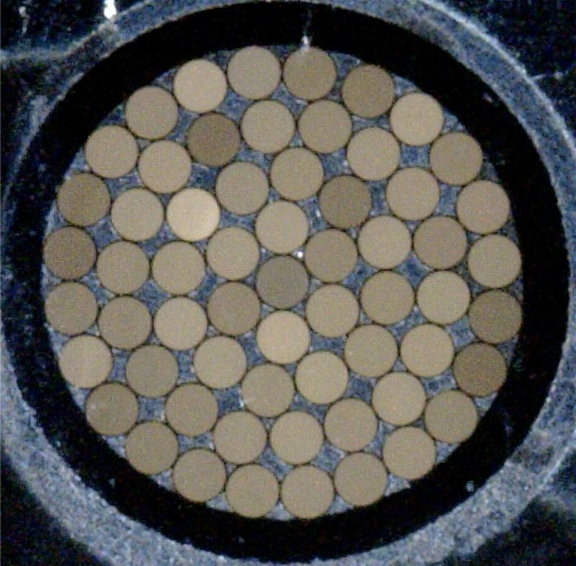
Fibre Bundle Configuration (3)
Number of fibres | 61 (9 fibres on an axis)
Spatial sampling | 0.2 arcsec / fibre
Bundle sky diameter | 1.8 arcsec (point to point)
Number of detector pixels per fiber | 4
Number of pixels per bundle | 244
Number of bundles per 2k detector | 8 (1952 pixels; plus sky fibers?)
Object Multiplicity (MOIRCS) | 16
Sky fibres/detector | 23 sky fibres plus 1 fibre gap
N=61 bundle (Bryant et al. 2014, MNRAS 438, 869)

Slide 8
Instrument setup
Starbugs unit will be attached to the Cassegrain focus
Spectrograph will be placed at the observation floor or at Nasmyth platform and connected to the starbugs with fibers.
  F-conversion might be necessary to reduce the F# (12.4à→(e.g. 3.0) and avoid the effect of FRD(?)
  Throughput of the fiber will be (e.g. 90%@NIR).
Fiber will be connected to the fiber slit in the focal plane module, which is placed in the cryogenic condition.
  Minimum spacing in between fiber centers should be 4 pixels or larger and the minimum spacing between the 90% EE diameter of each adjacent fiber should be 1 pixel or larger to avoid significant cross-talk and ensure the accuracy of the sky subtraction (<0.5%? based on PFS study).
  F-conv. optics in side of the FP module might be necessary to change the F# back to the original (12.4) or to the optimum number for the spectrograph.

Slide 9
Phase-I: Starbug+ New MOIRCS
First light instrument for GLAO
  Commissioning obs. will start from around 2017?
  Observations with OH suppression 2020?.
Number of bundles:
  (1) HK500, zJ500, R1300+BB(JHK), VPH: 26 (config 1); 52 (config 2); 16 (config 3)
  (2) R1300 or VPH + Narrow-band or Intermediate band filters: 78 (config 1); 156 (config 2); 48 (config 3)
Sensitivity: 60-70% of MOSFIRE/Keck (MOIRCS VPH only)
Sensitivity: 75- 85% of KMOS/VLT (MOIRCS VPH only)
Need to multiply by 70-80% efficency for fiber system
MOIRCS will be moved to the observation floor or Nasmyth platform and connected to the starbugs with fibers.
Focal plane unit of MOIRCS will be modified so as to feed the light into slits from fibers.

Slide 10
Phase-II: Starbug +new dedicated instrument
First light will be several years after GLAO commissioning
Number of bundles:
  52 (config 1); 104 (config 2); 32 (config 3) for each spectrograph!
  Φ13’.5 FOV
Sensitivity: 70-80% of MOSFIRE/Keck
  Sensitivity of the spectrograph should be same as or higher than MOSFIRE.
  Only difference is throughput and emissivity due to the fibers.
  Not including telescope diameter difference
New instrument will be placed on the observation floor or Nasmyth platform and connected to the starbugs with fibers.

Slide 11
Sensitivity comparison with MOSFIRE
 | MOIRCS |  | MOSFIRE
 | Current | New
FOV | 4’x7’ |  | 6’.1x6’.1
Imaging throughput (atm+Telescope+Instrument) | 0.23(J), 0.34(H),0.30(K) |  | 0.54(J),0.56(H),0.50(K)
Spectral resolution | 500, 1300, ~3000(VPH)* |  | 3500
Grating diffraction efficiency | HK500, zJ500: 0.8(J), 0.78(H), 0.65(K) R1300: 0.2(J), 0.3(H), 0.5(K) VPH: ~0.75(J), ~0.7(H) 0.80(K) |  | 0.60(J), 0.65(H),0.70(K)
Spec. throughput (atm+Telescope+Instrument) | HK500, zJ500: 0.18(J), 0.26(H), 0.20(K) R1300: 0.05(J), 0.10(H), 0.15(K) VPH: ~0.15(J), ~0.20(H), ~0.26(K) |  | 0.325(J), 0.361(H), 0.350(K)
Detector | HAWAII-2 | HAWAII-2RG | HAWAII-2RG
QE | ~80%(JHK) |  | ~80%(JHK)
Read-out noise | 15e rms (16NDR) | 5e rms (16NDR) | 5e rms (16NDR)
* For 0.5” slit. Using a fiber with 0.2” spatial sampling, resolutions are 2.5 times higher.

Slide 12
Sensitivity Improvement of MOIRCS
HAWAII2 => H2RG
  Readout noise: 15e- => 5e-
Grism replacement
  System throughput: 15%(R1300) => 25%(R2000)
Sharp and stable image with GLAO
Improvement of emission line sensitivity
  Point source: >1.2 mag. (>3x)
  Extended source: ~0.5 mag. (~1.6x)

Slide 13
Sensitivity comparison with MOSFIRE
Current MOIRCS sensitivity is 4~7 times lower than MOSFIRE (difference in the telescope diameter is not taken into account).
If the new MOIRCS can successfully reduce the RO-noise down to 5e-, the sensitivity difference is about 1.4(VPH)~2.3(R1300).
This difference can not be reduced without changing the optical coating.
  MOSFIRE has 31 surfaces
  Average throughput in each surface is about 0.992.
  Total throughput of the optical coating is about 0.78
  MOIRCS has 24 surfaces.
  Average throughput of the coating is 0.983.
  Total throughput of the coating is 0.64.

