Slide 1
Microscopic views of galaxy formation and environmental effects with ULTIMATE-Subaru
Subaru GLAO-WS (2014/7/29, Mitaka)
Yusei Koyama (ISAS/JAXA)
MAHALO-Subaru collaboration

Slide 2
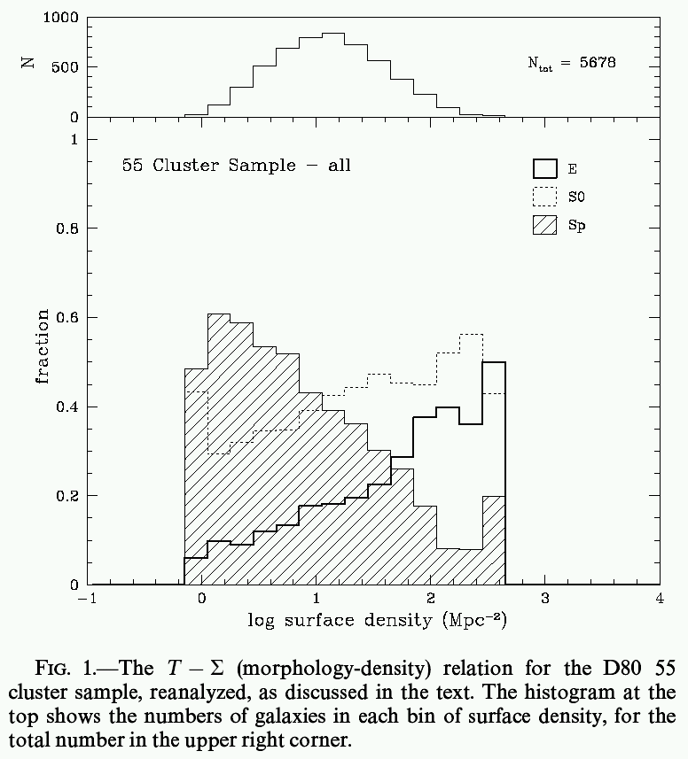
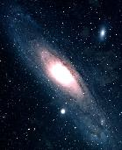
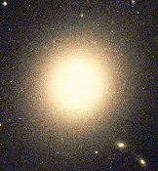
Galaxy evolution & environment
“ Morphology–Density Relation”
Spiral
red, old, low SF activity
E
S0
blue, young, high SF activity
Low-density
High-density
(Dressler 1980)
Notes:
2

Slide 3
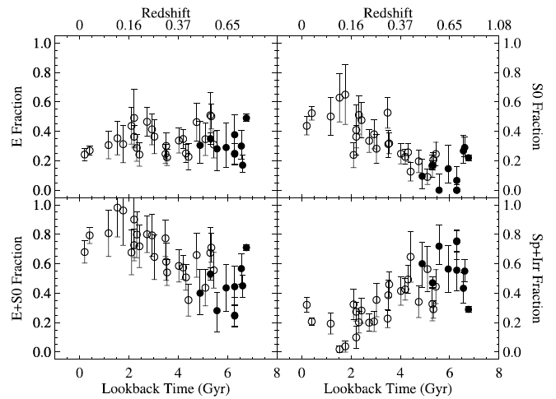
Morphological evolution in clusters
Rapid increase of S0s since z~1 coupled with decrease of spirals.
E
S0
Sp
(Desai et al. 2007)

Slide 4
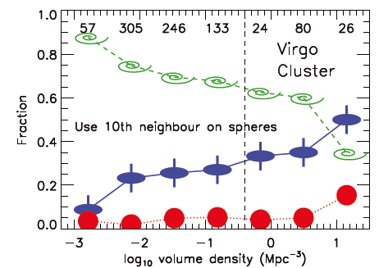
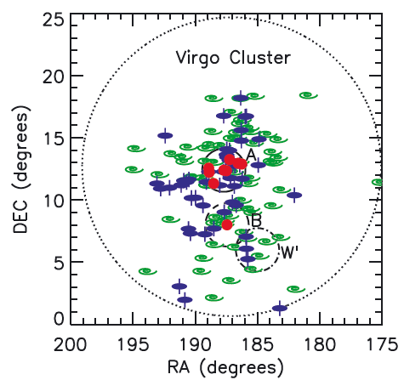
“Kinematical” M-D relation
A new look of the morphology-density relation from ATLAS-3D.
・Slow rotators:
- Little/no rotation, misalignment bet- ween photometric and kinemetric axes.
・Fast rotators:
- Regular disk-rotating early-types.
Understanding the kinematical evolution of galaxies and the role of environment is becoming increasingly important.
(Cappellari et al. 2011)

Slide 5
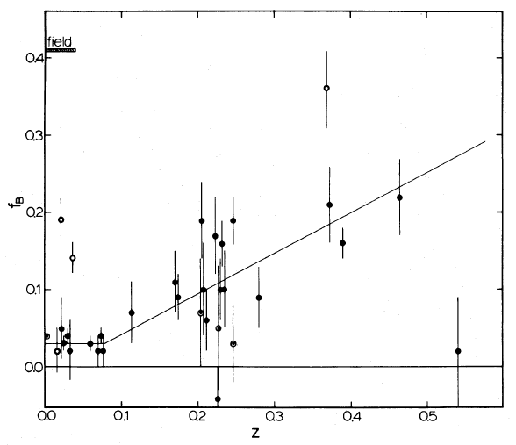
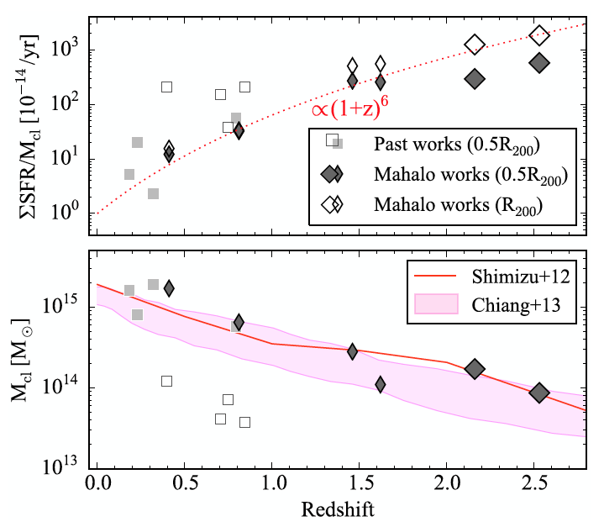
Star formation in clusters
・Butcher-Oemler effect :
- SF (blue) galaxy fraction is higher in higher-redshift clusters.
f(SF gals)
(Butcher & Oemler 1984)
ΣSFR/Mcl
・Cluster specific-SFR :
- Cluster-mass-normalised SFR shows rapid decline since z~2. Accelerated SF quenching in cluster environments?
(Shimakawa et al. 2014)

Slide 6
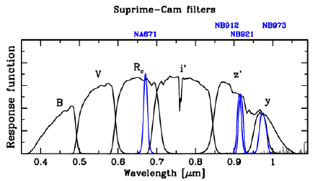
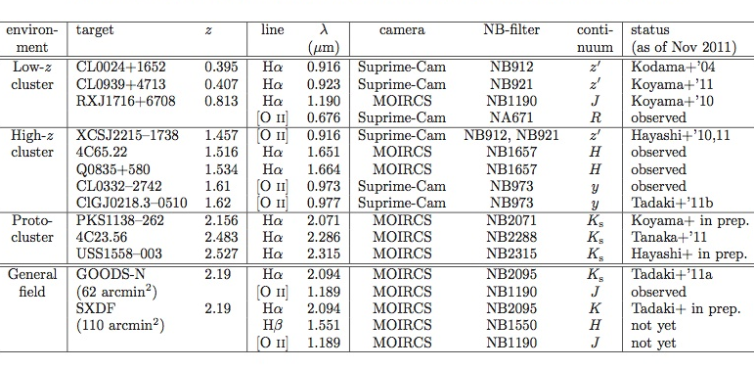
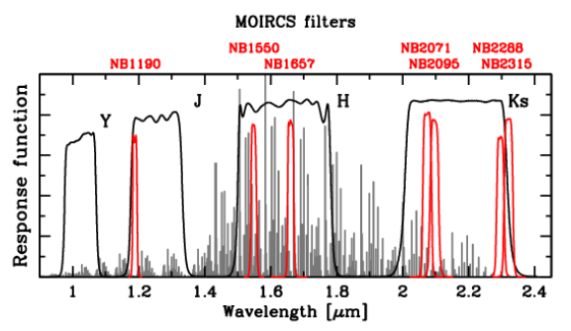
MAHALO-Subaru project
Collaborator: T. Kodama (PI), M. Hayashi, K. Tadaki, I. Tanaka, R. Shimakawa, T. Suzuki, M. Yamamoto
MApping H-Alpha and Lines of Oxygen with Subaru
Narrow-band Hα/[OII] emission-line survey for 0.4<z<2.5
Jul. 2014
,14
Koyama+ ‘14
Tadaki+’12
Koyama+’13a
Hayashi+’12
Tadaki+’13,14

Slide 7

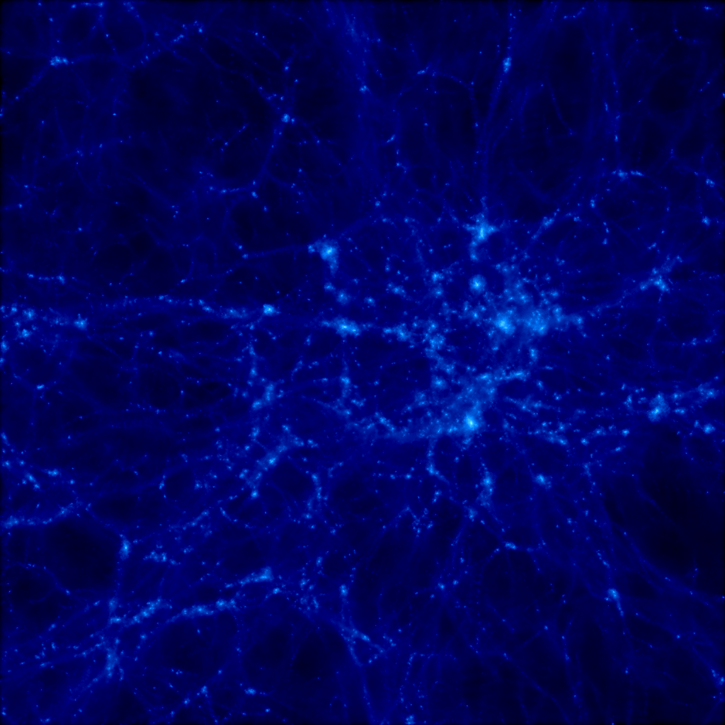
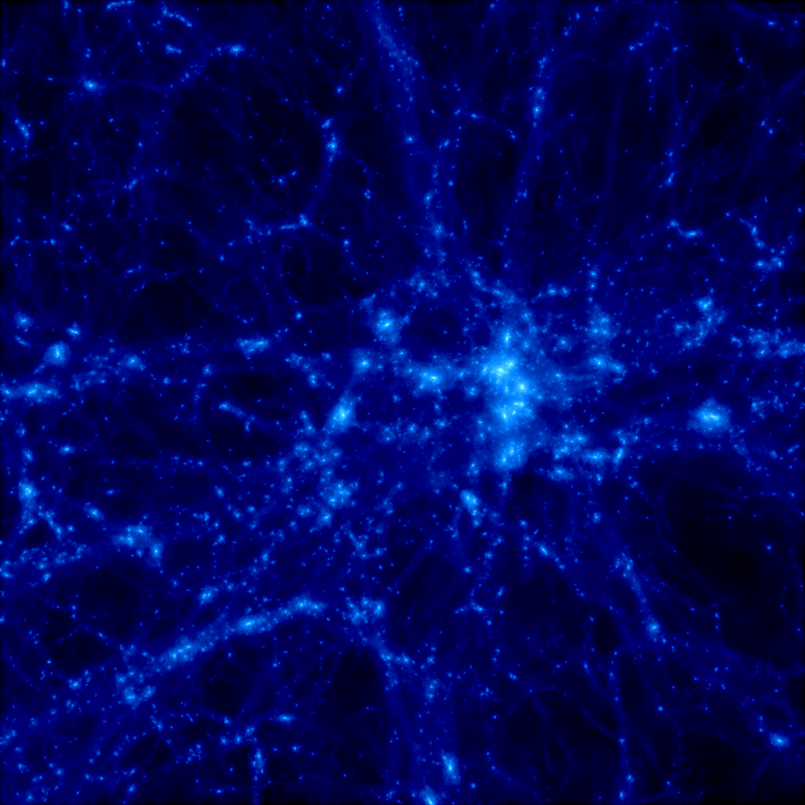
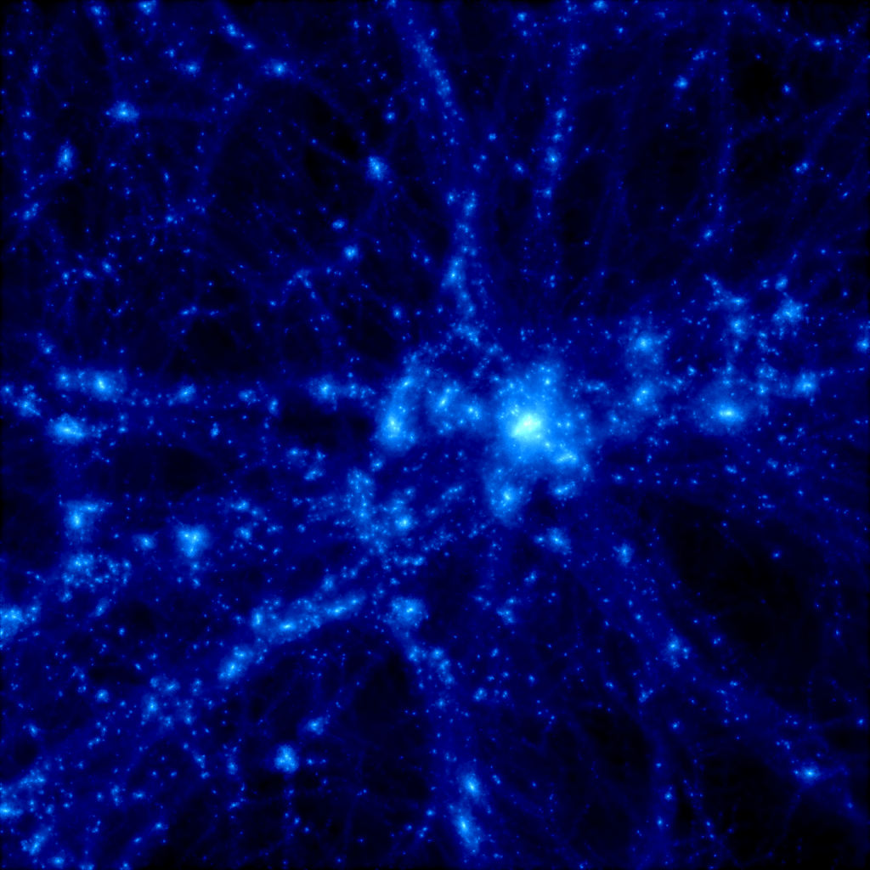
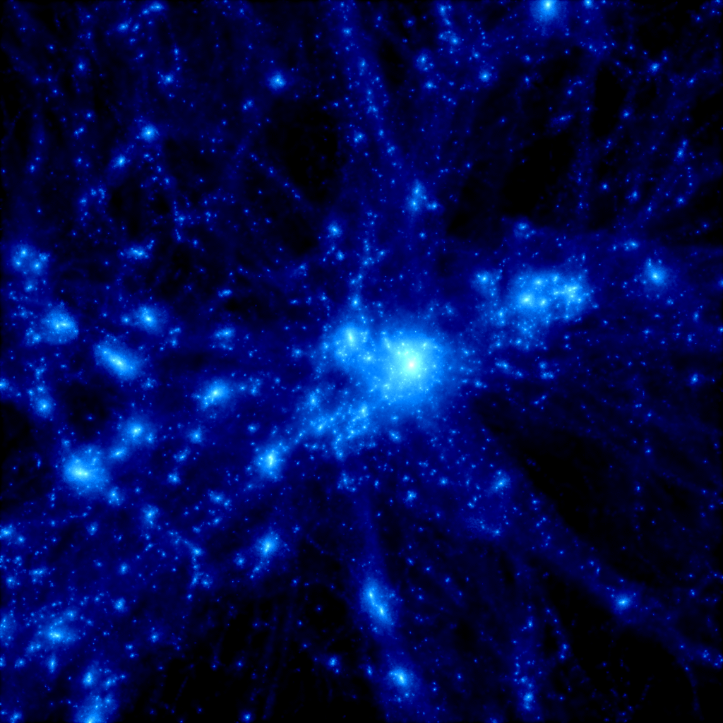
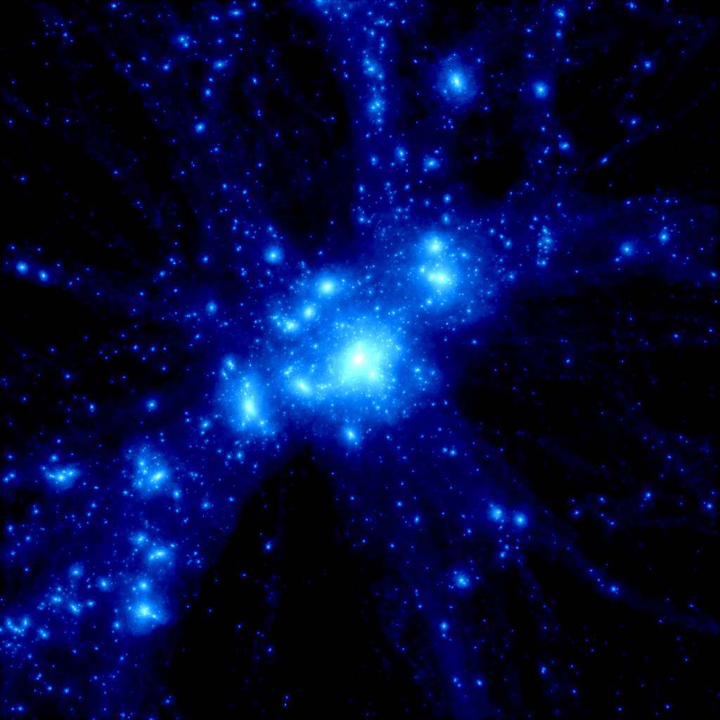
Big advantage of Subaru
z = 30
z = 5
z = 3
MOIRCS
z = 2
z = 1
z = 0
MOIRCS
(4’ x 7’)
Suprime-Cam (34’ x 27’)
M=6×10¹⁴ Msun, 20Mpc×20Mpc (co-moving)
Yahagi et al. (2005)

Slide 8
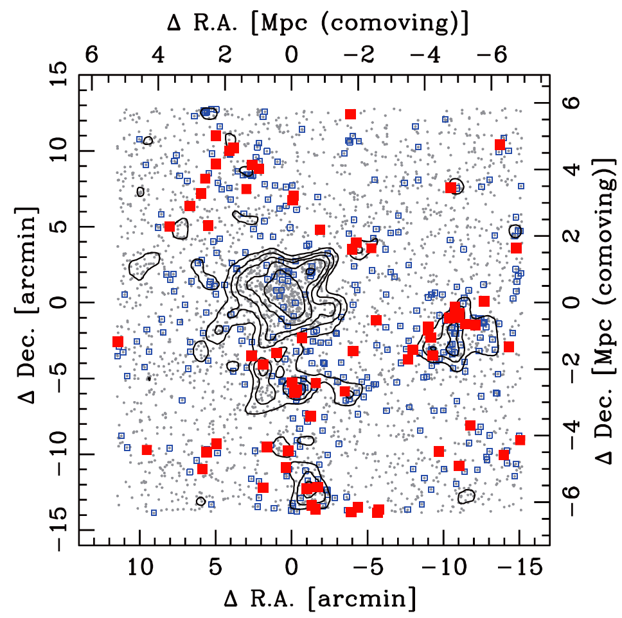
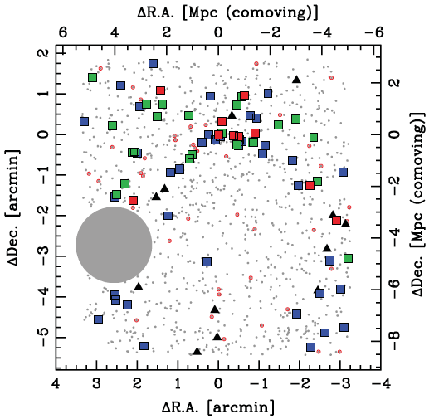
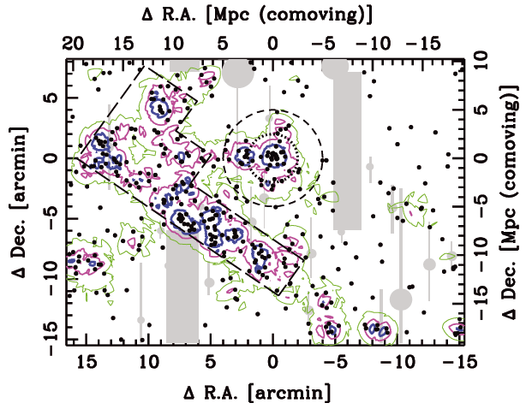
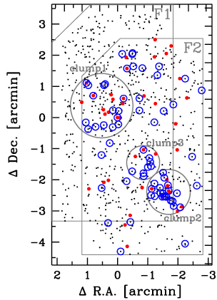
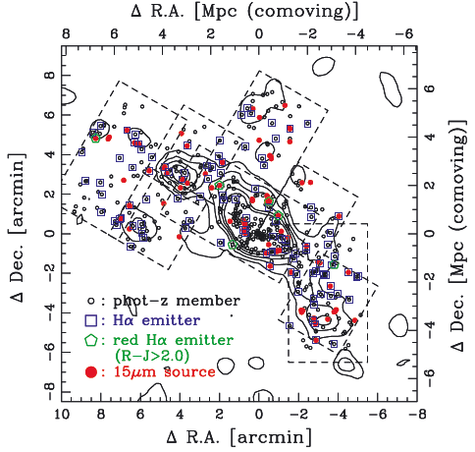
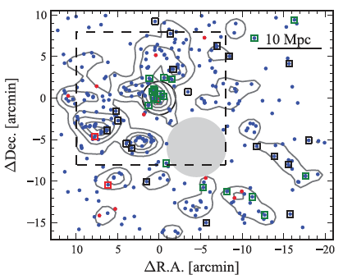
High-z structures revealed by MAHALO
(Hayashi+10, 11)
z=2.2
z=0.4
(Koyama+13)
(Koyama+11)
z=1.5
Many strong emitters
in z>1.5 cluster cores
(Tadaki+12)
z=0.8
z=2.5
z=1.6
(Koyama+10)
(Hayashi+12)

Slide 9
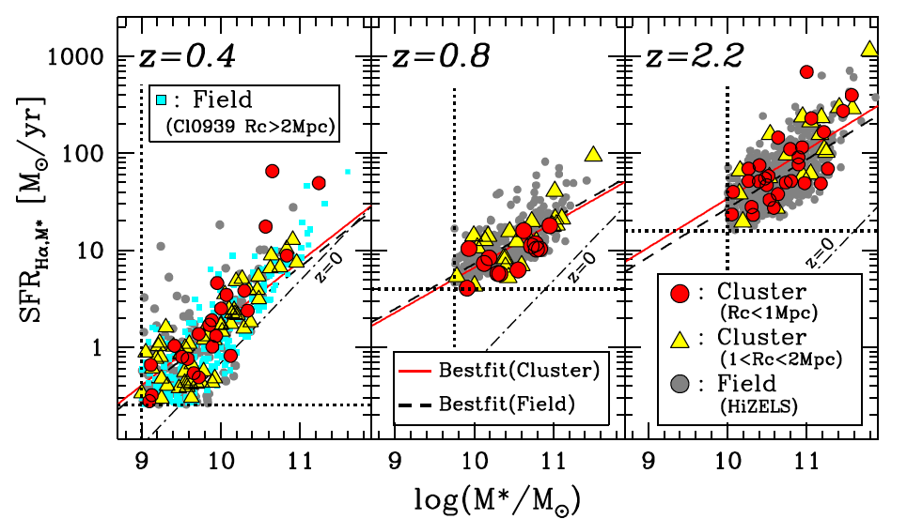
Cluster vs. Field comparison out to z~2
The MS location is always independent of environment since z~2 !
From L(Hα) + M★-dependent dust correction
From rest-frame
R-band photometry
+ M/L correction
Hα emitters with EWr > 30A
(Koyama et al. 2013b, MNRAS, 434, 423)

Slide 10
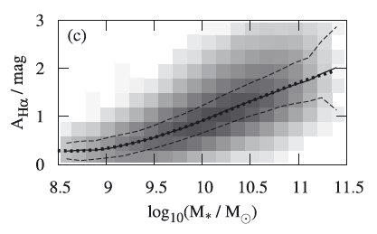
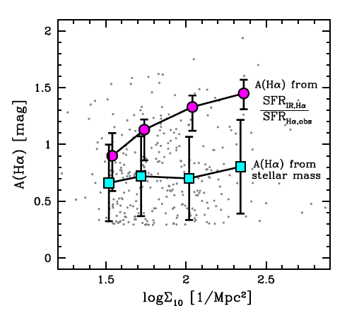
Dust extinction vs. environment (z=0.4)
Higher dust extinction (different SF mode) in high-density env?
AHα-M★ relation (z=0)
A(Hα) from
SFR(IR)/SFR(Hα)
z=0.4 sample
(Garn & Best 2010)
A(Hα) from
A(Hα)-M★ relation
(Garn & Best 2010)
(Koyama et al. 2013b)

Slide 11
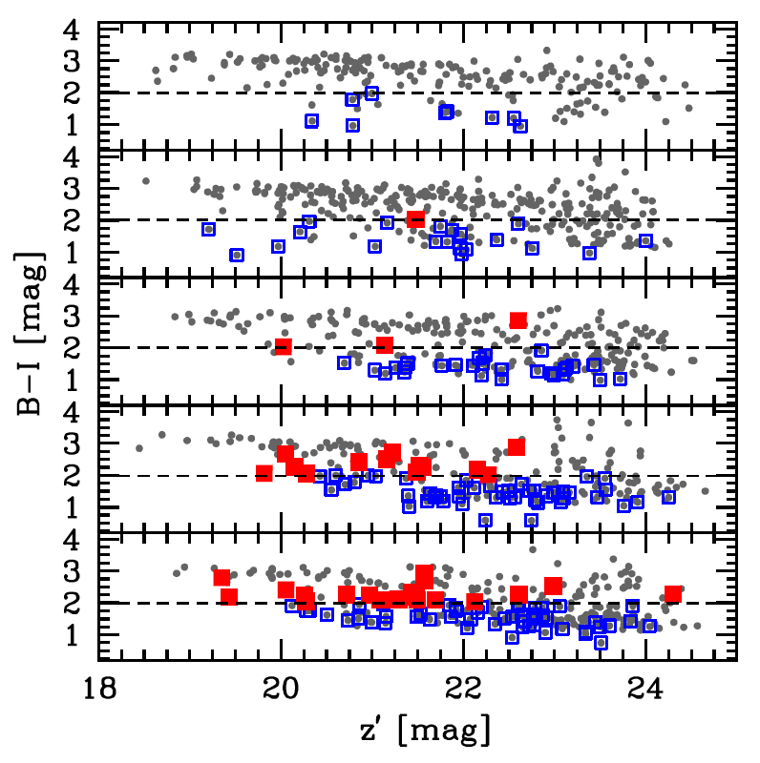
Red star-forming galaxies
A key population most frequently seen in group-scale environments
Abell851 (z=0.4)
Rc<0.5 Mpc
0.5<Rc<1.0 Mpc
1.0<Rc<1.5 Mpc
West Clump
Groups
■:red Hα emitter (B-I>2)
□:blue Hα emitter (B-I<2)
(Koyama et al. 2011)

Slide 12
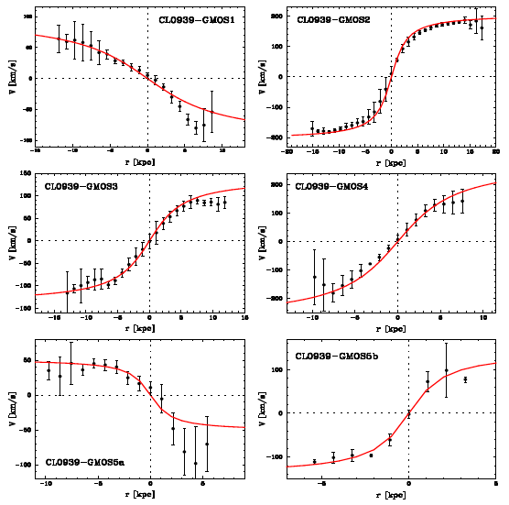
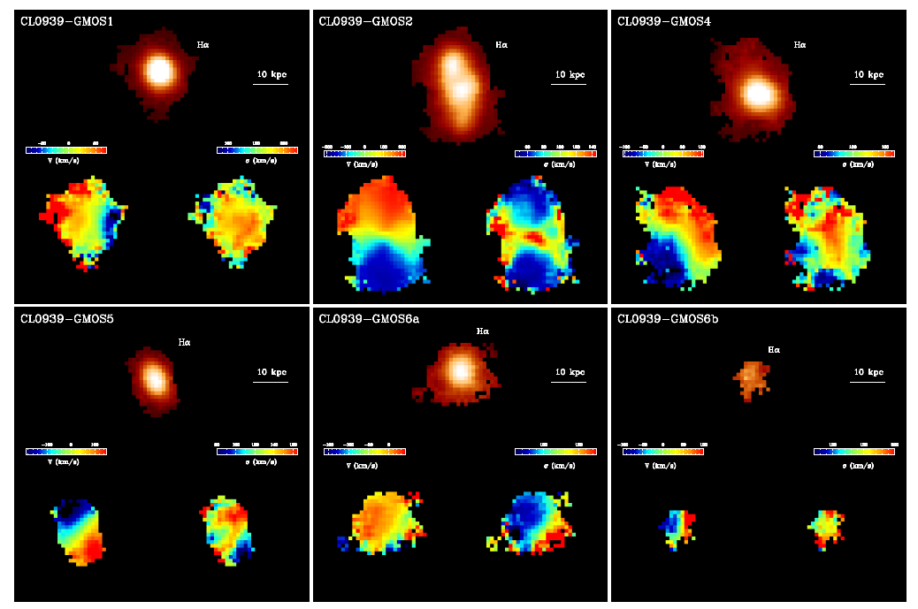
Red SF galaxies: progenitors of local S0s?
3-D views of red SF galaxies (z=0.4) with GMOS+IFU observation.
Hα
V
σ

Slide 13
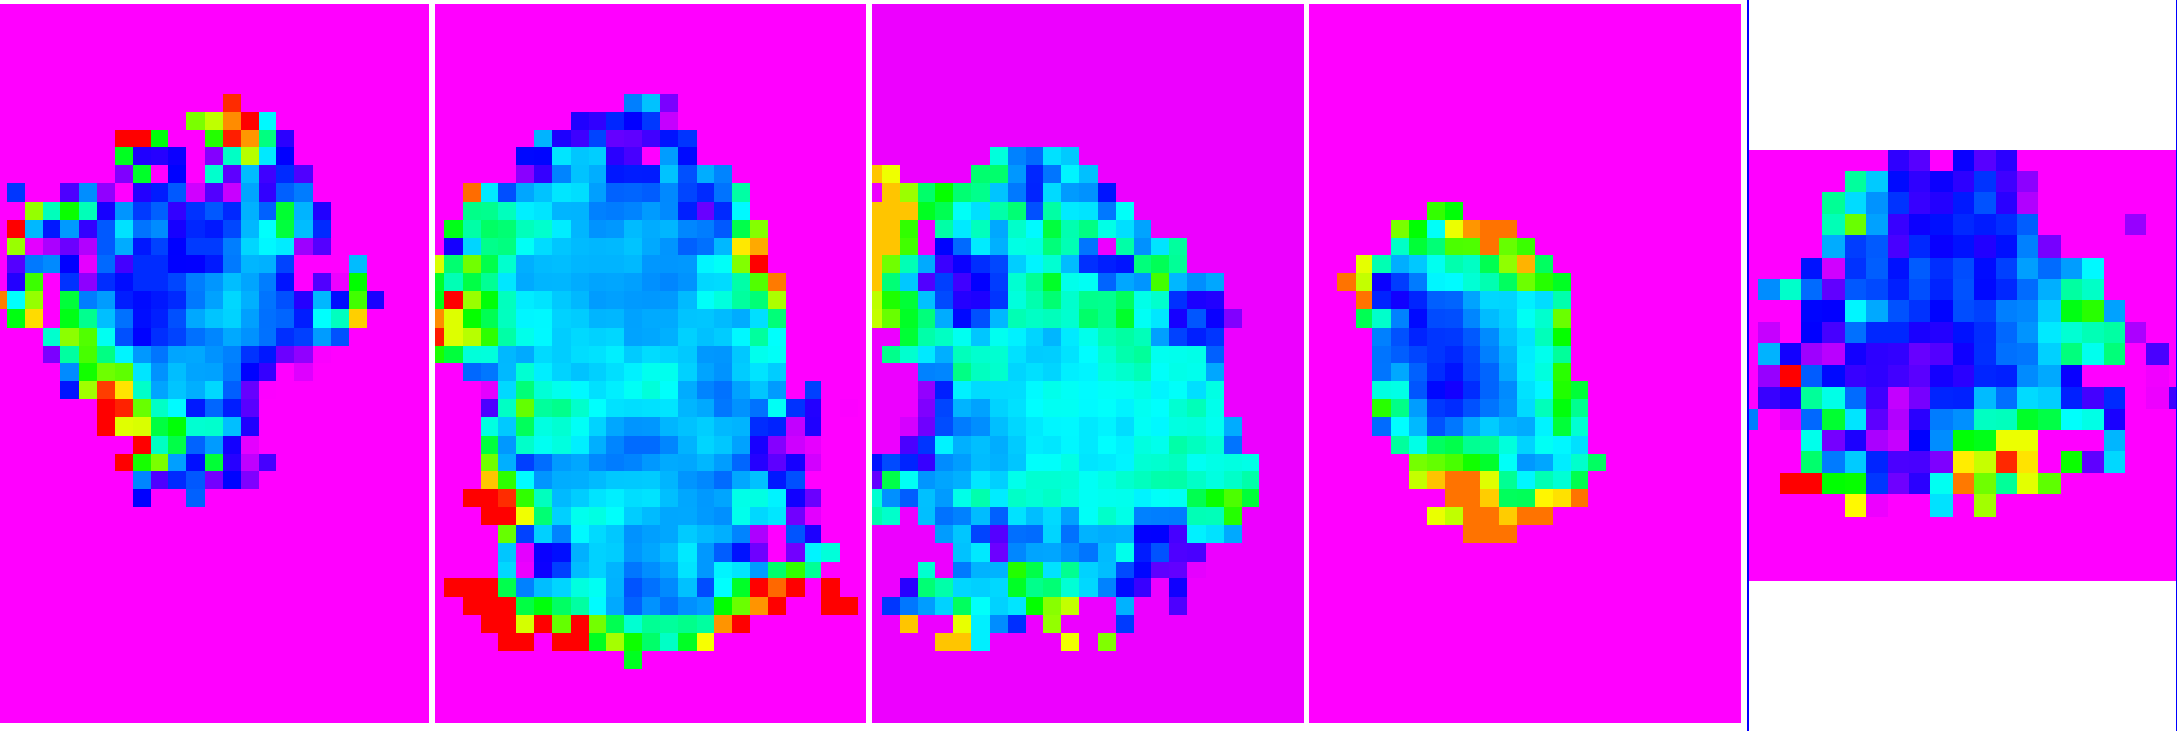
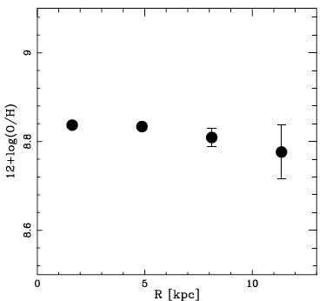
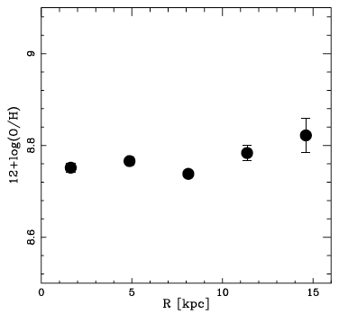
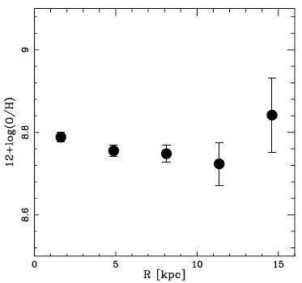
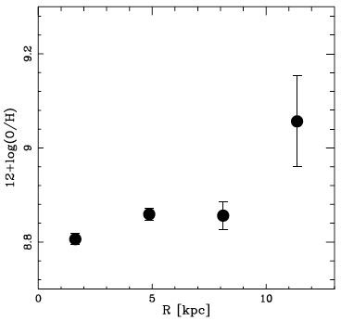
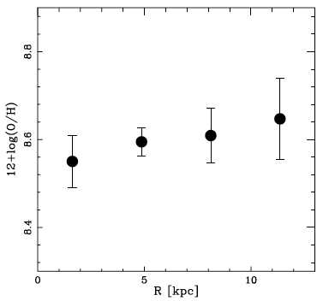
Metallicity gradient of red SF galaxies
Constant [NII]/Hα over the galaxies, but some hints of positive gradient?
CL0939-GMOS1
CL0939-GMOS2
CL0939-GMOS3
CL0939-GMOS4
CL0939-GMOS5
1” (5 kpc)

Slide 14
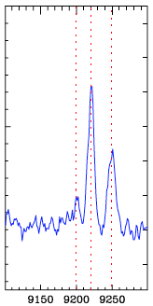
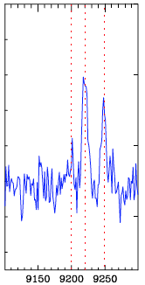
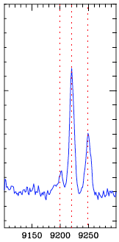
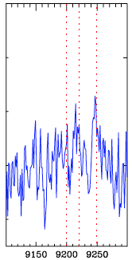
Metallicity gradient of red SF galaxies
Constant [NII]/Hα over the galaxies, but some hints of positive gradient?
CL0939-GMOS1
CL0939-GMOS2
CL0939-GMOS3
CL0939-GMOS4
CL0939-GMOS5
1” (5 kpc)

Slide 15
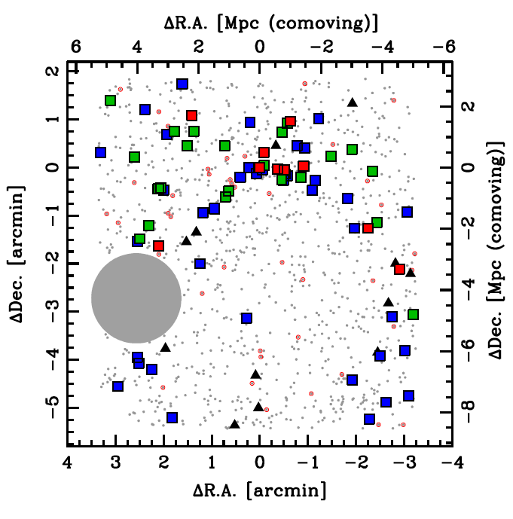
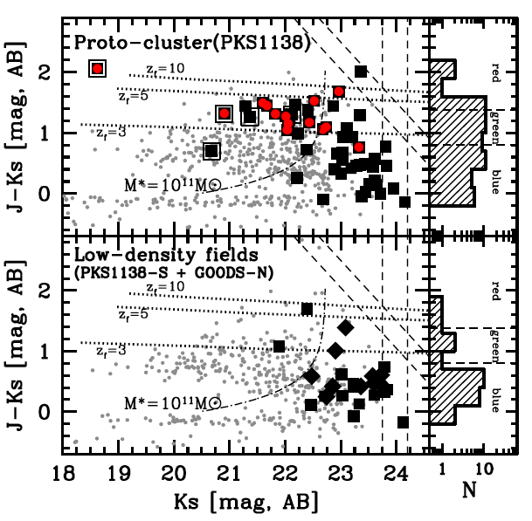
Massive SF galaxies in z>2 proto-cluster
Our MOIRCS+NB(Hα) survey revealed red Ηα emitters dominate the core of z=2.16 proto-cluster (PKS1138-262).
: 24um-source
■: red HAE (J-K>1.4)
■: green HAE (0.8<J-K<1.4)
■: blue HAE (J-K<0.8)
Red emitters are massive (M★ >10¹¹M), and clearly dominate dense environment at z~2.
(Koyama et al. 2013a)

Slide 16
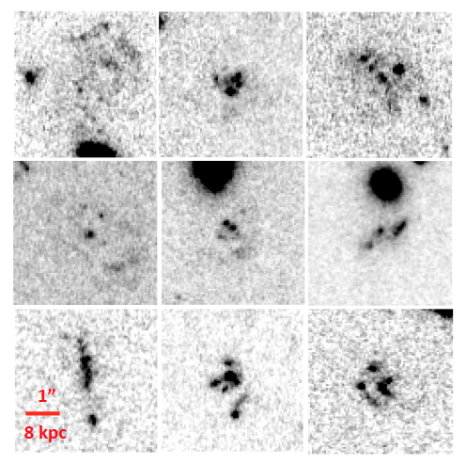
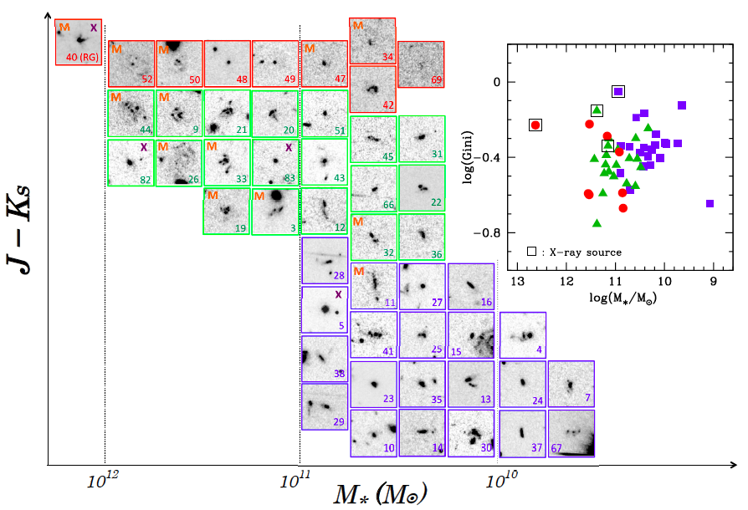
Big clumpy galaxies in proto-cluster env.
cluster phenomena !
Rest-frame UV morphologies of z=2.2 Hα emitters
in PKS1138 proto-cluster env.
M: 24um source
X: X-ray source
HST/i-band snapshots
(4”x4”=30 kpc for each)
(Koyama et al. 2013a)
Notes:
16

Slide 17
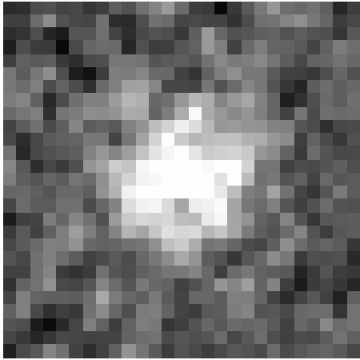
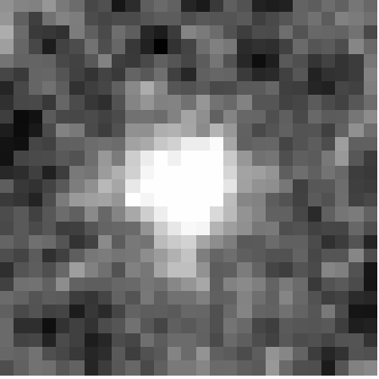
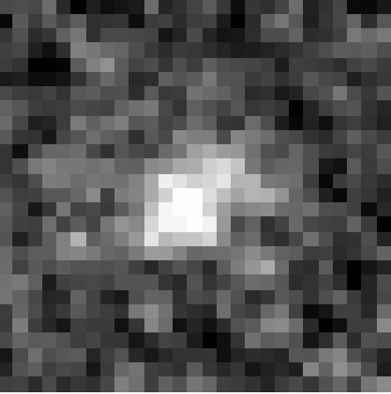
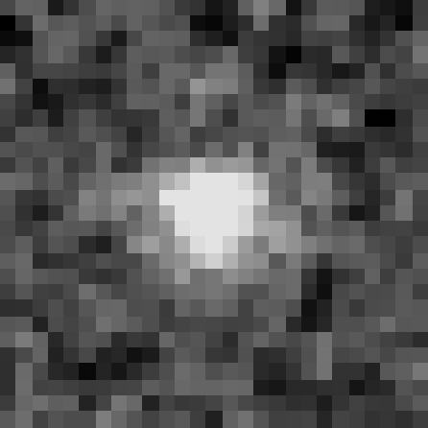
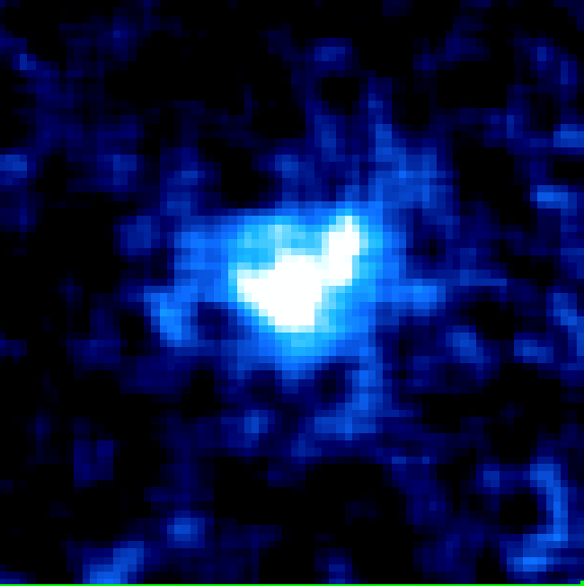
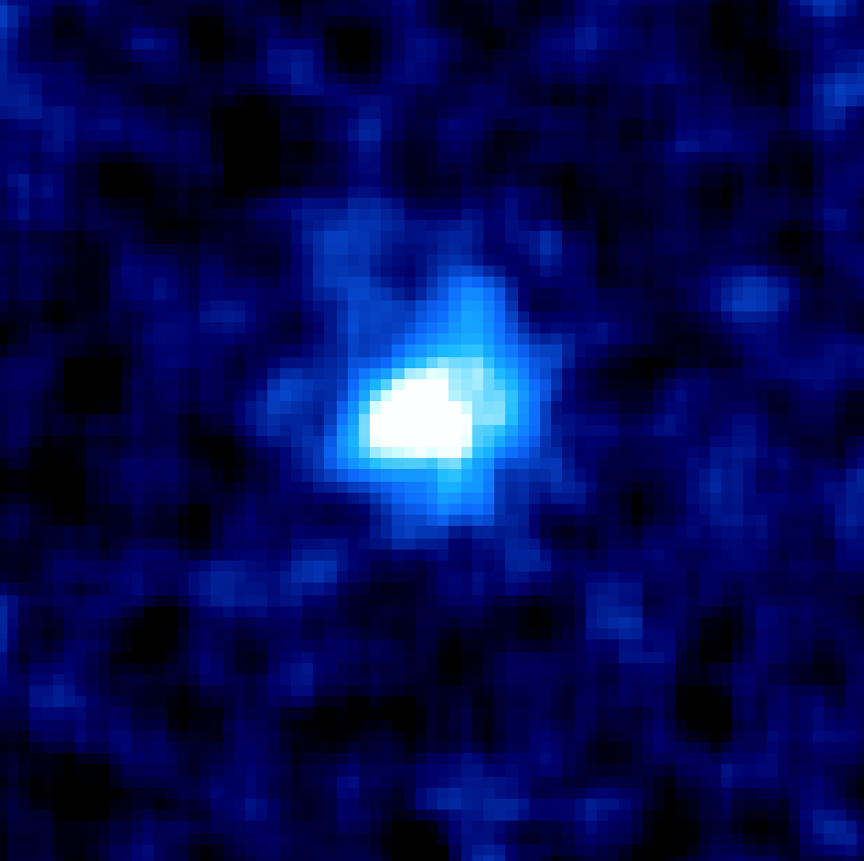
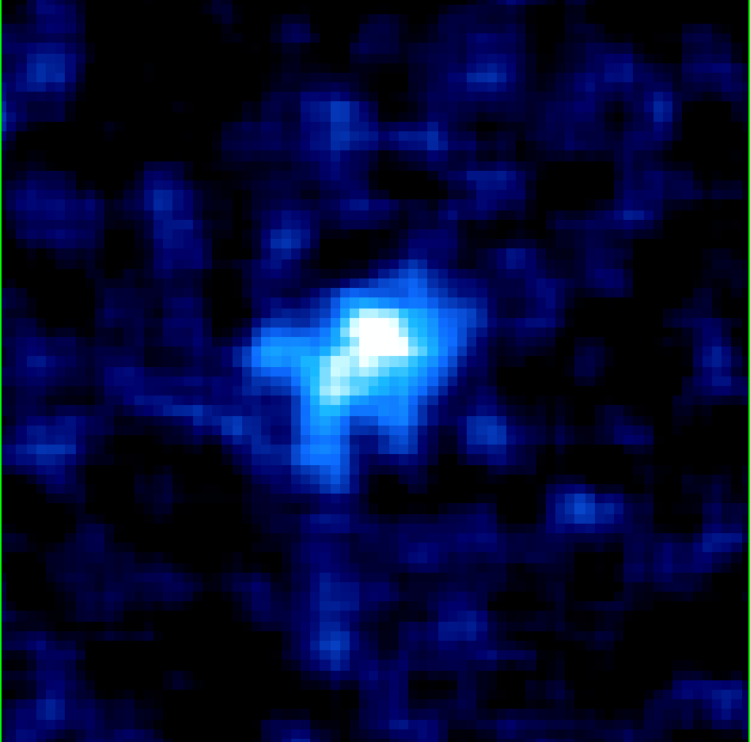
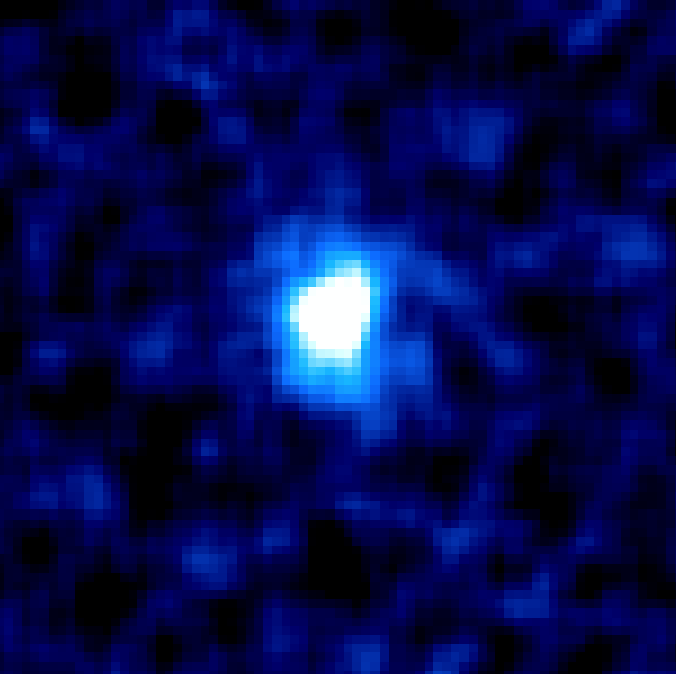




GANBA-Subaru
Collaborator: Y. Minowa, MAHALO-Subaru team, HiZELS team
Galaxy Anatomy with Narrow-Band AO imaging with Subaru
COSMOS-HAE1
COSMOS-HAE2
COSMOS-HAE3
COSMOS-HAE4
(z=2.2)
(z=2.2)
(z=2.2)
(z=2.2)
CFHT K-band
(seeing ~0.7”)
4”x 4”
IRCS K’-band
(AO ~0.2”)
4”x 4”
IRCS NB(H2)
(AO ~0.2”)
4”x 4”

Slide 18
From “GANBA” to “ULTIMATE”
z = 30
z = 5
z = 3
IRCS 1’x1’
ULTIMATE 13’x13’
z = 2
ULTIMATE 13’x13’
z = 1
ULTIMATE 13’x13’
z = 0
IRCS 1’x1’
IRCS 1’x1’

Slide 19

Pinpointing the site of stellar build-up
Galactic centre? On disk? In clumps? Any environmental dependence?
clump
Bulge
(nuclear)
Disk
From CANDELS 3D-HST by Wuyts et al. (2013)

Slide 20


Follow-up with multi-IFU
Hα
V
σ
Hα
V
σ
KMOS: 24 IFUs over 7’ FoV. Each IFU has 2.8”x2.8” with 0.2” sampling (i.e. 14x14 elements per IFU)
KMOS 3-D spectroscopy of ~20 Hα emitters at z=2.2/2.5 selected by our MAHALO project.
An extremely high success rate (~90%!) of our KMOS observation demonstrates that NB- based sample selection can provide excellent IFU targets.

Slide 21
Answers to the questions

Slide 22
(Q1) What is the optimum spatial sampling (or diameter in arcsec of each fiber in the bundle) and FoV of the bundle?
(A1) 0.2” per fibre is fine. In terms of sample selection for TMT, it is probably most important to have highest multiplicity. However, with only 1” FoV, we may miss a large fraction of signals from outskirts of galaxies. I therefore prefer config.1.
(Q2) What is the optimum and minimum number of the fiber bundles (or multiplicity) in the 13'.6 diameter FoV?
(A2) I think we don’t need to have too many bundles – we can observe as many targets as we want by spending several fibre configurations. The FoV of each bundle (i.e. the point of Q1) must be a more important issue.
(Q3) What is the critical wavelength range in near-infrared covered by the Starbug system (0.9-2.0micron)?
(A3) I strongly recommend to have wavelength coverage at λ>2.0um (to observe Hα at z>2). If it is unrealistic, let’s start from 0.9-2.0um in phase-1, and extend its wavelength coverage in phase-2?

Slide 23
(Q4) What is the optimum spectral resolution?
(A4) I think R~4000-5000 (following e.g. KMOS) will be a reasonable choice, with which we can resolve velocity structure within galaxies down to < 50 km/s.
(Q5) What is the sensitivity requirement for the phase-I instrument?
(A5) The expected sensitivity for phase-1 (~50% of MOSFIRE) is acceptable. Higher sensitivity is of course better, but I think earlier start of operation is more important – e.g. getting KMOS/VLT time is currently VERY hard (>10x oversubscribed), demonstrating that multi-IFU instruments can attract a great deal of attention from all over the world !
(Q6) Please describe a brief observation plan for your science case with the fiber bundle multi-object IFU.
(A6)
Phase 1: [1] we will do NB Hα imaging of MAHALO clusters (~10 clusters at 0.4<z<2.5) to get Hα size for complete sample of galaxies in cluster environments across cosmic time. [2] We will follow them up by using multi-IFU modes (~20 galaxies per cluster) to get their kinematics and metal gradient. For each cluster, we typically need ~4-5 hours to complete NB+BB imaging and ~6 hours to complete IFU obs, yielding ~100 hours (12 nights) to complete this survey.
Phase 2: A more complete 3D mapping of blank fields (e.g. full CANDELS fields) by using upgraded multi-IFU Starbugs by exploiting “mosaic” mode ?

Slide 24

(Q4) What is the optimum spectral resolution?
(A4) I think R~4000-5000 (following e.g. KMOS) will be a reasonable choice, with which we can resolve velocity structure within galaxies down to < 50 km/s.
“Mosaic mode” of KMOS allows us to cover ~1’x1’ field with 16 ptgs.
(Q5) What is the sensitivity requirement for the phase-I instrument?
(A5) The expected sensitivity for phase-1 (~50% of MOSFIRE) is acceptable. Higher sensitivity is of course better, but I think earlier start of operation is more important – e.g. getting KMOS/VLT time is currently VERY hard (>10x oversubscribed), demonstrating that multi-IFU instruments can attract a great deal of attention from all over the world !
(Q6) Please describe a brief observation plan for your science case with the fiber bundle multi-object IFU.
(A6)
Phase 1: [1] we will do NB Hα imaging of MAHALO clusters (~10 clusters at 0.4<z<2.5) to get Hα size for complete sample of galaxies in cluster environments across cosmic time. [2] We will then follow up by using multi-IFU modes (~20 galaxies per cluster) to get their kinematics and metal gradient. For each cluster, we typically need ~4-5 hours to complete NB+BB imaging and ~6 hours to complete IFU obs, yielding ~100 hours (12 nights) to complete this survey.
Phase 2: A more complete 3D mapping of blank fields (e.g. full CANDELS fields) by using upgraded multi-IFU Starbugs by exploiting “mosaic” mode ?

Slide 25
(Q7) How could the proposed science cases be competitive or complementary to the science with 30m class telescopes (e.g. TMT) or space telescopes (e.g. JWST) in 2020s?
(A7) The proposed observations will provide an excellent sample to TMT/ALMA/SPICA. In this sense, I hope it to be complementary rather than completely competing with them. Wide-field NB survey + IFU follow-up will be a key strategy for Subaru GLAO to survive.
(Q8) Please describe the requirements for Phase-II instrument (Starbugs + dedicated spectrograph) to develop your science case.
(A8) I request to extend the wavelength coverage towards λ>2um (in case we can have a coverage of only λ<2um in phase-1). Also let’s discuss the possibility of having more survey-like observation with “mosaic” mode.
(Q9) What is the unique point of the fiber bundle multi-object IFU with Starbugs compared to the imager or multi-object slit spectrograph?
(A9) The IFU observation will allow us to study kinematics and spatially resolved line ratios of high-z galaxies, which is not available with multi-slit spectroscopy.

Slide 26
Summary
(1) I agree that the multi-IFU + GLAO is a great combination for studying galaxy evolution and environmental effects out to z>2.
(2) The key strategy is wide-field NB imaging + multi-IFU follow-up, with which we can study the history of stellar build-up across cosmic time and environments.
(3) “MAHALO-Subaru” can provide an excellent sample of distant SF galaxies, and our on-going “GANBA-Subaru” project will provide an important test on what we can do with “ULTIMATE-Subaru”.
(4) I strongly recommend to have sensitivity at λ>2um (which is essential to study dynamical properties of z>2 galaxies with Hα).
(5) Earlier start of operation is most important. Notice that KMOS/ VLT is highly over-subscribed, meaning that everyone has a strong interest in using multi-IFU facilities.

