Slide 1
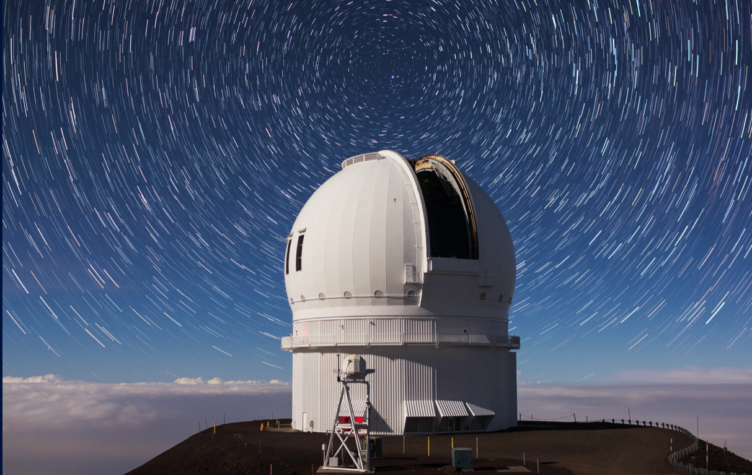






Canada France Hawai’i
Telescope (CFHT)
Subaru Users
Meeting FY2024
Jean-Gabriel Cuby
Executive Director
Agencies
Associate Partners

Slide 2
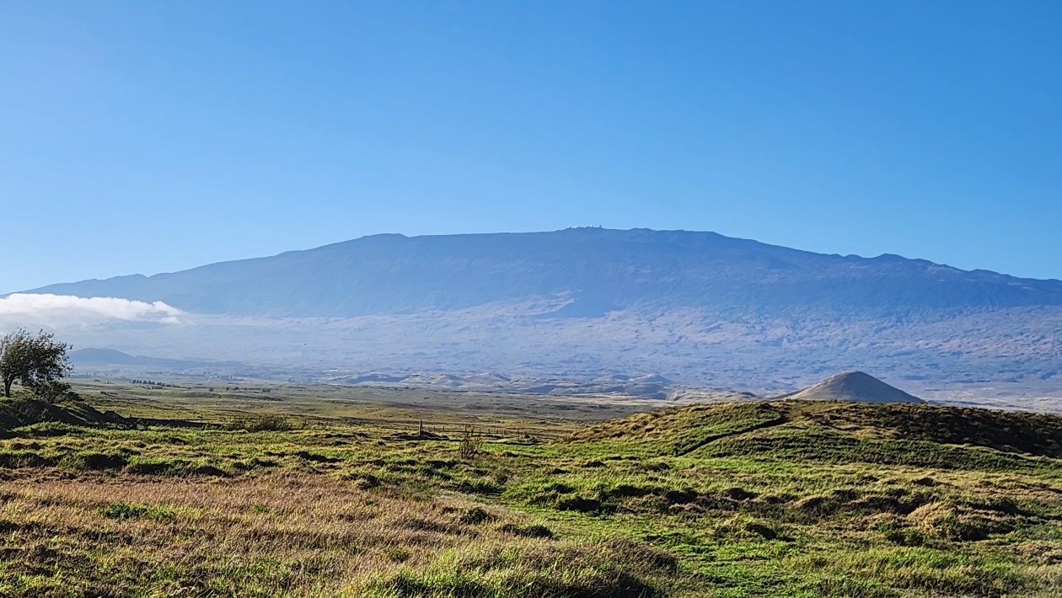
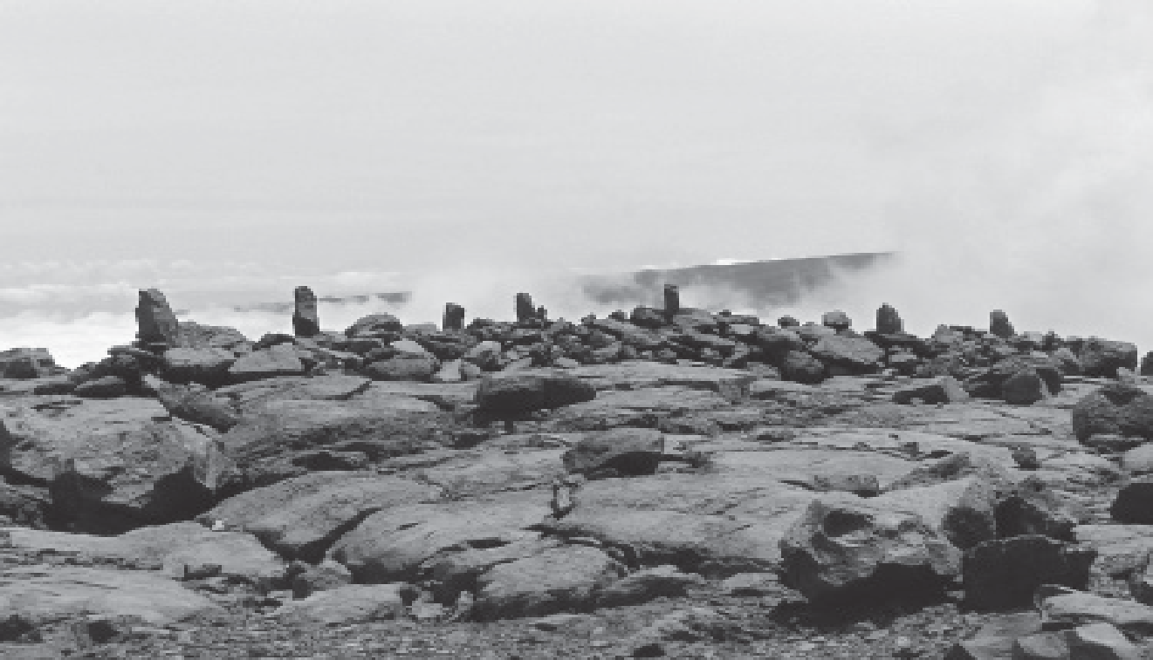

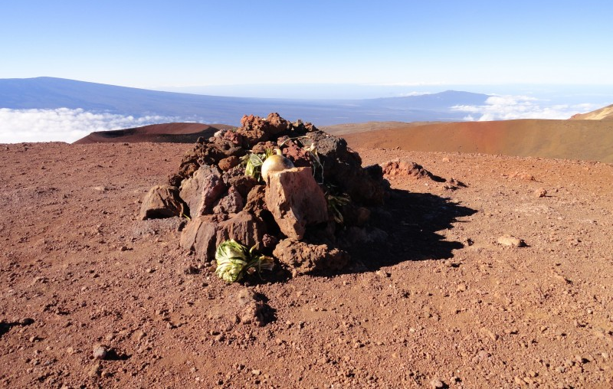
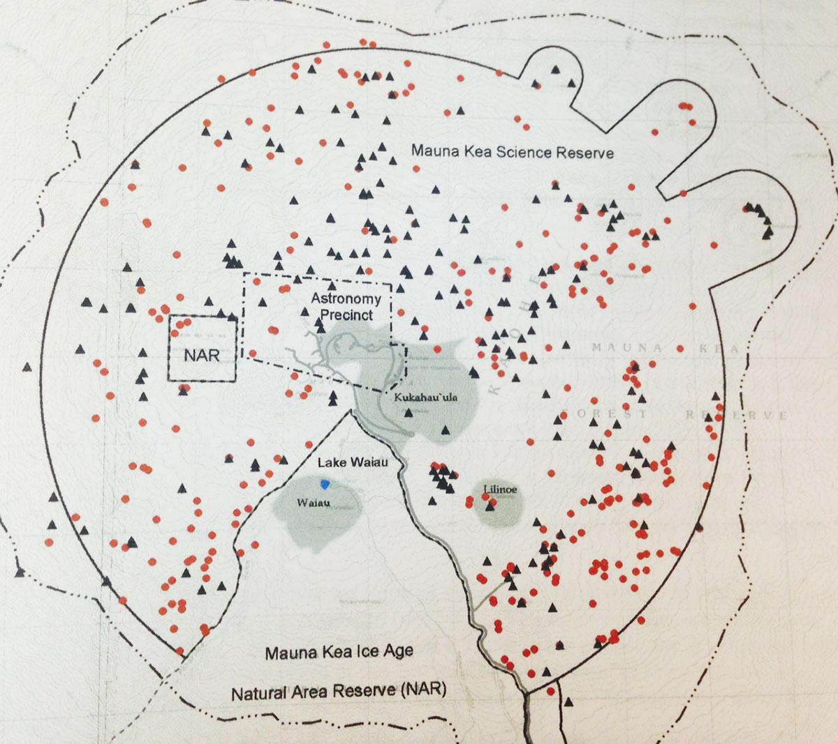
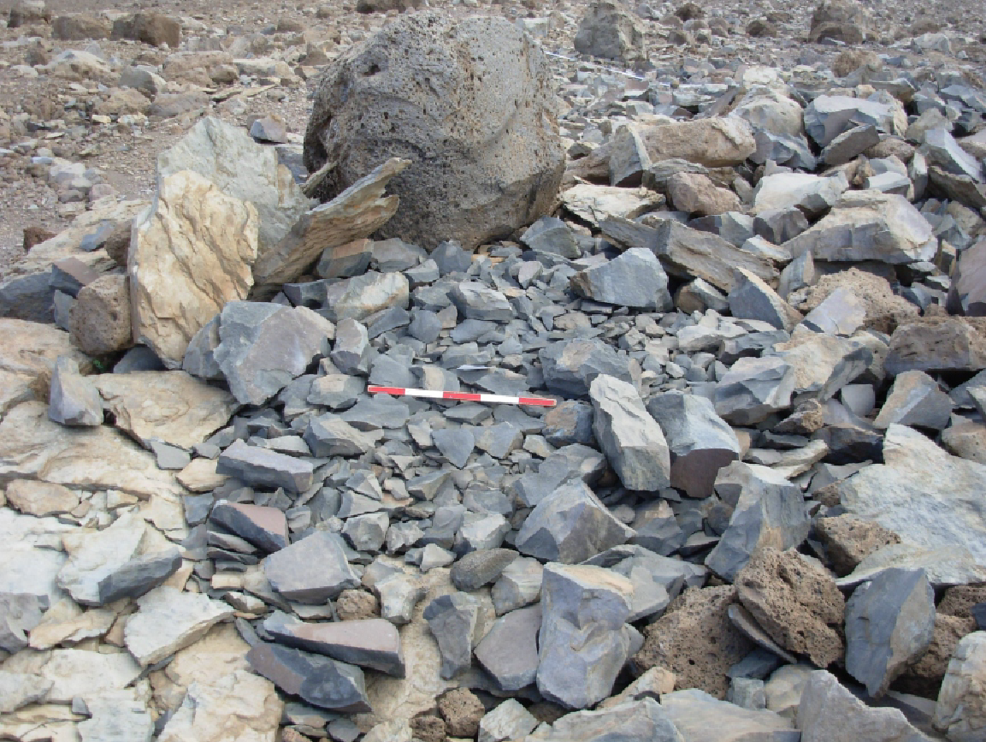
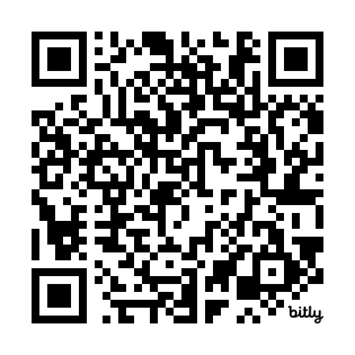
Acknowledgment
CFHT operates on the land of the Kānaka Maoli people, on the summit of Maunakea
There are hundreds of historic sites, archaeological remains, shrines and burials on its slopes and summit.
We are committed to working closely with local communities in Hawaiʻi to define a shared governance model of community astronomy on Maunakea.
“Astronomy’s relationship with the lands and communities of Maunakea”. Cuby, Matsuda, Matsuda, Adamson, O’Meara, Manset, Proc. SPIE 13094-47 (2024) (available on arXiv)
Copyright Herbert K. Kane, LLC
Source: Honolulu Magazine

Slide 3
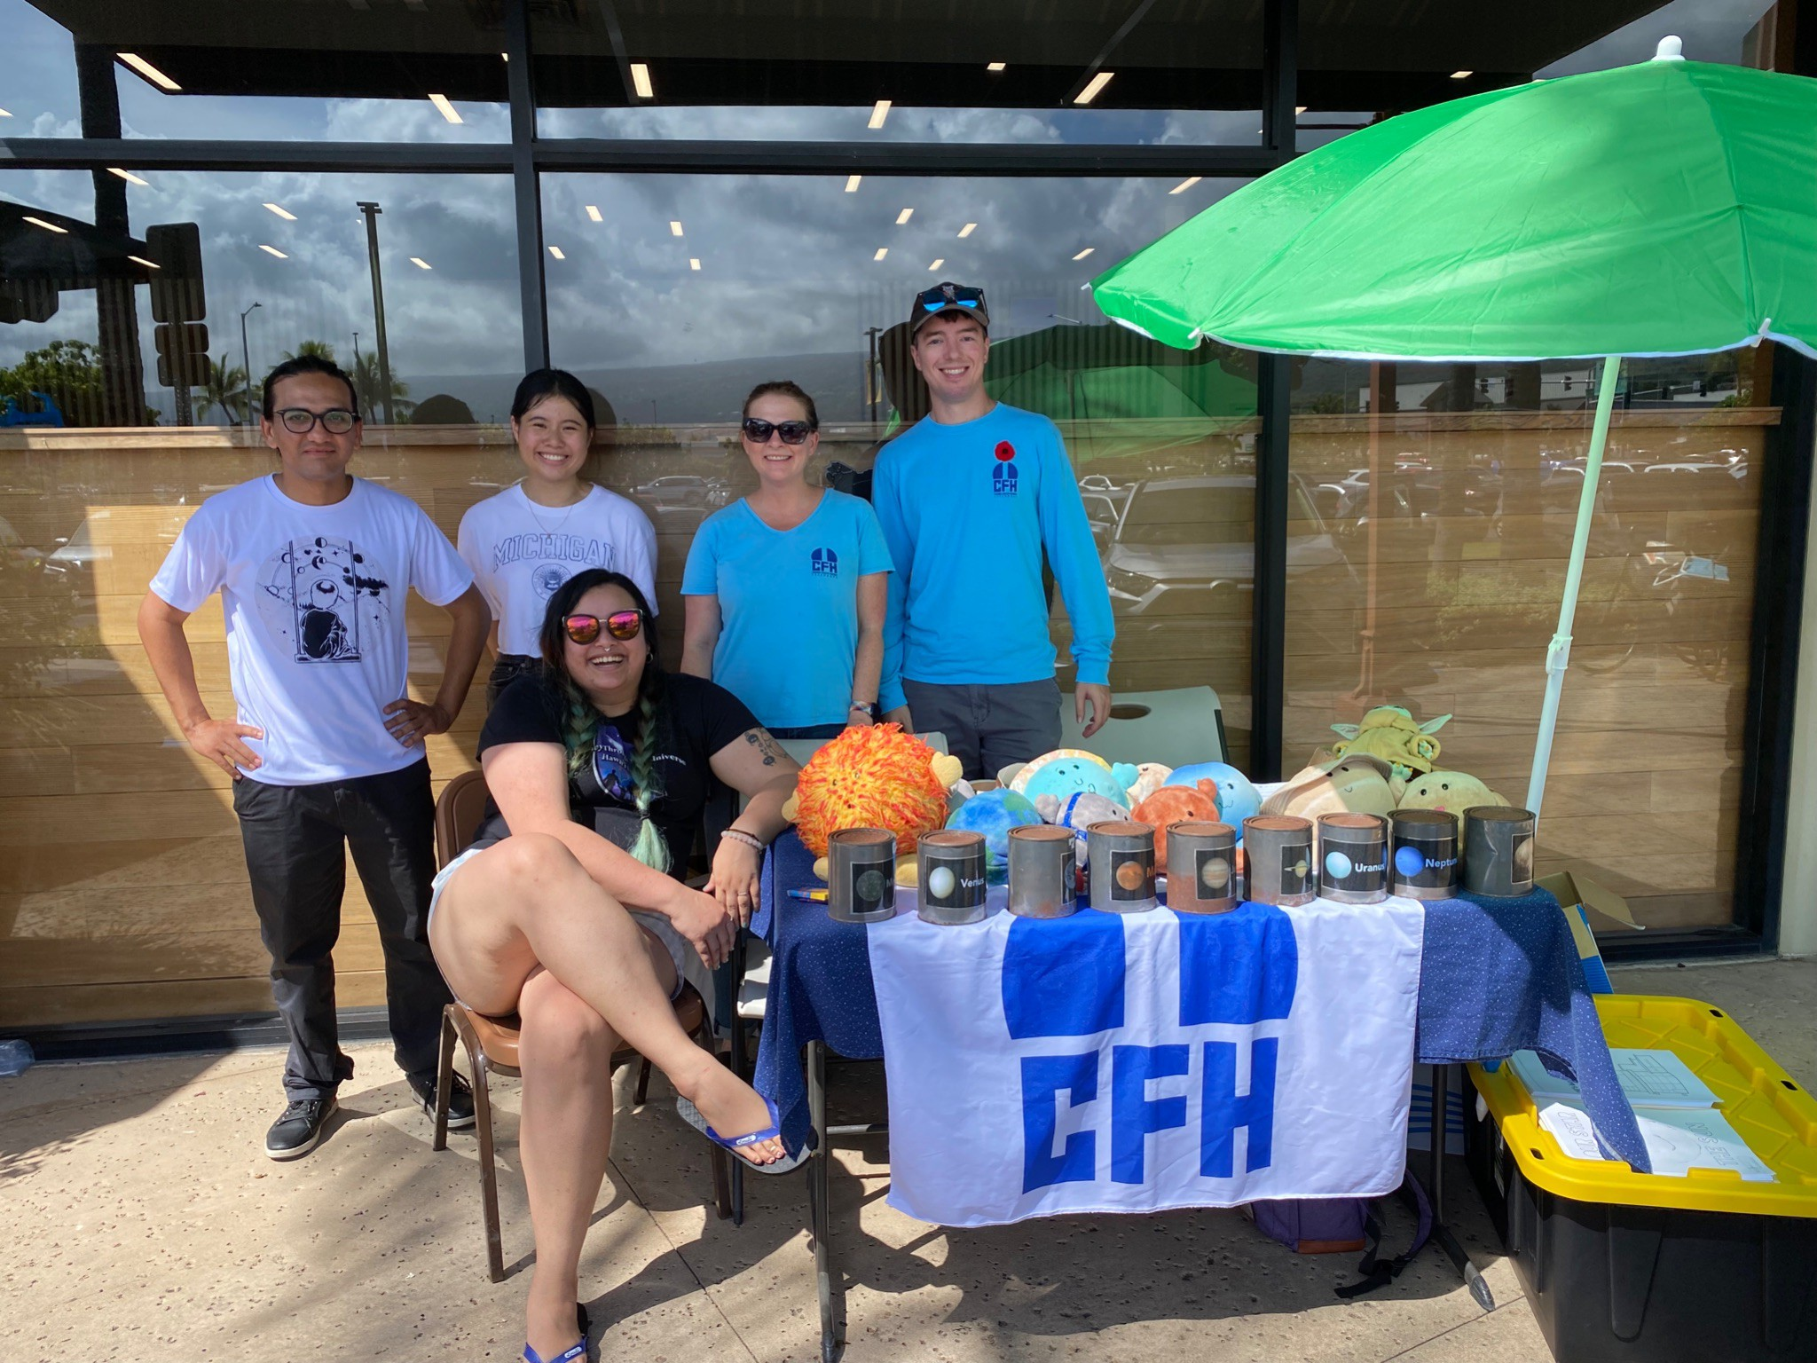
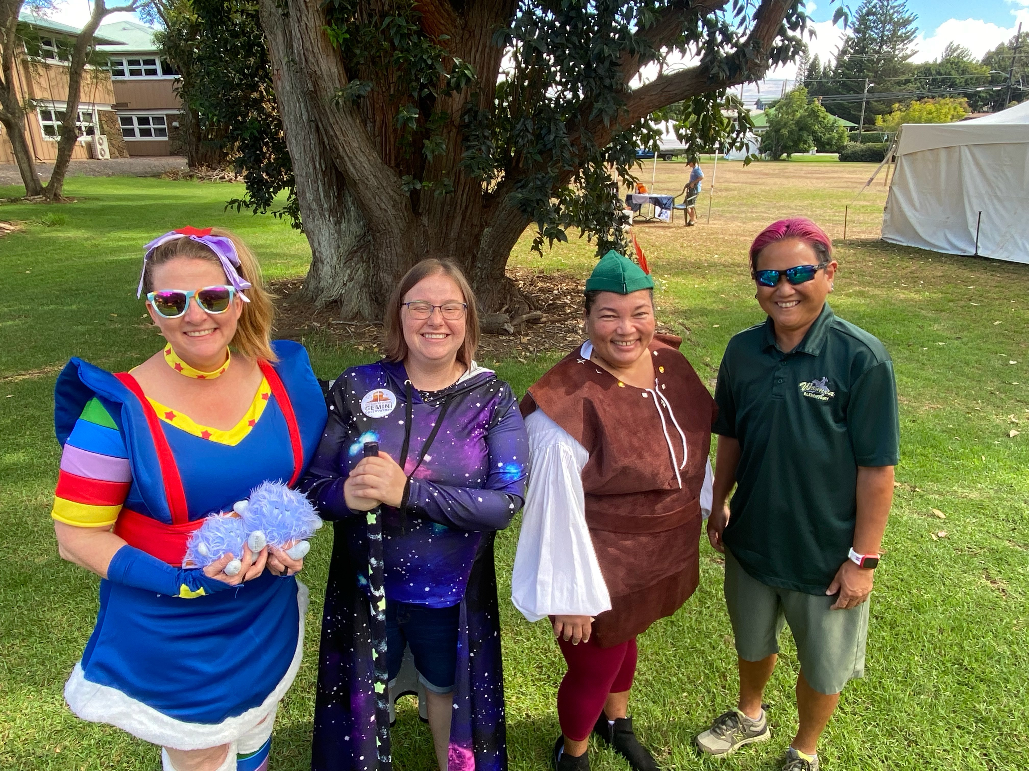
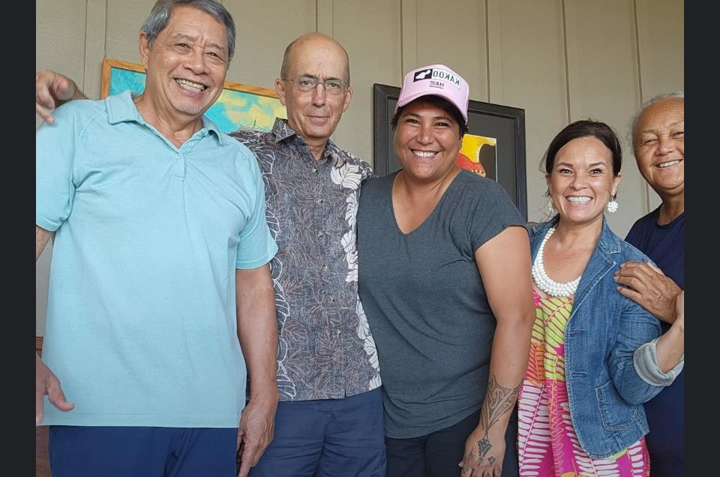
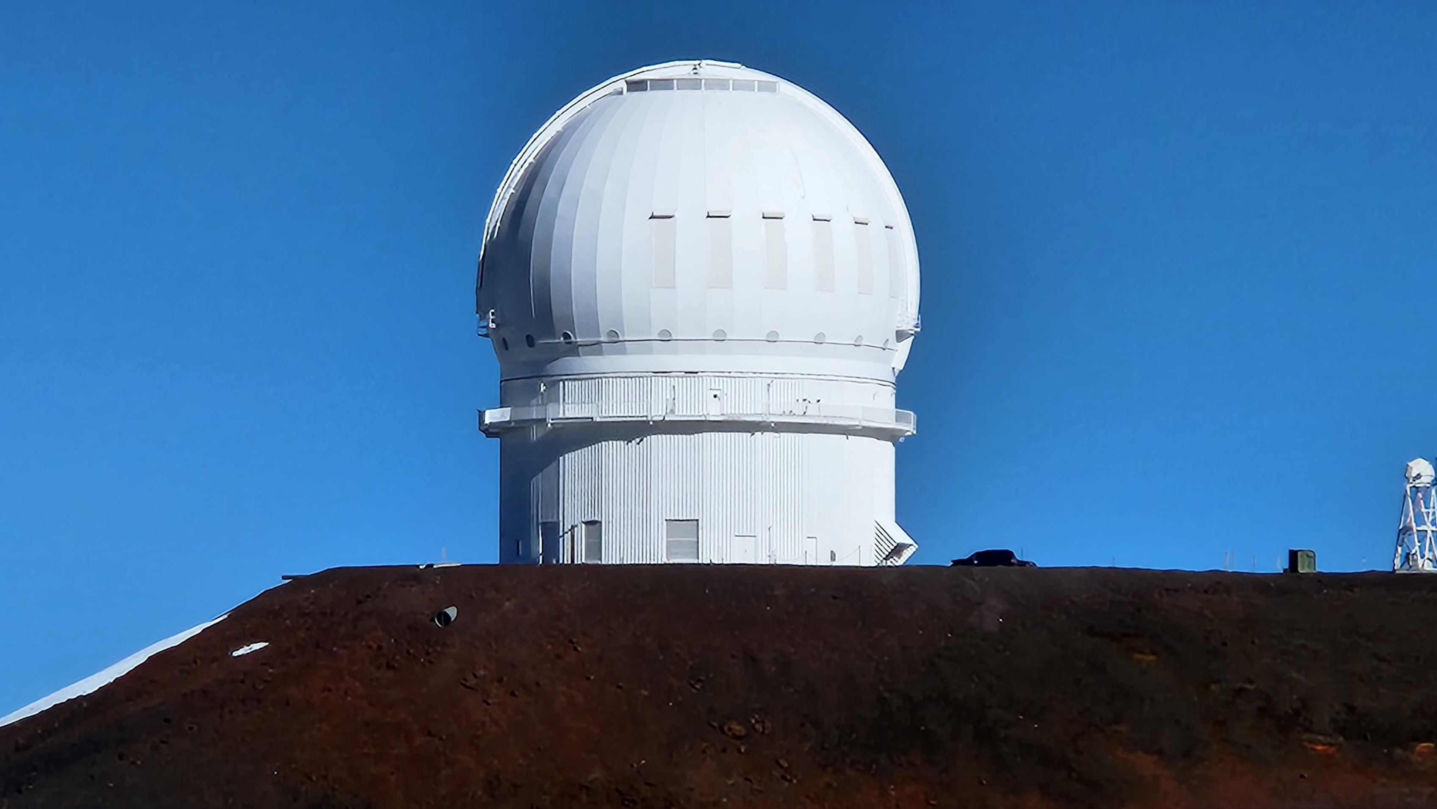
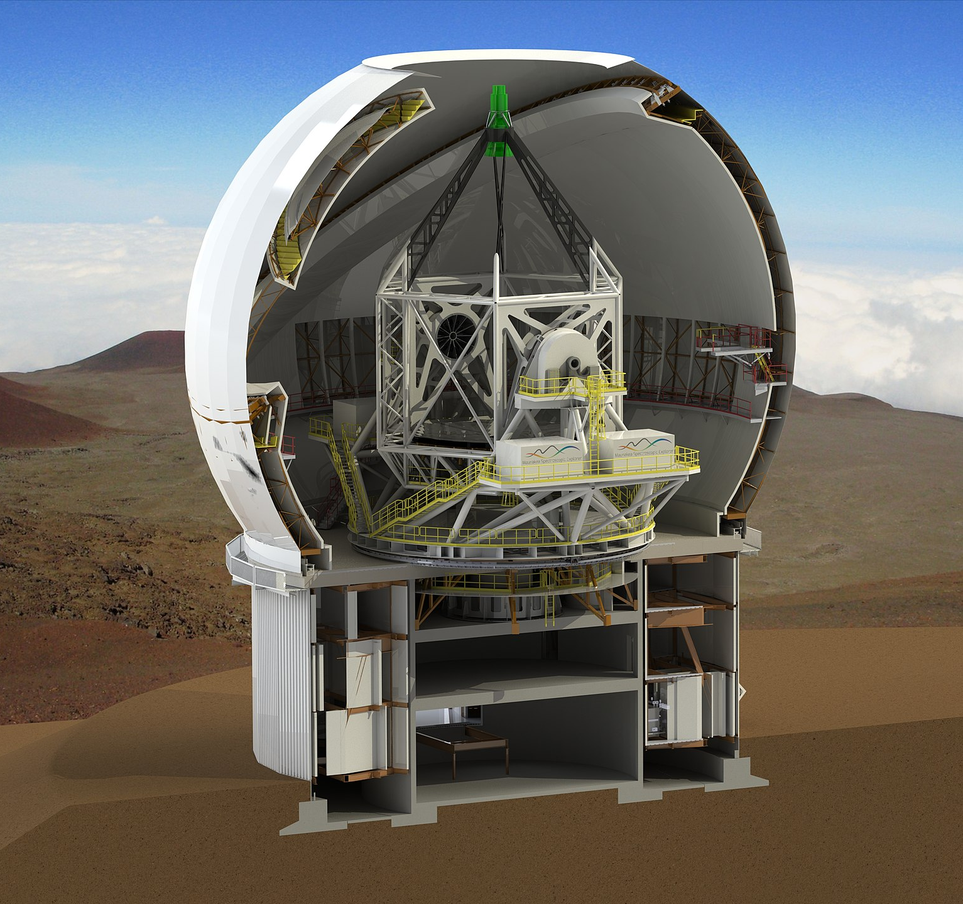
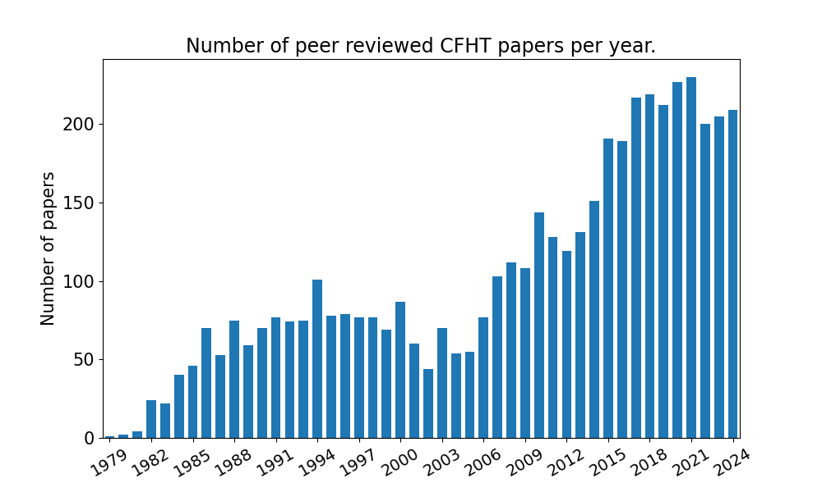
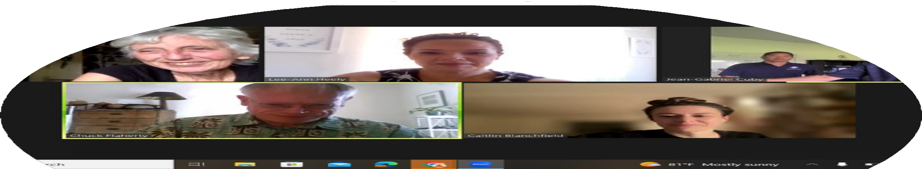
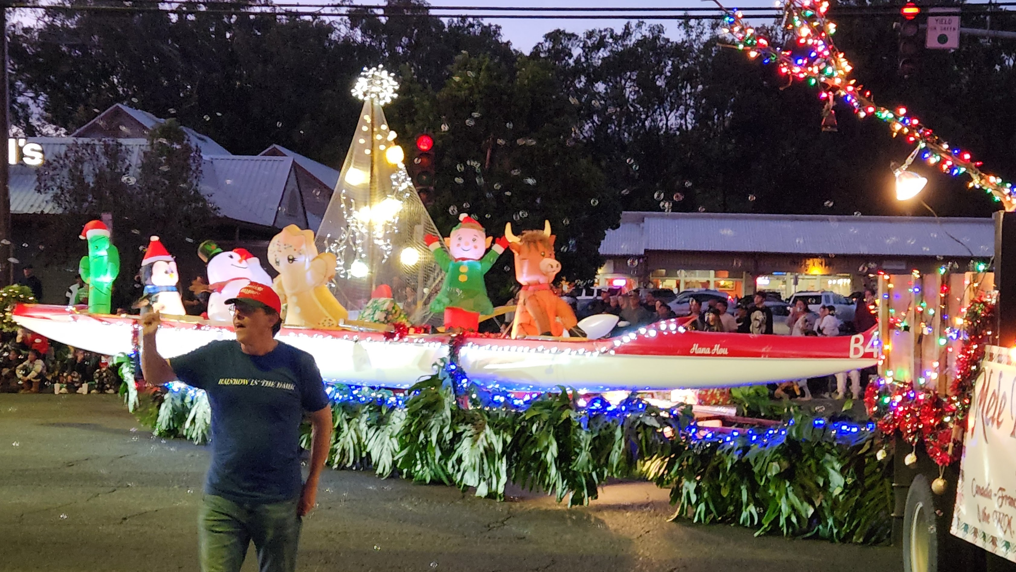
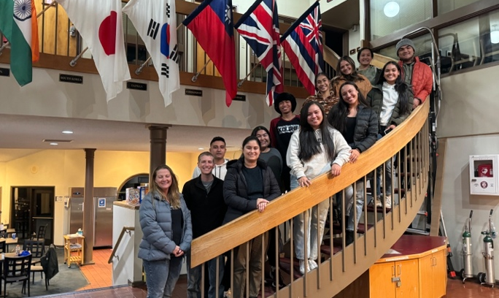
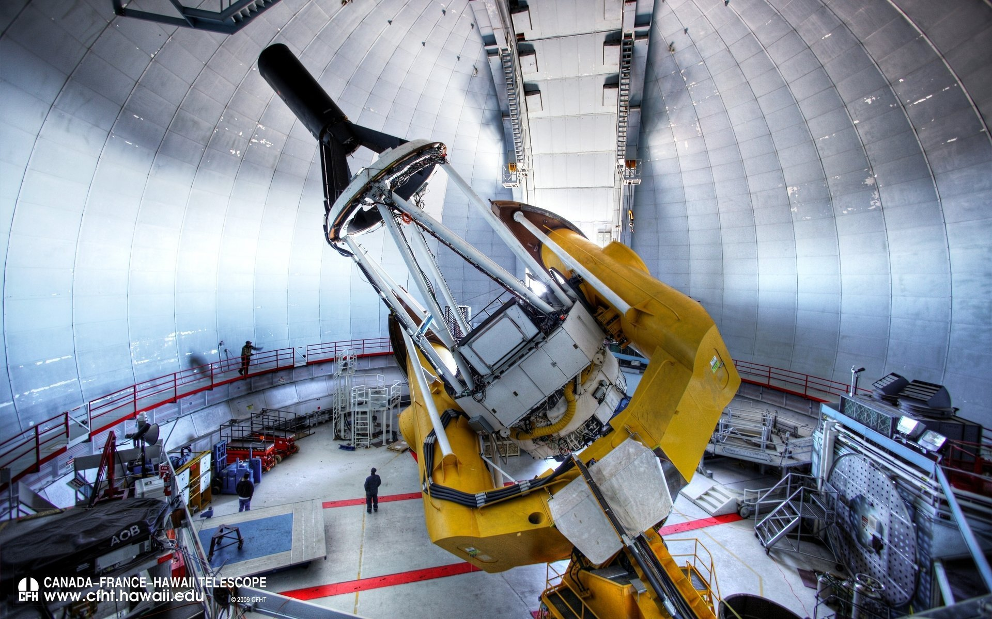
CFHT in a nutshell
Operations started in 1979
3.6 –m aperture, equatorial mount
100% Service Mode, delivering reduced / science ready data to users
100% remotely operated from Waimea HQ
5 Instruments
Very productive telescope
Active outreach and community engagement program
Very large dome!
  → Maunakea Spectroscopic Explorer (MSE)
CFHT view from Subaru

Slide 4

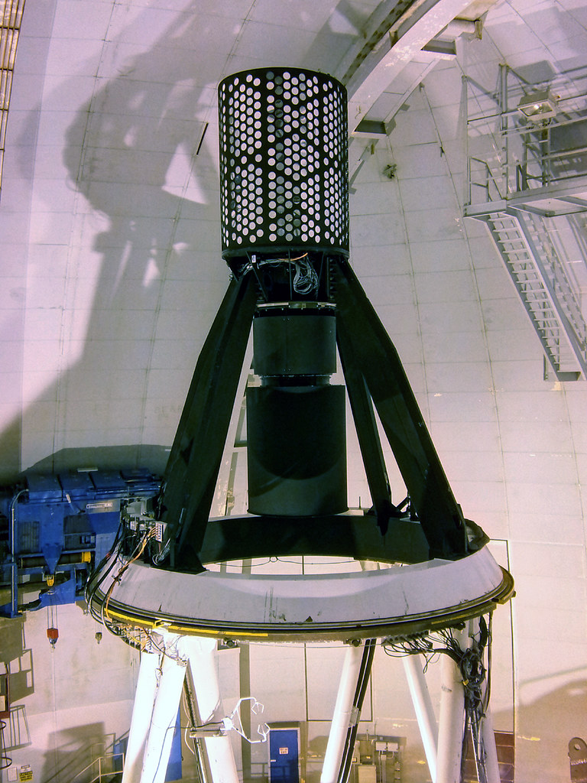
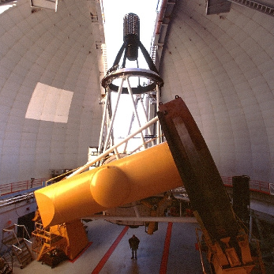
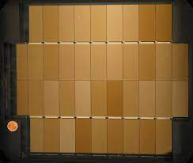
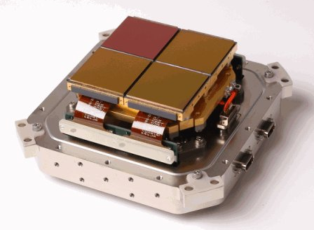
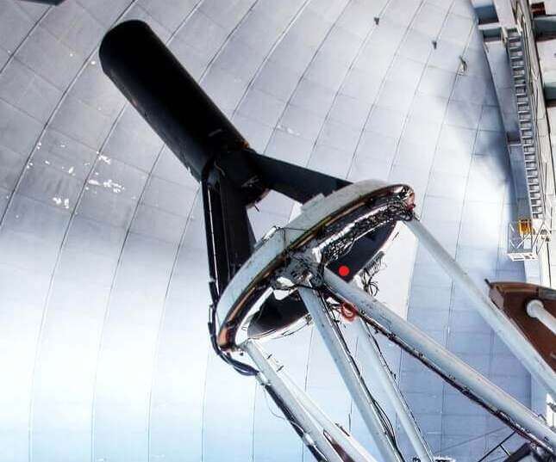

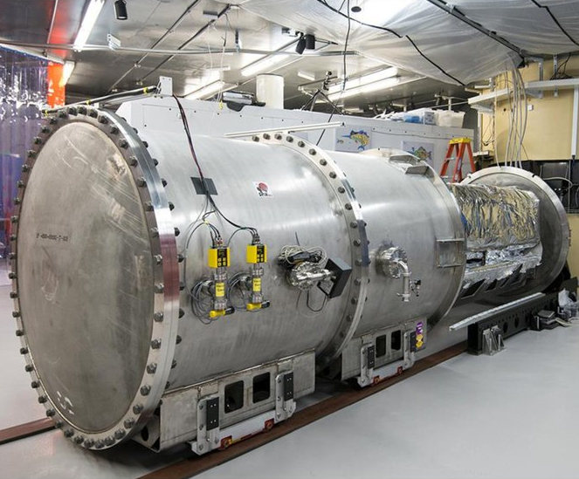
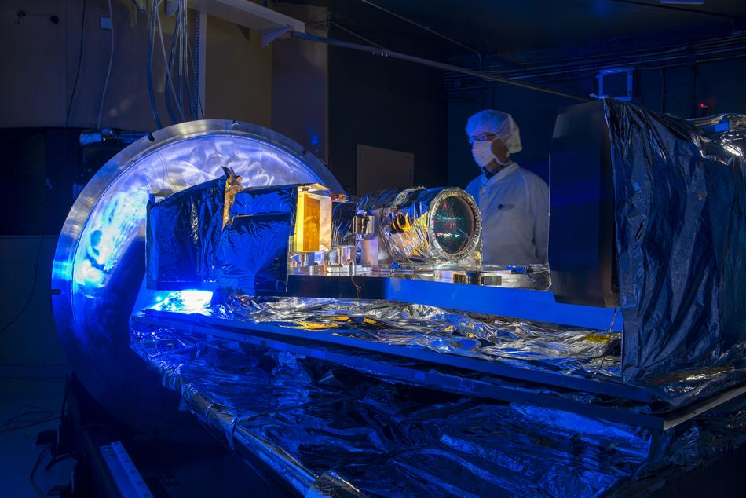
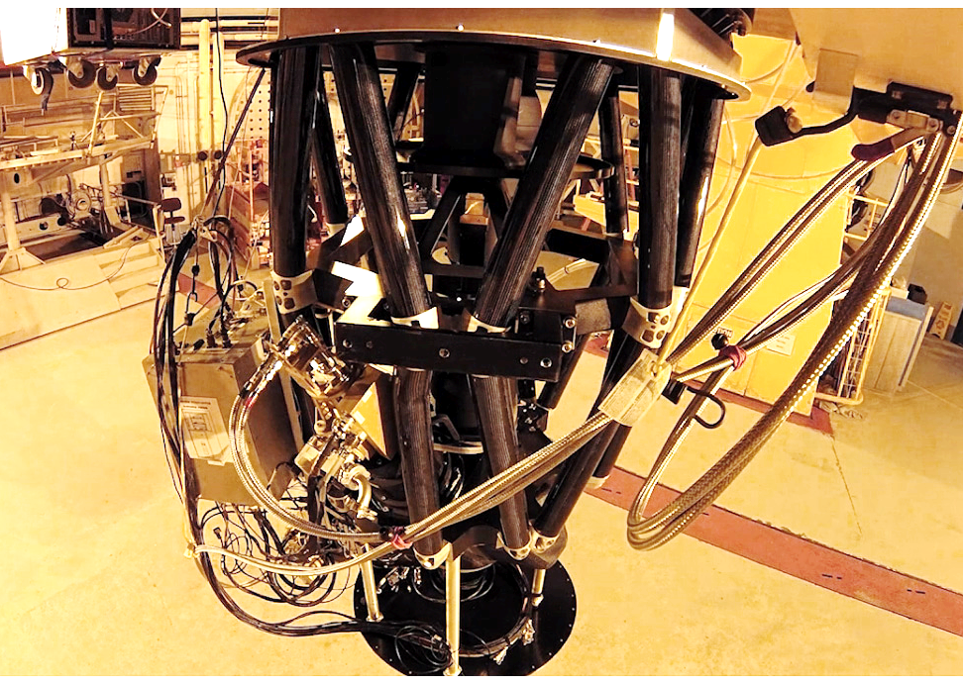
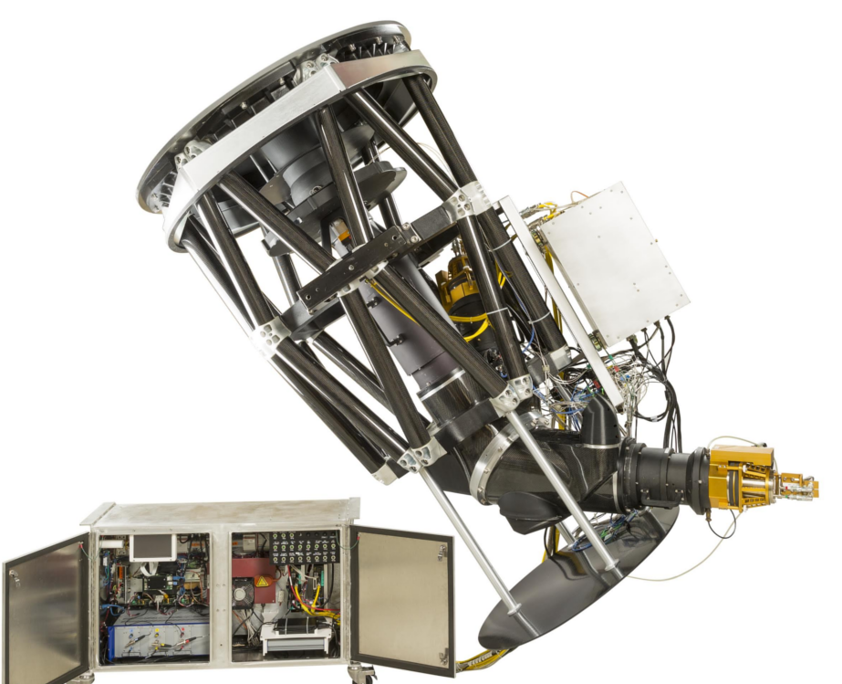

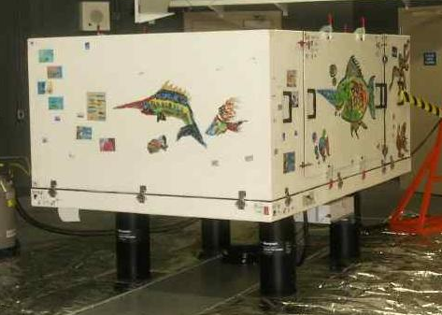


CFHT Instruments
Prime Focus: MegaCam
1º x 1º optical imager
360 Mpix @ 0.189 arcsec/pix
Broad band and NB filters
Prime Focus: WIRCam
20’ x 20’ NIR imager
128 Mpix @ 0.306 arcsec/pix
Broad band and Narrow band filters
Cass: SITELLE
11’ x 11’ Fourier Transform Spectro-imager
350-900 nm
2k x 2k @ 0.32 arcsec/pix
R = 6,000 – 10,000
SPIRou
High Resolution NIR spectropolarimeter
970-2490 nm - R = 70,000
1.5 m.s⁻¹ radial velocity accuracy
ESPaDOnS
High Resolution optical spectropolarimeter
370-10,000 nm
R = 70,000

Slide 5
Recent Science Highlights
Measuring Sub-Kelvin Variations in Stellar Temperature with High-Resolution Spectroscopy
Artigau et al., 2024, ApJ 168
Differential Temperature time series of HD189733 b transit. The apparent temperature of the host star increases close to ingress and egress. From TESS & CFHT / SPIRou observations.
Notes:
apparent disk-averaged temperature change appears during a transit.
This change in the disk-averaged temperature is designated as dTemp
dTemp time series of four HD189733 b transit observed with SPIRou and phase-binned values. One notes the ∼1K
increase in the apparent temperature of the host star close to ingress and egress as cooler regions of the stellar disk are masked
by the planet. The beige domain corresponds to the window between 1st and 4th contact for an impact parameter of 0.69.

Slide 6
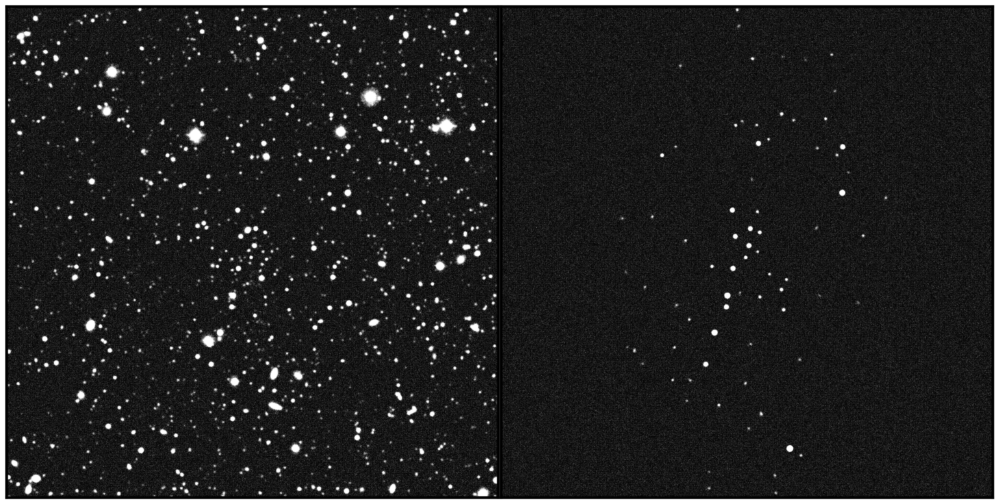
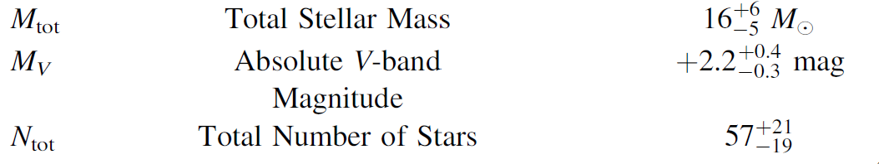
Recent Science Highlights
The Discovery of the Faintest Known Milky Way Satellite Using UNIONS, Smith et al., 2024, ApJ 961:92
Ursa Major III/UNIONS 1: The Darkest Galaxy Ever Discovered?, 2024, Errani et al, ApJ 965
UMa3/U1. From CFHT/MegaCam, Pan-STARRS & Subaru UNIONS, and Keck/DEIMOS observations.
Notes:
We identified this satellite as a resolved overdensity of stars consistent with an old, metal-poor isochrone in the deep, wide-field survey UNIONS. With radial velocities (from Keck/DEIMOS) and proper motions (from Gaia), we have confirmed that UMa3/U1 is a coherent system. We have measured an intrinsic velocity dispersion of 3.7-1.0+1.4 km s−1, which could be interpreted as the signature of a massive dark matter halo.
UMa3/U1 is the least luminous known satellite of the Milky Way.
Ultrafaint dwarf galaxies (UFDs).

Slide 7
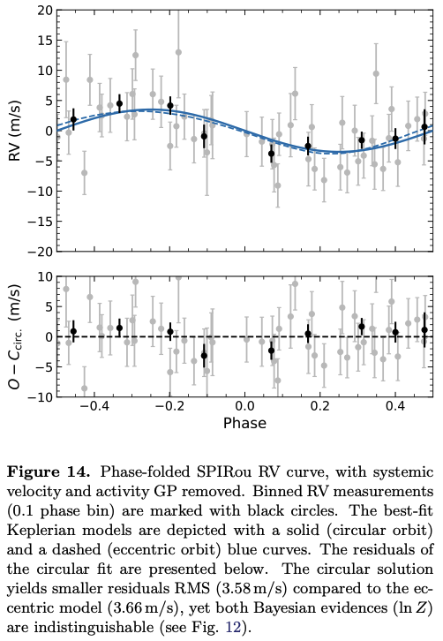
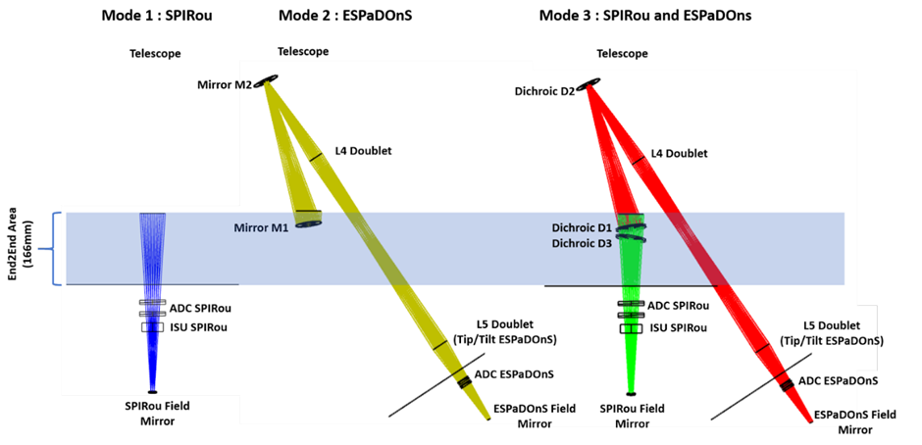
Instrument News : Wenaokeao (2026+)
Cadieux et al., 2022
Co-mount of ESPaDOnS and SPIRou (fibre-fed from Cassegrain focus)
Both instruments have excellent polarimetric capabilities (linear and circular)
Precision Radial Velocity (Near IR) ~ 1 m s⁻¹
The only spectropolarimeter offering spectral coverage 370 – 2350 nm at R ~ 70,000
Time Domain (availability and AEON)
RV semi-amplitude:
K=3.5+/- 0.9 m/s
P= 11d
H=10.0 star
ESPaDOnS
SPIRou

Slide 8
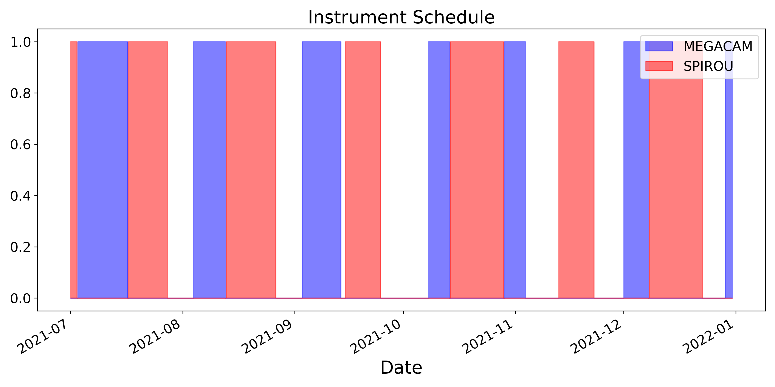
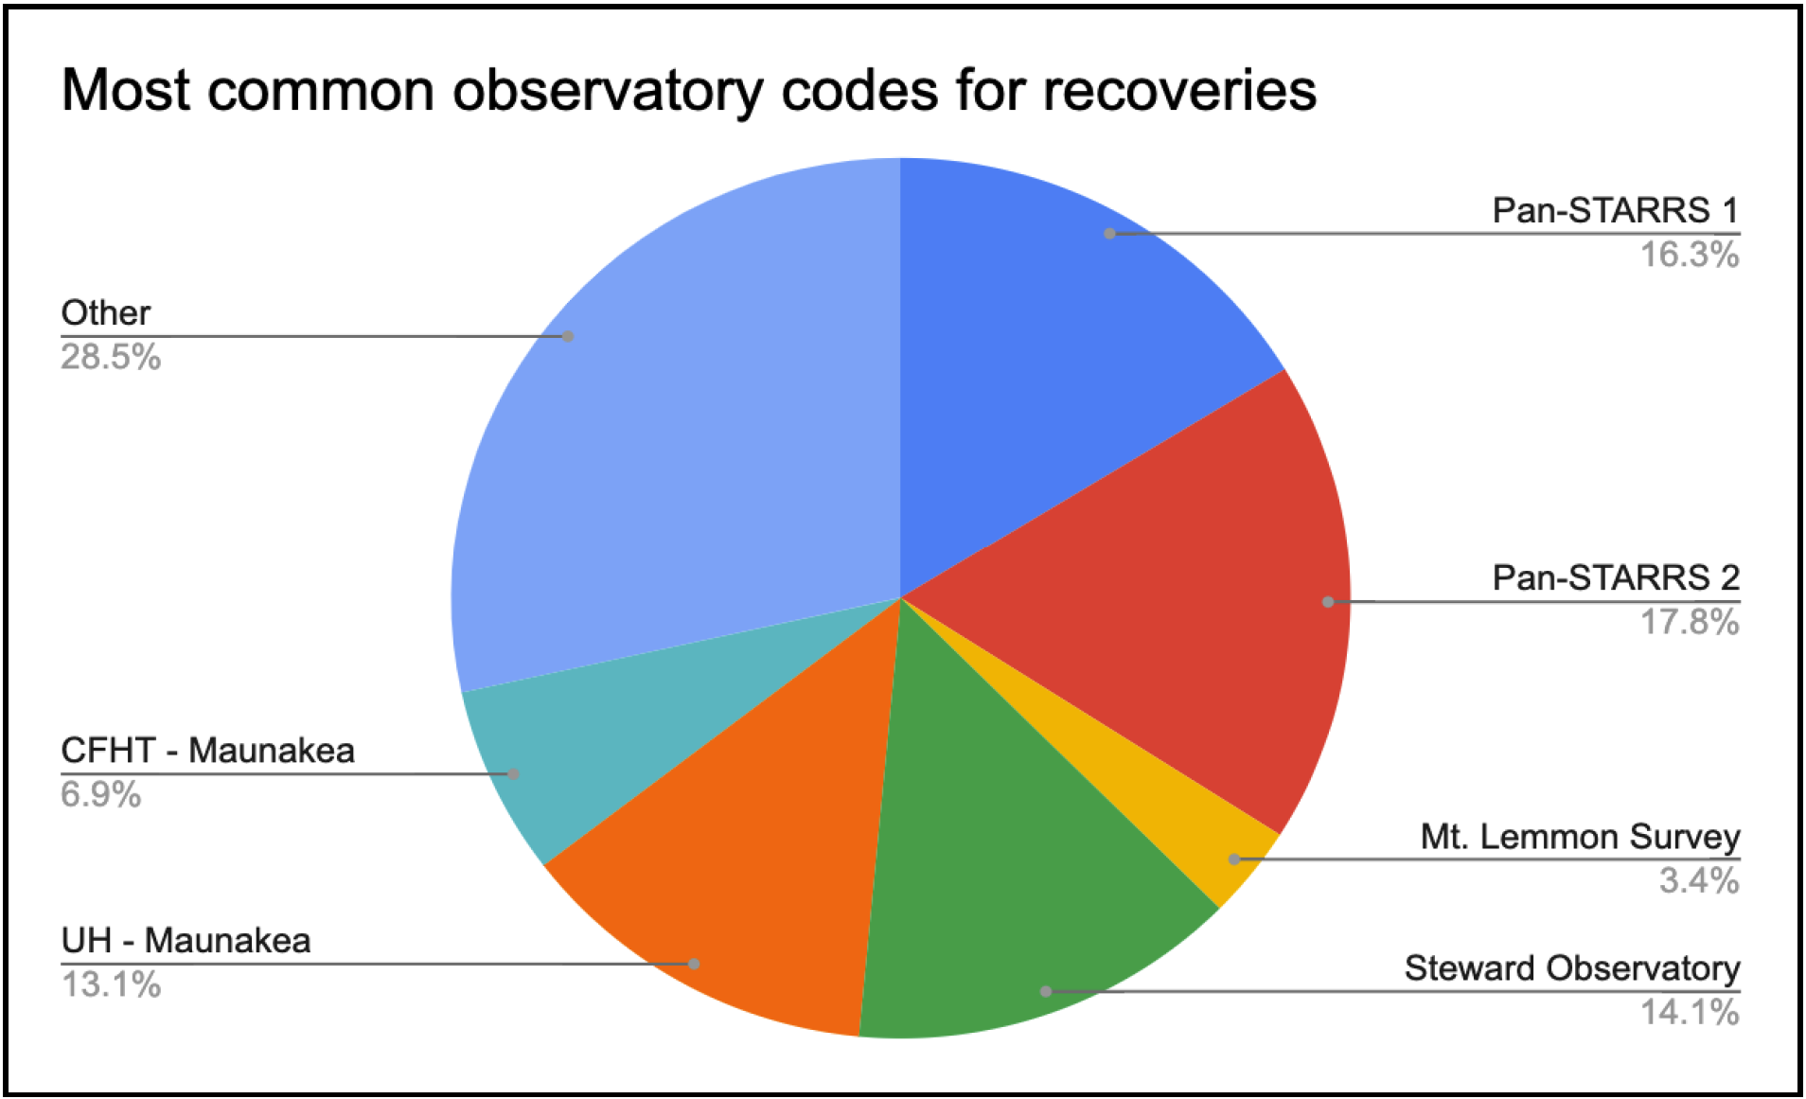


Operations News
Each instrument is mounted ~ 35% of the time
In the coming years, only two instruments: MegaCam and Wenaokeao, each instrument available ~ 50% of the time (contingent on time allocation).
CFHT already recognized as a key player in minor planet recoveries.
Real-time / Rapid Response mode in development (2026).
Funded by the National Science Foundation (NSF) to join the Astronomical Event Observatory Network (2026 or 2027).
  APIs for other networks / collaborations?
Access (6 nights) offered to Astrophysics Centre for Multimessenger studies in Europe (ACME) – funded by the European Commission

Slide 9
Community Surveys 2028+
Large Programs in 2025 and 2026
Community / Legacy Surveys afterwards (approx. 2028-2032)
800 to 1,400 nights, over 4 to 5 years (up to 85% of the time)
Two instruments:
  MegaCam – 1sq degree field of view wide field imager
  Wenaokeao – co-mount of ESPaDOnS and SPIRou
Competitive components of the surveys utilizing other instruments, WIRCam, SITELLE or visitor instruments, will be considered.

Slide 10
Publications : Impact of Legacy Surveys (LS) and Large Programs (LP) vs. PI programs
PI programs: since 1980
CFHTLS : Legacy Survey carried out between 2003 and 2008. 450 nights
Large Programs: 20 programs since 2008, between 30 and 300+ nights allocation per program.
 | Number of Publications | Number of Nights | Publications per night
PI programs | 3481 | ~42 years | 0.30
LPs (excluding CFHT-LS, and recent / ongoing LPs) | 918 | 1220 | 0.75
CFHT-LS | 666 | 450 | 1.5

Slide 11
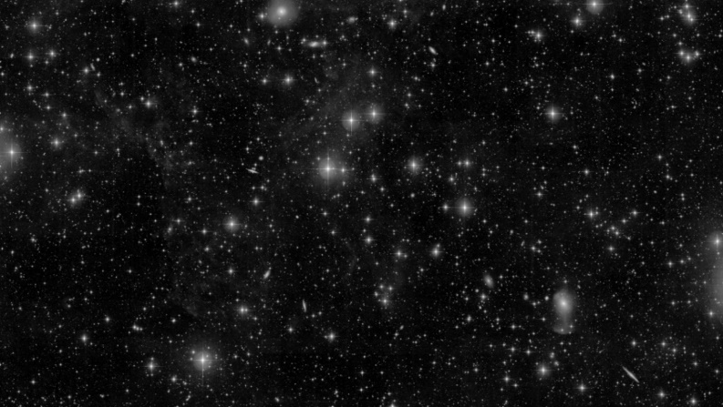
Community Surveys (in prep)
MegaCam
  u-band “all-sky” survey, reference for 10+ years
  Photo-z and / or Target selection for massive spectroscopic surveys
    Ex: Pristine, UNIONS/Euclid
  Preparation and/or follow-up of Euclid & Roman
  Time-domain, follow-up and monitoring of alerts from Rubin, LVK, CTA, GRB missions, IceCube/KM3NeT, etc.
Wenaokeao
  Exoplanet science: detection and characterization, atmospheres, etc.
  Stellar magnetism
  Planet formation
  Galactic archeology
Credit: CFIS-UNIONS / CFHT / J.-C. Cuillandre
Cadieux et al., 2022
RV semi-amplitude:
K=3.5+/- 0.9 m/s
P= 11d
H=10.0 star

Slide 12
Summary. CFHT’s 10+ next years
Work to be part of the new lease process
Work on the development and proposal of a community astronomy model
Focus on CFHT operations and reliability
Development of Wenaokeao
Development of rapid response mode and integration into AEON network
Community / Legacy Surveys 2028-2032+
Possible start of Maunakea Spectroscopic Explorer construction middle of next decade, contingent on renewal of the lease and local community consent.

Slide 13
