Slide 1
Answers to questions about Canadian astronomy from Iwata-san
Dennis Crabtree
Director, Optical Astronomy, NRC Herzberg
January 18, 2018

Slide 2
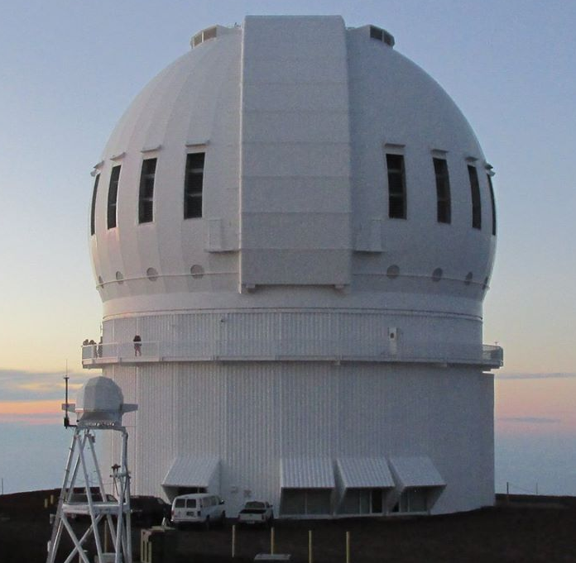
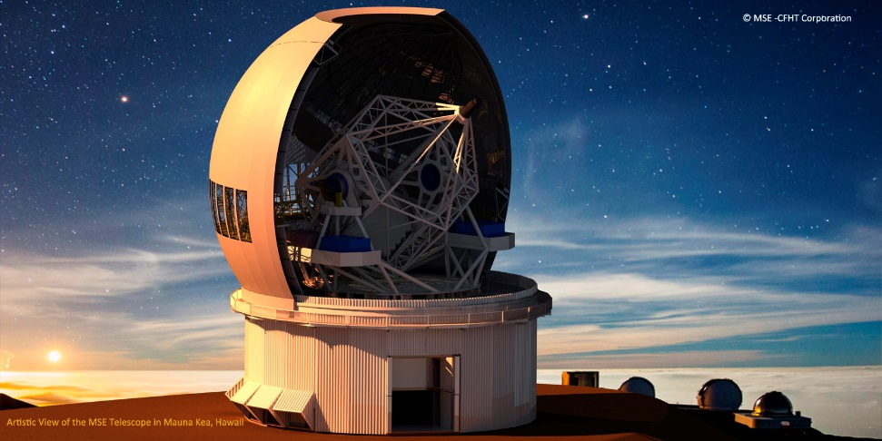
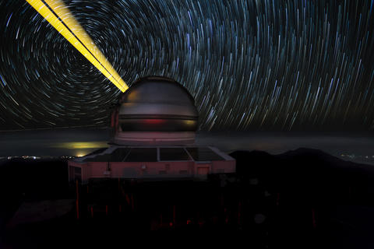
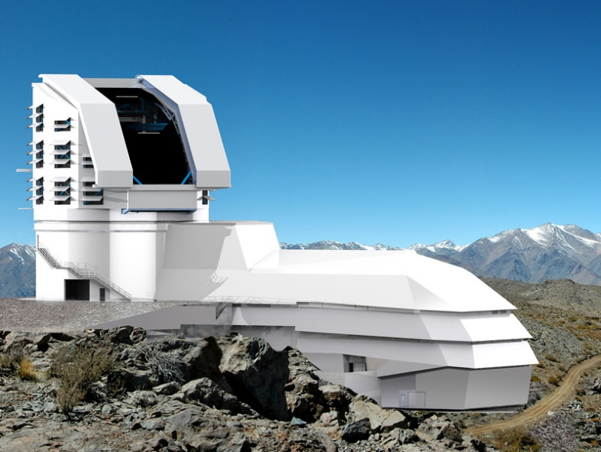
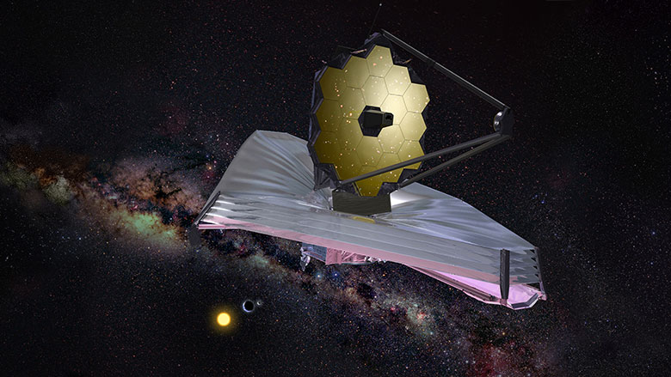

Slide 3
What Telescopes Do Canadians Use? (2011-2015)

Slide 4
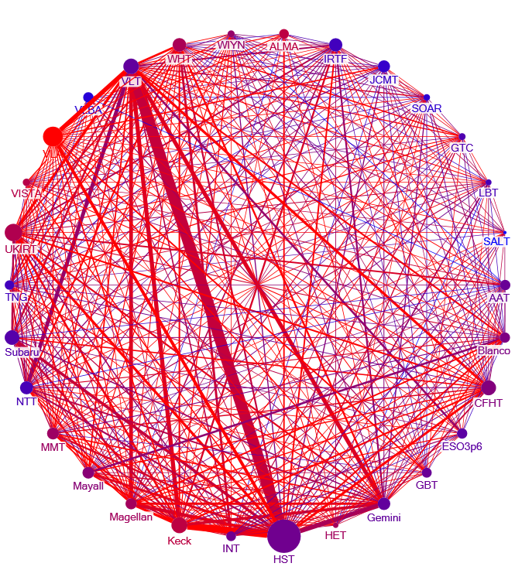
Same color scale used
for AIPP on vertices
and edges

Slide 6
Gemini Instruments Requested by Canadians (2015B – 2018A)

Slide 7
Instruments used in published papers

Slide 9
Gemini Assessment Point
Current Gemini agreement end in 2021
At November Board meeting participants to declare their interest in renewing the Agreement.
NRC Herzberg will establish a Review Panel that will provide recommendations to the NRC Herzberg Director-General
  Should our Canadian share of Gemini stay the same, increase or decrease?
  Should Canada consider to seek access to other operating or soon-to-be operating 8m facilities, such as Subaru, Keck or LSST?
Chair of panel has been selected – Sarah Gallagher (Western)
Full panel has not been formed.

Slide 10
Long Range Planning Process
LRP 2010, “Unveiling the Cosmos: A Vision for Canadian Astronomy“, was released in February 2011.
Process for LRP 2020 will begin ramping up late in 2018
Lunch session on LRP 2020 will be held at the CASCA meeting in Victoria

Slide 11
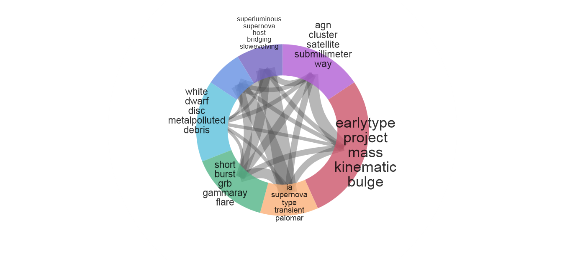

Slide 12
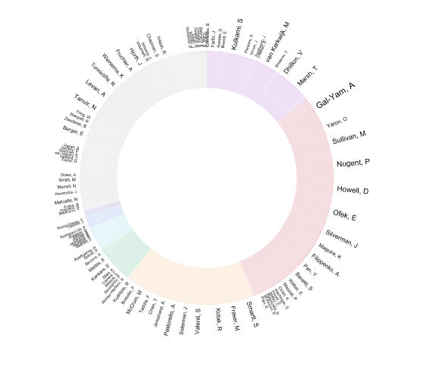

Slide 13
Thank you
13

