Slide 1
Discussion with EAO (and India)
Nagayoshi Ohashi
(Subaru Telescope)

Slide 2
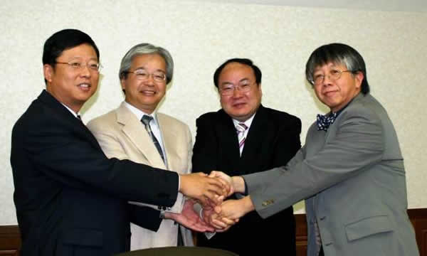
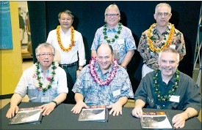
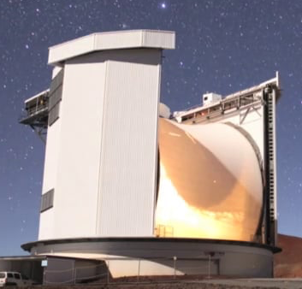
East Asian Observatory (EAO): Background
In order to promote more collaboration with in the East Asian region, East Asian Core Observatories Association (EACOA) was established in September 2005.
Core observatories are NAOC (China), NAOJ (Japan), KASI (Korea), and ASIAA (Taiwan)
In 2014 East Asian Observatory (EAO) was formed by EACOA for the purpose of pursing joint project in astronomy within the East Asian region.
EAO took over the JCMT operation in March 2015 as the first project of EAO.
Collaboration with Subaru Telescope was already in the scope of EAO future plan.

Slide 3
Collaboration within EA on astronomy
ASIAA (Taiwan)-NAOJ
ALMA, HSC, PFS, MOIRCS upgrade, Software development
KASI (Korea)-NAOJ
ALMA, KaVA
SAO (China)-KASI (Korea)-NAOJ
East Asian VLBI Network
Good collaborations have been made within EA,
naturally expanding to the collaboration with Subaru

Slide 4
Discussion with EAO
April 2016:
Arimoto-san, the former Subaru Director, was invited to the EAO board meeting
Arimoto-san expressed Subaru’s interests in collaborating with EAO for the joint operation of Subaru Telescope
EAO board also expressed a strong interests to join the Subaru Operation, and decided to have further discussions.
October 2016:
Arimoto-san proposed EAO to have “EAO time”
Subaru allocated 6 nights as EAO time in 2017 (17A and 17B)
April 2017:
EAO board and Yoshida-san discussed to have “letter of Intent (LoI)” to have further and more concrete discussions on possible partnership between EAO and Subaru
LoI was signed in June 2016
November 2017:
Yoshida-san proposed EAO to establish “working group” to discuss details of the partnership. He also proposed to resume “EAO time” with actual contribution.

Slide 5
EAO Board of Directors
China
Yan Jun (NAOC) → will step down
Suijian Xue (NAOC), Ji Yang (PMO), Zhiqiang Shen (SAO)
Japan
Masa Hayashi (NAOJ) → will step down
Korea
Inwoo Han (KASI) → will step down
Taiwan
You-Hua Chu (ASIAA)
Hopefully new members of the Board of Directors can continue
to support possible collaboration with Subaru

Slide 6
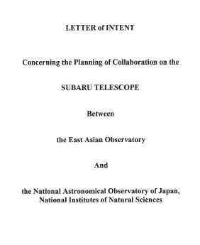
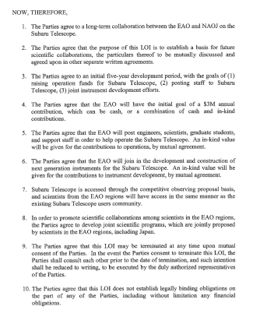
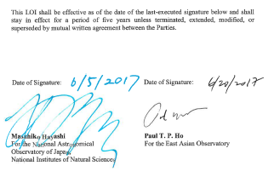

Slide 7
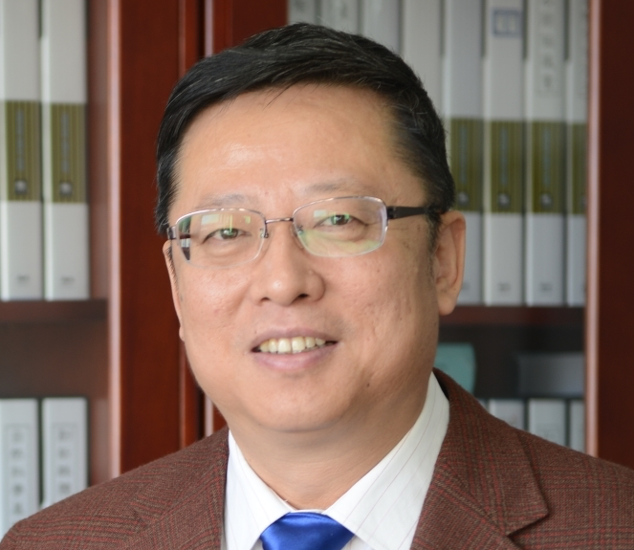
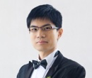
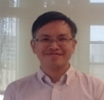
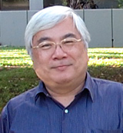

Working Group
China
Zhao Gang (NAOC)
Cai Zheng (UCSC → NTU)
Taiwan
Shiang-Yu Wang (ASIAA)
Wen-Ping Chen (NCU)
Japan
Taddy Kodama (Tohoku Univ.)
Nagayoshi Ohashi (NAOJ)
Korea
Still waiting for the new KASI president to be appointed.

Slide 8
Time Line (including my personal wish)
As soon as the new president for KASI is going to be appointed, two names from Korea for the WG will be decided.
Kick-off discussions will be held as soon as Korean members for the WG are decided.
Might be able to hold a face-to-face meeting before the next EAO board (April 2018), making a report at the Board meeting.
By the time of the Board meeting in the fall 2018, further practical discussions are done by the WG.
At the Board meeting in the fall 2018, decision to resume EAO time could be made at least?

Slide 9
Discussion with India
Former Director Arimoto sent a letter to prof. Ojha (TIFR) for discussion of possible collaborations in December 2016.
Dr. M. Puravankara (TIFR) and Ohashi/Pyo-san had personal informal discussions in December 2017 to follow up what happened after the letter was received.
India TMT SAC has been discussing a possibility to collaborate with Subaru.
Prof. A. Pandey (ARIOS) and Yoshida-san had a discussion in January 2018.
They are preparing a letter to submit to Chair of India-TMT
SAC to start official discussions with Subaru on international
Partnership.

