Slide 1

W. M. Keck Observatory Status and Plans Subaru Users’ Meeting 2018
Hilton Lewis
Director
January 17, 2018

Slide 2
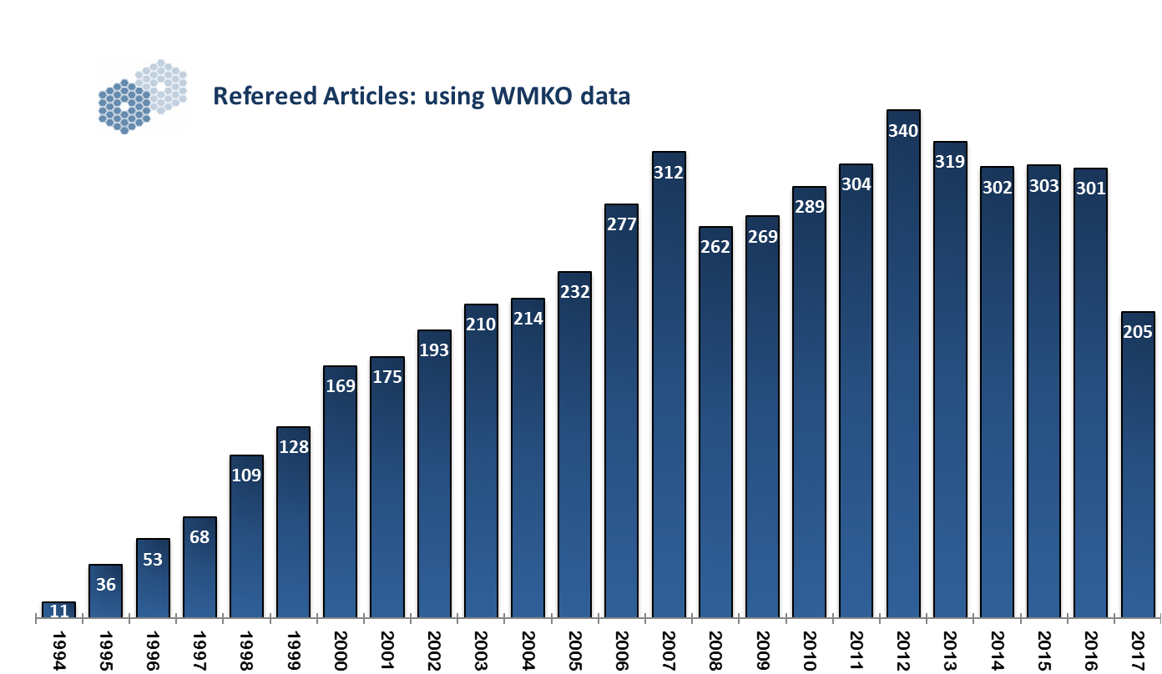
2017 Incomplete

Slide 3
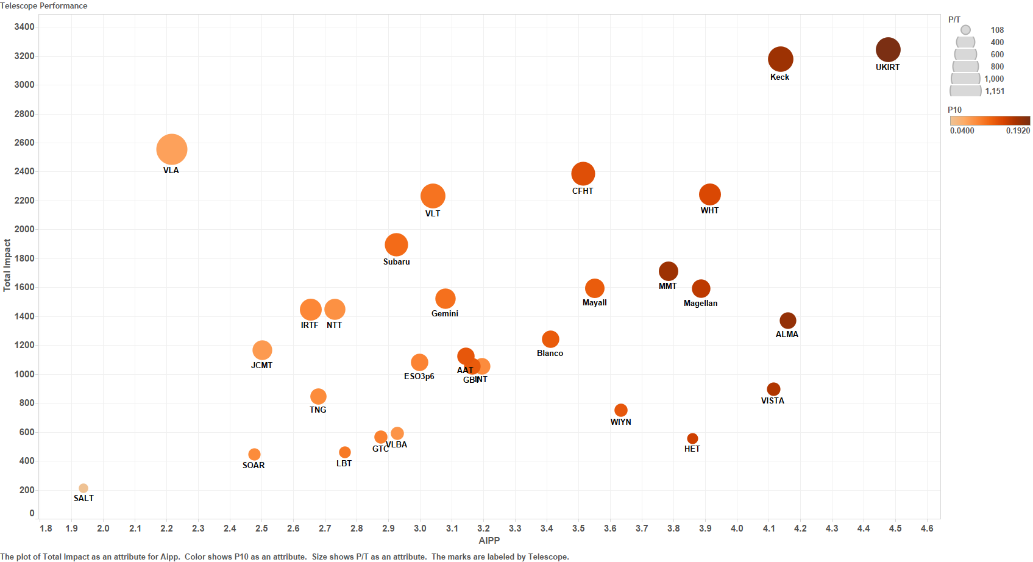
Overall Performance 2011 - 2015
This slide shows a summary of telescope performance. The two axes are AIPP and Total Impact, while the size of the points represent the total papers per telescope for 2011-2015. The color of the circles represents the fraction of papers in the top 10% of cited papers in the complete sample

Slide 4
PhD Theses using WMKO data

Slide 5
Distribution of Time, by Category, 2016

Slide 6
Science Program Trends

Slide 7
Engineering Time Statistics
Engineering Time Averages:
24 Nights Used/ Semester
29 reserved/ Semester
5 nights/ Semester give back science
Total includes weather losses
Hours
Hours of Good
Weather Used

Slide 8
Segment Exchange Engineering Time
Super Ultra Fine Screen, SUFS,
reduced segEx recovery time by 40%
Nights
Semester

Slide 9
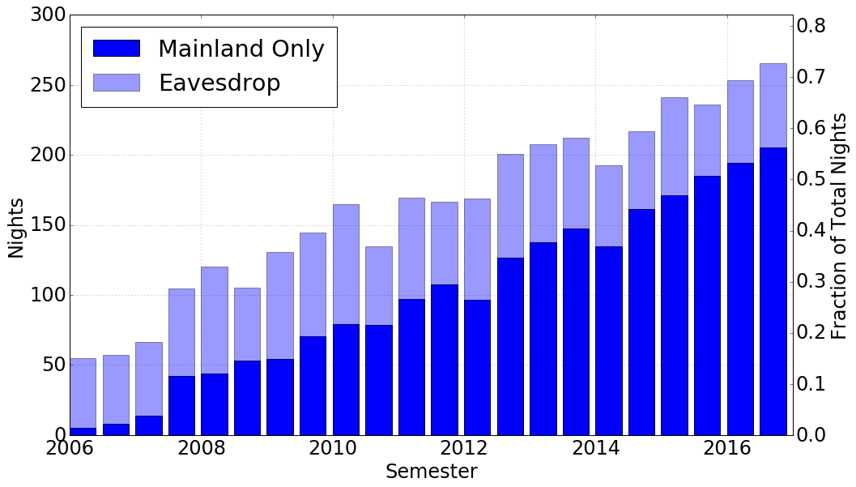
Mainland Observing Sites
15 sites
Some concern about weakened
engagement with observers
14 sites
11 sites
13 sites
9 sites
10 sites
6 sites

Slide 10
Instrument Report
NIRES, OSIRIS, DEIMOS, K1DM3, NIRSPEC, KCRM, KPF, Segment Repair & TCSU
Marc Kassis

Slide 11
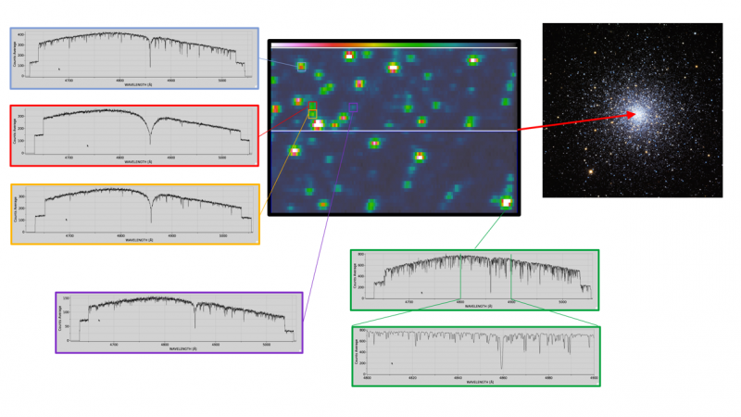
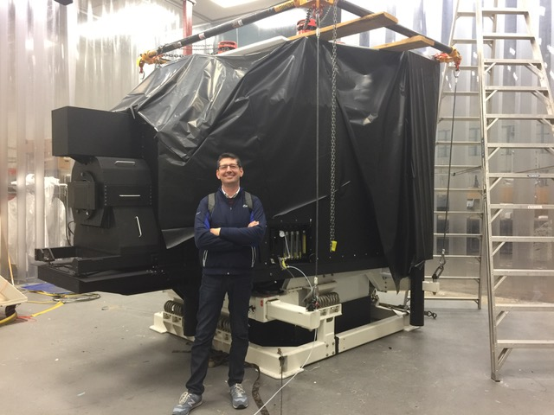
Keck Cosmic Web Imager (KCWI)
First light April 12th, 2017 (M3) for blue channel (350nm-700nm)
Commissioning proceeded very smoothly. All capabilities available except for installation of one remaining grating
KCWI in routine science operations since September 2017.
22 nights allocated to science so far (6 nights/month)
KCRM - Red channel (530nm-1050nm) preliminary design commencing. Full project funding is in place

Slide 12
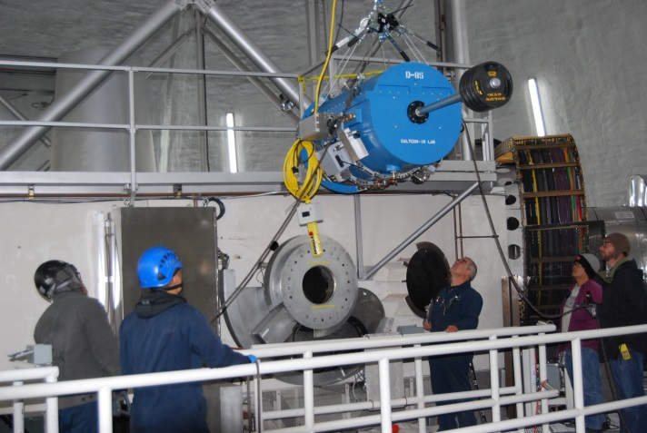
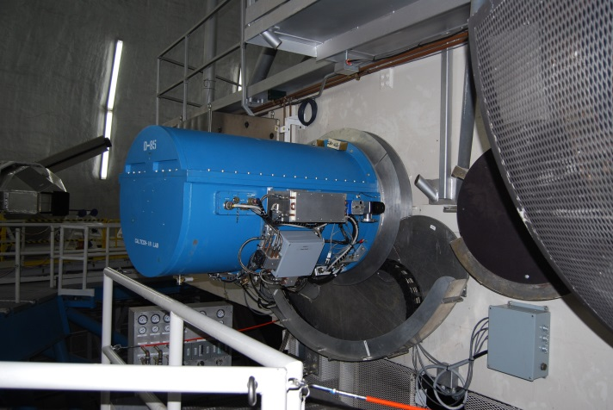
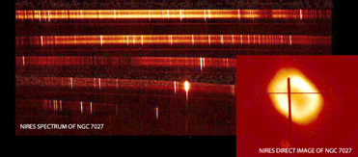
NIRES Status
NIRES achieved First Light on 10-5-2017.
Commissioning expected to be complete by the end of January 2018.
Available for shared risk observing in 2018A, regular science in 2018B
NIRES Lift
NIRES First Light Image NGC 7027
NIRES Installed on K2 RBC
Kudos to Keith Matthews, the PI for NIRES along with fellow Caltech PI Tom Soifer, as well as Percy Gomez (instrument master and lead), Mavourneen Wilcox (project manager), Shui Kwok (telescope commissioning lead), Dwight Chan and Steve Milner (instrument engineers), and all the many others who contributed to the success of NIRES!

Slide 13
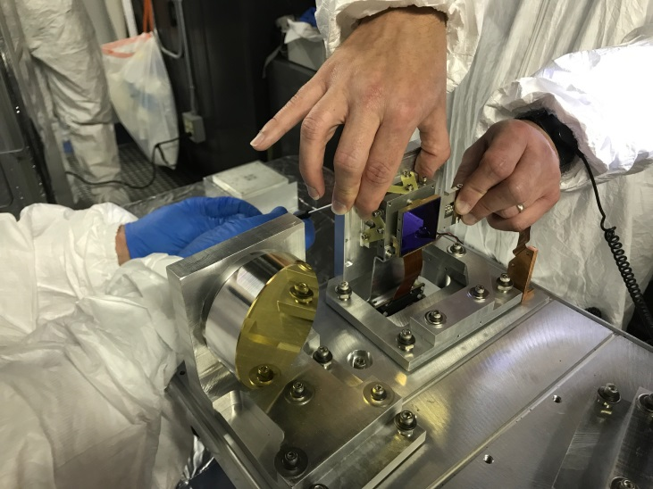
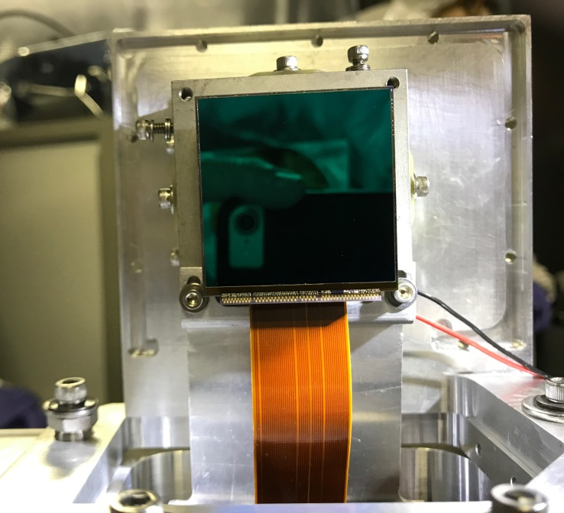
OSIRIS Imager Upgrade Status
The OSIRIS Imager and Filter Wheels were successfully installed on 11/15/2017.
An earlier attempt to install the detector aborted due to broken wire bonds. The detector was returned to Teledyne and fully repaired. Cause of the failure is unknown, but occurred during the installation attempt.
The detector passed a warm read test (with picture frame) and the installation team was able to demonstrate thermal control of the detector.
However, cold testing revealed a vignetting problem that will be addressed in Jan 2018
BUT upgraded specrograph works fine!

Slide 14
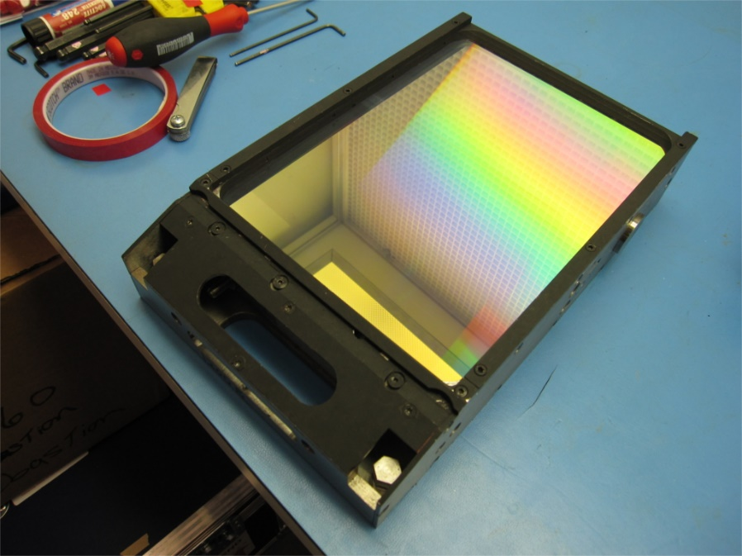
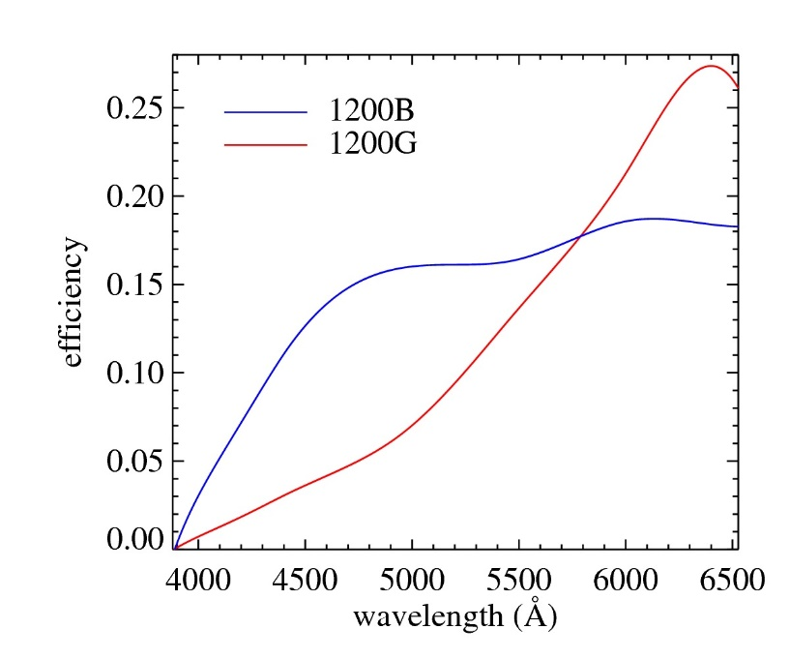
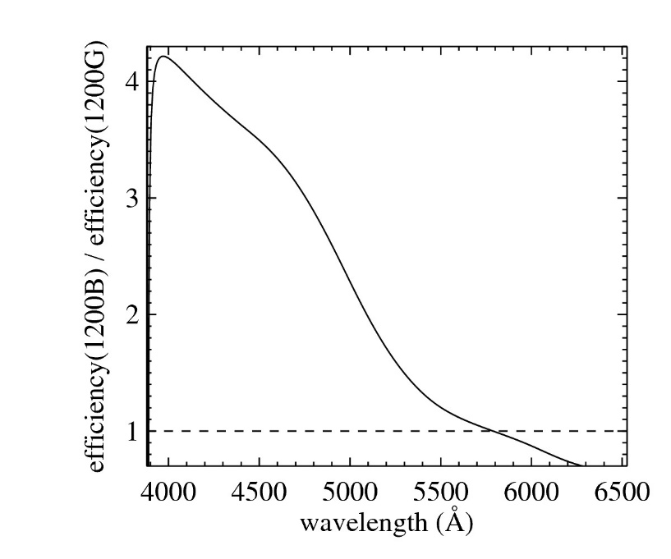
New DEIMOS Blue Grating Installed
New grating (1200B) integrated in the DEIMOS software:
Grating available in the DEIMOS configuration form
Integrated in the flexure control tracking software
Released for general use in semester 2017B
Web documentation still pending and will be available for 2018B proposal calls
Ratio Blue/Red
On Sky
with 0.7” slit
Kindly provided by Dr. Evan Kirby
Notes:
1200B is blue sensitive
1200G is red sensitive

Slide 15
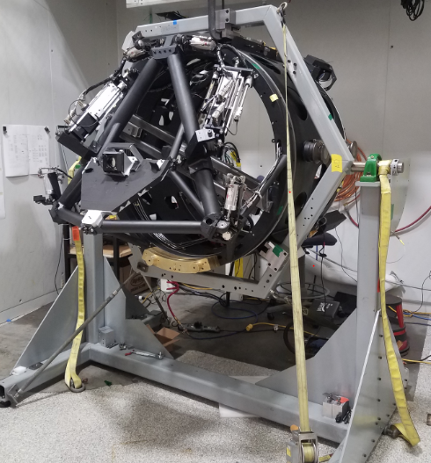
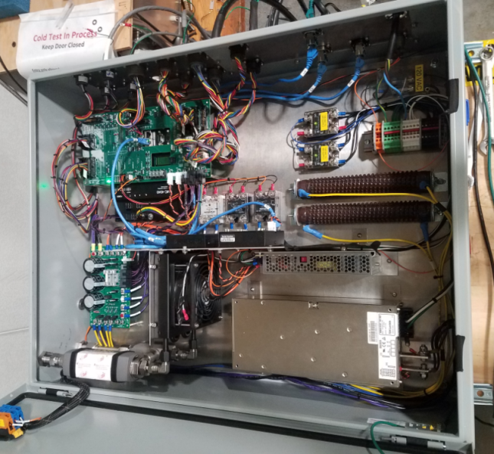
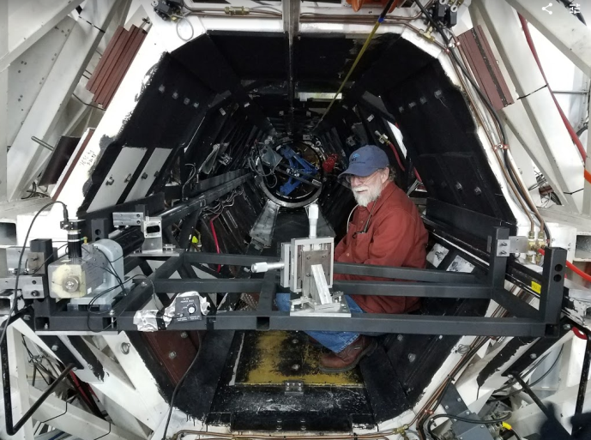
Keck I Deployable Tertiary Status
System in Final Test at UCSC, with fully integrated hardware, software
Preship review held in late Dec. Some outstanding issues, mostly related to reliability
Anticipated shipment in Feb. 2018 with installation complete in March
Alignment Dry-run at WMKO
Final Electronics
Undergoing Software and Functional Tests at UCSC

Slide 16
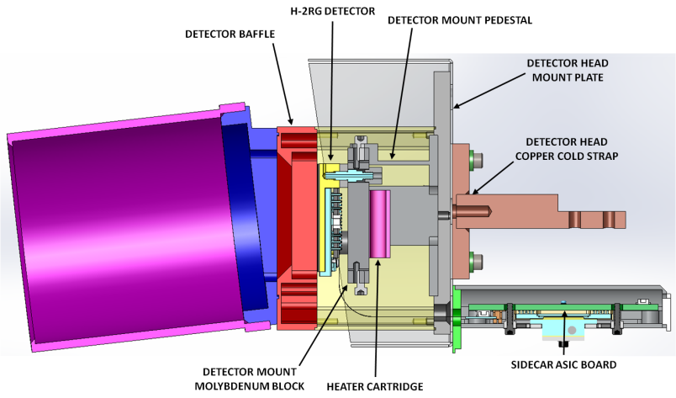
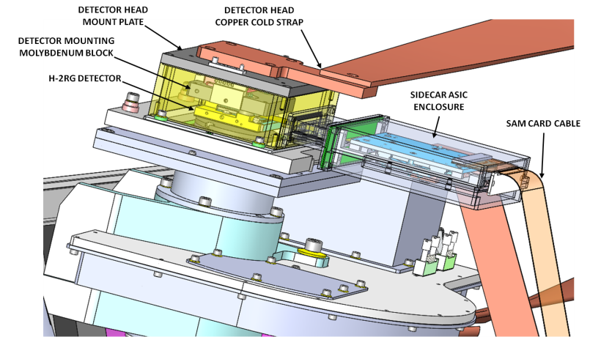
NIRSPEC Upgrade Status
NIRSPEC Upgrade review held at UCLA on Oct 13, 2017.
During the review, the new spectrometer, slit-viewing camera, electronics, associated hardware and planned dewar modifications were presented.
NIRSPEC downtime needed to integrate the new dewar expected to last 5 months, includes 3 cool down and warm up cycles.
A decision will be made in mid-February regarding whether to conduct the upgrade in the 2018B semester
Upgraded Science Detector Head Assembly
Upgraded SCAM Detector Head Assembly

Slide 17
Other Instrument Activities
Keck Planet Finder (KPF) preliminary design review held in November 2017.
Not fully funded yet
Commencing work on a replacement real-time controller for Keck 2 AO system
Proposal submitted for laser tomography system
GLAO study led by Jessica Lu (UCCB) and Mark Chun (UH)
Gathering Instrument specifications and modeling instrument performance
Hosted a GLAO two day workshop to develop science cases at the CfAO fall retreat – October

Slide 18
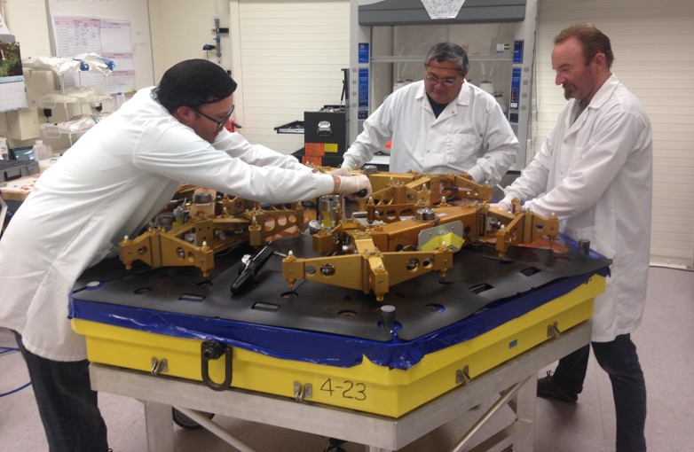
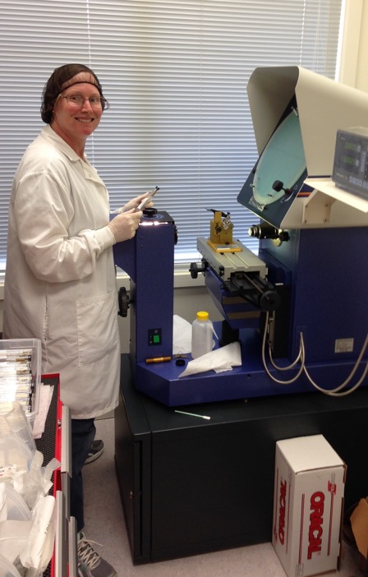
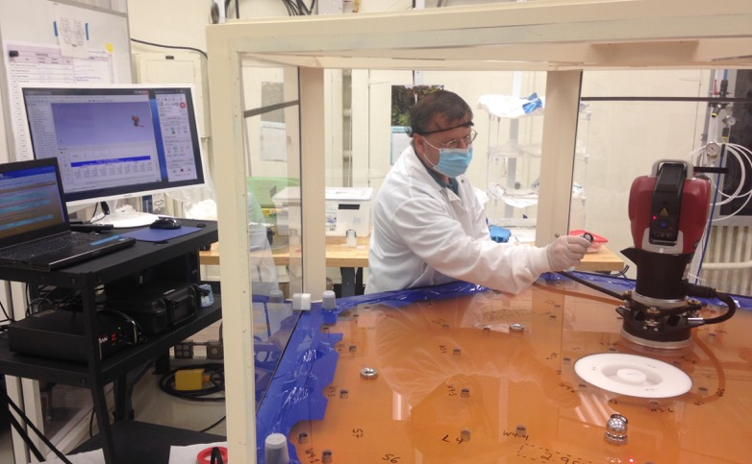
Segment Repair Project
Project proceeding smoothly
23 segments repaired so far
All previously unusable segments repaired
Keeping pace with routine segment exchange process – no impact to science operations
Average processing time is 28 days/segment Original plan was 33 days/segment
Expect to meet planned budget, but with modest schedule slip (<6 months)
Upper right, installing a radial pad. Lower right, calibrating the laser tracker. Middle, testing flexure rods.

Slide 19
Telescope Control System (TCSU)
TCSU is a major performance and obsolescence upgrade of hardware, computer systems and software
TCSU in use for science since October for all instruments on Keck 2.
Excellent pointing pointing performance ~1.2 arcsec rms over full sky, actual operations (not just fitted data)
Keck 1 is awaiting final engineering tests (scheduled for December, but weathered out). Expect to be in full science use by February
Night time revert capability to legacy systems remains in place – will remove after ~1 year

Slide 20
Keck Visiting Scholars Program
Anne Kinney

Slide 21
Keck Visiting Scholars Program
Program to bring graduate students and post doctoral fellows to Keck Observatory from a few weeks to a few months. Had 7 scholars in the first year.
Goal is to provide hands-on exposure to an observatory and instrumentation, to help develop the future leaders in the field.
Scholars engage in a project to benefit Keck while honing their own skills.
Visiting Scholars are assigned a Keck mentor to ensure their time at the observatory is productive.
Program funds travel and living expenses (no stipend). Costs are covered by grants from donors.

Slide 22
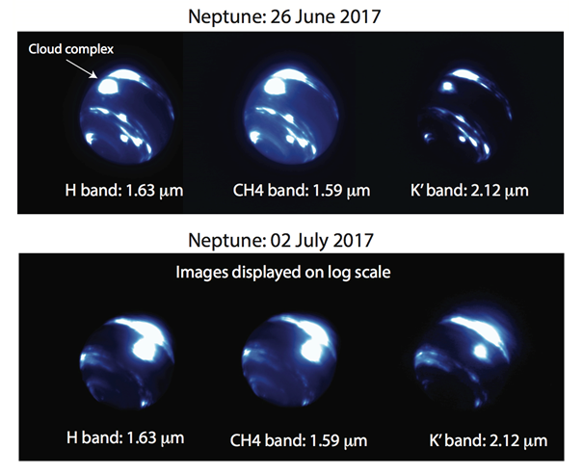
Massive Storm on Neptune N. Molter, I. De Pater, (UCB), C. Alvarez (WMKO)
Outcome of Keck Scholar Ned Molter’s work at the observatory
Detected an extremely large storm on Neptune
~9000 km diameter storm
Brightness varies irregularly with time
Storm located at the equator where storms have never been detected before
Example of how new pilot program for twilight observing can yield scientifically valuable results
Notes:
Molter is the 2nd of our visiting scholars, in the KVSP program
Amateur astronomers are playing an important role in follow-up
Coriolis force would normally prevent long-lived storm on equator

Slide 23
Other Matters
Hilton Lewis

Slide 24
Staff Matters
Major management activity is dealing with succession planning.
A significant fraction of our senior staff will retire in the next 5-10 years
Are budgeting additional funds so that we can hire to overlap with senior staff
Are starting training programs later this year to develop internal candidates
Hiring a new chief scientist (Dr. Kinney now heads the Math and Physical Sciences Division at NSF)
A new AO Operations Scientist position has been created to bring more focus and expertise to diagnosing AO issues and optimizing the AO systems for observing. Difficult to fill this position with the write operations skills
Have hired a senior systems engineer to train more junior staff, following the steady loss of expertise in this area over the past decade

Slide 25
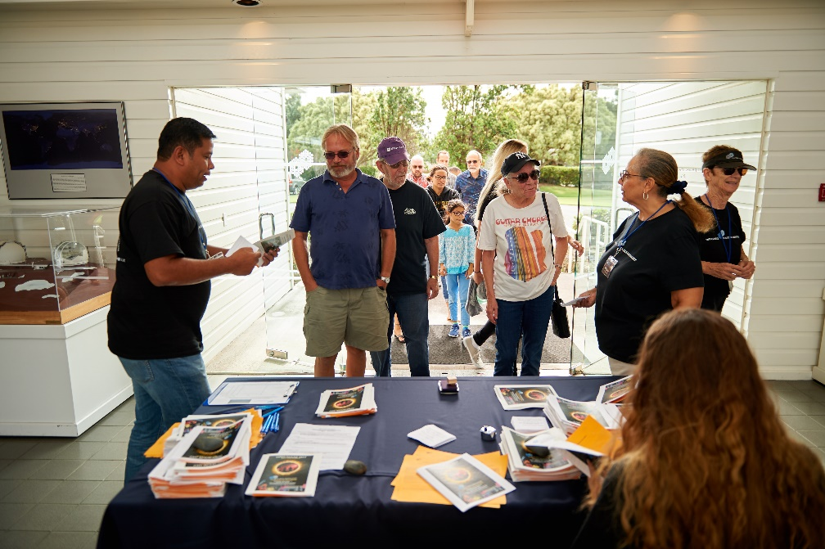
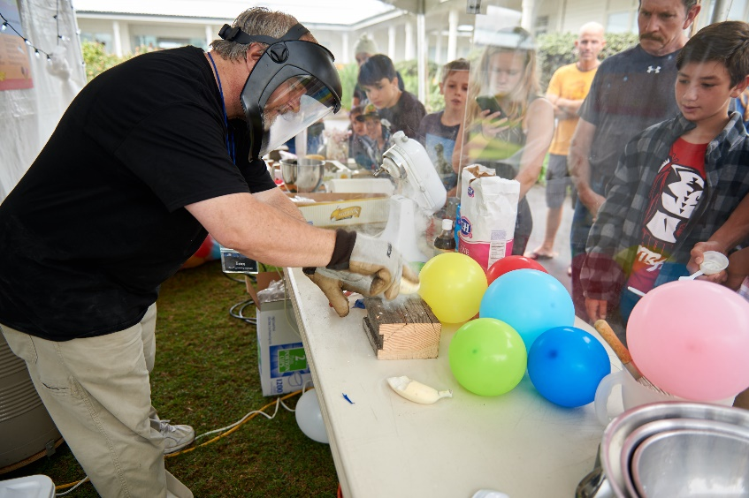
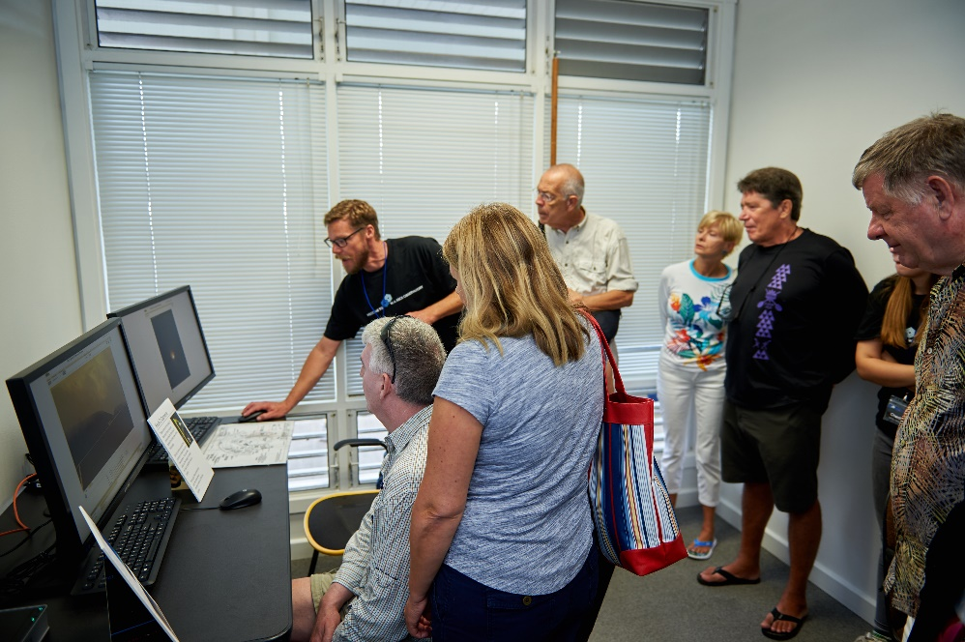
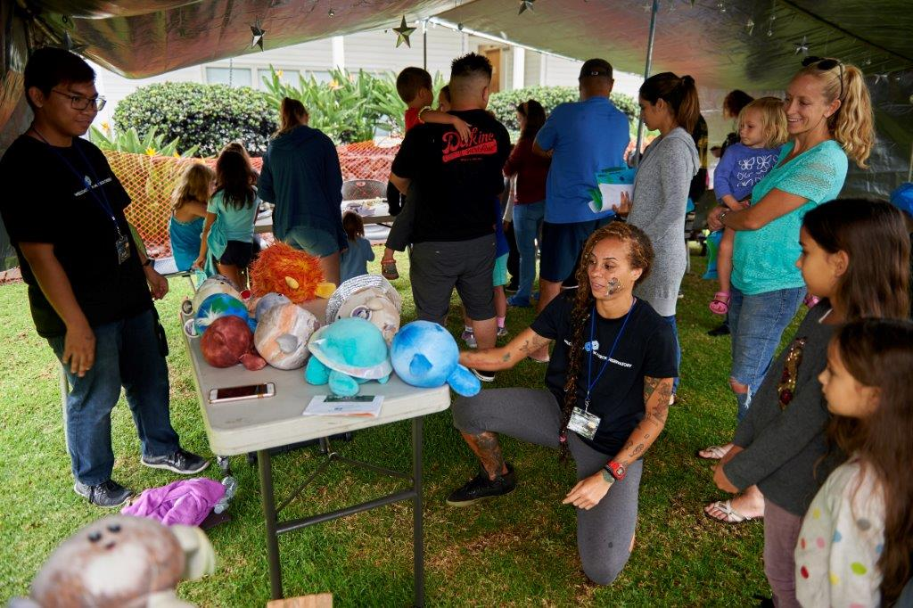
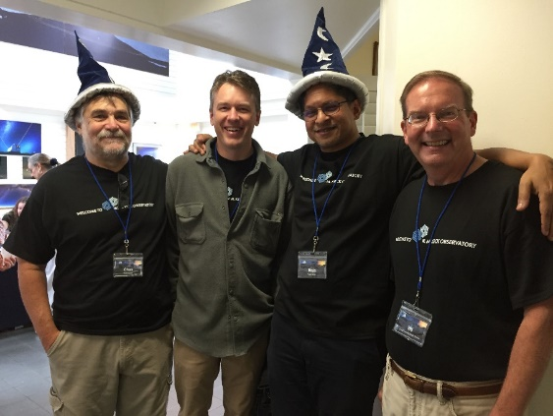
OPEN HOUSE HIGHLIGHTS
1,132 Attendees
26 Staffed Exhibits and Activities
49 Student Volunteers from 4 local schools and UH
5 Observers volunteered including Drs. Chas Beichman & Raja Guhathakurta
2 Staff Talks & 2 Student Talks: Akamai Intern & Keck Scholar
Media coverage on local television news stations, radio and print
http://www.keckobservatory.org/recent/entry/keck_observatory_open_house_2017

Slide 26
http://www.keckobservatory.org/recent/entry/kipthorne
Notes:
Nobel Prize in Physics 2017: Ray Weiss, Barry Barrish, Kip Thorne

