Slide 1
Science Operation Report FY2017
Tae-Soo Pyo
Subaru Telescope

Slide 2
Agenda of reports
New Members in Science Operation Div.
HSC Queue Mode Operation Report
Remote Operation Report
Announcements

Slide 3
New Members in Science OperAtion Div.
Etsuko Mieda : AO188 + IRCS Support Astronomer
Yuhei Takagi : HSC Support Astronomer
*cf. Resign: Joanna Bulger (AO188+IRCS), Francois Finet (HSC fellow), Jennie Berghuis (OSA)

Slide 4
HSC Queue Operation Mode News
HSC Queue Mode was opened to UH and Gemini TE
Subaru Users can submit Gemini Filler program at any time.
Available for Time Critical Programs since S17A
+ New HSC Queue Working Group members:
Terai (SA), Takagi (SA), Rusu (Fellow), Suh (Fellow)
HSC Queue Operation will be executed by SA (1) + Operator (1) as the final form.
SA Training for Queue operation
Operation policy and procedures for Filler and Grade C

Slide 5
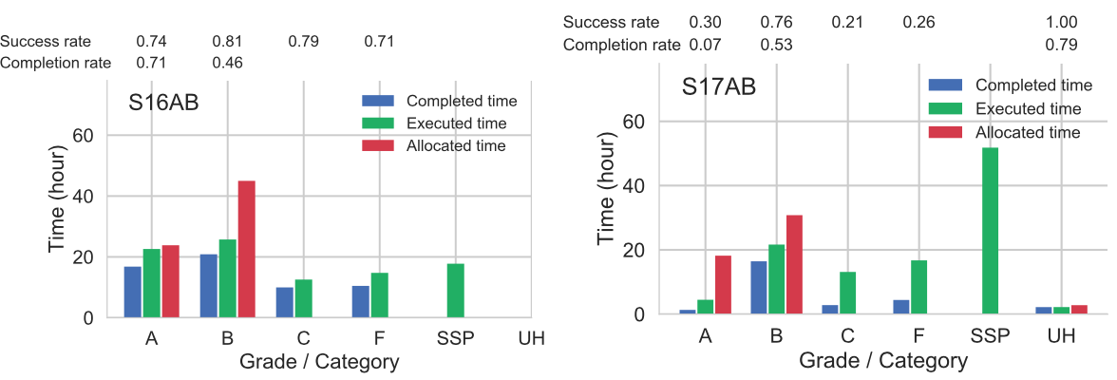
HSC Queue mode operation : Completion Rates for 2 years
* Success rate = (Good OB)/(Executed OB), Completion rate = (Good OB)/(Allocated OB)
From: HSC status report poster by Onodera & HSC QWG (Please see the poster for more detailed information)

Slide 6
Remote Observation report
Mitaka Observation statics
Until S15A: HiCIAO/IRCS/…
Since S15B: 50%-70% is HSC
S17B: 63/109 nights = 58% of total observing night
Hilo Remote Observation statics
Increasing since S17A
CHARIS+SCExAO, ToO
Opening Hilo Remote Request form Since S17B (https://www.naoj.org/Observing/HiloRemote/)
Enhance Remote observation/operation.

Slide 7
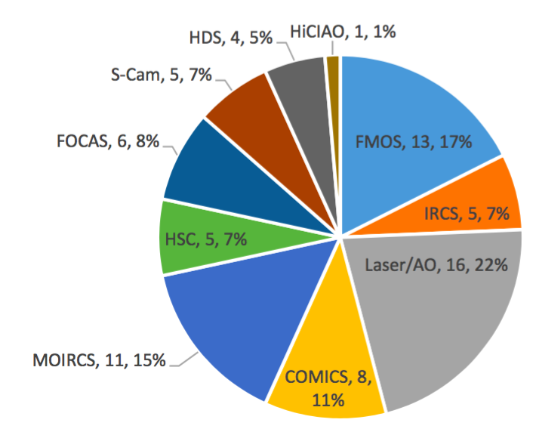
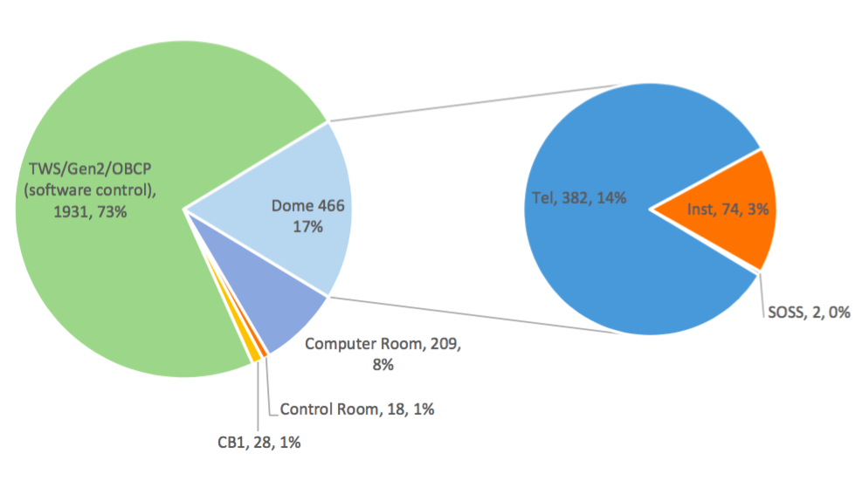
Trouble Recovery (2012-2017)
: Frequency of access to dome
Report by Michael Letawsky (2017)

Slide 8
Announcements (お願い）
[No wind screen] Please prepare the back up target for the case of strong winds.
[Schedule] Please check any problem for your observational schedule just after you get the acceptance letter (schedule conflict, target visibility, …). Then let me know it as soon as possible.
[Open Use Report] Please let us know your feed back!
[Observation consulting with SA] Please contact SA for the preparation of your observation one month before.

Slide 9
During 2018… Toward Full remote...
We will discuss the full remote operation mode in the final day program.
We will be asking for observer’s active participation in instrument operation.
Prepare User/Operation manual for practical and easy use .
Prepare tool to check and to make observation script (OPE file)
Improvement Hilo remote room for operation
Let’s talk more in the final day discussion.

