Slide 1
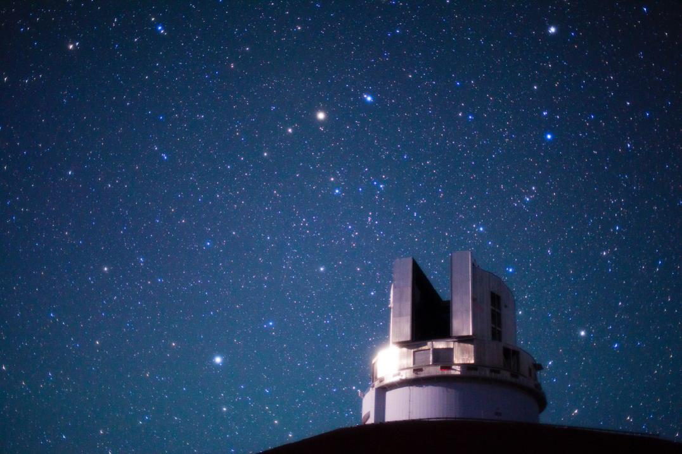
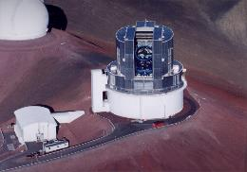
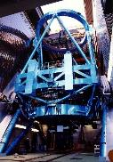
Annual Report of Subaru Telescope 2017
Michitoshi Yoshida
Subaru Telescope, NAOJ

Slide 2

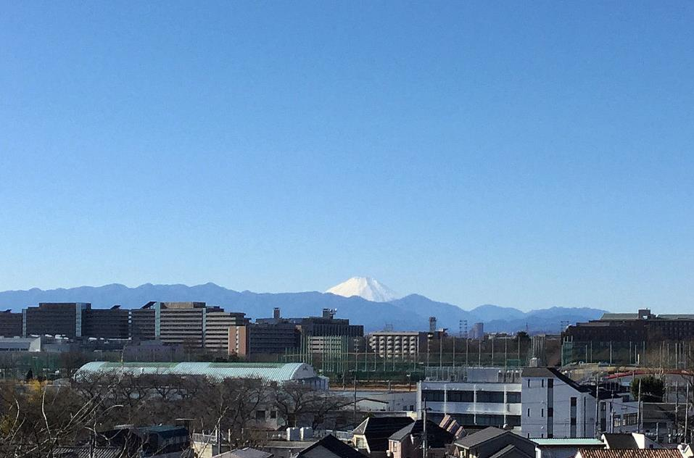
Welcome to Mitaka

Slide 3
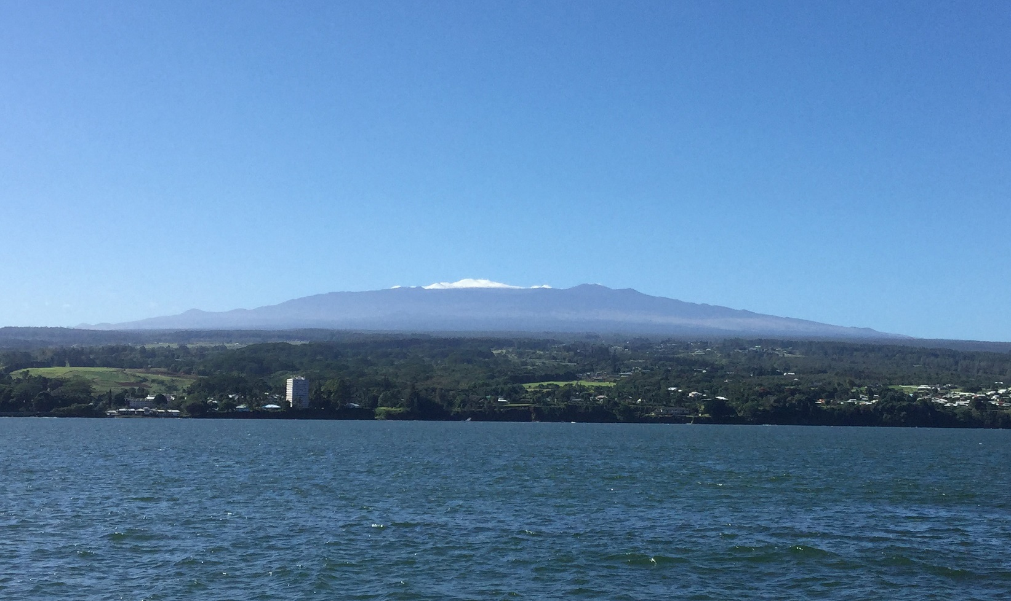
Beautiful Maunakea

Slide 4
Human resources and budget

Slide 5
Human resources
No. of staff members: 106
  Hawaii: 87 (NAOJ: 22, RCUH: 65)
  Mitaka: 19
Admin.
Scientists
Technicians
Engineers

Slide 6
Budget
M JPY
1962.8
1648.8
Fiscal Year

Slide 7
2017 budget

Slide 8
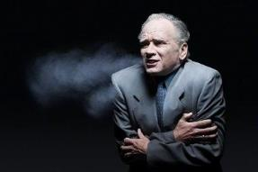
Budget
M JPY
1890.9
1212.7
Fiscal Year

Slide 9
Open-use status

Slide 10
Oversubscription rate is ~ 4 – 6

Slide 11
Telescope time allocation in 2017
The wind screen acc., the mirror hatch
repair works, and M1 recoating works
SSP
Downtime
Engineering
Regular Open Use
Staff
UH
Keck
Gemini

Slide 12
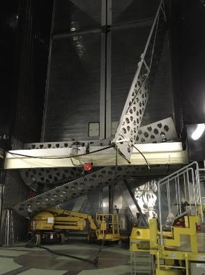
Wind screen accident
Occurred in Apr. 2017
The damaged panels were removed from the dome and put on the ground near the dome.
Mitsubishi and Subaru identified a possible cause of the accident – excessive tilt of the rotation axis of one of the sprockets which hang the drive chain of the screen.
Mitsubishi are considering repair work plan. Complete repair will take about two years.
Telescope operation is being continued without the wind screen. No big problems are reported so far, but, recently, some observations changed their targets to avoid strong winds.

Slide 13
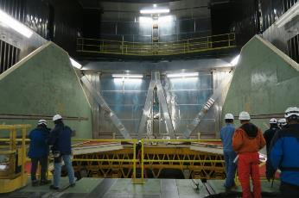
Mirror hatch accident
Occurred in Feb. 2016
Repair works took total of 21 whole days in June and July 2017 ➔ The hatch was fully repaired and tested in August 2017.
Reoccurrence prevention measures and safety measures were established in coordination with “Subaru Telescope review committee”.

Slide 14
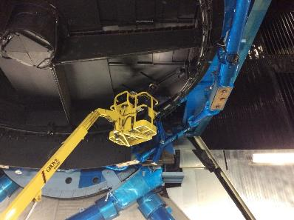
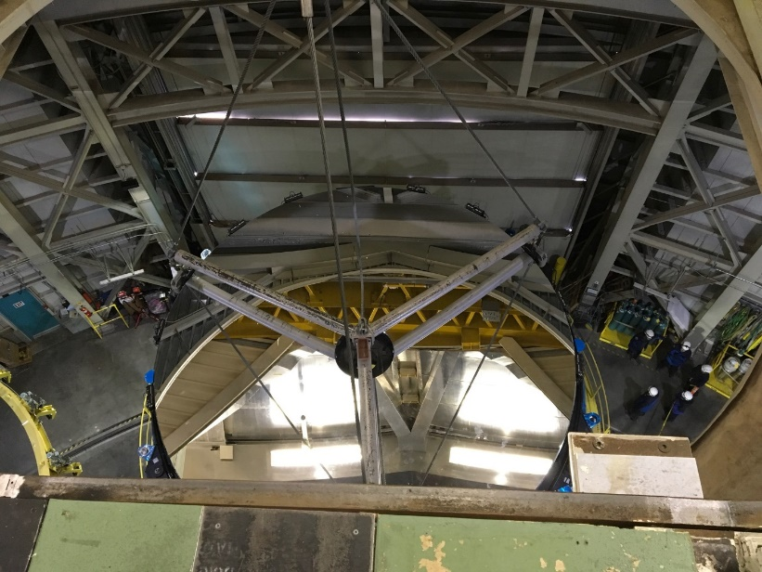
Primary mirror (M1) recoating
M1 surface recoating could not be made from Aug. 2013 due to the mirror hatch accident.
This year’s work : From Oct. 2 to Dec. 13 2017
  M1 recoating
  The CO2 cleaning system maintenance & other telescope maintenance
  Pointing & mirror analysis

Slide 15
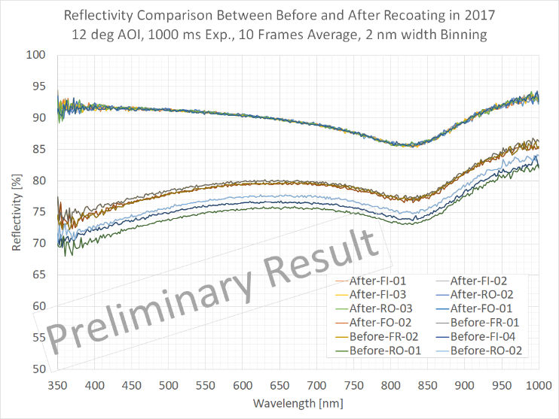
Reflectivity of the recoated M1
After recoating
~20%
Before recoating

Slide 16
Science results

Slide 17
Number of publications
In addition, PASJ HSC special issue (39 papers) will be published early next year.

Slide 18
2011 - 2015
Dennis Crabtree (2017)
NRC Herzberg

Slide 19
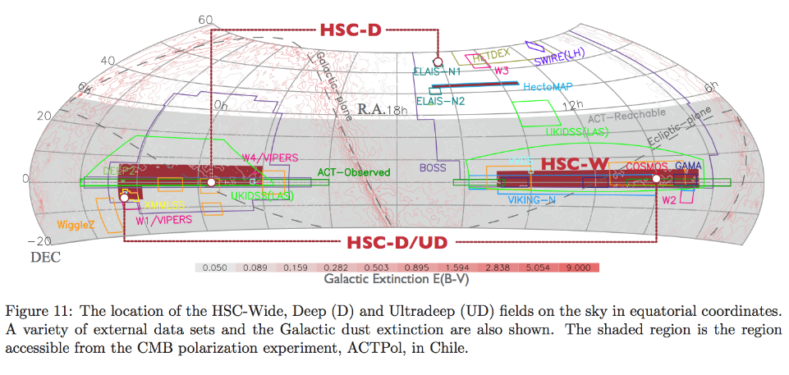
Subaru Strategic Program of HSC
Three layer survey
Wide: 1400 deg² g: 26.5, i: 25.9
Deep: 27 deg² g: 27.5 i: 26.8
Ultra Deep: 3.5 deg² g: 28.1 i: 27.4
300 nights are allocated from 2014 to 2019
1st Public Data Release (2017 Feb. 27)
https://hsc-release.mtk.nao.ac.jp

Slide 20
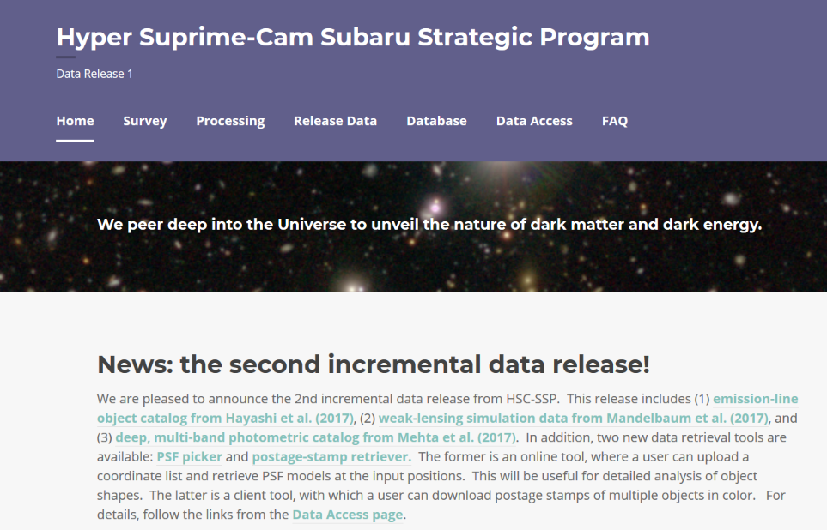
1st Public Data Release in Feb. 2017
2nd Incremental Data Release in Nov. 2017
https://hsc-release.mtk.nao.ac.jp
Released on Nov. 22 2017

Slide 21
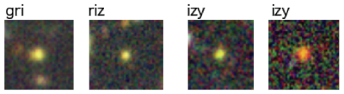
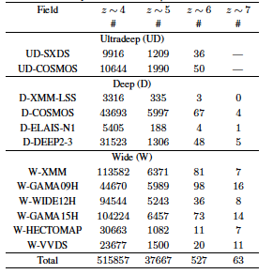

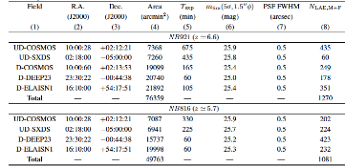
Subaru Telescope
Discovery of numerous distant galaxies
Ono et al. 2017, Shibuya et al. 2017
z=4
z=5
z=6
z=7
556,465 Galaxies at z=4-7 in 100 deg²
(incl. 2351 Lya emitters at z=6-7)
z=6-7
aa

Slide 22
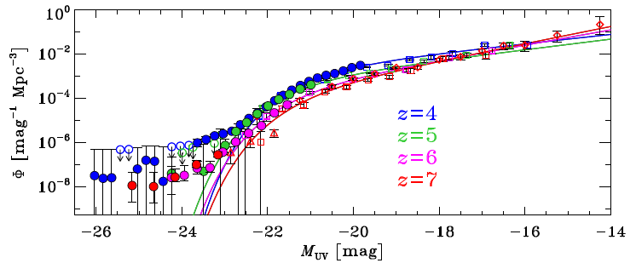
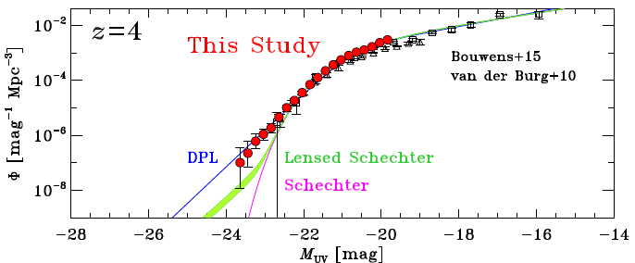
UV Luminosity Function (LF)
Ono et al. (2017)
UV LF of z=4 galaxies after correction of the AGN LFs
→ LF excess: Not Schechter+Lensing, but double powerlaw. (Bowler+15,+17)
Evidence of weak feedback?
Precision UV luminosity function (LF) → Bridging the LFs of galaxies and SDSS QSOs.
  Rychard Bouwens e-mailed us (Apr. 21), saying “Your figures showing the transition between the galaxy and quasar LF regimes will likely appear in many textbooks and reviews for many years to come.”

Slide 23
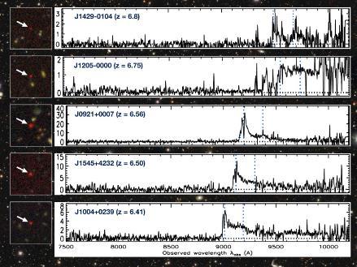
Subaru Telescope
Discovery of tens of low luminosity quasars in the early universe.
Matsuoka et al. 2017
Over 30 high-redshift quasars whose absolute magnitudes are fainter than -24 were discovered by HSC-SSP survey.
A sample of spectroscopic follow-up observations of the discovered quasar candidates with FOCAS
Rest UV absolute magnitude of newly discovered quasars (blue color)
Notes:
スペクトルの絵をつけて、たくさん検出されていることを示す。

Slide 24
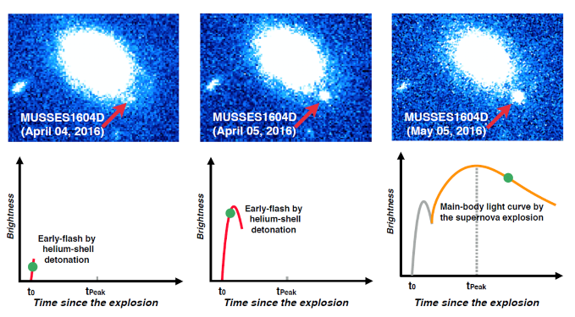
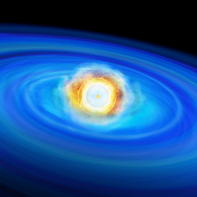
Subaru Telescope
Detection of early-flash by helium detonation of a type Ia supernova
A type Ia supernova within a day after the explosion is detected by HSC-SSP. The light curve showed a clear evidence of early-flash of helium detonation at the surface of the SN progenitor white dwarf.
Jiang et al. 2017

Slide 25
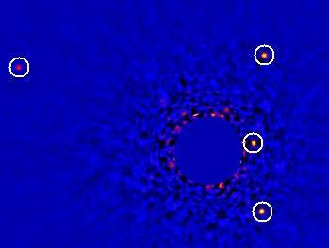
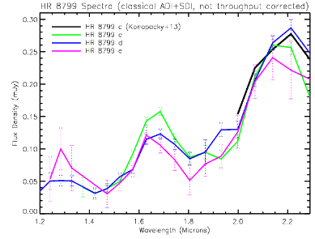
Subaru Telescope
Near-infrared spectroscopy of the four extra-solar planets around HR 8799
July 2016
HR 8799
Subaru extreme AO system SCExAO detected four exoplantes around HR 8799 with high signal-to-noise ratio ➔ Performance Comparable to the Gemini Planet Imager
Near-infrared spectra of the four exoplanets were first obtained with a high angular resolution spectrograph CHARIS + SCExAO.
Currie et al. 2017
Notes:
Gain (b,c,d,e) = 1, 2.2, 3, 10

Slide 26
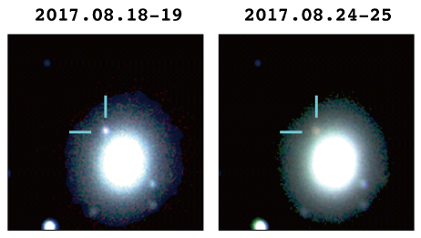
Subaru Telescope
Optical – infrared follow-up of the binary neutron star merger GW170817
2017.08.18-19
2017.08.24-25
NGC4993
HSC: z-band, IRSF: H, Ks-bands
Subaru HSC & MOIRCS succeeded to
get the optical – near-infrared light
from a binary neutron star merger
event GW170817.
We surveyed ~70% of the 90% credible area of the localization skymap of GW170817 with HSC. ➔ The OT at NGC4993 is the most promising candidate for the optical counterpart of GW170817
Ustumi et al. 2017
Tominaga et al. 2017
Notes:
Gain (b,c,d,e) = 1, 2.2, 3, 10

Slide 27
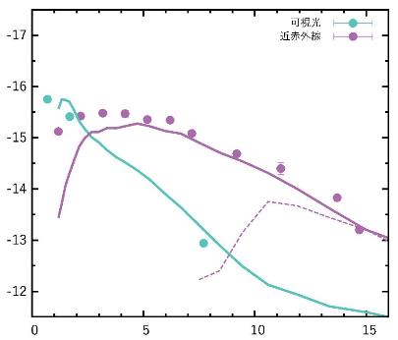
Kilonova models and the OT of GW170817
Optical
NIR
Abusolute AB magnitude
Kilonova models
IRSF Ks
IRSF Ks
MOIRCS
Ks
HSC z
Days after the GW event
The optical – NIR light curves and SED variation are well reproduced by the kilonova models ➔ The site of the cosmic r-process was observationally identified!

Slide 28
Instrumentation
SCExAO (operational)
IRD (commissioning)
PFS (under development)
ULTIMATE (conceptual design phase)

Slide 29
Instrument Lineup of Subaru
facility instruments
  Optical wide field camera: HSC [P]
  Optical camera and spectrograph: FOCAS [C]
  Optical high dispersion spectrograph: HDS [N]
  Near-infrared multi-object spectrograph: MOIRCS [C]
  Near-infrared camera and spectrograph: IRCS [N]
  Mid-infrared camera and spectrograph: COMICS [C]
visiting instruments (PI-type)
  Coronagraphic High Angular Resolution Imaging Spectrograph (CHARIS) [N]
  Extreme adaptive optics: SCExAO [N]
adaptive optics
  Adaptive optics system: AO188 [N]
Suprime-Cam and HiCIAO
were decommissioned

Slide 30
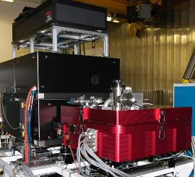
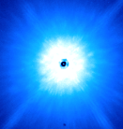
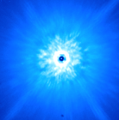
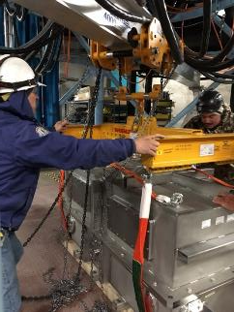
1. SCExAO (operational)
  Extreme AO with a pyramid wave front sensor + a 2000 actuators deformable mirror ➔ Strehl ratio > 0.9 at H-band
  Current/future development
    CHARIS : integral field spectrograph
    MKIDS Exoplanet Camera for ultra-precise speckle cancellation
2. IRD (InfraRed Doppler spectrograph) (commissioning)
  A fiber fed high-dispersion (R=70,000) NIR spectrograph with laser frequency comb ➔ precision of radial velocity measurement < 1m/s
  First light was done Aug. 2017. Science operation will start in late 2018.
SCExAO
CHARIS
SCExAO off
(30% Strehl)
SCExAO on
(80-90+% Strehl)

Slide 31
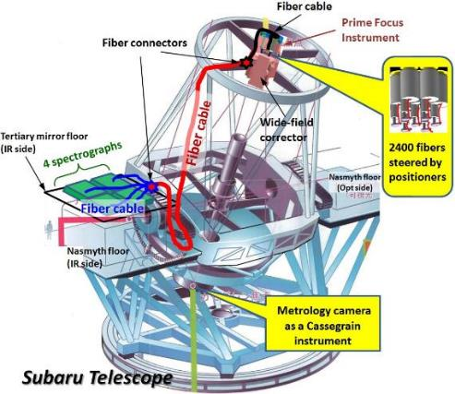
3. PFS (Prime Focus Spectrograph)
(under development)
A fiber fed multi-object spectrograph attached to the prime focus of Subaru
2,400 fibers FOV: 1.25 deg²
λ range: 0.38 – 1.26 μm
Spec. R: 2,300 – 5,000
2018 – 2019: installation at Subaru
2019 – 2021: commissioning
Late 2021 – : science operation
Sensitivity
Band | magnitude
Blue (0.38 – 0.65 μm) | 22.5
Red (0.65 – 0.97 μm) | 22.4
NIR (0.97 – 1.26 μm) | 21.4
S/N = 5 @ 1 hour exposure

Slide 32

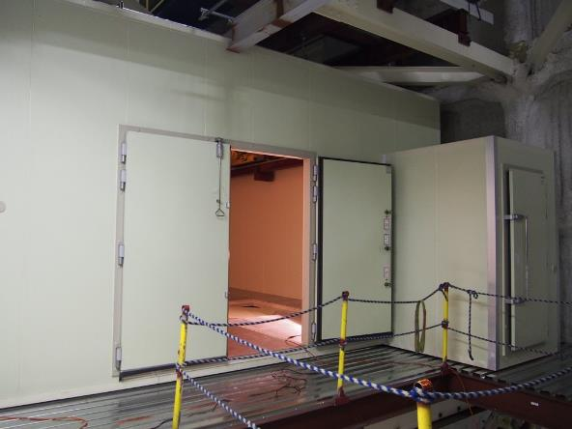
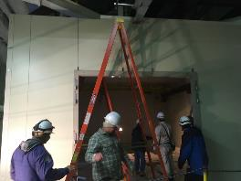

Floor and Clean Room for PFS Spectrographs completed
Day Crews installing CR

Slide 33
PFS Installation Timeline
Installation Schedule
2018 2019 2020 2021
Top Unit w/
fiber positioner
Science
Obs.
1st Sp-graph
3rd Sp-graph
Metrology
Camera
2nd Sp-graph
4th Sp-graph

Slide 34
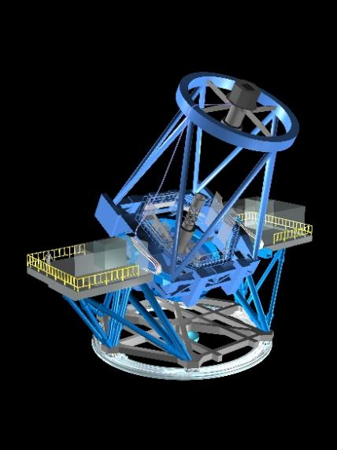
4. ULTIMATE-Subaru
(conceptual design phase)
4 Laser Guide Star System
Wide field near-infrared observation facility using ground layer adaptive optics (GLAO) system
Science Operation:
2026 -
Deformable
Secondary
Mirror
Wavefront Sensors
Wide Field Near-infrared Instruments

Slide 35
Subaru Telescope Instrument Timeline
(version 2017/12/28)
 |  | 2017 | 2018 | 2019 | 2020 | 2021 | 2022 | 2023 | 2024 | 2025 | 2026 | 2027
PF
Cs
Ns
GLAO
  Suprime-Cam
End
  HSC
  PFS
FOCAS
End
COMICS
End
w/ GLAO
MOIRCS
ULTIMATE WFC
w/ GLAO
(w/ GLAO)
  PFS MCS
HDS
TBD
IRCS
End
SCExAO
TBD
w/ ASM? (ULTIMATE)
IRD
PI-type
End
CHARIS
End
AO188
upgrade
Optical Inst.
IR Inst.

Slide 36
International partnership

Slide 37
Discussions with potential international partners
Subaru Telescope has been discussing with the following countries/organizations on the international partnership:
  Australia
  East Asian Observatory (EAO)
  Canada
  (India)

Slide 38
Basic “policy” for international partnership
International partners are expected to contribute on the operation of the telescope (in-cash and in-kind), including the governance of the telescope.
Subaru intends to keep significant amount of the telescope time for larger projects (SSP, intensive) for all the partners; no intention to divide the telescope time into small pieces for each partner

Slide 39
Discussion with EAO
Subaru provided 6 nights to EAO members in 2017 (S17A & S17B).
EAO and NAOJ signed Letter of Intent to have further and more concrete discussions on possible partnership between EAO and Subaru in June 2017.
EAO is going to have a working group to discuss more details of the partnership, under the EAO board.

Slide 40
Discussion with Australia
Discussion started in 2015
Regular working group meeting to discuss details of partnership
Subaru has “Australian Time” (10 nights) in 2018 (S18A and S18B), with contributions (~$1M) from Australia.
May 2017 Australia has decided to enter into a ten-year strategic partnership with ESO
Subaru still continues to discuss with ANU and AAL to see whether there is any possible collaboration on instrumentation.

Slide 41
Discussion with Canada
There have been several visits to Canada from Subaru Telescope to discuss possible collaboration with Canada.
20% partner of Gemini Observatory, until 2021 (renewal in 2018); it might be possible that a part of the future budget could be used for the collaboration with Subaru?
Subaru continues to discuss with Canadian institutes to see whether there is any possible collaboration on instrumentation.

Slide 42
Strategy of Subaru
2018
2020
2024
2028
2033
2040
2050
TMT construction
Subaru/TMT operation
Subaru operation
Distribution of dark matter
Origin of dark matter
more than 20 habitable planes
Life signs on exoplanets
TMT
detailed study
Millions of
galaxies
Origin of dark energy
100 of
z>7.5 galaxies
Reionization
HSC
Ultra wide field survey
IRD・CHARIS
Earth-like planets, young planets
Subaru
wide field survey
PFS
Expanding universe
ULTIMATE-Subaru
High-z galaxy survey
WFIRST collaboration

Slide 43
Summary
The Subaru telescope is working well with the oversubscription rate of the proposals of about 5.
Number of annual science publications is ~120 – 150. (112 for 2017)
A large survey program, HSC SSP is going very well and about half of the project has been done. First public data release was made in Feb. 2017.
The mirror hatch accident was completely fixed and the primary mirror (M1) recoating was done in Oct. – Dec. 2017. The reflectivity of M1 increased 10-20% after the recoating work.
The first light of IRD was done in Aug. 2017. Preparation of PFS installation is ongoing in the Subaru dome.
Subaru is exploring international partners that can jointly operate the telescope.
Financial situation of Subaru is still very severe.

Slide 44
Beautiful Maunakea

Slide 45
To Japanese participants
ユーザーズミーティング3日目（1月19日）の朝一番のセッション（午前9時開始）の冒頭に、林台長からハワイ観測所に関する重要なお話があります。ぜひ、出席してください。

