Slide 1
Implication for star formation
in the central parsec of our Galaxy
with Subaru observations
Tatsuhito Yoshikawa (Kyoto Univ.)
Shogo Nishiyama, Motohide Tamura, Miki Ishii ,
Naoto Emi, Hiroto Kawabata
and Tetsuya Nagata
2014 Subaru Users’ Meeting
2014/01/21-23 @Mitaka, NAOJ
Notes:
My name is Tatsuhito Yoshikawa, a PhD student of Kyoto University.
I will talk about “Implication for star formation in the central parsec of our Galaxy with Subaru observations".
These people are my collaborators.
In my talk, I call the central parsec of our Galaxy, the Galactic Center.

Slide 2
INTRODUCTION
MOTIVATION
Notes:
At the beginning, I talk the introduction of the Galactic Center and motivation of our study.

Slide 3
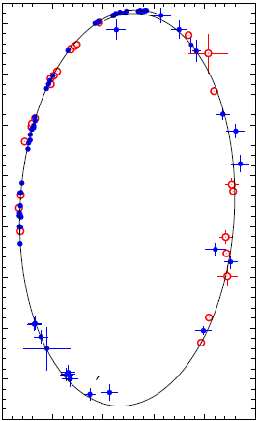
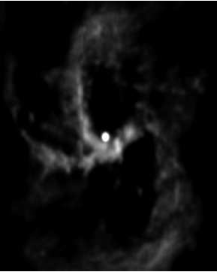
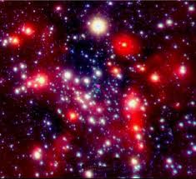
1/15
Central parsec of Our Galaxy (GC)
・super massive black hole, Sgr A* (M ~ 4×10⁶Msun, d~8kpc)
・mini spiral & circumnuclear disk
・many (>100) young massive stars (OB, Wolf-Rayet star)
(e.g., Gillessen+ 09)
(e.g., Paumard+ 06, Bartko+ 09, Lu+ 09)
H92α(8.3GHz)
H(1.65um)+Ks(2.16um)+L’(3.76um)
0.05” (400AU)
Sgr A*
Sgr A*
SMBH
~4×10⁶Msun
50” (2pc)
10” (0.39pc)
NTT, VLT & Keck
VLA
ESO/VLT
(Genzel+ 03)
(Gillessen+ 09)
(Roberts & Goss 1993)
Notes:
The Galactic Center is the most nearest galactic nucleus in the universe.
Thanks to the proxy, people have carried out many kinds of observations and studies for the GC.
As you know, there is a supermassive black hole, called Sgr A* in the GC.
This is revealed by astrometric observations for the star called S2.
This orbit provides the accurate position and mass of the SMBH.
This picture is obtained with radio observations using VLA.
This compact bright objects is Sgr A*.
You can also see three gas streams, called the mini spiral.
Some people believe that in this picture, we see the tracks of mass transport to the supermassive black hole.
Recently, thanks to high-resolution near-infrared observations with Adaptive Optics,
We know there are more than 100 young massive stars in the GC.
This picture is one example of such discoveries.

Slide 4
2/15
young stars in the GC
young (≳3Myr) massive stars in the GC (e.g, Krabbe+ 95)
= star formation occurred in the GC ≳3Myr ago
BUT
Sgr A*・・・strong tidal force→shear molecular clouds
→difficult conditions for star formation (Morris 93)
n~10⁹/cm³ at 10”(0.4pc)
cf. molecular cloud (10K)・・・10⁴/cm³
molecular cloud core・・・10⁵/cm³
What is the origin of young stars in the GC?
Notes:
When we know new objects, we want to know their origin.
Past studies showed that the age of young massive stars in the GC is about 3 Myrs.
Thinking simply, this means that star formation occurred in the GC about 3 Myrs ago.
However, the situation is not so simple.
In the GC, strong tidal forces from Sgr A* shear molecular clouds,
and it makes difficult for stars to be formed by "normal" gravitational collapse.
According to the study of Morris 1993, 10^9 per cubic centimeter is needed to form stars at 10 arcseconds from Sgr A*.
This value is much greater than that of molecular cloud core.
"What is the origin of young stars in the GC?"
This is a controversial issue.
Various scenarios have been constructed for this issue and now two of them are predominant.
I show you them briefly in the next slide.

Slide 5
3/15
scenarios of star formation
1. in-situ star formation
(e.g., Genzel+ 03)
2. infalling stellar cluster
(e.g., Gerhard 01)
cluster
SMBH
SMBH
~30 pc
disk
~1 pc
・collision of molecular clouds
→loss of angular momentum
・gas infall (accretion)
・star formation in the disk
・star formation far from Sgr A*
as a stellar cluster
・the stellar cluster falls into the GC
by dynamical friction
Notes:
The first scenario is called "in situ star formation" scenario.
In this scenario, molecular clouds collide far from Sgr A* and lose their angular momentum.
And then, molecular clouds accrete to Sgr A* and make a high-density gaseous disk.
Finally, in this gaseous disk, star formation occurs due to gravitational instability.
The second scenario is called "infalling stellar cluster" scenario.
This scenario escapes the problem of strong tidal forces from Sgr A*.
In this scenario, stars are not formed in the GC, but formed about 30 pc away from the GC as a stellar cluster.
The stellar cluster falls into the GC by dynamical friction and breaks up on its way.
and stars move to the position we observe now.

Slide 6
4/15
YSO is the key for young stars in the GC
<Motivation>
・infall timescale: 3Myr (~ the age of young star in the GC)
(condition: M_{cluster}~10⁶Msun, R_{g}~30pc (Gerhard 01, Kim & Morris 03))
cf. Arches or Quintuplet・・・~10⁴Msun, 30pc (e.g., Figer+ 99)
↓
The existence of younger objects (<1Myr) can reject
“infalling stellar cluster” scenario!
・younger objects:
Young Stellar Object (YSO) with circumstellar disk
→target: Herbig Ae/Be stars
lifetime of disk is <1Myr (Alonso-Albi+ 09)
・method:
→polarimetric observations
Notes:
However, "Infalling stellar cluster" scenario has a critical problem,
which a stellar cluster have to fall into the GC within the age of young stars we observe.
The infall time is shorter when the stellar cluster is heavier and the initial position of the stellar cluster is nearer from Sgr A*.
According to some studies, if we set the infall timescale is 3Myrs and initial position of the stellar cluster is 30 pc away from Sgr A*,
10^6 solar mass is needed for the stellar cluster.
This value is comparable to the mass of the largest globular cluster.
This is the disadvantage of "infalling stellar cluster" scenario, and motivates our study.
The existence of younger objects, whose age is less than 1 Myrs, can reject "infalling stellar cluster" scenario.
As younger objects, we consider intermediate-mass YSOs with circumstellar disk, called Herbig Ae/Be stars.
According to some observations, the lifetime of disk of Herbig Ae/Be stars is less than 1 Myrs.
To search this kind of objects, we carried out near-infrared polarimetric observations.
In the next slide, I show you how we can find Herbig Ae/Be stars with polarimetric observations, briefly.

Slide 7
5/15
YSO search with polarimetric observations
scattering
→polarization
(Whitney & Hartmann 92)
scattered light
direct starlight
interstellar polarization
central star
re-emission
→infrared excess (red)
circumstellar disk
“intrinsic” polarization
= circumstellar disk →YSO
Notes:
When we observe YSO with circumstellar disk, we see three kinds of light.
The first is direct light from the central star.
The second is re-emission from dust in the circumstellar disk, which is warmed by radiation from the central star.
This light causes infrared excess and the color of YSO is redder than normal stars such as main-sequence stars.
The third is the light scattered by dust in the circumstellar disk and this light is polarized.
Since normal star is not polarized, we can search YSOs with polarimetric observations.
However, we have to care that there is interstellar polarization when we observe toward the GC.
So, we need to detect intrinsic polarization, which reflects the exsistence of circumstellar disk and YSOs.

Slide 8
OBSERVATION
ANALYSIS
Notes:
Now, we move to observations and analysis.

Slide 9
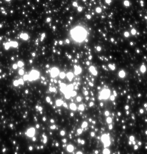
6/15
observation
17” (~0.7pc)
・Subaru/CIAO+AO36
(21.7mas/pix)
・2008/05/26-28
・Ks band
・polarimetric observation
1/2 waveplate
wire grid polarizer
・20 sec×189 sets
Sgr A*
DEC
RA
Notes:
We carried out Ks-band polarimetric observations toward the GC with Subaru/CIAO using AO36 during three nights of May, 2008.
This picture shows our observational field.
To obtain polarimetric information, we used half-wave plate and wire grid analyzer.
The exposure time is 20 sec and during three nights, we obtained 189 sets.

Slide 10
7/15
data analysis
software: IRAF/DAOPHOT
・ordinary data reduction (dark, flat, sky, bad pixel correction)
・PSF photometry + aperture correction for each night
・check the reproducibility through three nights
→remove no-reproducibility stars
318-stars polarization (m_{Ks}<15.5, δP<1%)
Stokes Parameters:
Notes:
For data analysis, we use IRAF/DAOPHOT.
After ordinary data reduction, we conduct PSF photometry and aperture correction for the data of each night,
and check the reproducibility through three nights.
Finally, we obtain good-quality polarization data of 318 stars,
which are brighter than 15.5 magnitude and whose polarization error is smaller than 1%.

Slide 11
RESULTS
Notes:
Then, let me talk about our results.

Slide 12
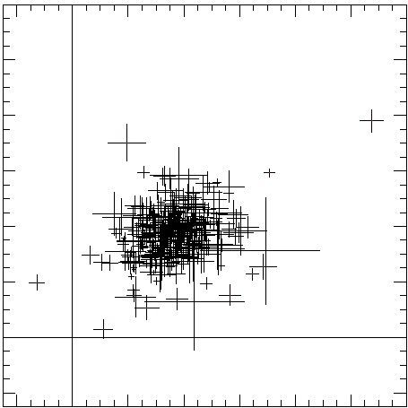
8/15
intrinsically polarized stars are found
qu diagram
0.12
degree of polarization:
0.08
U/I
0.04
degree of polarization
polarization angle：
polarization angle
0
(TY+ 13)
0
0.04
0.08
0.12
Q/I
Notes:
When we see polarimetric information, qu diagram is useful.
This figure is qu plane for our data.
The horizontal axis represents Stokes Q/I and the vertical axis represents Stokes U/I.
By definition, the distance between data point and the origin represents degree of polarization,
and the angle from horizontal axis represents polarization angle.

Slide 13
9/15
intrinsically polarized stars are found
qu diagram
0.12
degree of polarization:
0.08
intrinsic polarization
U/I
observed polarization
polarization angle：
0.04
interstellar polarization
0
(TY+ 13)
0
0.04
0.08
0.12
Q/I
Notes:
Seeing this figure, you can see most data points are concentrated in this region and apart from the origin
This means that most objects have similar polarization and this is the interstellar polarization.
For our purpose, we check intrinsic polarization.
In this figure, intrinsic polarization are roughly represented like this,
and we have to check this part of polarization is significant or not.

Slide 14
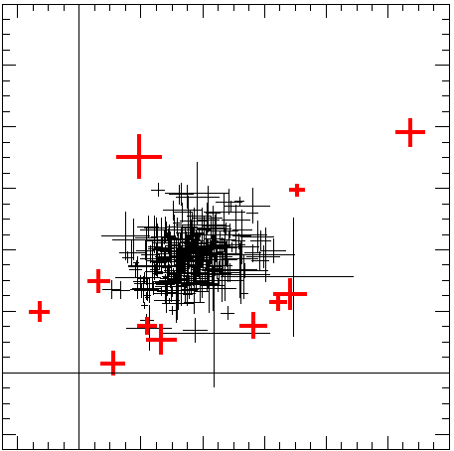
10/15
intrinsically polarized stars are found
qu diagram
0.12
#1
#6
0.08
spread of data points
#5
U/I
intrinsically polarized
stars are found!
>3σ: 11
0.04
#4
#11
#2
#8
#9
#10
0
#7
#3
photometric error
(TY+ 13)
0
0.04
0.08
0.12
Q/I
Notes:
To check the significance, we consider two elements.
The first is “photometric error“ of each star.
The second is “spread of data points",
which reflects the variation of interstellar polarization in our observational field and observational errors.
This is obtained with gaussian fit to this part.
We define quadratic sum of these two elements as sigma,
and find 11 3-sigma sources.
We call these sources intrinsically polarized stars.
In this figure, red points are 3-sigma sources.

Slide 15
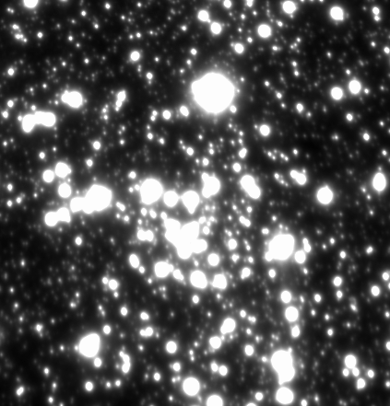
11/15
intrinsically polarized stars are found
#1
8
#3
#4
#8
4
#7
ΔDEC[arcsec]
#9
#10
intrinsically polarized
stars are found!
>3σ: 11
0
#2
#6
#11
-4
-8
#5
(TY+ 13)
8
4
0
-4
-8
ΔRA[arcsec]
Notes:
This figure shows the spatial distribution of intrinsically polarized sources.

Slide 16
DISCUSSION
Notes:
Now, we move to discussion.

Slide 17
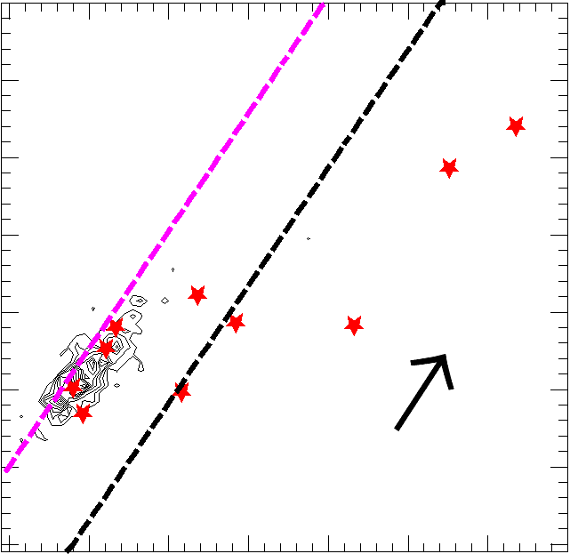
12/15
color of intrinsically polarized stars
color-color diagram
4.5
YSO・・・“red” color
(infrared excess)
(TY+ 13)
4
3.5
7 polarized stars
are red (infrared excess)
YSO
#6
#11
3
H-Ks
#7
2.5
#8
polarization + color
↓
certain YSO candidates
#5
#4
#3
#1
2
#2
A_{Ks}=1
#9
1.5
★： >3σ polarized star
--- color of early-type dwarf
late-type giants
--- color of T Tauri star
HKsL’ from Schödel+ 10
1
1
1.5
2
2.5
3
3.5
4
4.5
Ks-L’
Notes:
For searching YSOs, the information of color is also useful
because YSOs have infrared excess, namely, red color due to re-emission from circumstellar dust.
This figure is HKL color-color diagram.
The horizontal axis represents Ks-L' and the vertical axis represents H-Ks.
This purple line represents color of early-type dwarf and late-type giant reddened by interstellar matter.
So when objects exist in the right part from this line, that means they have infrared excess.
When we plot intrinsically polarized stars in this figure, 7 of them show infrared excess.
These are good YSO candidates because they have both intrinsic polarization and infrared excess.

Slide 18
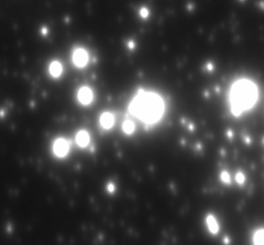
13/15
ALMA finds YSO candidates in the GC
ALMA finds 11 SiO clumps in the GC
SiO clump reflects outflow from massive protostar
(Yusef-Zadeh+ 13)
(Gibb+ 04, 07)
8
SiO clump
→t~10⁴-10⁵ yr
(line ratio)
polarized stars
→t<10⁵yr
(brightness)
4
ΔDEC[arcsec]
0
clump 1
(Yusef-Zadeh+ 13)
clump 1
(Yusef-Zadeh+ 13)
-4
our YSO candidate
(#2)
latest（on going？）
in-situ star formation
-8
8
4
0
-4
-8
ΔRA[arcsec]
Notes:
Recently, ALMA also pays attention to the GC.
According to the study of Yusef-Zadeh et al. , they find 11 SiO clumps in the GC.
SiO is used the probe of star formation
because outflow from massive protostar sometimes shows SiO emission.
Most of their SiO clumps are outside of our observational field,
but one of them, clump 1, is very close to one of our YSOcandidates.
clump 1 may be the counterpart of our YSO candidate.
Considering the brightness of our YSO candidates, the age of them are less than 10^5 yr.
This is consistent with the age of SiO clump estimated by line ratio.
These results suggest the latest, perhaps on-going, in-situ star formation in the GC.
To ensure this, we need to know the nature of our YSO candidates in detail.

Slide 19
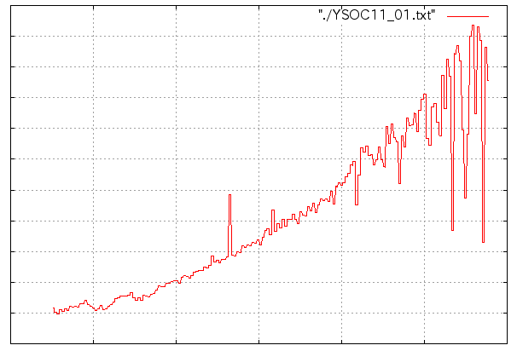
14/15
Spectroscopic observations
・Subaru/IRCS+AO188 (52mas/pix)
・2013/05/21, 22
・grism mode (K-band filter)
・R=1200
#11
Br γ
Intensity
preliminary!!
2.0
2.2
2.4
wavelength [μm]
Notes:
Last year, we carried out spectroscopic observations for our YSO candidates with Subaru/IRCS using AO188.
This is the preliminary result of our analysis.
One of our YSO candidates shows the emission line of Br γ,
which is a character of YSO.
We need to continue analysis,
and want to reveal the nature of our YSO candidates,
and want to know the process of the star formation in the GC.

Slide 20
15/15
Summary
・young massive stars in the central parsec of our Galaxy
(in situ star formation? inspiraling stellar cluster?)
・YSO is the key to solve this question
・near-infrared polarimetry with Subaru/CIAO+AO36
・find intrinsically polarized stars (>3σ: 11)
・color → 7 “good” YSO candidates
・ALMA find the counterpart of one of our YSO candidates
・in-situ star formation is acceptable
・spectroscopic observations with Subaru/IRCS+AO188
・under analysis …
Thank you!
Notes:
This is the summary of my talk.
In the central parsec of our Galaxy, there are many young massive stars and the origin is the mystery.
We think YSO is the key to solve this question and carried out near-infrared polarimetric observations with Subaru/CIAO.
As a result, we find intrinsically polarized stars and 7 of them have infrared excess.
They are good YSO candidates.
ALMA observations find SiO clumps as YSO candidates,
and one of them may be the counterpart of one of our YSO candidates.
If they are genuine YSOs, they cannot be formed by infalling stellar cluster scenario,
and we support in-situ star formation scenario.
We carry out spectroscopic observations with Subaru/IRCS and it will advances our study.
Thank you for your attention.

Slide 22
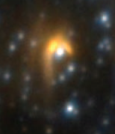
YSO or DES?
mini spiral
DES (Dust Embedded Source) (e.g., Eckart+ 95, Ott+99)
distributed along mini spiral
nearly featureless near-infrared spectra
・“red” color
・intrinsically polarized
→the same characteristics as YSO
observational
field
(Roberts & Goss 93)
DES≠YSO (Tanner+ 02, 05)
some DESs are not YSOs but windy massive stars
heating surrounding dust
→“red” color
scattered by surrounding dust
→polarization
DES with bow shock
How about our YSO candidates?
(Geballe+ 04)
Notes:
DESs are distributed along mini spiral and show nearly featureless near-infrared spectra.
Since they also show intrinsic polarization and infrared excess, they were often treated as YSO candidates.
However, according to Tanner's study, some DESs are not YSOs but windy WR stars.
They think DESs are massive stars experiencing rapid mass loss, plowing through the Northern Arm
and generating a bow shock and interaction between the wind or the bow shock and mini spiral creates dust around massive stars.
Surrounding dust causes both infrared excess and intrinsic polarization,
because when massive star heats surrounding dust it leads to red color
and when light from massive star is scattered at surrounding dust it leads to polarization.
Then, we have to check how about our YSO candidates.
Are they DESs, not YSOs?

Slide 23
YSO or DES?
<reported DES>
IRS 21, 10W:
>3σ polarized, red
IRS 1W: not measured
IRS 5, 8: out of field
IRS 10W
our YSO candidates
within mini spiral
→new DESs?
far from mini spiral
→YSO candidates
IRS 1W
DEC
IRS 21
need spectroscopy!
→Subaru/IRCS
(2012/06/17)
×：2-3σ ×： >3σ
○: “red” stars
RA
Notes:
This figure shows the spatial distribution of intrinsically polarized stars.
Blue cross represents 2-sigma sources and red cross represents 3-sigma sources.
Yellow circle represents that the sources show infrared excess and they are our YSO candidates.
We superimpose 3 reported DESs and two of them are 3-sigma sources.
Since we can only obtain 1st-night data of IRS 1W, we do not include IRS 1W in our results.
But about only 1st-night data, IRS 1W is 3-sigma polarized.
As a result, DESs are contamination of our YSO candidates.
Next, we superimpose mini spiral roughly.
You can see some YSO candidates exist within the mini spiral and they may be new DESs.
But other YSO candidates exist far from the mini spiral.
They are still YSO candidates.
To discuss the detail of intrinsically polarized stars and identify YSO candidates as genuine YSOs,
we need spectroscopy observations.
We can obtain 1-night Subaru/IRCS observations in June, so I'm looking forward to it.

Slide 24
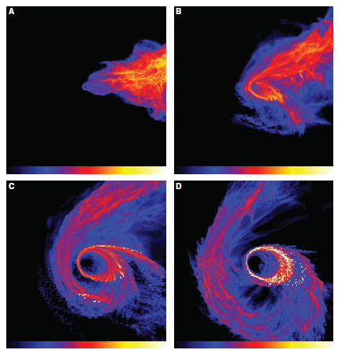
シミュレーション Ｉ
・10⁴Msunの分子雲が
10⁶MsunのSMBHに落下
・3pcの位置から落下し、
0.051MyrでD図
・離心率は0.6-0.76
・短径は0.11-0.19pc
・分子雲の質量が10⁵Msun
だと、e=0-0.53、a=0.13pc
1.5pc
Bonnel et al. 2008
Notes:
1つの図は1.5pc四方。二次元（平面）シミュレーション。
密度スケール(g/cc)は、A:0.01-100、B:0.025-250、C,D:0.1-1000
落ち込む前にできた星は外に散らばる。
星の数は498個。

Slide 25
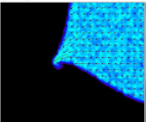
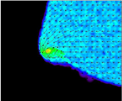
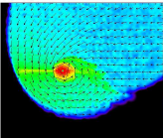
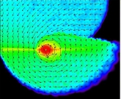
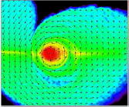
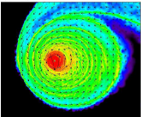
シミュレーション ＩＩ
分子雲の初期条件：
位置3.5pc
温度50K（等温）
密度10⁴cm⁻³
質量8.81×10⁴Msun
結果（0.25Myr）：
質量0.75-6.95×10⁴Msun
離心率0.24-0.51
サイズ1-1.7pc
5pc
Alig et al. 2009
Notes:
SMBHの周りをKepler運動している分子雲を考えたとき、現在観測されているような星のディスクを形成できるレベルのものなら、
0.5pcの位置にディスク構造を持つには、最初から0.5pcの位置にいなければ、SMBHと衝突を起こす。
SMBHの質量は3.5×10^6Msun
密度のスケール（Msun/pc^3）は全て0-6

Slide 26
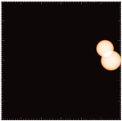
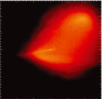
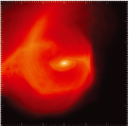
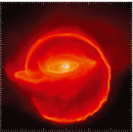
シミュレーション ＩＩＩ
分子雲の初期条件：
質量3.4×10⁴Msun
2.6×10⁴Msun
離心率0.12, 0.39
位置(25, 0, 0), (22, 6, 7)
結果(0.06Myr)：
衝突パラメータやcooling
timeを変えることで
ディスク構造の数が変わる
共通の性質は
・離心率は内側で低く、
外側で高い
・星の数面密度はSMBH
からの距離の2乗に反比例
・歪んだディスク
2.4pc
Hobbs & Nayakshin 2009
Notes:
2つの分子雲はSMBHの周りをKepler運動
SMBHの質量は3.5×10^6Msun
時計回りディスクだけなら、1つの分子雲を考えるだけでいい。
反時計回りディスクを作ろうと思うと、2つの分子雲の衝突を考える必要がある。
同じ機構でCNDも作れる？
観測に見合うディスクは小さな衝突パラメータで。

Slide 27
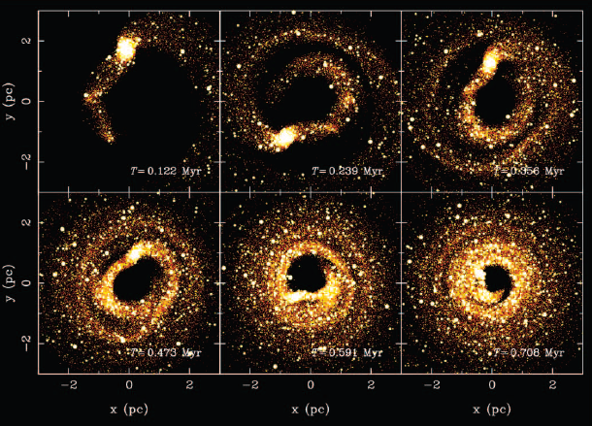
星団落ち込みシナリオの例 (Fujii et al. 2008)
8×10⁴Msunの星団が2pcの位置から落下（元々は円軌道）
Notes:
元々の星団を構成していた星の数は65536個。
この絵の銀河はSMBHではなく、0.66pcのコアを持つ。

Slide 28
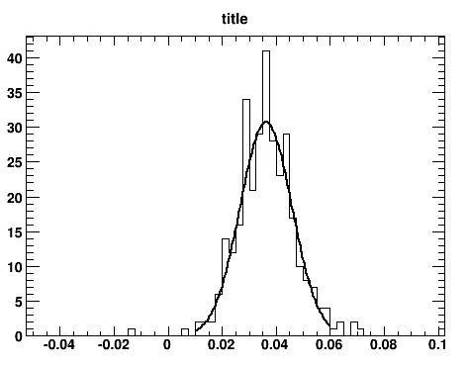
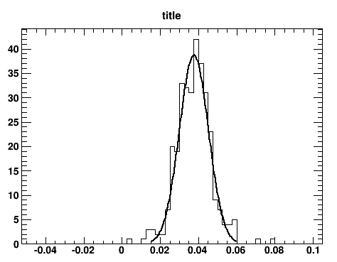
spread of data points
Q/I
U/I

Slide 29
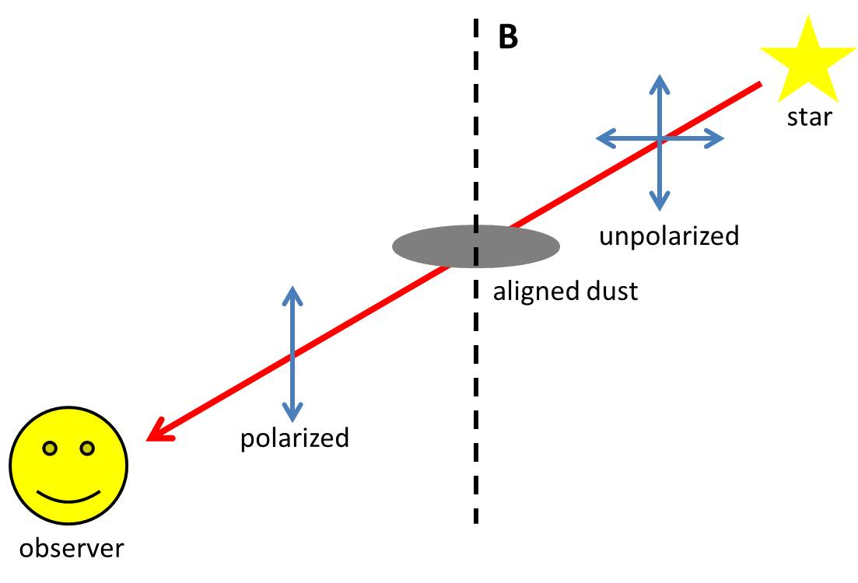
interstellar polarization
B
star
aligned dust
unpolarized
polarized
observer

Slide 30
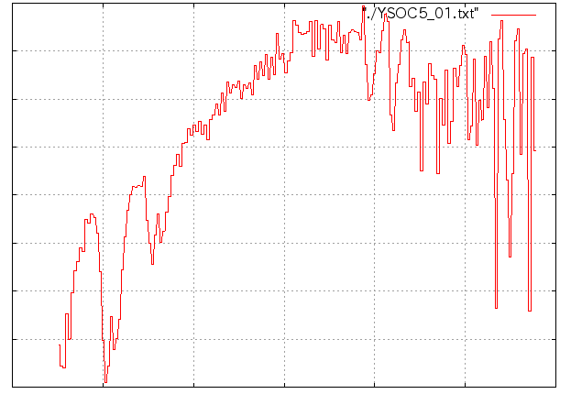
Spectroscopic observations
・Subaru/IRCS+AO188 (52mas/pix)
・2013/05/21, 22
・grism mode (K-band filter)
・R=1200
#5
Intensity
CO (v=2-0)
2.0
2.2
2.4
wavelength [μm]

