Slide 1
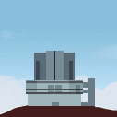
STARS2
Subaru Telescope Archive
stars2.naoj.hawaii.edu
University of Hawaii
stars.naoj.org
ATT
Tom Winegar - winegar@naoj.org
National Astronomical Observatory of Japan
Notes:
I am very happy to introduce STARS 2, which provides access to the Subaru Telescope Archive. STARS is hosted from Hilo by the University of Hawaii network, connected to the public Southern Cross fiber-cable network between Seattle and Australia, and public ATT fiber between California to Japan.

Slide 2




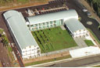
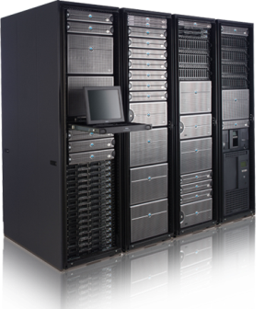
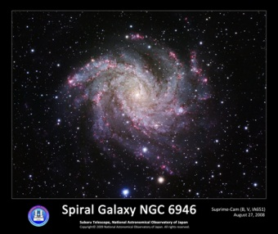
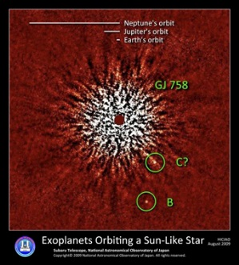
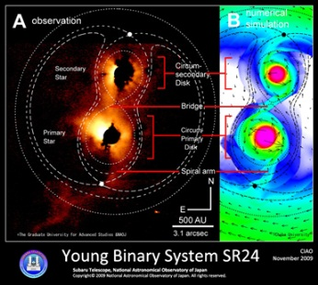
Observation data stored in
Mitaka, Japan & Hilo, Hawaii
MASTARS
STARS
00:00
20:00
Notes:
STARS primary purpose is storage of Observation data. When pictures are taken at the summit and retrieved in Hilo, they are copied and forwarded to the MASTARS mirror archive at NAOJ Headquarters in Mitaka. This occurs throughout each night - each picture takes about 20 minutes to reach MASTARS.

Slide 3
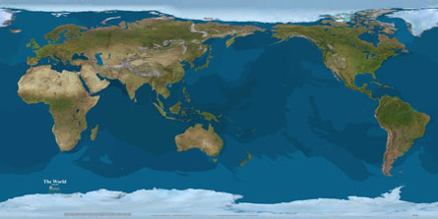




and provided to astronomers
Asia
US
EU
AU
Notes:
Each archive transfers data to observers. The Mitaka Archive serves Japan and Asia, westward. The Hilo Archive serves the Americas and Europe, eastward. The Southern Crossing gives us the Hilo Archive good bandwidth to Australia.

Slide 4
Who can use STARS?
STARS is a Private Archive
for Observers and Subaru staff
Request account from helpdesk !
SMOKA is our Public Archive
smoka.nao.ac.jp
Request account from SMOKA !
Notes:
STARS only supports Subaru Observers. We are a private archive, and the general public has no privileges. There is no change in STARS 2 for current STARS users, your current password will work fine. Our public archive is SMOKA, which serves observation data to the general public after the observer’s proprietary period. Accounts for SMOKA are available by request.

Slide 5
What is inside the Archive?
Files
( 1999 – 2014 )
4,896,067 frames
156,763 logs
Growth
( 1999 – 2014 )
200 - 400K frames/yr
( 2015 )
2,000,000 frames/yr
~50 TB
more than 1 Million Exposures!
4 TB/yr
40 TB/yr

Slide 6


How to receive data?
1. Observers FTP from summit
( put to laptop or offsite )
2. NextDay Delivery – email to PI
You forward email to Co-I
choose URL for your location
S2Query.tar – wget python script
3. STARS 2 Query and Download
(Hilo) (Hilo or Mitaka)
stars2.naoj.hawaii.edu
stars.naoj.org
STARS 2
Notes:
There are three ways to receive data from STARS and MASTARS. 1st – Observers FTP from the summit to their laptops and Co-Is. 2nd – STARS 2 features NextDay Delivery of last night’s observation files through email notification. The PI can choose URLs in the email for download depending on their physical location, or use the email’s attachment - S2Query.tar – which is a python wget script including all download URLs and password. Note this email may be forwared to your Co-I. 3rd, you can use STARS 2 Query – which is only available in Hilo, but observation data may be download from either Hilo or Mitaka. Note: we will be upgrading stars.naoj.org to STARS 2 next month in Febraury.

Slide 7
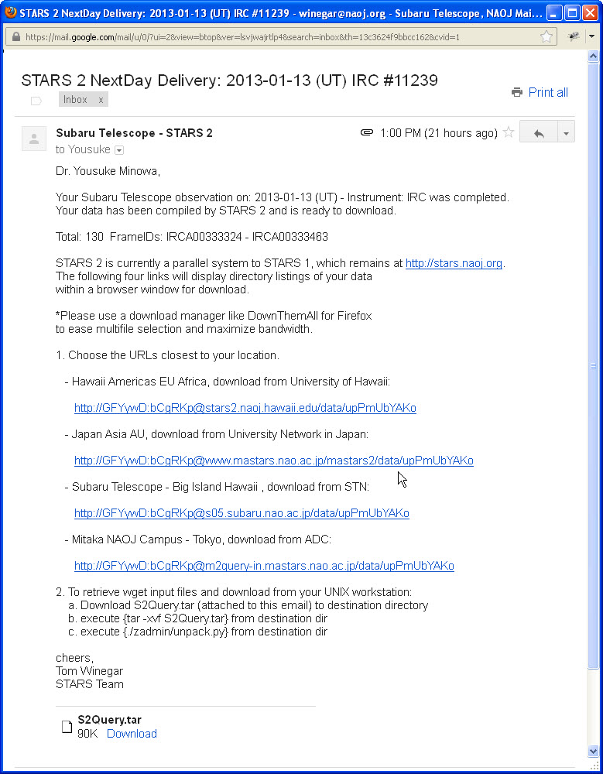
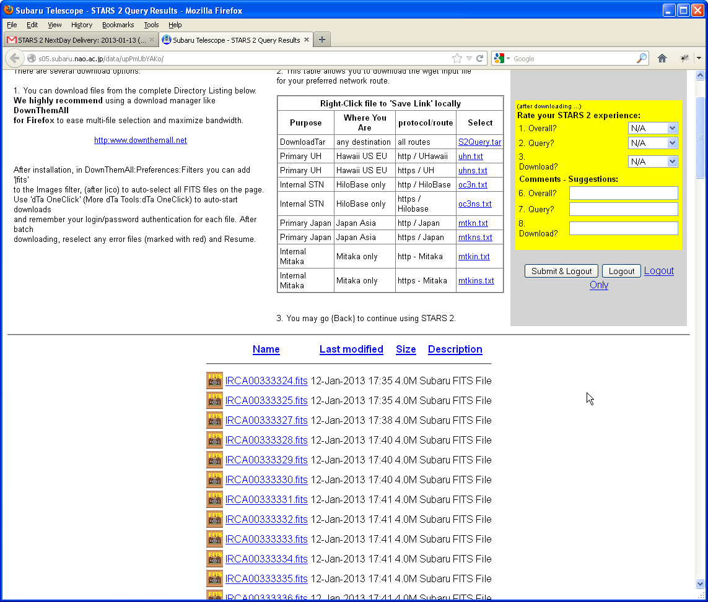
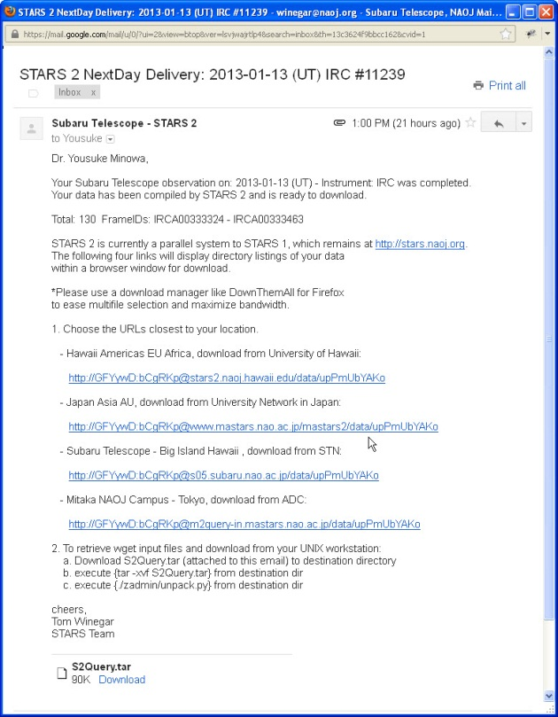
NextDay Delivery email
Last Nights frames prepared for download
2. Email sent to PI @ 14:30 HST
Notes:
If you do not observe at the telescope, I recommend NextDay Delivery. Your data is packaged for you in the mornng. It notifies the PI at 13:00 HST the next day. NextDay Delivery does not require you to learn any query software, and it gets around the PI having to reveal their STARS login and password. The PI can forward the email to Co-Is. In the email, you choose your closest archive and when you click on the correct link, the frames are displayed for download. I also recommend a download manager like DownThemAll for Firefox, for selecting and authenticating many files at the same time and parallel download.
If you do use STARS 2 Query, there are Help Files on every page in both English and Japanese, Recipes for basic operations, and tutorial videos.

Slide 8
STARS2
stars2.naoj.hawaii.edu
stars.naoj.org
Tom Winegar - winegar@naoj.org
National Astronomical Observatory of Japan

