Slide 2
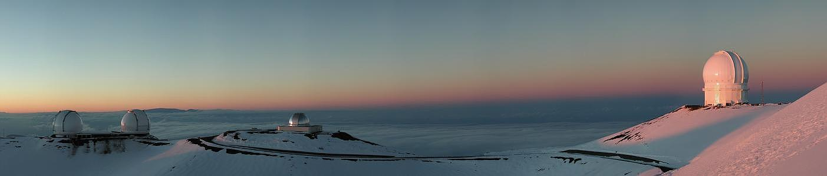
CFHT Status Report and Future Plans
CFHT’s New Look
New Instrumentation
Next Generation CFHT
Future of Mauna Kea Astronomy

Slide 3
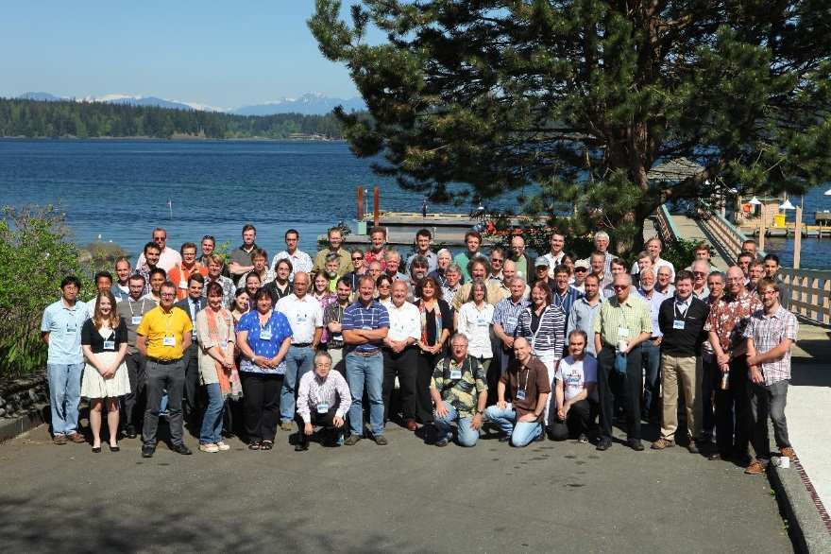
Mauna Kea Observatory Directors Collaboration
CFHT Directors
(past/present)
Subaru
Director
Gemini
Director
Not pictured
JAC Director
CFHT Users’ Meeting – British Columbia, 2013

Slide 4
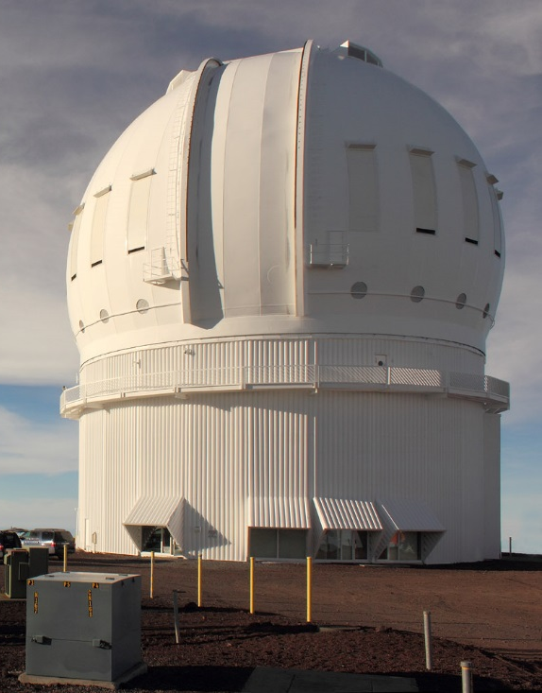
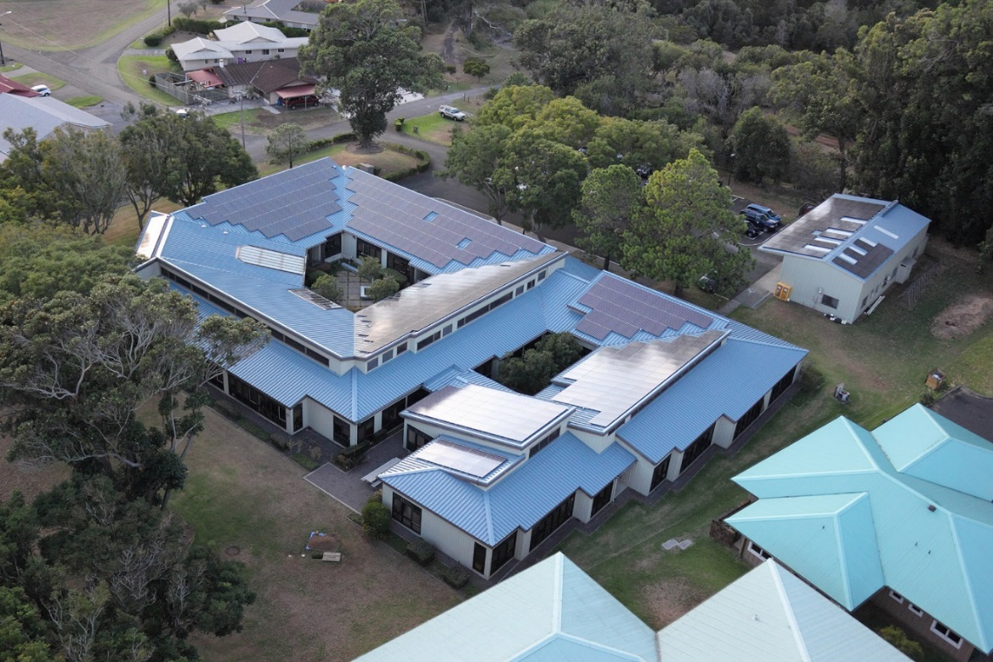
CFHT’s New Look!
~$2,000,000 dome venting project complete
~$500,000 solar power system installed
Photos courtesy
Tom Benedict

Slide 5
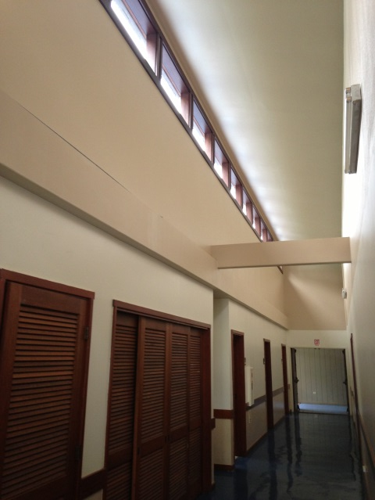
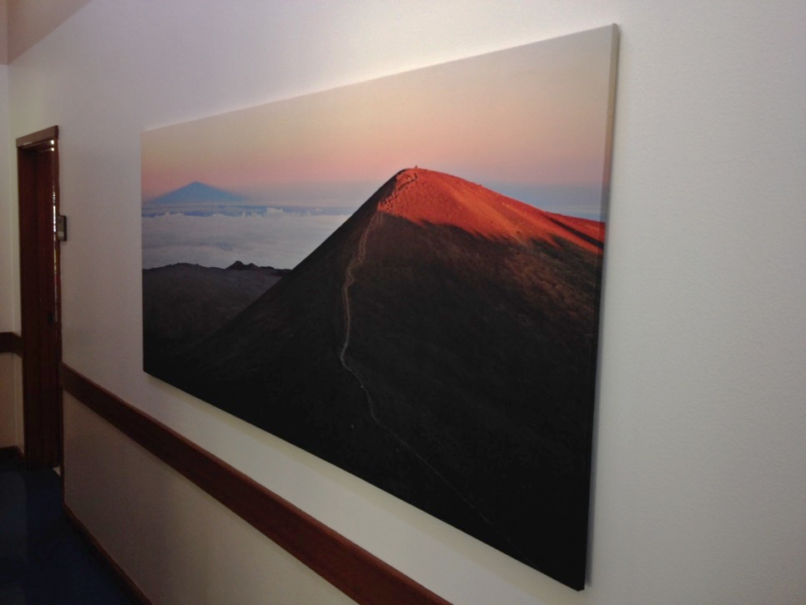
CFHT’s New Look!
Base facility interior remodeling

Slide 6

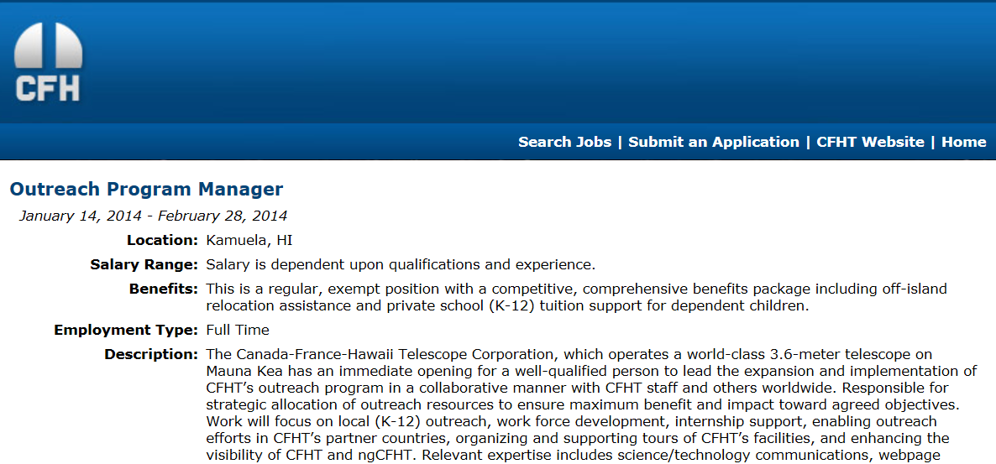
Outreach Program Expansion
Opportunity rich environment in west Hawaii island for astronomy outreach
  CFHT is expanding its outreach program by hiring a full-time manager, with a focus on –
    K-12 education opportunities
    Workforce development
    Internships
    Supporting out in CFHT partner countries
    Enhancing visibility of CFHT and ngCFHT in the local community
Venus Transit @ CFHT Office

Slide 7
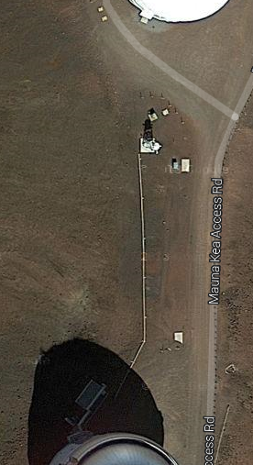
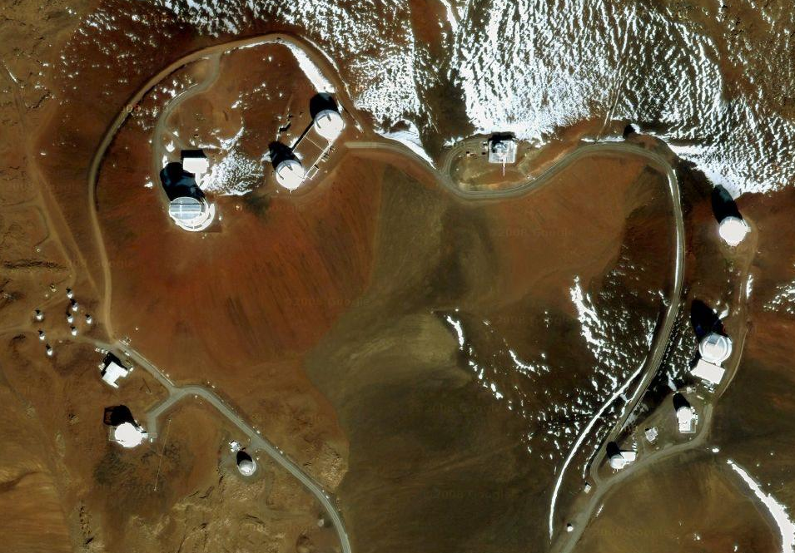
GRACES Project

Slide 8
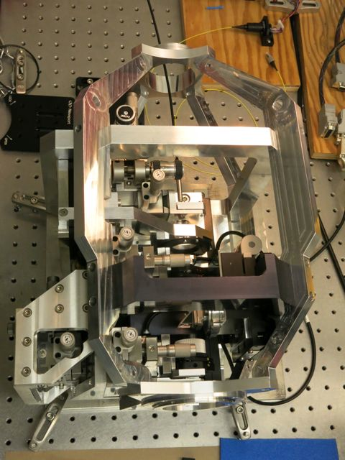
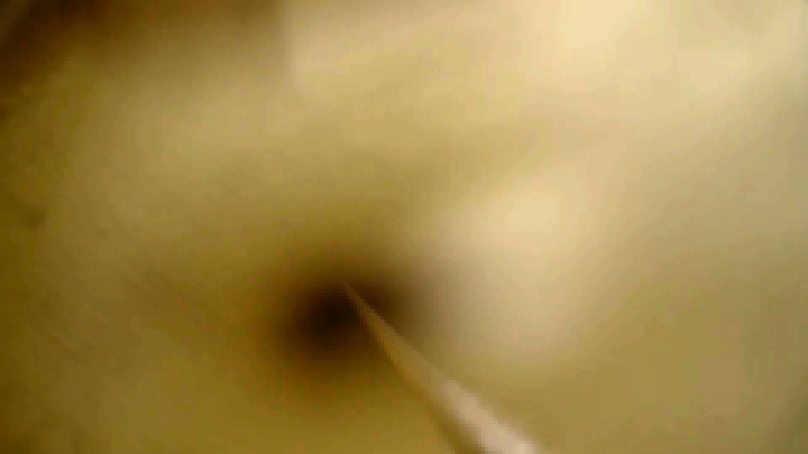
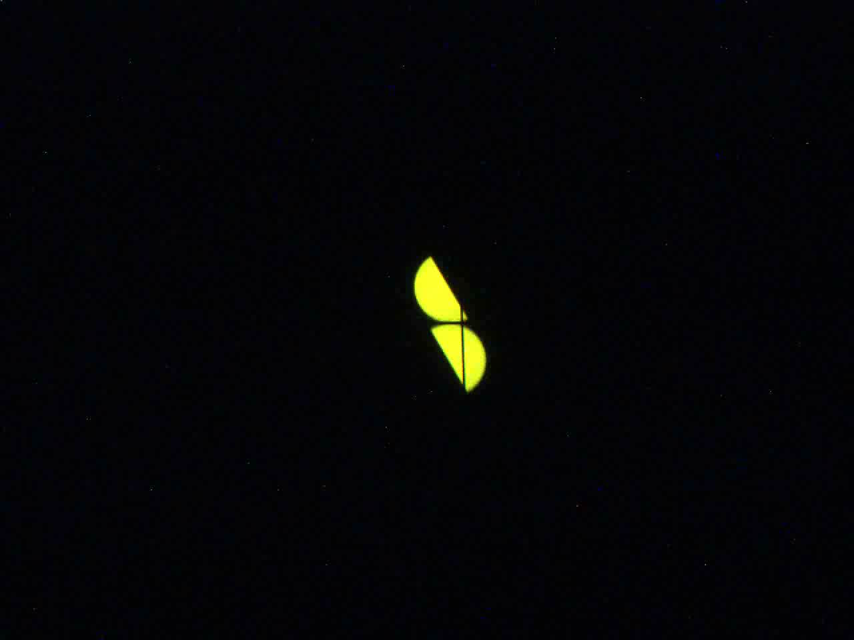
GRACES Project
GRACES fiber test pull (December 2013)
Image slicer toggling between low and high res modes
GRACES is a unique experiment to feed CFHT’s high-res optical spectrometer Espadons with light from Gemini through a ~300 m optical fiber
Espadons-GRACES fiber injection module at NRC-Herzberg

Slide 9

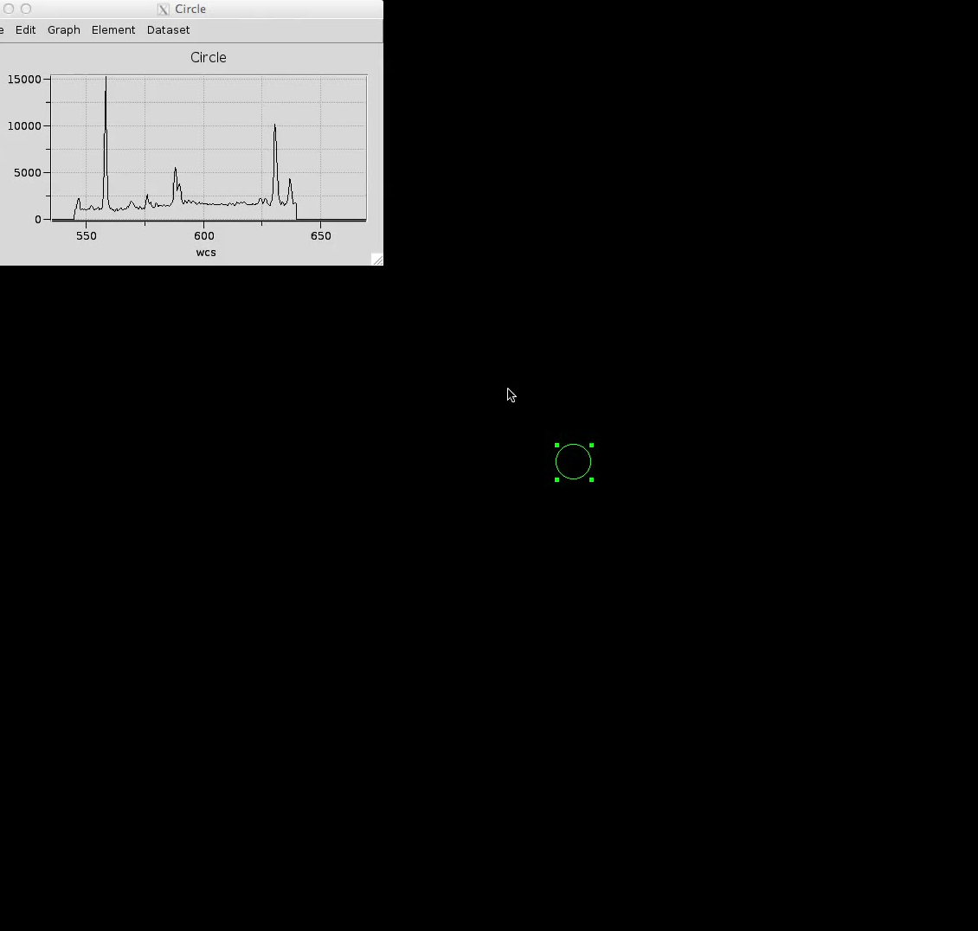
SITELLE
Imaging Fourier Transform Spectrometer
  Based on SpIOMM (Mont Mégantic) but with improved transmission and modulation efficiency at short wavelengths
  Intended to study the structure and kinematics of emission line sources (nebulae, galaxies, clusters)
Wavelength range: ~350-970 nm; resolution >6.4 cm⁻¹
Field of view: 11x11 arcmin
  Square FOV uses 2048 x 2048 pixel CCD (0.32’’ per pixel)
Filter wheel supports up to 5 optical filters to determine band pass of each scan
Built-in calibration sources
M27 w/ SpIOMM

Slide 10
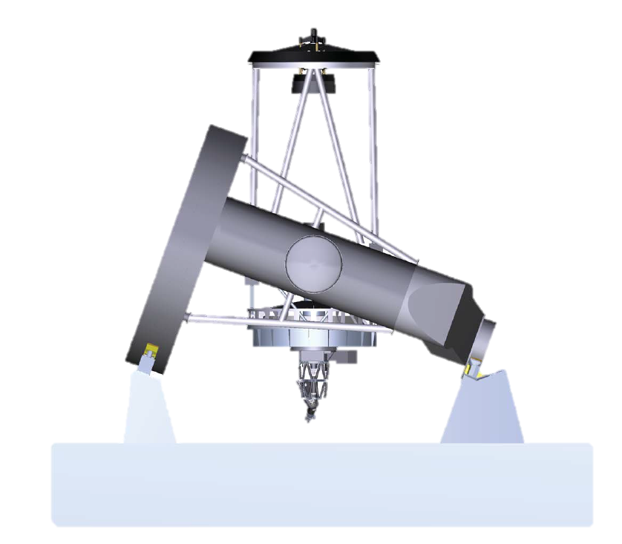
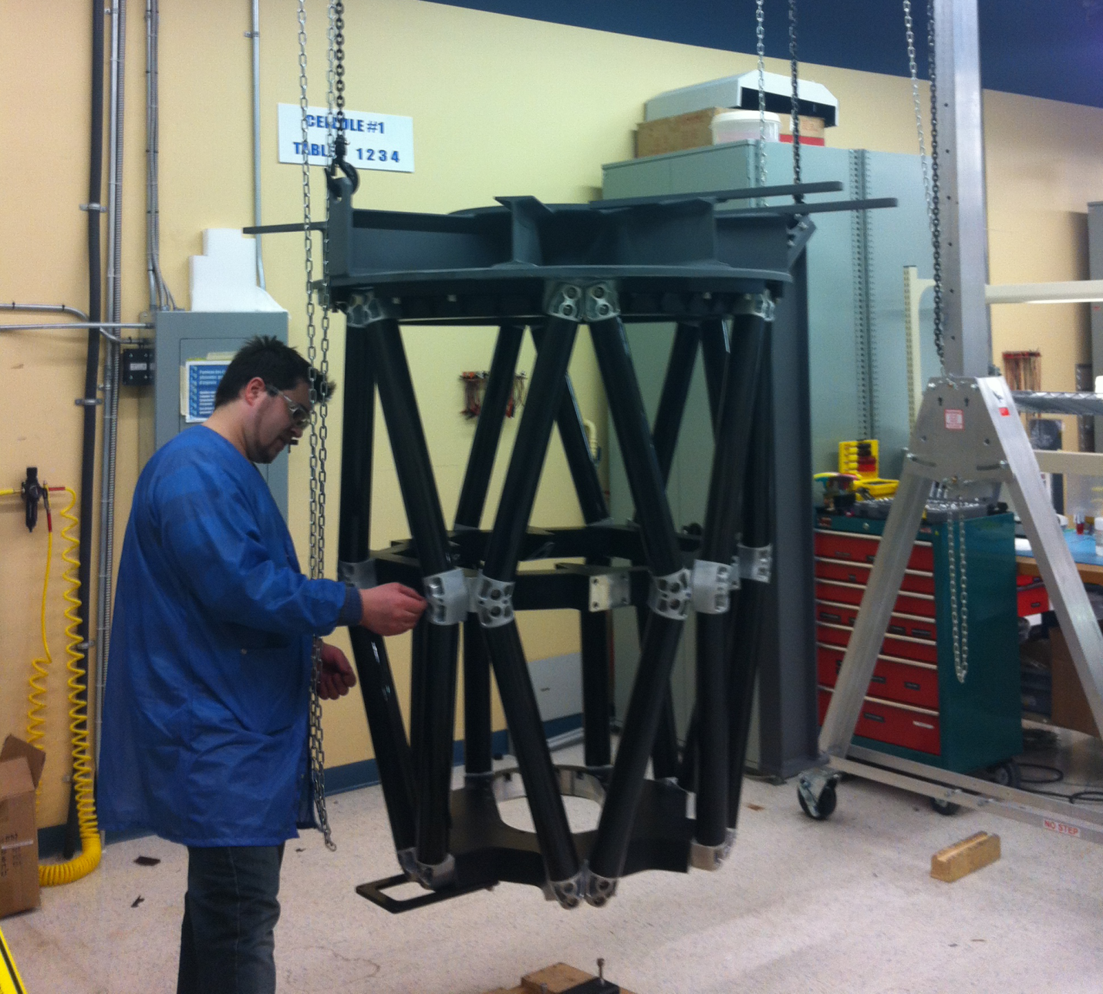
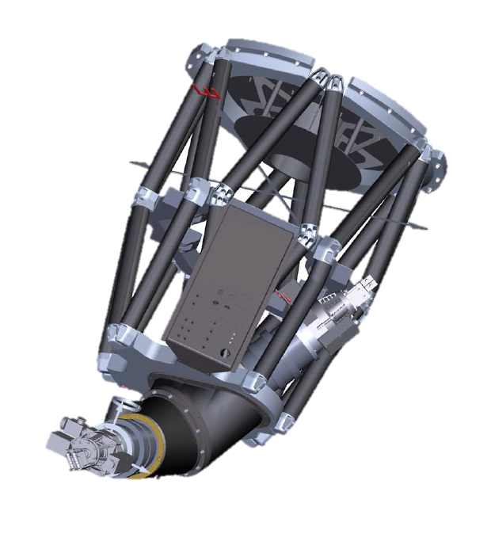
SITELLE
SITELLE at ABB…
Stiff/Light Carbon Fiber Structure
Laser Metrology System
SITELLE on CFHT
Dual CCD Detector System
Delivery to CFHT in 2014

Slide 11
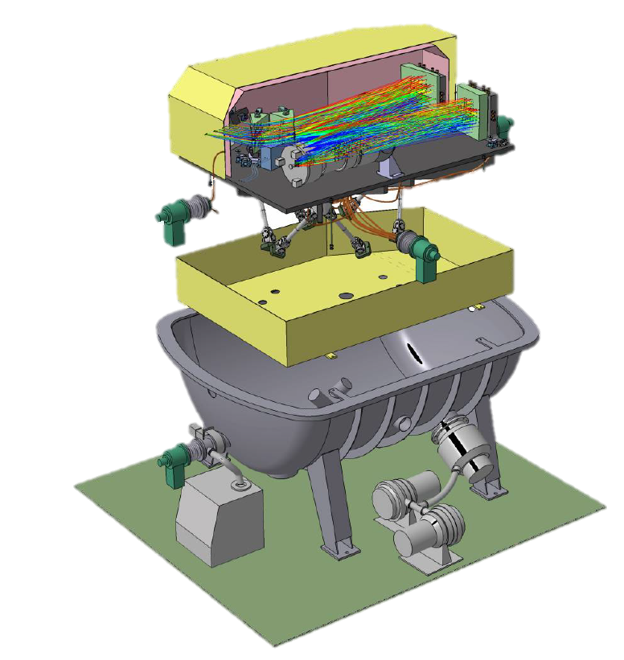
SPIRou
NIR high-res fiber-fed X-dispersed spectrometer
Single‐shot spectral domain 0.98‐2.4 μm (YJHK)
  Background limited at K
Resolution ~70k with ~1 m/s RV stability
Polarization measurements with <1% channel cross-talk
Throughput >15%, end-to-end
Core SPIRou science includes –
  Detecting & characterizing Earth-like planets in the habitable zone of low-mass stars
  Investigating how magnetic fields impact star/planet formation
SPIRou CDR 2014, deployment on CFHT in ~3 years
Anticipate ~500 night survey of nearby low mass stars

Slide 12
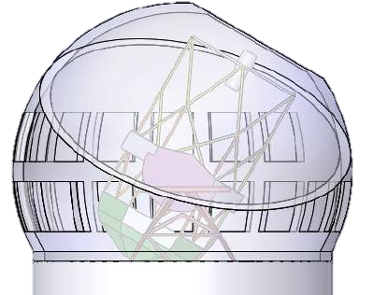
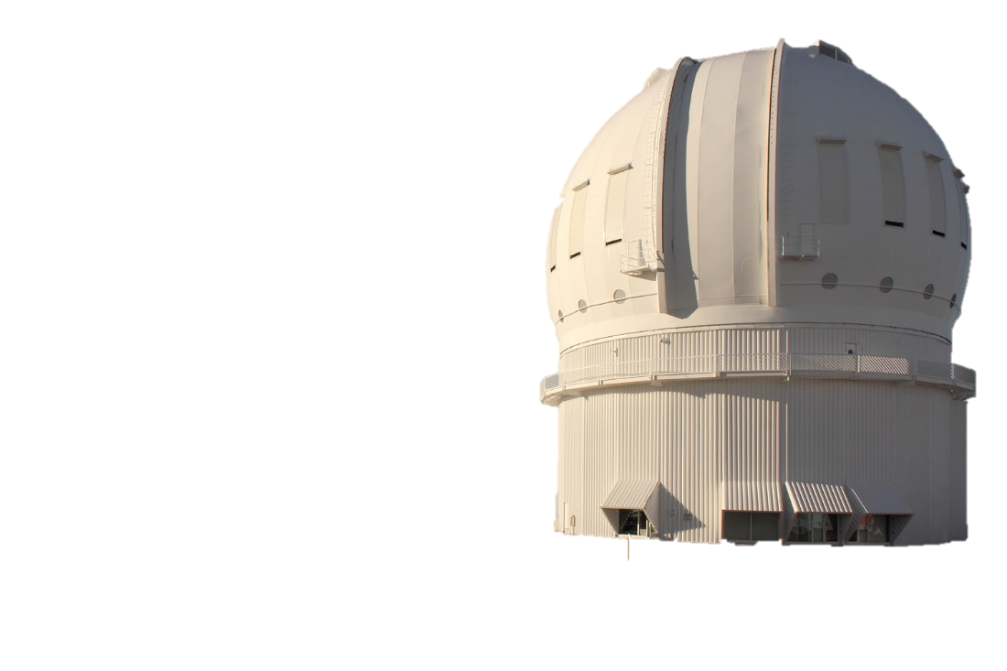

ngCFHT Concept
3000 Fiber
Positioner
Fiber Coupling
1.5° Wide Field
Corrector
10 m Primary
Bank of spectrometers
R~2000-20,000

Slide 13
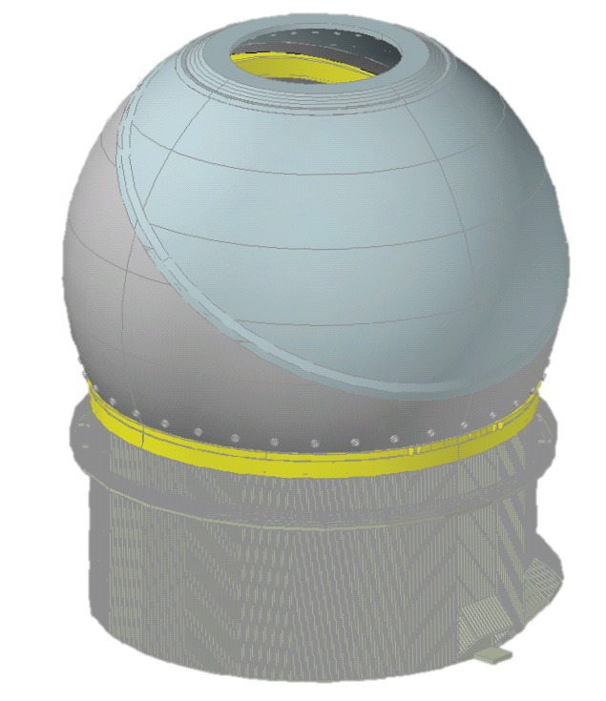
Recent ngCFHT Development as We Seek Partners…
Technical studies completed thus far -
  Load capacity studies of telescope and enclosure piers
  Telescope and enclosure configuration studies
  Aero-thermal study
  Telescope optical designs
  Spectrograph conceptual designs
  Telescope downtime study (deconstruction and construction)
  Valuation study of existing infrastructure
  Cost, schedule and development plan
Science case has been developed in considerable detail by an international team of ~60 scientists from a dozen countries –
  Exoplanets
  ISM
  Stars and Stellar Astrophysics
  Milky Way Structure and Stellar Populations
  Local Group
The growing ngCFHT consortium seeks scientific and technical collaboration and partnership with similar facilities worldwide as we explore the possibility of pursuing this future for CFHT…
  Nearby Galaxies/Clusters
  Galaxy Evolution
  Intergalactic Medium
  QSO’s and AGNs
  Cosmology and Dark Energy

Slide 14
ngCFHT Project Office
2014 will be a “building year” focused on partnership building and key startup Project Office tasks
  Office infrastructure in Waimea
  Draft Science Requirements, Operational Concepts Documents
  Work Breakdown Structure, Position Descriptions for future full-time staff, recruiting full-time Project Manager & Project Scientist
  Assess options for key long lead subsystems (e.g., spectrometers)
Core objective of the ngCFHT Project Office is to develop over the next 3-4 years a Construction Proposal at the Conceptual Design Level to support a future decision about proceeding with ngCFHT
Terminate?
Construct?
Advance Design?

Slide 15
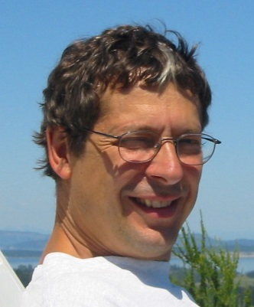

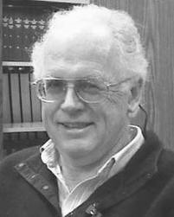
ngCFHT Project Office Initial Staff
Interim Project Manager
Rick Murowinski – Formerly NRC-Herzberg, GMOS Project Manager, ALMA Project Engineer
Interim Project Scientist
Alan McConnachie – NRC-Herzberg
Research Officer & Instrument Scientist
Interim Project Engineer
Derrick Salmon – CFHT
Director of Engineering

Slide 16
CFHT/Project Office Organizational Structure
Executive Director is responsible to the Board to provide ngCFHT-PO deliverables while sustaining robust CFHT operations to community

Slide 17

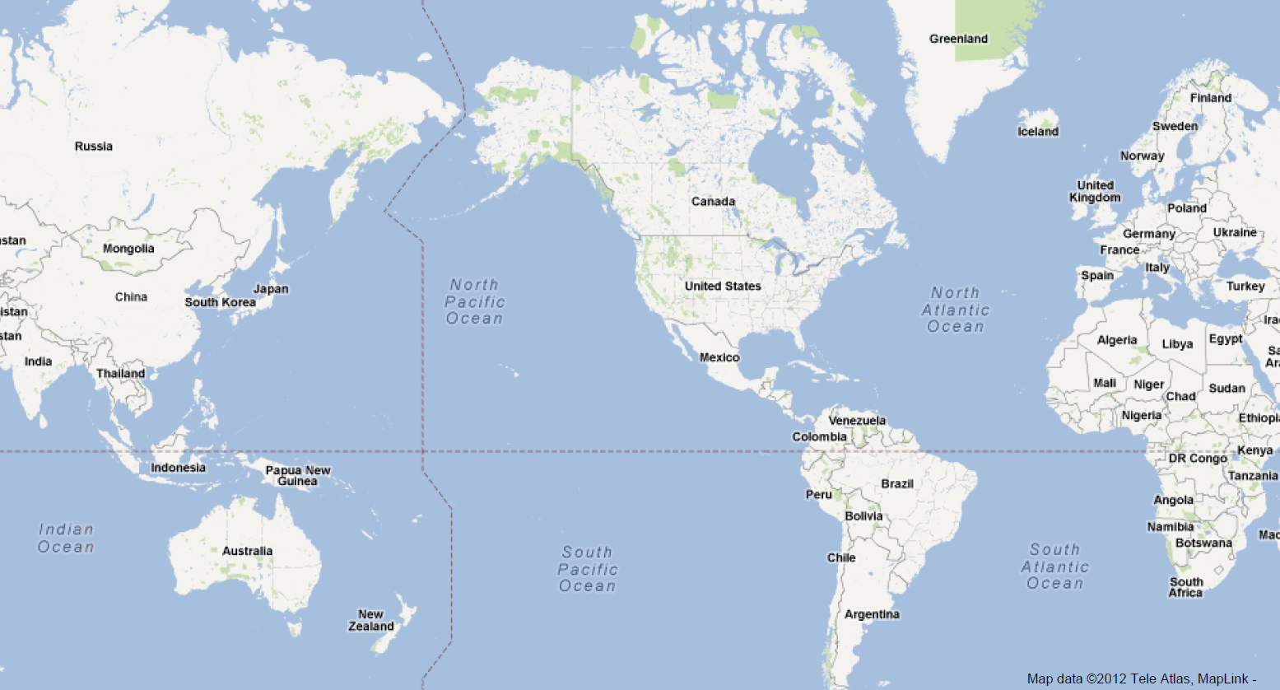

On the Road with ngCFHT in 2014…

Slide 18
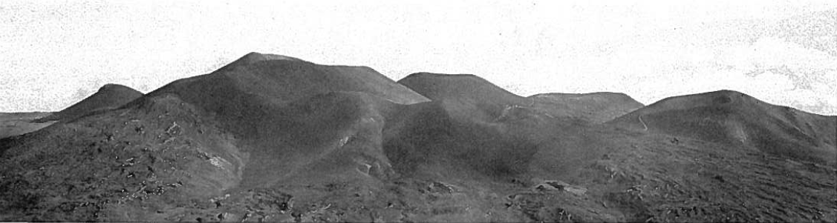
Future of Mauna Kea (CFHT)
Summit of Mauna Kea, 50 years ago or 50 years in the future?
Photo credit: Sky & Telescope Magazine

Slide 19
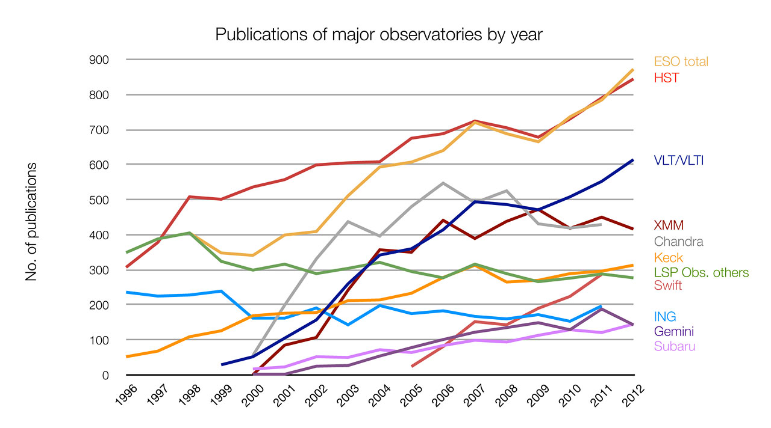
Importance of Mauna Kea Observatories to Astronomy
Mauna Kea Observatories Total
Plot courtesy Markus Kissler-Patig

Slide 20
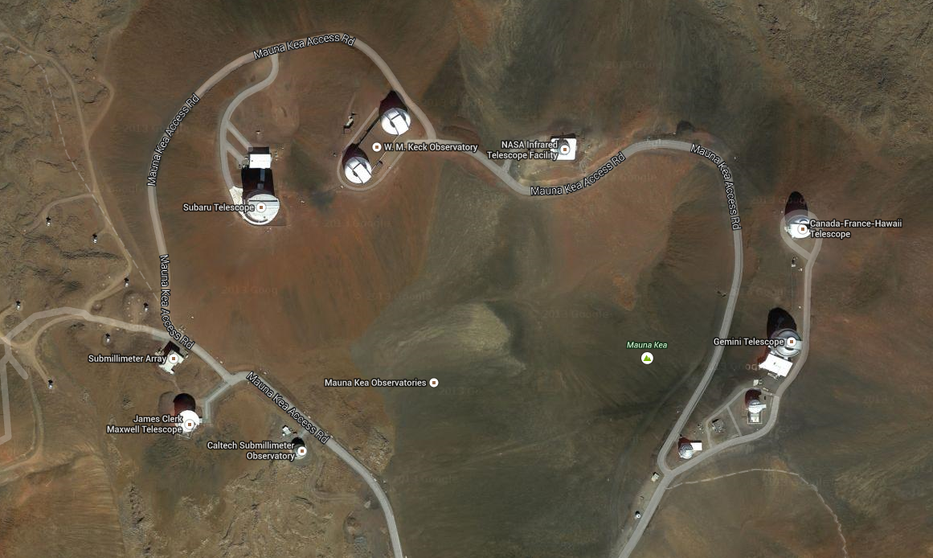
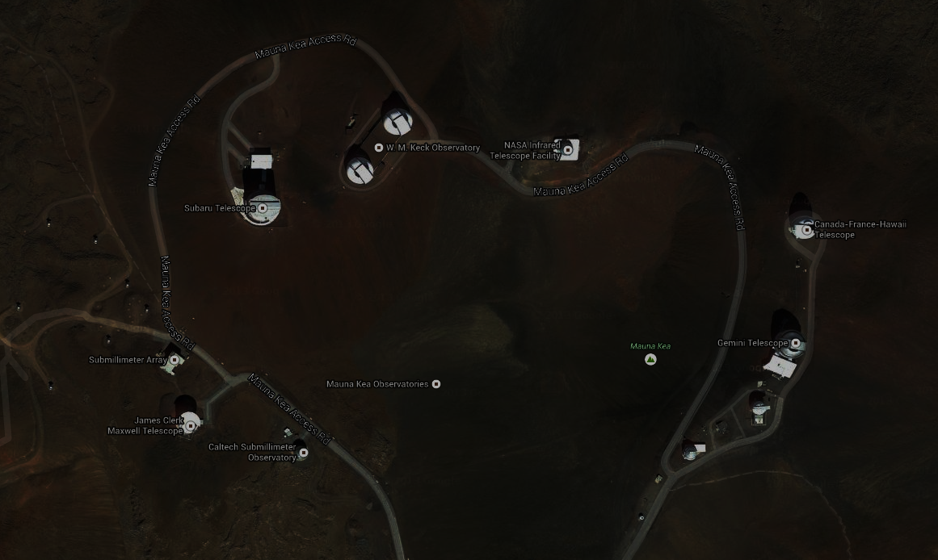
Mauna Kea Observatories at Risk
With ~1/3 of the Mauna Kea Observatories at risk of decommissioning, on-going challenges with securing TMT, infrastructure funds waning, pending sub-lease terminations, etc., and given the critical contributions of the Mauna Kea Observatories to astronomy, the future of CFHT is woven into a large and important tapestry of global astronomy
JCMT?
CSO?
UKIRT?
VLBA?

Slide 21
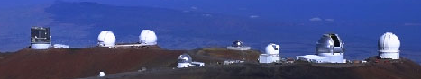
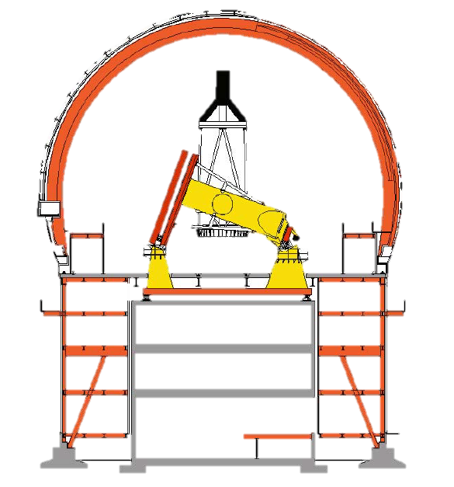
CFHT – A Unique Opportunity to Demonstrate “Recycling”
~30 m dome
Large volume of enclosed space
High load capacity pier

Slide 22
CFHT – A Unique Opportunity to Demonstrate “Recycling”
This is a unique combination among the 2-4 m telescopes on Mauna Kea and suggests a simpler strategy to replace CFHT with a larger telescope than perhaps any other facility on Mauna Kea.
ngCFHT would be a pathfinder in the evolution of telescope sites on Mauna Kea, thus the need to “get it right” in advance of other sites being recycled

Slide 23
Notional Timescales
2014
2015
2016
2017
2018
2019
2020
2021
2022
2023
2024
2025
2026
2031
2032
2033
2034
Current Operations
MegaCam, WIRCam, Espadons?
SITELLE
Com.
Operate
SPIRou
Build
Operate
Large Programs
Current
New
UKIRT Operations?
10 yr Agreement?
ngCFHT?
Proj. Office - CoDR
Detailed Study
Construction
→
Operations
Sub-lease Expires
New Sub-lease?
→

Slide 24
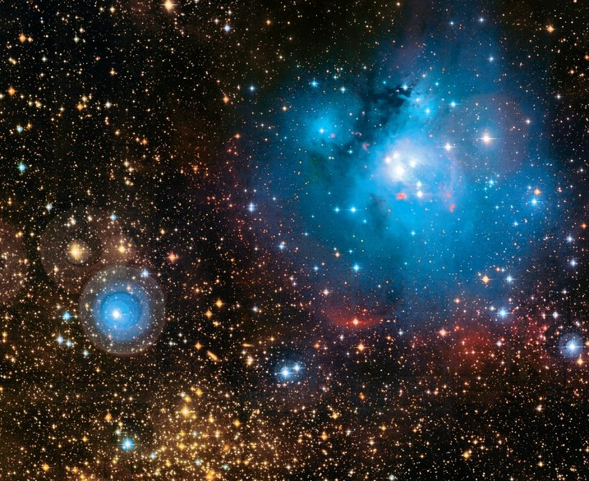
ng

