Slide 1

Queue Observation
Tae-Soo Pyo
2014. 1.21

Slide 2
2012 SAC Report Recommendation

Slide 3
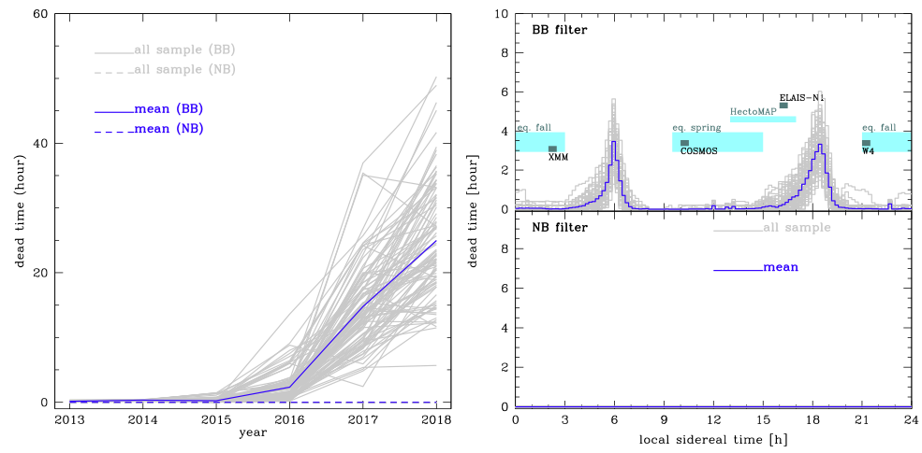
Queue for HSC from S16A[?]
S14-S15 : D/UD/W survey regions scheduling by using Survey Simulator
(by Nishizawa, Yasuda, & Takada)
From S16A, dead times are increasing at the gap of wide field
courtesy of Nishizawa, Yasuda, & Takada

Slide 4
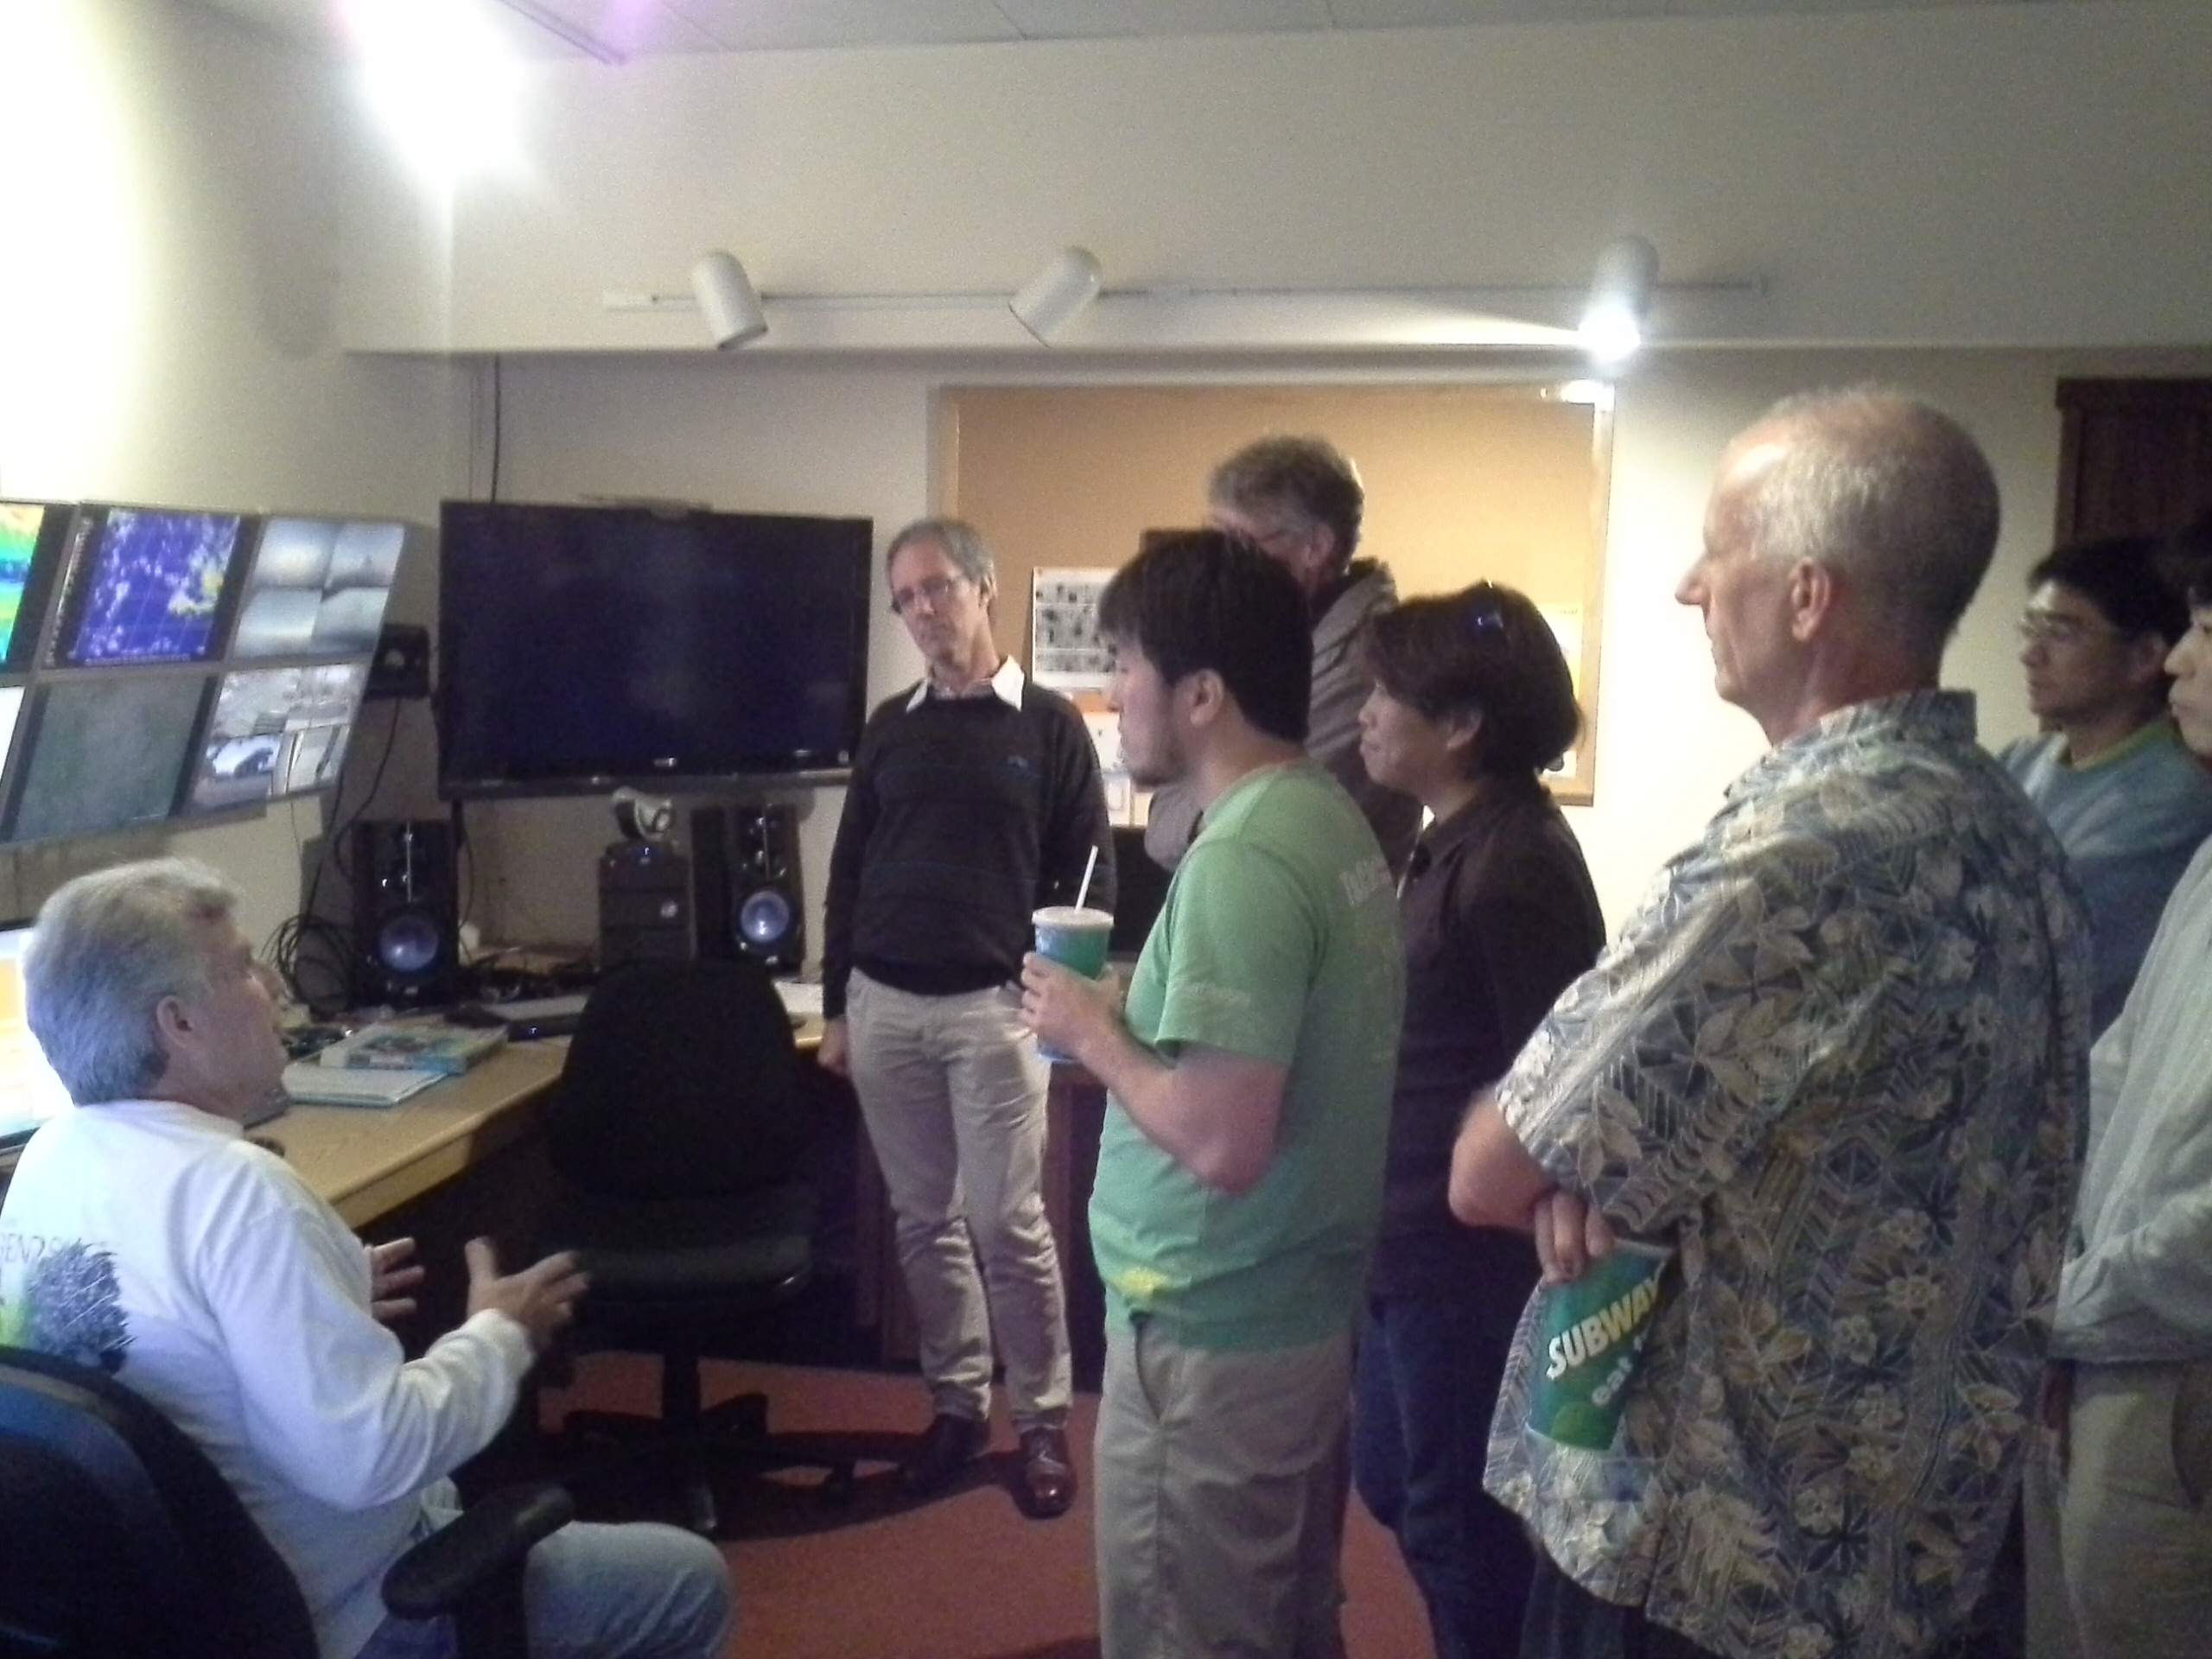
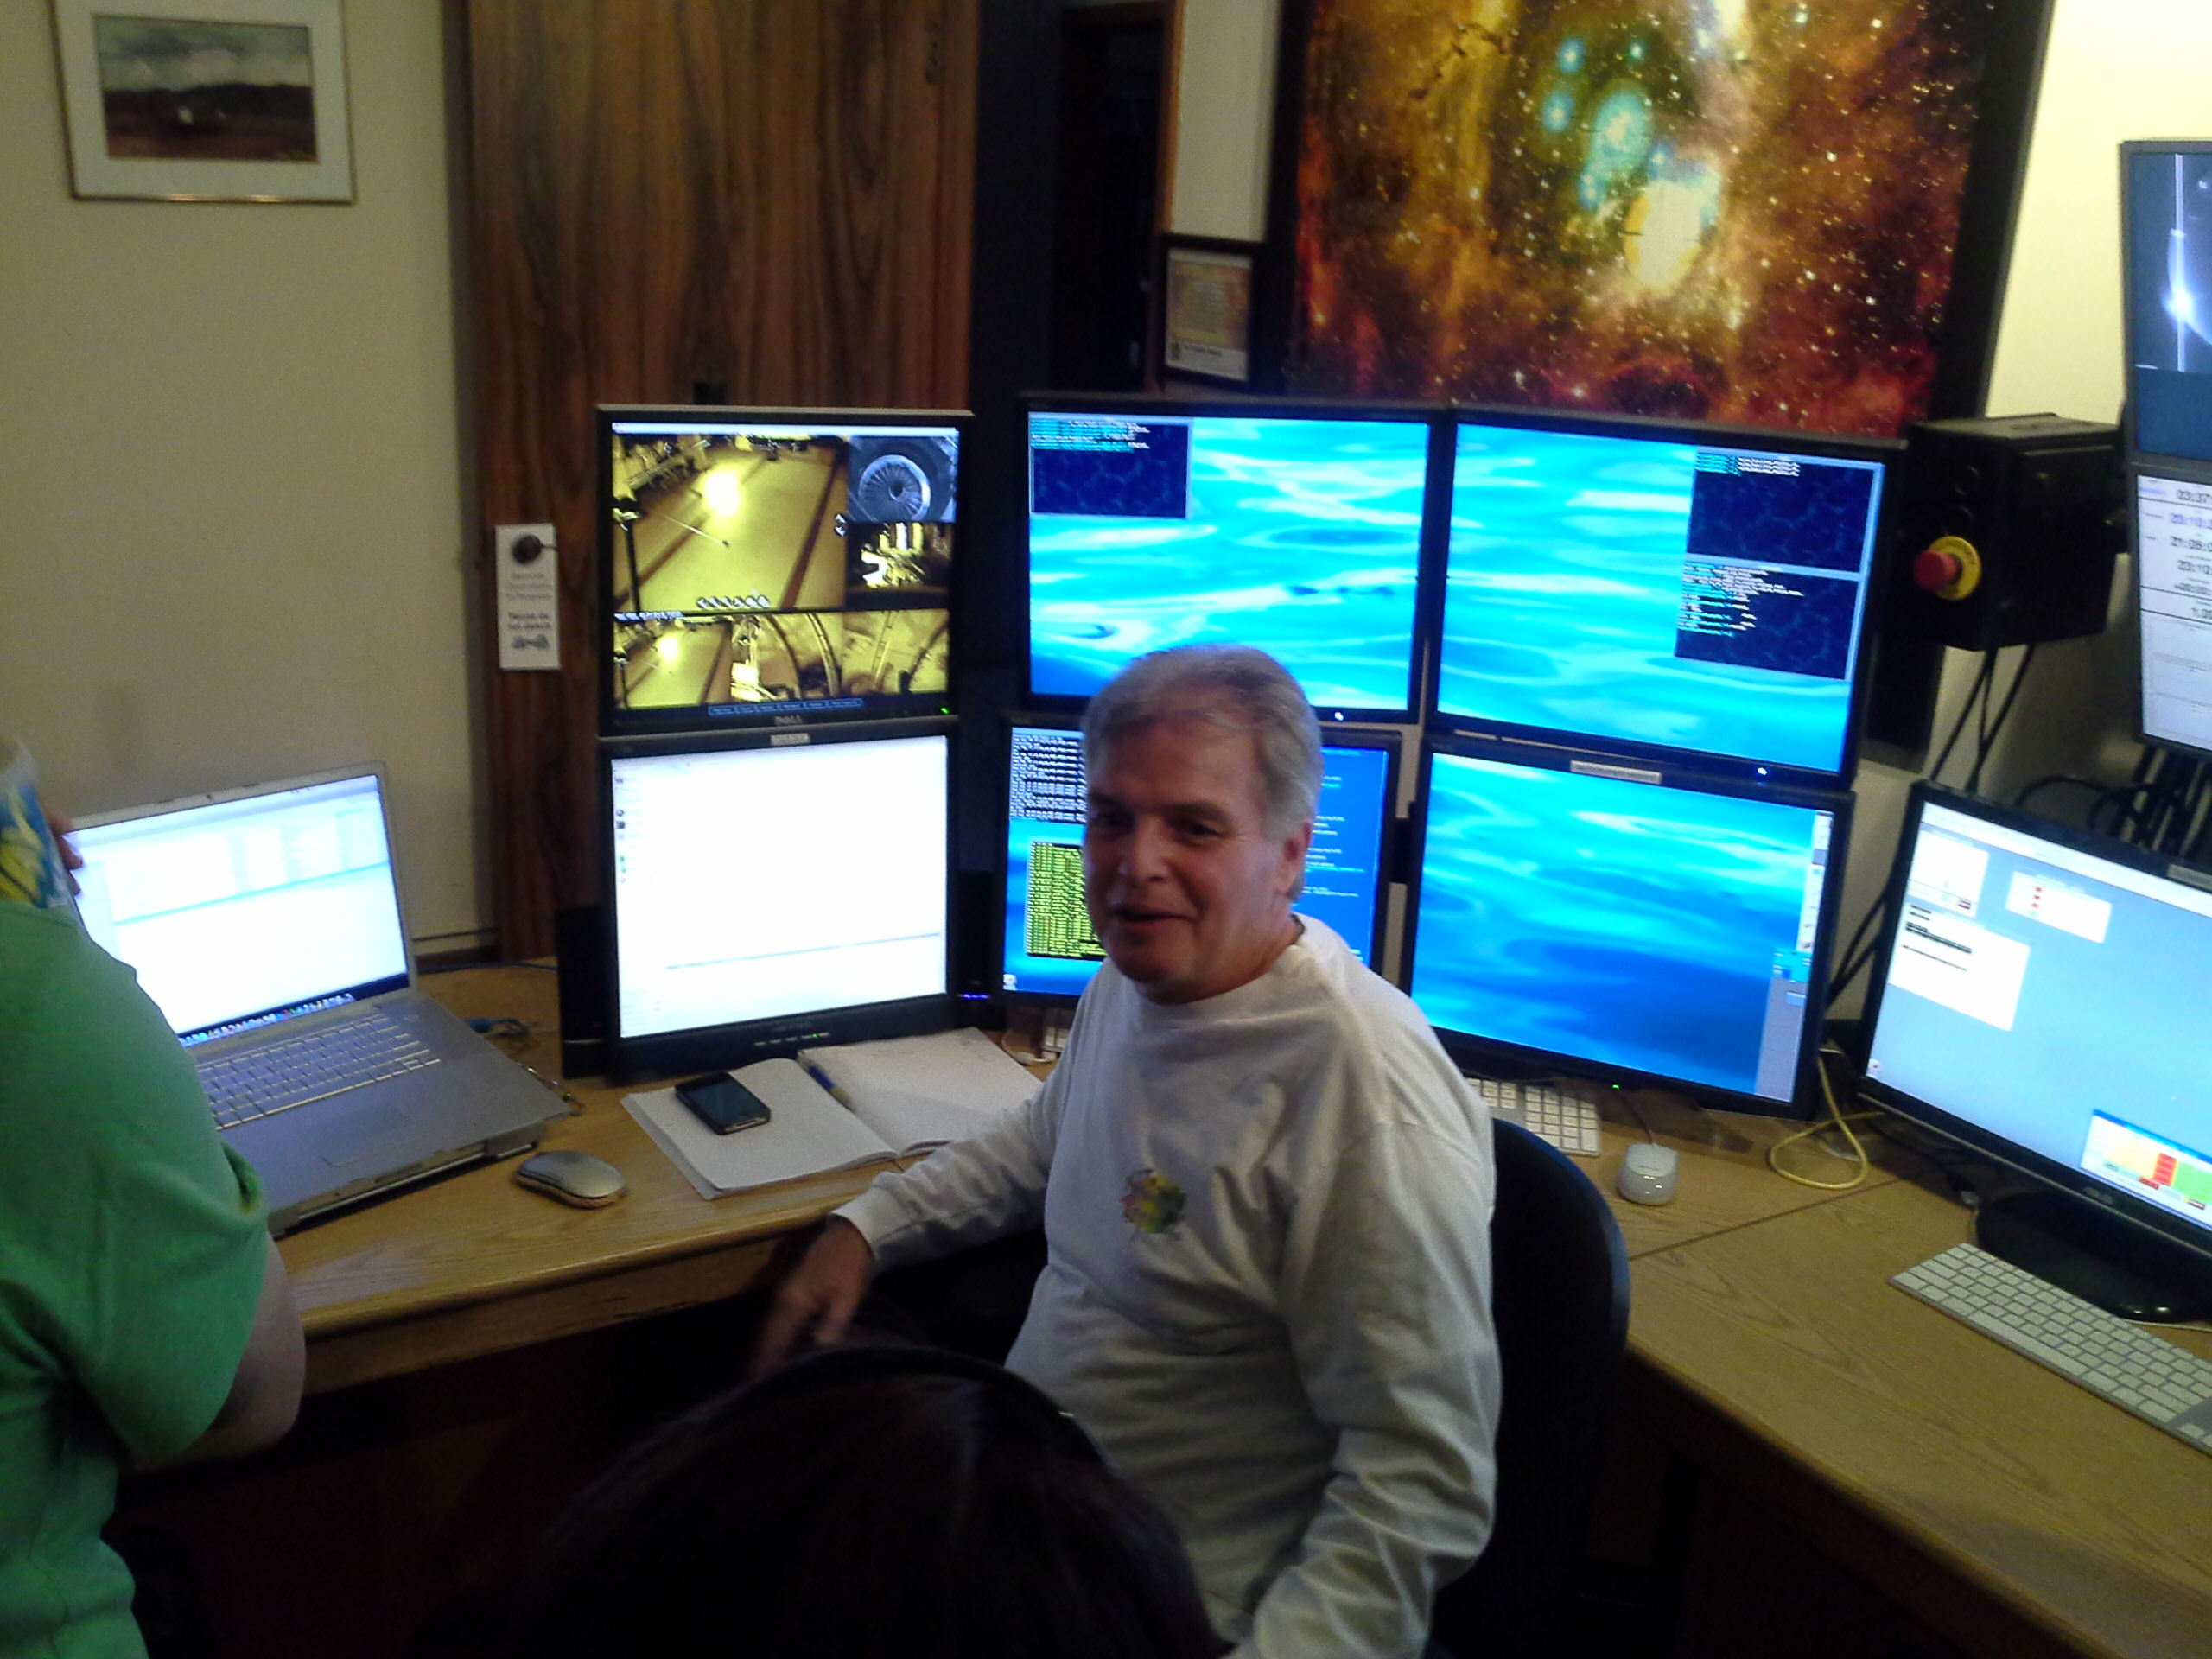
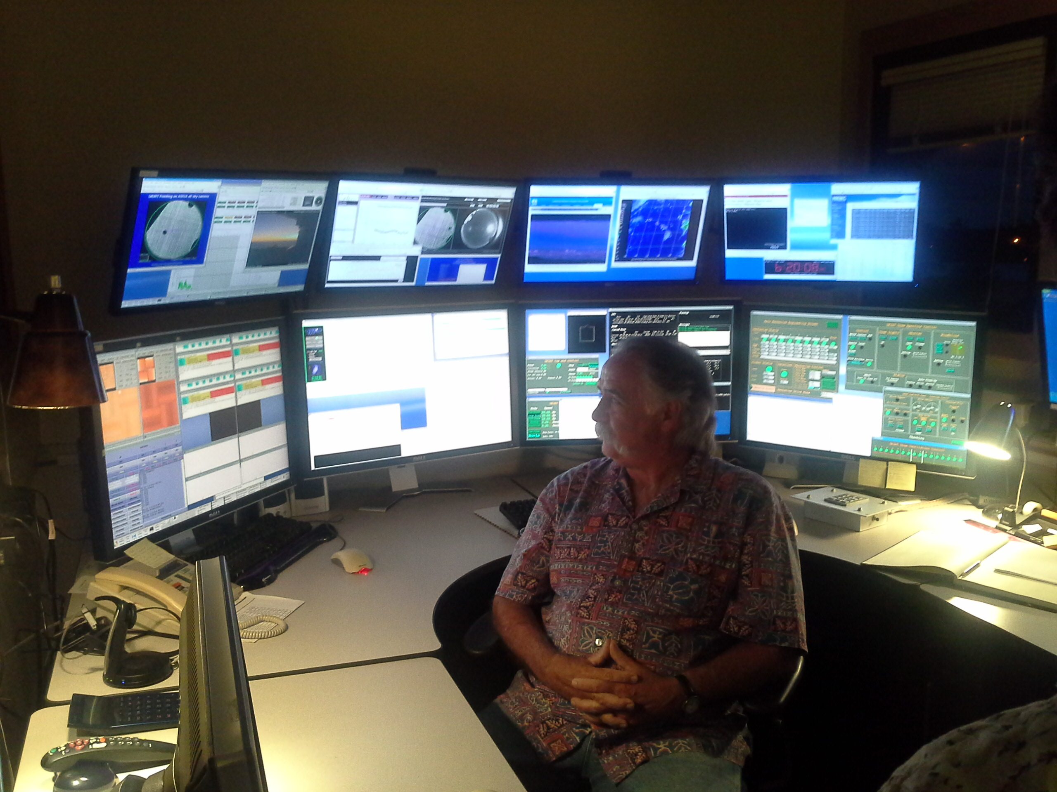
Activities for Queue
2014/02/??: Visit Gemini (Scheduling 中）
2014/01/09: Visit JAC
2013/12/19: Visit CFHT
2013/12/12: "Queued Service Observing at CFHT"
by Nadine Manset
2013/11/07: Gen2 advisory committee meeting
2013/05/06: Meeting with SSP team (Takada et al.)
2013/04/05: HSC Queue discussion
2013/03/07: HSC Survey Simulator by Nishizawa-san
2013/01/15: Presentation by Terada-san in UM2012

Slide 5
What are needed for Queue

Slide 6
Queue-Observation

