Slide 1
Spectral Properties of Superflare Stars, KIC 9766237, and KIC 9944137
Daisaku Nogami (Kyoto University)
Collaborators: K. Shibata, H. Maehara, S. Honda, T. Shibayama,
S. Notsu, Y. Notsu, T. Nagao, H. Isobe, A. Hillier,
A. Choudhuri, T. Ishii
2014/01/23(Thu)
Subaru User's Meeting 2013@NAOJ

Slide 2
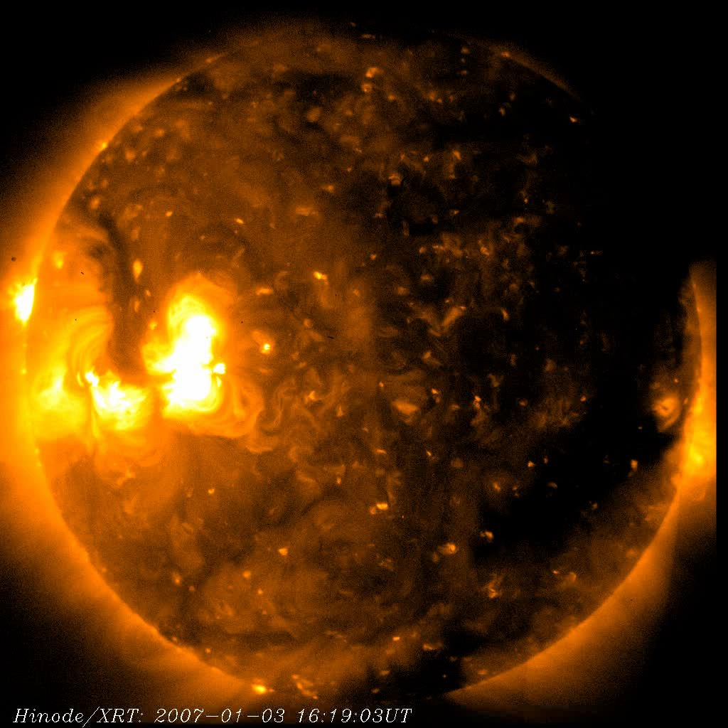
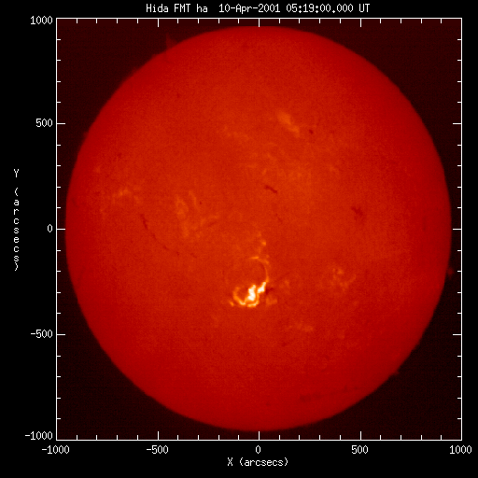
Solar flares
・Most energetic explosions on the surface of the Sun
・Hα, X-ray emission, radio, etc
・Time scale : minutes – hours
・Release of the magnetic energy stored around the sunspot
・Total energy ~ 10²⁹ - 10³²erg
Hinode / ISAS
Soft X-ray (1keV)
Hα 10,000K
Hida Obs./Kyoto Univ.
Notes:
First, I will talk about previous studies about solar flares.
Solar flares are the most energetic explosions on the surface of the Sun.
It is known solar flares are magnetic energy release and generate strong Ha line emission, X-ray emission and so on.
The timescale of solar flares ranges from one minitues to one hour.
The maximum released energy is 10 to the thirty two erg.
Understanding of solar flares is the first step of investigating stellar flares.

Slide 3
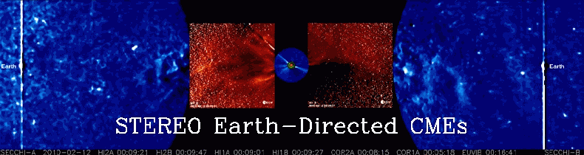
Earth
Sun
Ejected coronal masses and blast waves propagate through the interplanetary space.
→ effects on the terrestrial environment

Slide 4
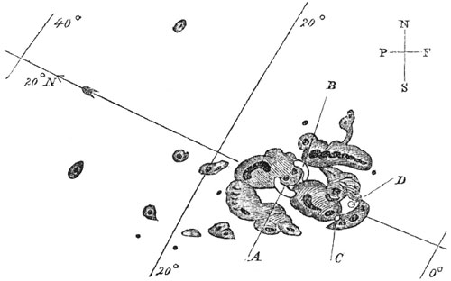
Carrington flare
(1859, Sep 1, am 11:18 ）
The first flare that human beings observed by Richard Carrington (England)
white flare for 5 minutes
Very bright aurora appeared next day morning at many places on Earth, e.g. Cuba, the Bahamas, Jamaica, El Salvador, and Hawaii.
E~factor x 10^32 erg
Largest magnetic storm (> 1000 nT) in recent 200 yrs.
Telegraph systems all over Europe and
North America failed, in some cases
even shocking telegraph operators.
Telegraph pylons threw sparks and
telegraph paper spontaneously caught
Fire （Loomis 1861）
http://en.wikipedia.org/wiki/Solar_storm_of_1859

Slide 5
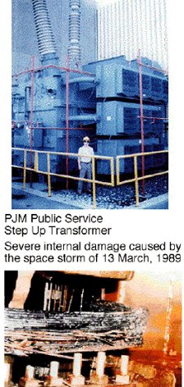
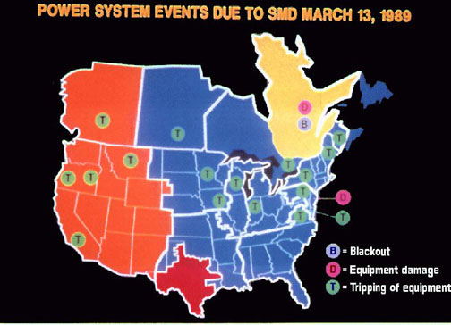
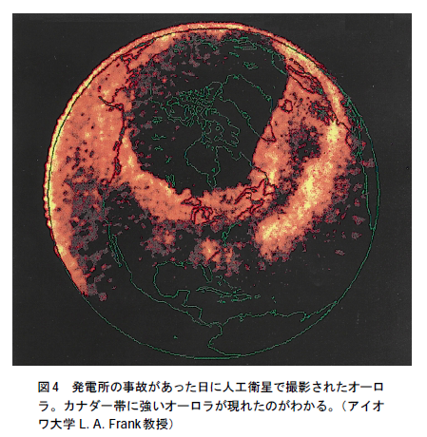
The magnetic storm on
1989 March 13 lead to Quebeck blackout
Magnetic storm ~ 540 nT
Solar flare X4.6
http://www.stelab.nagoya-u.ac.jp/ste-www1/pub/ste-nl/Newsletter28.pdf

Slide 6
If the Carrington-class flare occur now, what will happen? Troubles of all satellites? whole earth blackout? Long-time communication stop?
For those interested in this, see http://science.nasa.gov/science-news/science-at-nasa/2008/06may_carringtonflare/

Slide 7
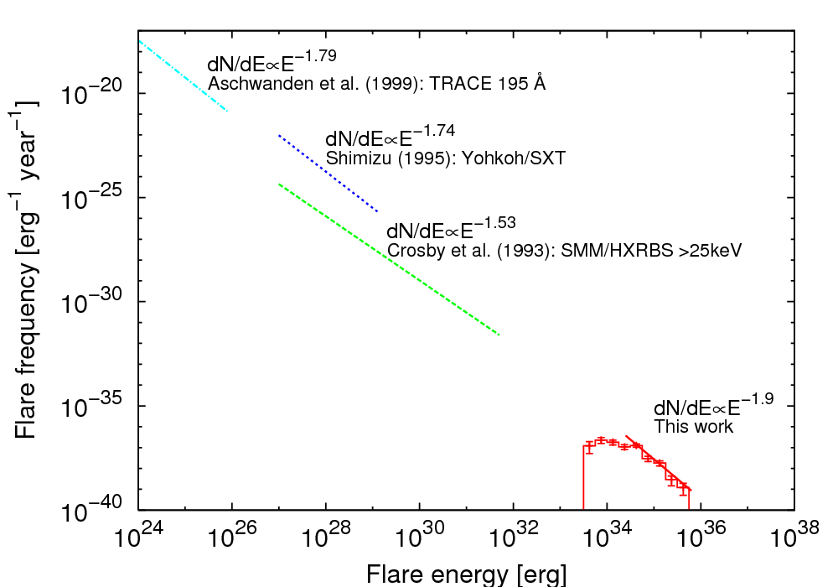
statistics of occurrence frequency of
solar flares, microflares, nanoflares
Frequency
dN/dE~E^(-1.5~-1.7)
nanoflare
microflare
1000 in 1 year
100 in 1 year
10 in 1 year
1 in 1 year
1 in 10 year
1 in 100 year
1 in 1000 year
1 in 10000 year
solar flare
？Superflare?
Largest solar flare
superflare
[erg]
Total Energy [erg]
C M X X10 X1000 X100000

Slide 8
Will superflares occur on our Sun?

Slide 9
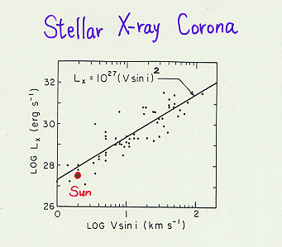
Stellar flares
・ Young stars and close binary stars are known to produce superflares, 10- 10⁶ times more energetic (10³³ - 10³⁸erg) than the largest solar flares (~10³²erg).
・ Such stars rotate fast (10 -100 km s⁻¹)
and the magnetic fields of a few kG
are distributed in large regions
on the stellar surface.
In contrast, the Sun slowly rotates
(~2 km s⁻¹) and sparsely has very small spots.
⇒ Superflares cannot occur on Sun-like stars ・・・??
fast
Slow
(Pallavicini et al. 1981）
Notes:
Similarly, flares are known to occur on various types of stars.
Young stars or close binary stars often produce Superflares.
Superflares are the flares which are much more energetic than the largest solar flares.
Such stars rotate fast and the magnetic fields of a few kG are distributed in large regions on the stellar surface.
This figure shows X-ray luminosity as a function of stellar rotation.
In contrast, the Sun slowly rotates, and the magnetic fields are weak.
Because of this, it has been thought that superflares cannot occur on slowly-rotating Sun-like stars.

Slide 10
Discovery of superflares on ordinary solar type stars
Schaefer, B. E., King, J. R., Deliyannis, C. P.
ApJ, 529, 1026 (2000)
9 superflares (with energy 10 ~ 10^6 times that of largest solar flares) were discovered
Main sequence stars with spectral type F8-G8
Rotational speeds are low (like our Sun),
not young stars

Slide 11
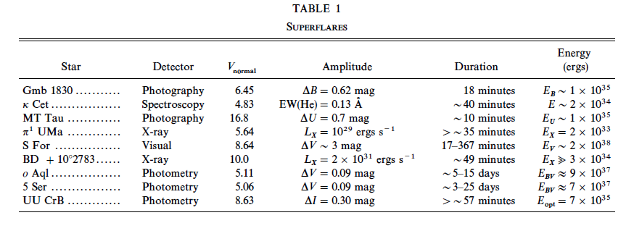
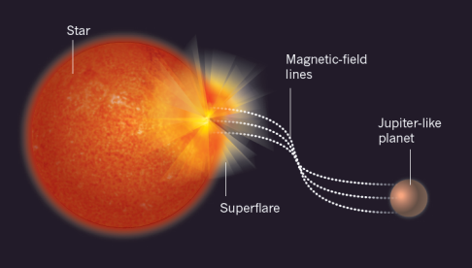
superflares
Shaefer et al. (2000) ApJ 529, 1026
Only 9 events. Too few to discuss statistics
Schaefer argued that superflares would not occur on
our Sun because there are no historical records in recent
2000 years and there are no hot Jupiters on our Sun.
Are superflares really occurring on single solar type stars ?

Slide 12
Observations of the Sun for 10,000 years
are similar to
Observations of 10,000 solar-type stars for one year.

Slide 13
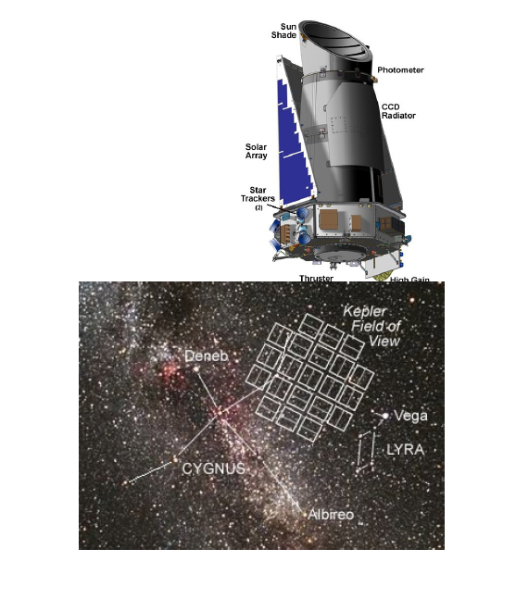
Kepler spacecraft
Space mission to detect exoplanets by observing transit of exoplanets
0.95 m telescope
Observing 150,000 stars continuously in a fixed region.
~30 min time cadence (public data) and a very high precision (<10⁻⁴)

Slide 14
Analyses of Kepler data of ~90,000 G-type stars obtained from 2009 April to 2010 Augutst (Q0-Q6) detected 1,547 superflares on 279 stars (Shibayama et al. 2013, ApJS, 209, 5; see also Maehara et al. 2012, Nature, 475, 478).

Slide 15
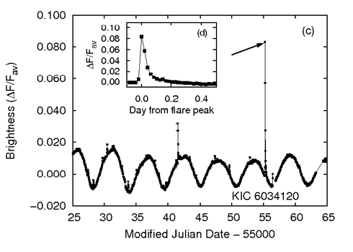
typical superflare observed by Kepler
Total energy
~ 10^36 erg
(~10^4 times of that of the Carrington event)
Brightness
variation
Amplitude: 0.1-10%
Duration: ~0.1 days
Total energy: 10^(33-36) erg
Time (day)
Maehara et al. (2012)

Slide 16
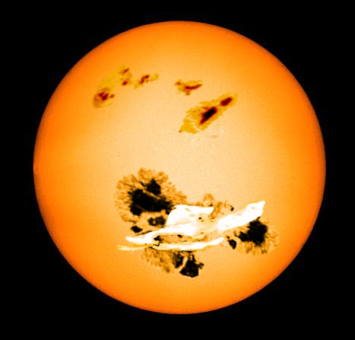
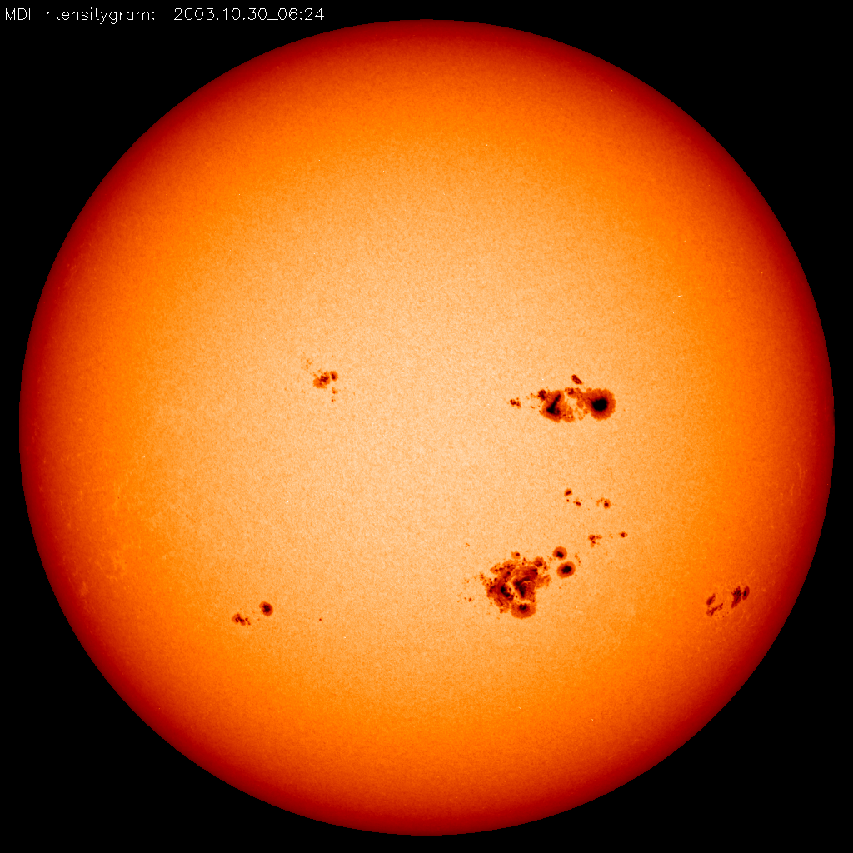
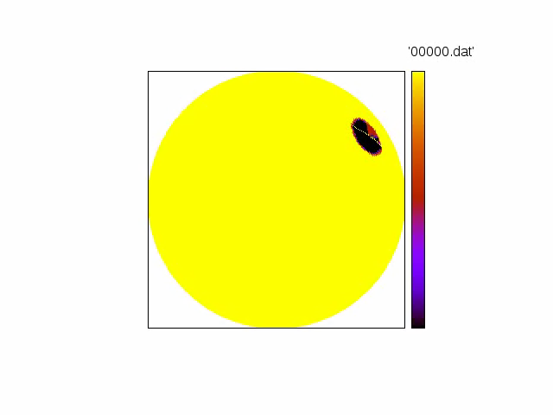
typical superflare observed by Kepler
What is the cause of
stellar brightness variation ?
Brightness variation
Total energy
~ 10^36 erg
(~10^4 times of that of the Carrington event)
It is likely due to rotation of a star with a big star spot
Time (day)
Maehara et al. (2011)

Slide 17
Period of the brightness variation
→Rotation period
Amplitude of the brightness variation
→total area of starspots

Slide 18
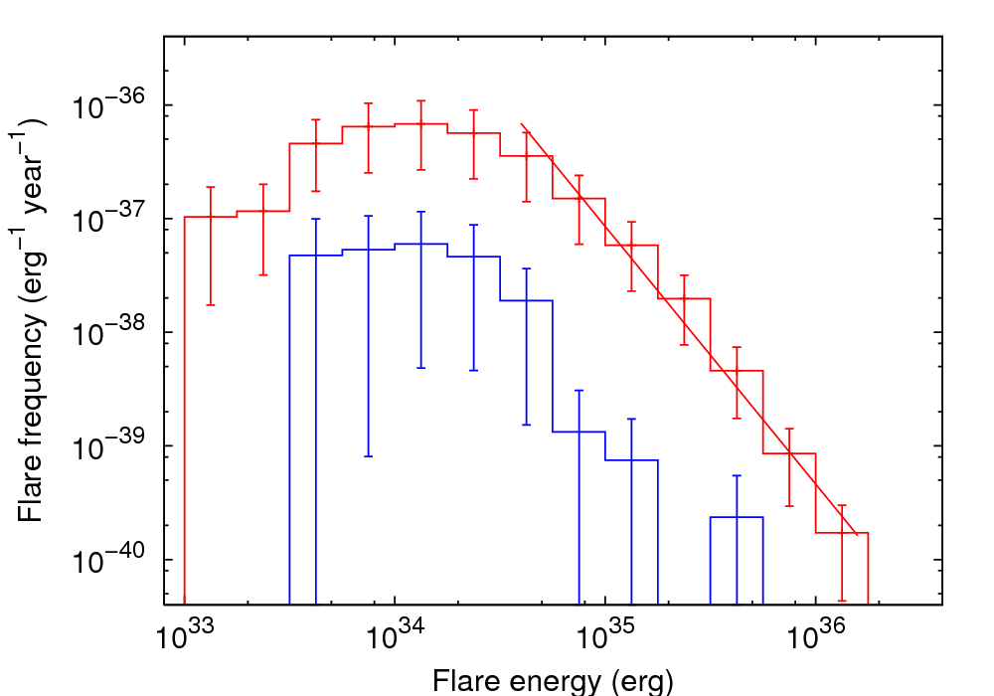
Energy-frequency distribution
Power-law distribution with the index of -2.3+/- 0.3
  The frequency distribution is similar to that of solar flares.
All G-dwarfs
T_{eff}: 5100-6000K
1 in 800 years
1 in 5000 years
Sun-like stars
T_{eff}: 5600-6000K
Period: >10 days
※Flare frequency = $\frac{Number of superflares}{\left(number of stars\right)×(length of observation period)×(bin width)}$
Notes:
This figure shows the frequency distribution of superflares on G-dwarfs. Flare frequency is calculated from number of flares, number of observed stars, length of observation, and width of each bin by using this formula.
Red-histogram shows the frequency distribution for all G-dwarfs, and blue one shows that for the Sun-like stars which have the surface temperature between 5600 and 6000K and the rotation period longer than 10 days.
The frequency distribution shows the power-law distribution with the index of -2.3 which are similar to that of solar flares.

Slide 19
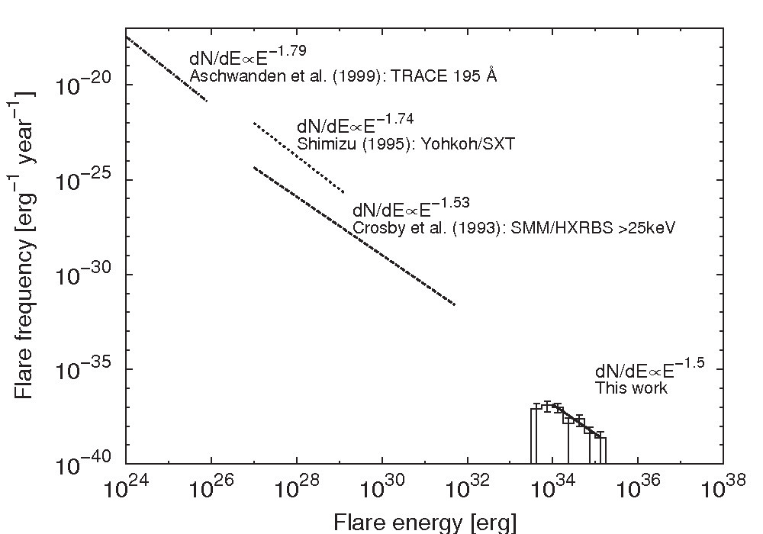
Comparison of statistics between
solar flares/microflares and superflares
nanoflare
microflare
solar flare
？
Largest solar flare
superflare

Slide 20
Comparison of statistics between
solar flares/microflares and superflares
nanoflare
microflare
1000 in 1 year
100 in 1 year
10 in 1 year
1 in 1 year
1 in 10 year
1 in 100 year
1 in 1000 year
1 in 10000 year
solar flare
Largest solar flare
superflare
Shibayama et al. (2013)
C M X X10 X1000 X100000
C M X X10 X1000 X100000

Slide 21
Spectroscopy of superflare stars with Subaru
Is there really a superflare star which is very similar to the Sun?
We have been currently undergoing a follow-up project of high dispersion spectroscopy of the superflare stars with the Subaru telescope, for checking the rotation velocity, binarity, chemical composition, and so on.
We have observed about 50 superflare stars with Subaru/HDS in S11B (service mode), S12A, and S13A. The result of the first pilot observation in S11B was already published by Notsu et al. (2013, PASJ, 65, 112).

Slide 22
We have discovered two superflare stars really similar to the Sun!
(Nogami et al. 2014, submitted to PASJ)

Slide 23
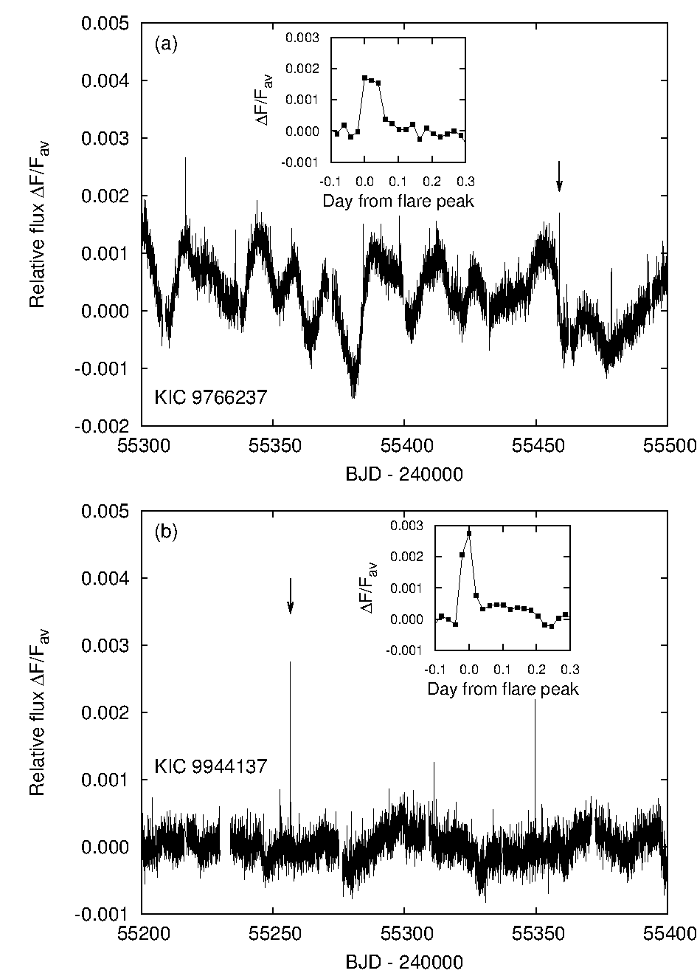
Star | Prot [day]
KIC9766237 | 21.8
KIC9944137 | 25.3
The total energy emitted during these superflares in these figures were ~10^34 erg.

Slide 24
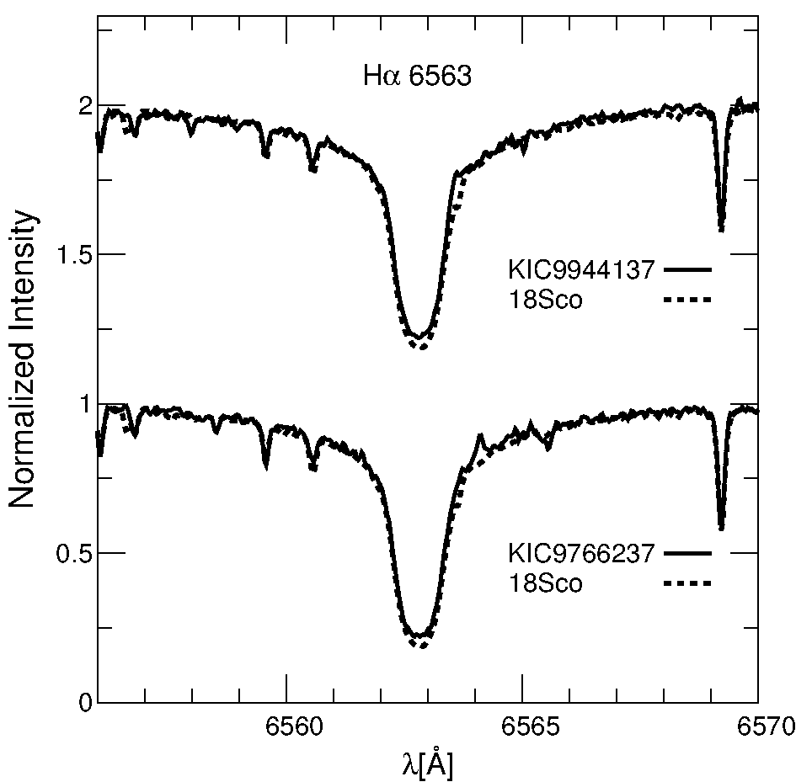
The absorption line of Hα is slightly shallower than that of 18 Sco, a solar-twin star.
→high chromospheric activity!

Slide 25
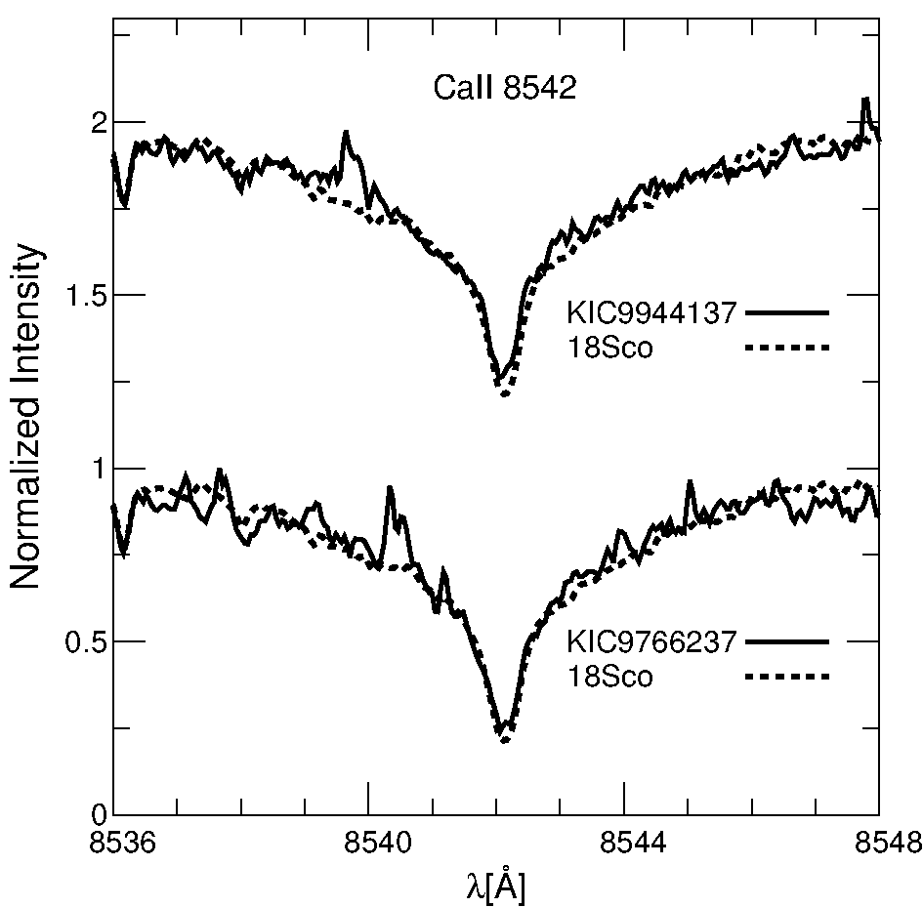
The absorption line of Ca II 8542 is slightly shallower than that of 18 Sco, a solar-twin star.
→high chromospheric activity, and average magnetic field of 1-20 G

Slide 26
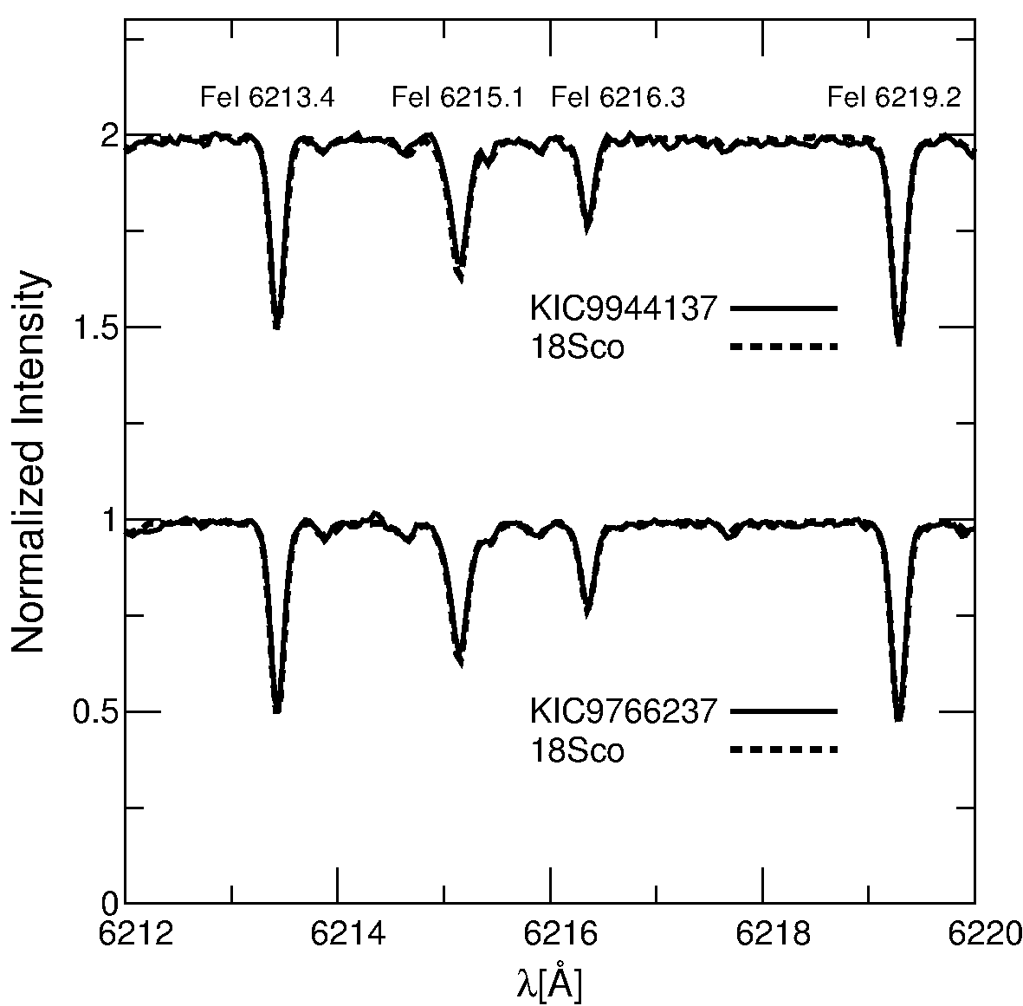
The profile of photospheric absorption lines of Fe I is well reproduced with a single Gaussian function.
→No hint of binarity! v sini ~2.0 km/s → Not young!

Slide 27
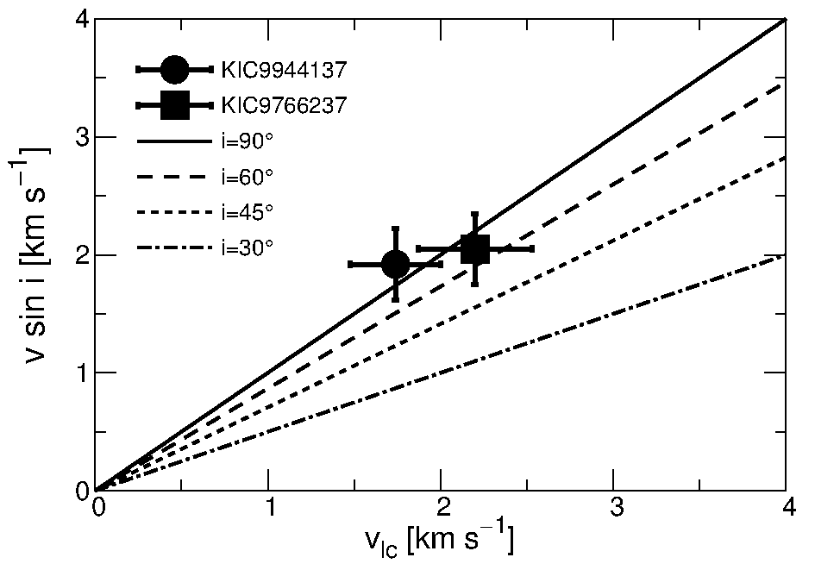
The inclination angle of both targets is fairy high.

Slide 28
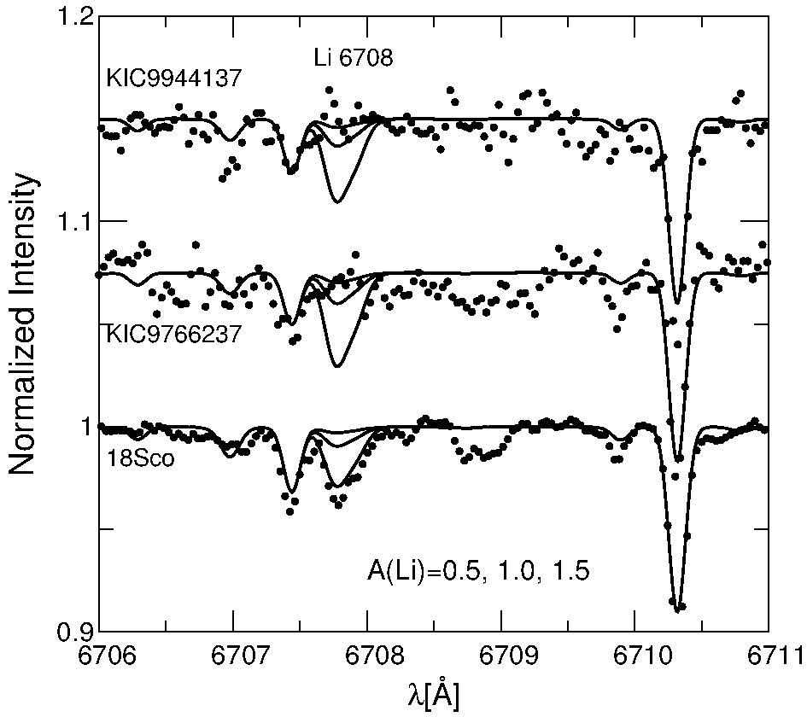
Low Li abundance of both of the targets (A(Li)<1.0)
→Not young!

Slide 29
Star | Prot [day] | v sini [km/s] | Teff [K] | Log g | [Fe/H] | A(Li)
KIC9766237 | 21.8 | 2.1 | 5606 | 4.3 | -0.16 | <1.0
KIC9944137 | 25.3 | 1.9 | 5666 | 4.5 | -0.10 | <1.0
Sun | ~27 | 2.0 | 5725 | 4.37 | 0.0 | 0.92
These stellar parameters are very close to those of the Sun, and these stars are not young!
→Support the hypothesis that a superflare can occur on our Sun!

Slide 30
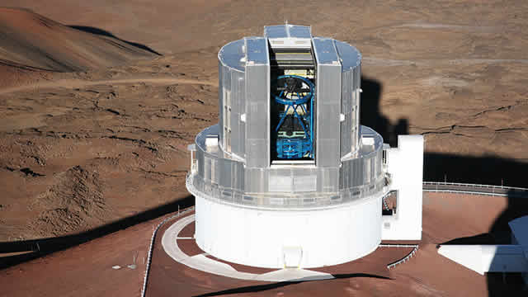
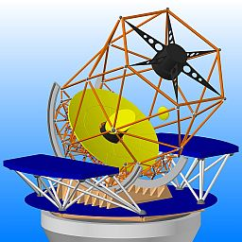
Future plan
We will continue the Subaru observations for fainter superflare stars, and make a high S/N spectroscopy of some bright stars, for revealing the whole picture of superflare stars.
After construction of the Kyoto-Okayama 3.8m
new technology telescope, we will
perform monitoring of some stars
for checking the radial velocity
variation, and activity variation.

Slide 31
Summary
Superflares of 10^(33-36) erg really occur in solar-type stars.
We have carried out high dispersion spectroscopy of 50 superflare stars with Subaru.
Two stars, KIC 9766237, and KIC 9944137 were found to have stellar properties very similar to the Sun, in terms of the rotation velocity, effective temperature, surface gravity, metalicity, and age.
This fact supports the hypothesis that superflares may occur on the Sun.
We continue the high dispersion spectroscopy survey with Subaru, and will make monitoring observations with the 3.8m telescope.

Slide 32
Please check the size of spots on the Sun!

Slide 33
Thank you
very much
for your attention!

