Slide 1
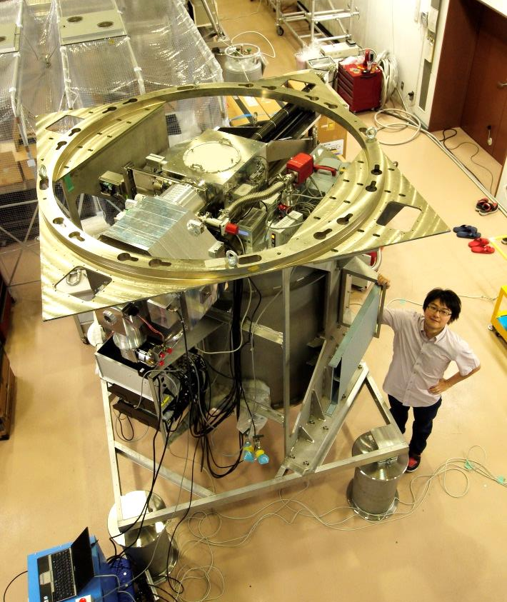
Simultaneous-color
Wide-field
Infrared
Multi-object
Spectrograph
S W I M S
Masahiro Konishi (IoA, UTokyo),
SWIMS Team

Slide 2
Members and Collaborators
Development Team
  Kentaro Motohara (PI)
  MK, Hidenori Takahashi, Natsuko Kato
  Ken Tateuchi, Yutaro Kitagawa, Soya Todo
IFU Team
  Shinobu Ozaki (NAOJ), Tomohiro Yoshikawa (Kyoto Niji Koubou)
SWISM18 Project Team
  Tadayuki Kodama (NAOJ), Makoto Tanaka (NAOJ), Masao Hayashi (UTokyo)
Science collaboration
  Tadayuki Kodama (NAOJ), Makoto Tanaka (NAOJ), Masao Hayashi (UTokyo), Ken’ichi Tadaki (NAOJ), Tohru Nagao (Ehime U.), Keiichi Maeda (Kyoto U.)

Slide 3
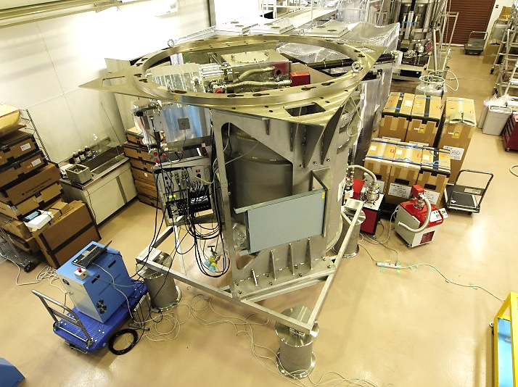
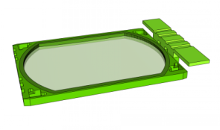
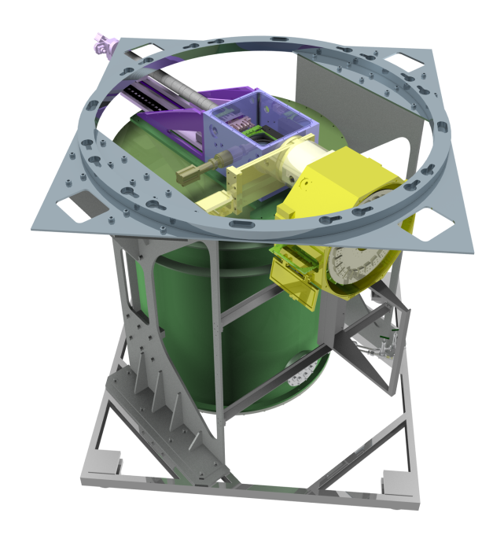
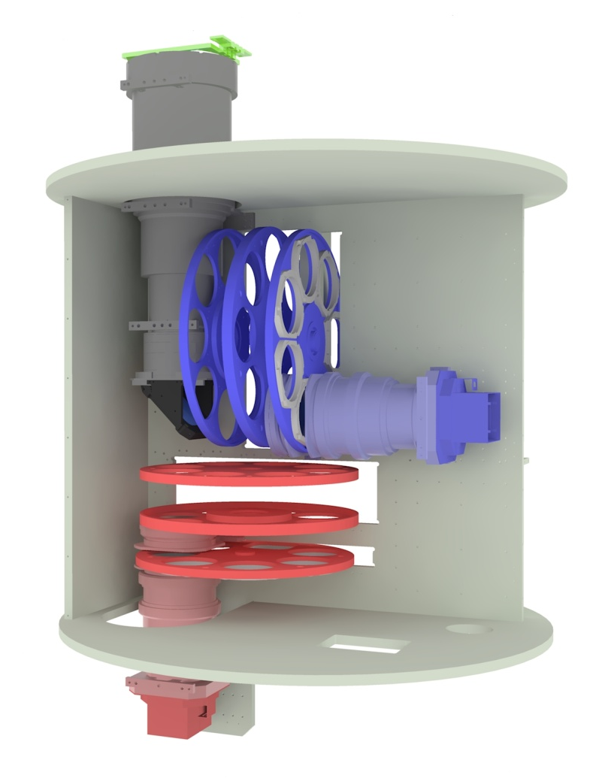
Overview
First generation instrument for TAO 6.5-m telescope
Two-color simultaneous wide-field observation
  Blue: 0.9—1.4 μm / Red: 1.4—2.5 μm
Wide spectral-range spectroscopy
  R~500—1000 YJHK_{s} (MOS, IFU) spectroscopy
From Telescope
FOV Layout
Slit mask
IFU module
λ →
6’.6 x 3’.3
(0”.096 pixel⁻¹)
2x H2RG

Slide 4
Specifications of SWIMS
Observation Mode | Imaging and multi-object spectroscopy
Dimensions, weight | 2.0 x 2.0 x 2.0 m³ , 2.5 tons
Field of View | 6.6 x 3.3 arcmin² (2.8 x 3.3 for MOS)
Spatial Resolution | 0.096 arcsec/pixel
Wavelength Range | 0.9-1.4 / 1.4-2.5 μm (blue/red arm)
Detector | HAWAII-2RG (two arrays per arm)
Filters (broad-band, narrow-band) | Y, J, H, K_{s}, N129, N133, N1875, N195
Spectral Resolution | Blue : R ~ 700 – 1,000 Red : R ~ 500 – 900
Number of slit masks | ~ 20 (including long slit masks)
MOS multiplicity | ~ 30 objects/mask
IFU | 14” x 5.2” with 13 slices
Expected Total Throughput | Imaging: 31%, Spectroscopy: 20%
Expected limiting magnitudes (in AB) Imaging (1hr, S/N=5) Spectroscopy (1hr, S/N=5, R=1,000) | Y=25.3, J=24.5, H=23.7, K_{s}=24.0 Y=23.6, J=22.7, H=22.5, K_{s}=22.2

Slide 5
Target Science
Approaches:
  NBF* (+ BBF + MBF*) imaging
  YJHK_{s} simultaneous imaging, (MOS/IFU) spectroscopy
Science Case:
  Formation of massive, compact, quiescent galaxies*
  Protocluster search at z~3.3*
  YJHK_{s} multiple line survey for z~2 QSOs
  NIR spectral sample of nearby SNe
  NIR search, classification of massive stars
(* : SWIMS18 project)

Slide 6
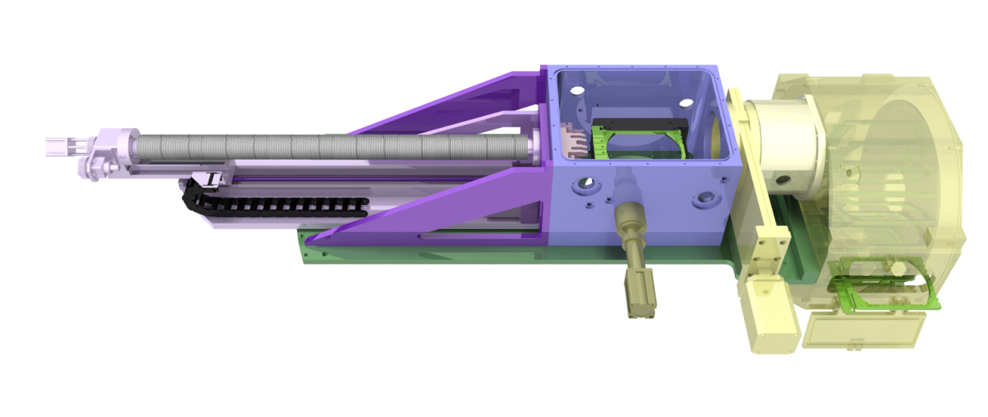
MOS Unit
Mechanical design: based on MOIRCS heritage
  Mask dewar with a GM cooler
  Mask exchanger using a robot arm
24 mask slots
  2 for IFU, 1 for engineering, a few for long slits
Cooling cycle: ~ 3 days
Exchange time: ~ 2 min.

Slide 7
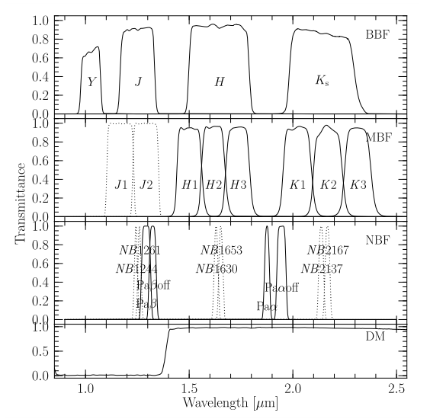
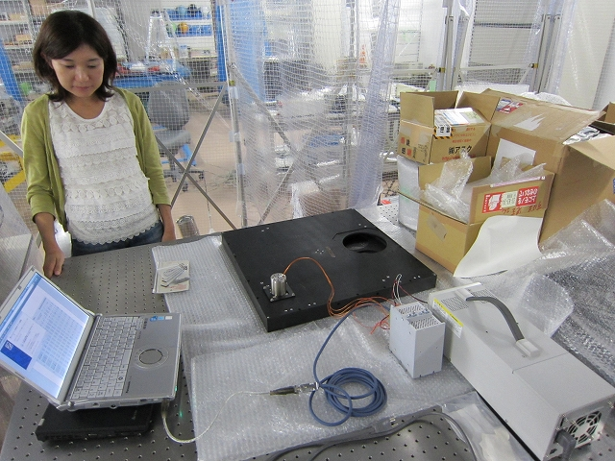
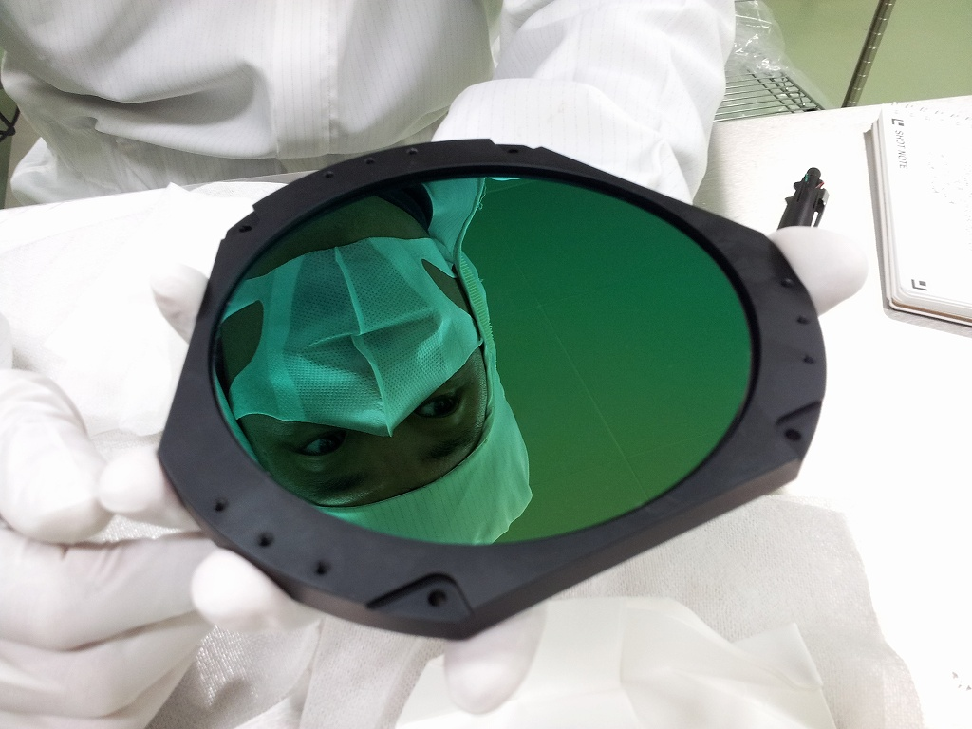
Filters
 | Name | λc | FWHM
BBF | Y | 1.03 | 0.09
 | J | 1.25 | 0.16
 | H | 1.64 | 0.3
 | Ks | 2.14 | 0.32
3 filter/grism wheels per arm
4 BBF, 8 MBF, and 10 NBF procured
  including SWIMS18 filters
MBF | J1* | 1.17 | 0.13
 | J2* | 1.29 | 0.12
 | H1* | 1.5 | 0.12
 | H2* | 1.61 | 0.11
 | H3* | 1.73 | 0.12
 | K1* | 2.02 | 0.14
 | K2* | 2.17 | 0.14
 | K3* | 2.31 | 0.13
NBF | NB1244* | 1.244 | 0.012
 | NB1261* | 1.261 | 0.012
 | NB1630* | 1.63 | 0.016
 | NB1653* | 1.653 | 0.016
 | NB2137* | 2.137 | 0.021
 | NB2167* | 2.167 | 0.021
 | NB1292 | 1.292 | 0.04
 | NB1326 | 1.326 | 0.034
 | NB1875 | 1.875 | 0.02
 | NB1945 | 1.945 | 0.04
(* : SWIMS18 project)

Slide 8
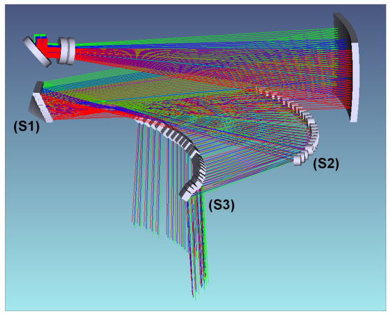
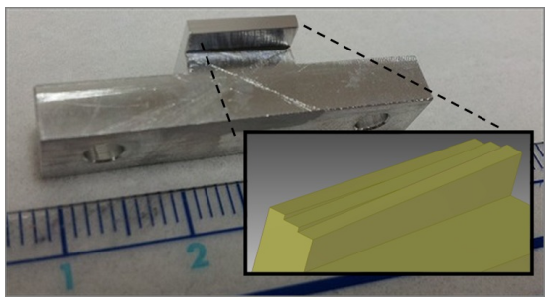
Integral Field Unit
Foreoptics (enlarger) and Image slicer
Identical mechanical I/F as MOS masks → retractable.
  < 240 x 170 x 60 mm, < 1 kg
FoV: 14” x 5.2” (13 slices with 14” x 0.4”)
Image quality: ~0.3” (worst)
Test fabrication of a slicer mirror
(Nano-opt/Nagase)
SWIMS Optics

Slide 9
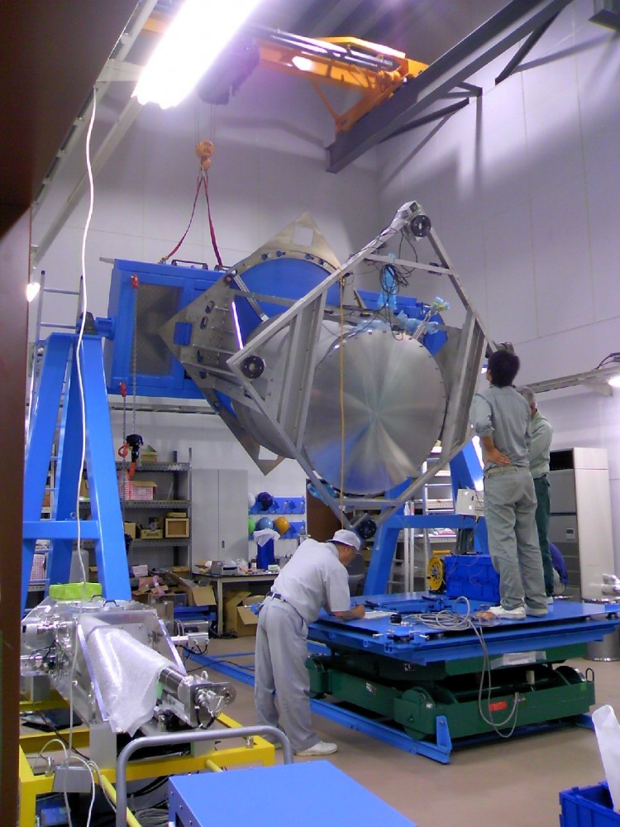
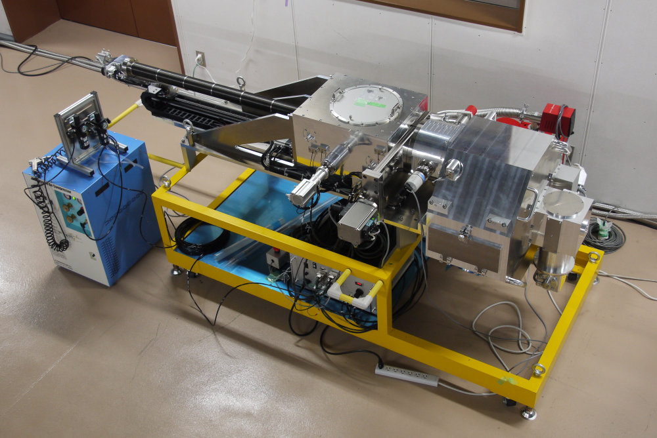
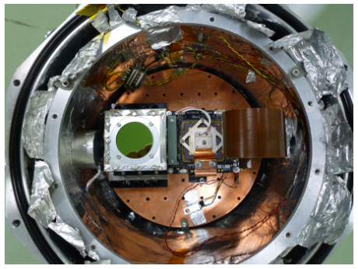
Current Status and Next
Cryostat
  Improvement of cooling performance (~Feb 2014)
  Flexure test
MOS Unit
  Cooling/Mechanical performance Test (OK)
  Reliability &Reproducibility Test
Detector
  Performance evaluation of H2RG+ASICs (in prog.)
  Simultaneous operation of multiple H2RGs

Slide 10
Schedule
System Integration (~2014)
  Mechanical performance
  Cooling performance
  Imaging performance
Transportation (late 2015)
Preparation at Hilo and Summit (2016)
Test and science observation (~2017)
Transportation to TAO (2017)
Now preparing a proposal for PI instrument.

Slide 11
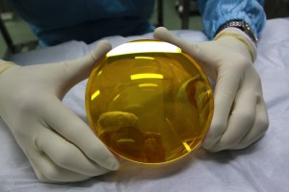

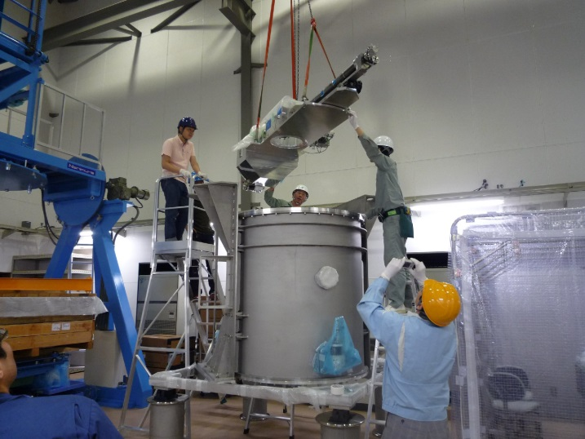

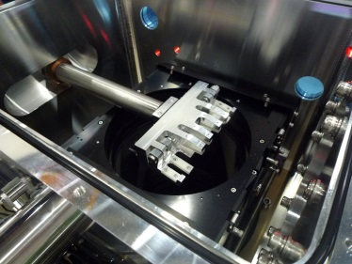
Summary
Simultaneous-color Wide-field Infrared Multi-object Spectrograph
First generation instrument for TAO 6.5-m telescope
Two-color simultaneous wide-field observation
Wide spectral-range spectroscopy
Wide-field IFU
Will be at Subaru for observation during 2016-2017.
Contact us at swims@ioa.s.u-tokyo.ac.jp

