Slide 1


A mid-infrared PI Instrument for Subaru
Takafumi Kamizuka (P.D @ IoA/UT)
MIMIZUKU Development Team

Slide 2
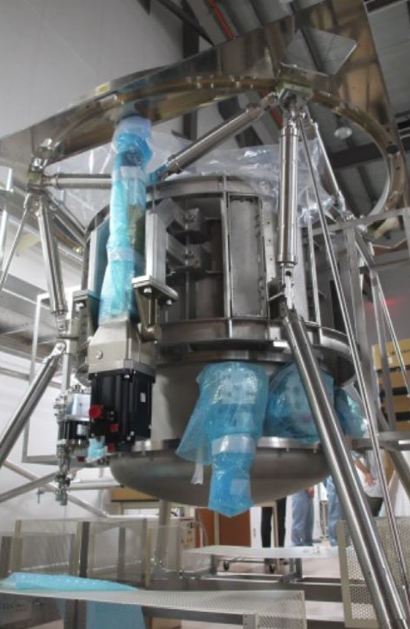
About MIMIZUKU
MIMIZUKU = Mid-Infrared Multi-field Imager for
gaZing at the UnKnown Universe
1st-gen. instrument for TAO 6.5-m telescope
Unique Capability of MIMIZUKU
Wide Band Coverage
  2—26 μm (for Subaru)
  2—38 µm (for TAO)
High-Precision Observation
  Utilizing “Field Stacker” Device
High Spatial Resolution
  0.3”/0.6” @ 10/20μm
  1” @ 30μm available at TAO
MIMIZUKU (2m x 2m x 2m; 2.4t)

Slide 3
Development Team
Institute of Astronomy, UT
  Takashi MIYATA (P.I.; Assoc. Prof.)
  Shigeyuki SAKO (Assist. Prof.)
  Takafumi KAMIZUKA (P.D.)
  Kentaro ASANO (D3)
  Mizuho UCHIYAMA (D2)
  Kazushi OKADA (M2)
Department of Astronomy, UT
  Takashi ONAKA (Prof.)
  Itsuki SAKON (Assist. Prof.)
  Tomohiko NAKAMURA (P.D.)
Institute of Space and Astronautical Science, JAXA
  Hirokazu KATAZA (Assoc. Prof.)
Subaru Telescope, NAOJ
  Takuya FUJIYOSHI (Sr. Resident Astronomer)

Slide 4
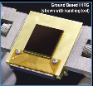

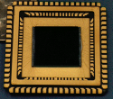
Capabilities of MIMIZUKU
Wide Band Coverage
λ = 2—38 µm is covered by 3 Cameras
with capability of Imaging and Spectroscopy
Some specs are slightly
modified from proposal
 |  | NIR | MIR-S | MIR-L
Wavelength |  | 2—6μm | 6—26μm | 24—38μm
Detector |  | Teledyne H1RG HgCdTe 1kx1k | Raytheon Aquarius Si:As 1kx1k | DRS HF-128 Si:Sb 128x128
Pixel Scale |  | 0.052”/pix | 0.087”/pix | 0.18”/pix
FoV | w/ FS | 0.9’ x 0.9’ | 1.5’ x 1.5’ | 0.4’ x 0.4’
 | w/o FS | 0.9’ x 0.4’ x 2 fields | 1.5’ x 0.7’ x 2 fields | 0.4’ x 0.2’ x 2 fields
Img. Filter |  | L’, M J, H, K | N-band (R~10) x 4 Q-band (R~20) x 2 Narrow-band (Δλ~0.2μm) | 31μm (R~10) 35μm (R~10) 37μm (R~10)
Spectroscopy |  | 2.8—5.5μm R~180 | 7.5—13.5μm R~230 16.5—25.5μm R~160 | 26—38μm R~70
Slit |  | 0.3”x60” | 0.3”/0.6” x 60” | 1.2”x50”
Specifications of MIMZIUKU
Gray letter means Optional

Slide 5
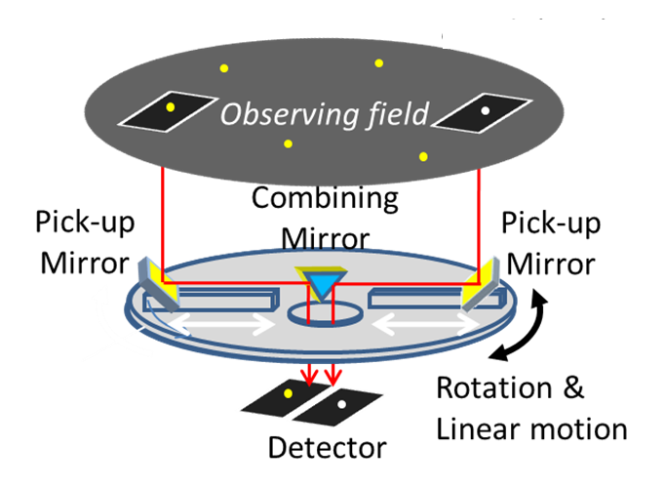
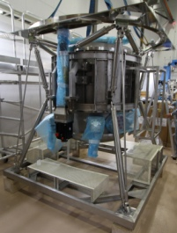
Capabilities of MIMIZUKU
High Precision Observation
“Field Stacker” enables real-time calibration,
which is free from atmospheric time variation
➔ Precise Photometry/Spectroscopy
Installed here!
Field Stacker
φ 5’ (Subaru)
Target and Std. obj. are observed simultaneously
➔Precise Calibration
➔Long-term monitoring
Reliable Spectroscopy
Schematic view of Field Stacker

Slide 6
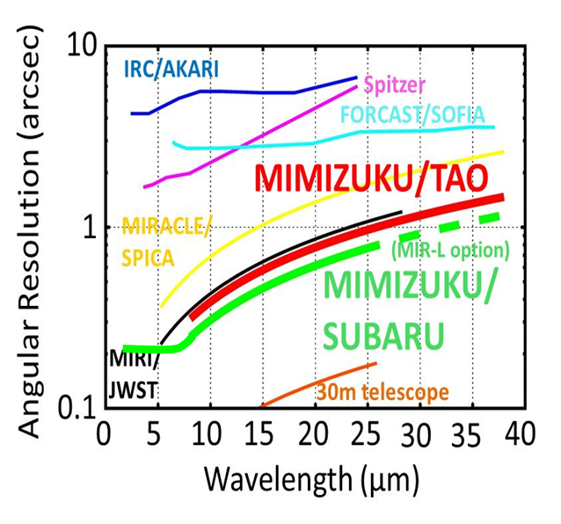
Capabilities of MIMIZUKU
High Spatial Resolution
Diffraction limited image at λ > 8μm
Resolution of NIR camera is ~ 0.2”
Subaru 8.2m telescope gives us the highest spatial resolution at MIR.
At 30μm band, MIMIZUKU will achieve the highest spatial resolution
(mainly for TAO)
Spatial resolution of recent MIR instruments

Slide 7
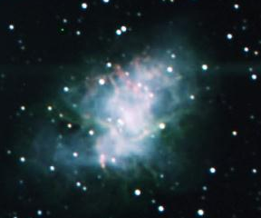

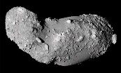
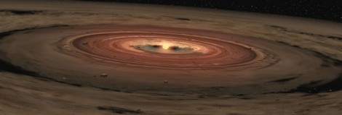
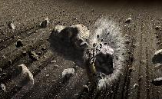
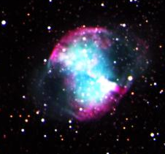
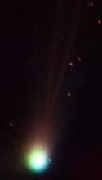
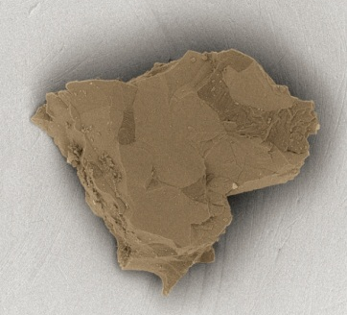
Science Case
Origin of Terrestrial Material
from dying stars to aborning earths
From dying stars to aborning earths
Dying Stars
Protoplanetary
Disk
Planetesimal
Primordial bodies
Earth
Interstellar
?
?
Formed & Modified?
Supernovae
?
Modified?
Modified?
?
Planetary nebulae
Destroyed?
The history is recorded
in small grains…

Slide 8
Science Case
MIMIZUKU Monitoring Program
Missing Iron Grains (AGBs)
Dust Stream in Protoplanetary Disks (PPDs)
Giant Impacts on Young Exoplanets (Debris Disks)
Fresh Dust in Explosions (SNe/Novae)
Follow-up of Space Missions (Solar system)
We want to propose an intensive / strategic program to monitor these objects.
~20 targets
1-2 runs / semester
~3 semesters
In addition …
  MIMIZUKU Science Workshop
  was held on 2013/5/24
  ~40 scientists attended
  ~15 talks were presented

Slide 9
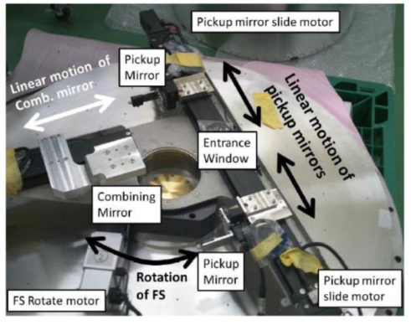
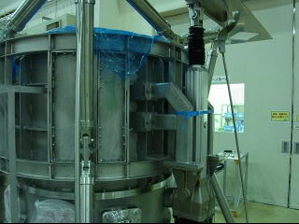
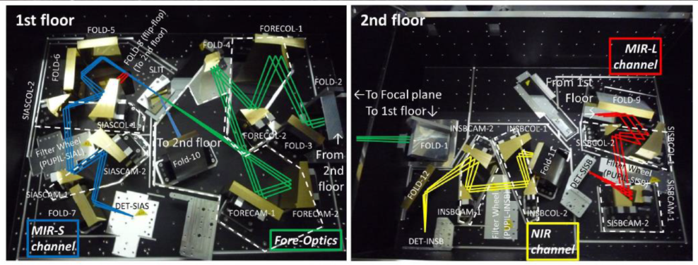
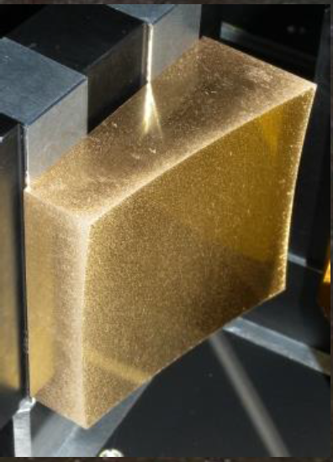
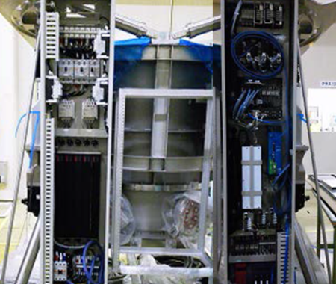
Development
Cryostat & Field Stacker
Optics
Cryostat
Field Stacker
Up & down motion test
Cold Optics
Optics is fabricated
Degradation of mirrors occurred (galvanic corrosion)
Re-fabrication is ongoing
  SiO coating will be applied to avoid the degradation
Re-fabrication will be done in the early 2014.
Motion test of F/S is successfully done
Switch board is completed
Improving cooling capability of Cryostat
Cryostat & F/S will be completed in the early 2014
Damaged mirror
Switch Board

Slide 10
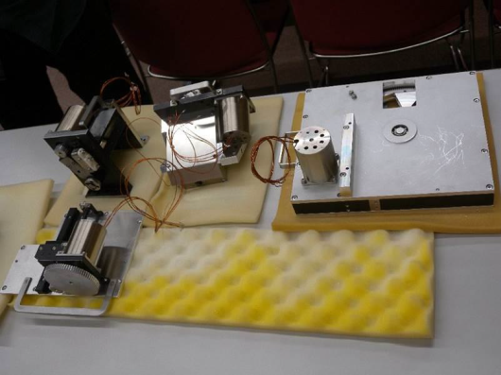
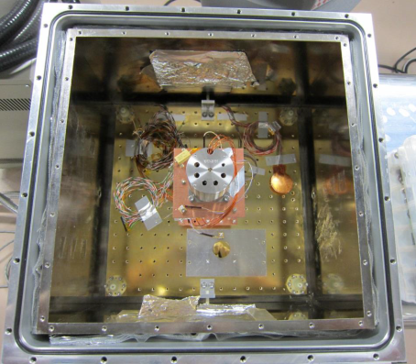
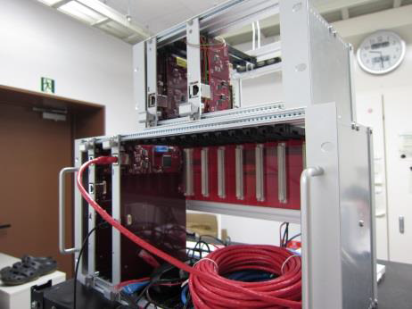
Development
Cryogenic Drive System
Detector System
Cryogenic Drive Units
(Filter wheel etc.)
Cryogenic motor test
Fabricated Board
Aquarius is already purchased
H1RG and Si:Sb HF-128 are coming soon
Digital boards are completed
Analog boards are under development
Detector drive system will be completed in the middle of 2014.
Fabrication is almost done
Black painting is being applied
Cryogenic motion test is ongoing
Control programs are being developed
These will be completed until the middle of 2014

Slide 11
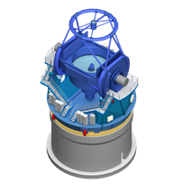
Schedule
FY2014
FY2015
FY2016
FY2017
FY2018
FY2019
Cryostat & F/S
Control System
Total Test
Optics
To Hawaii
Cryo. Driv. Sys.
Test
PV Obs.
Detector
Open Use
To Chile
Construction of TAO
Test & Obs.

Slide 12
Summary
Development of MIMIZUKU is going on to realize precise monitoring observation for investigating the origin and evolution of cosmic dust.
The development will be completed at the end of FY 2014.
Then, MIMIZUKU will be transferred to Hawaii.
MIMIZUKU will be available for open-use programs
from 2016A to 2017B.
MIMIZUKU will be transferred to Chile after the completion of TAO around 2018.
Visit our HP : http://www.ioa.s.u-tokyo.ac.jp/TAO/mimizuku/pub/

Slide 14
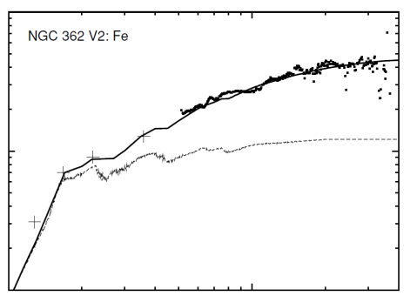
10
F_{ν}λ² (Jy/μm²)
Excess = Iron grains?
Water vapor?
1
Photosphere
(McDonald et al. 2010)
0.1
1
10
Wavelength (μm)

Slide 15
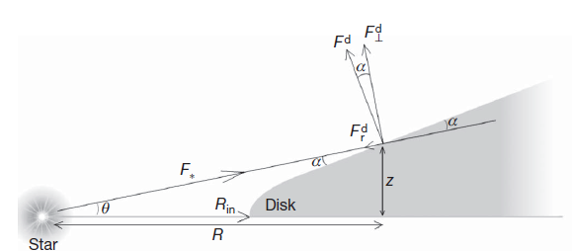
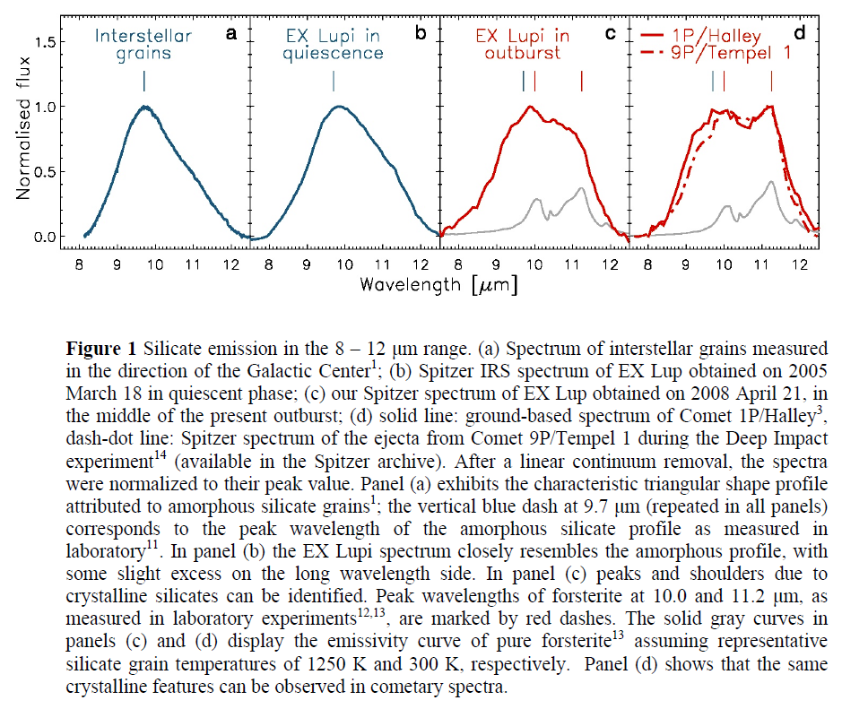
Trajectory of dust grain
L = 120L_{o}
L = 50L_{o}
Circumstellar disk
Vinkovic 2009
Example of EX Lupi
quiescence
outburst
2005/3
2008/4
crystalline
+
amorphous
amorphous
Abraham+ 2009

Slide 16
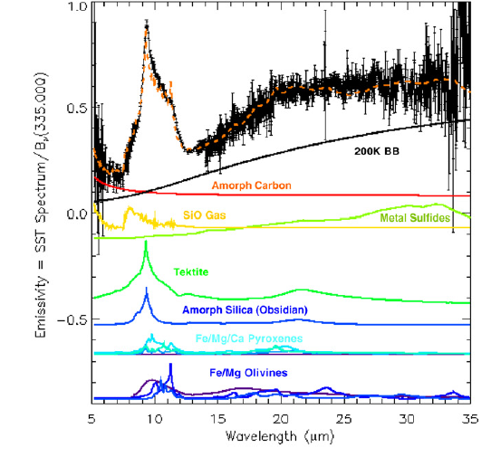
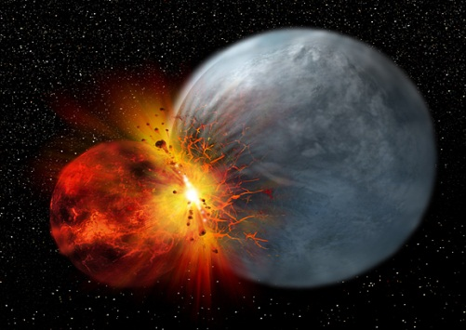
Debris disk HD172555
Silica
Silica
spaceref.com

Slide 17
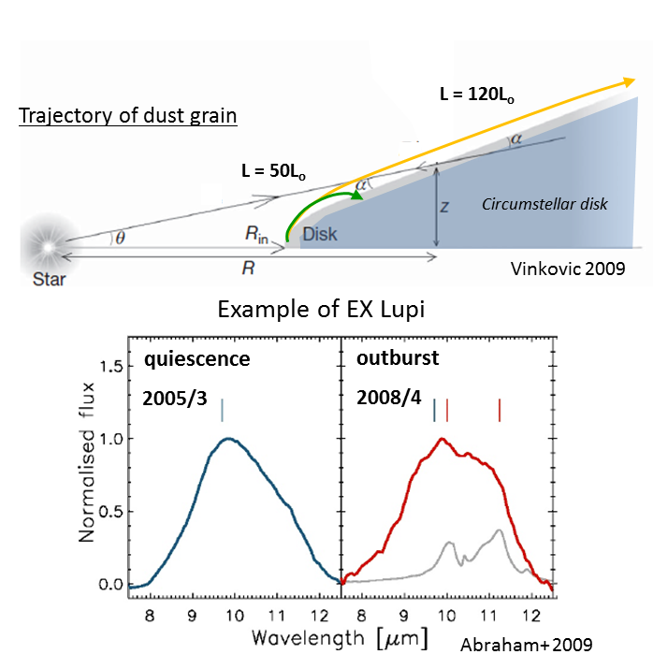
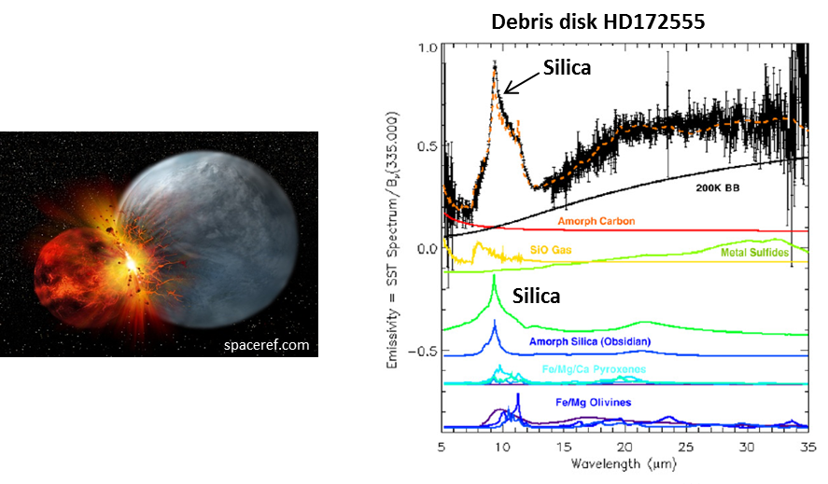
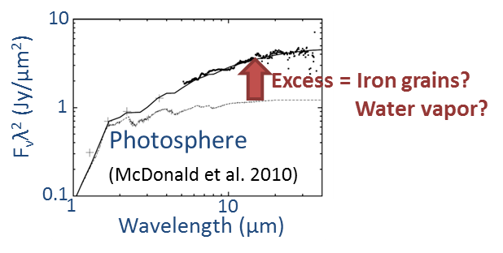
Science Case
MIMIZUKU Monitoring Program
Missing Iron Grains (AGBs)
Dust Stream in Protoplanetary Disks (PPDs)
Giant Impacts on Young Exoplanets (PPDs)
Fresh Dust in Explosions (SNe/Novae)
Follow-up of Space Missions (Solar system)
We want to propose an intensive / strategic program to monitor these objects.
~20 targets
1-2 runs / semester
~3 semesters
In addition …
  MIMIZUKU Science Workshop
  was held on 2013/5/24
  ~40 scientists attended and
  ~15 talks were presented

